Slide 1
Effects of Expectancy on Performance.
Student Name
Institution Affiliation
Date
Notes:
Good morning and welcome all to this PowerPoint presentation. The presentation is about a research to determine how expectancy affects performance. Thank you for taking time out of your busy schedules to listen to this proposal. My name is name and I hope that by the end of this presentation, both students and teachers will be able to understand different aspects of cognitive performance and expectancies.

Slide 2
Proper Citation
This presentation focuses on research done by (Rosenthal et al, 1963) to analyze the understanding of self-fulfilling prophesy.
Work Cited.
Rosenthal, R., & Jacobson, L. (1966). Teachers' expectancies: Determinants of pupils' IQ gains. Psychological reports, 19(1), 115-118.
Notes:
This presentation focuses on research done by (Rosenthal et al, 1966) to analyze the understanding of self-fulfilling prophesy. The author argues that self-fulfilling prophesy describes a certain way in which our expectations work. That is, if we expect certain things to work in a particular way, a person’s expectations will tend to make it that way. Therefore, whether or not self-fulfilling prophecies happen in a predictive way or not, some researches have shown that they may be a reality. Some of these researches will be viewed in later slides.

Slide 3
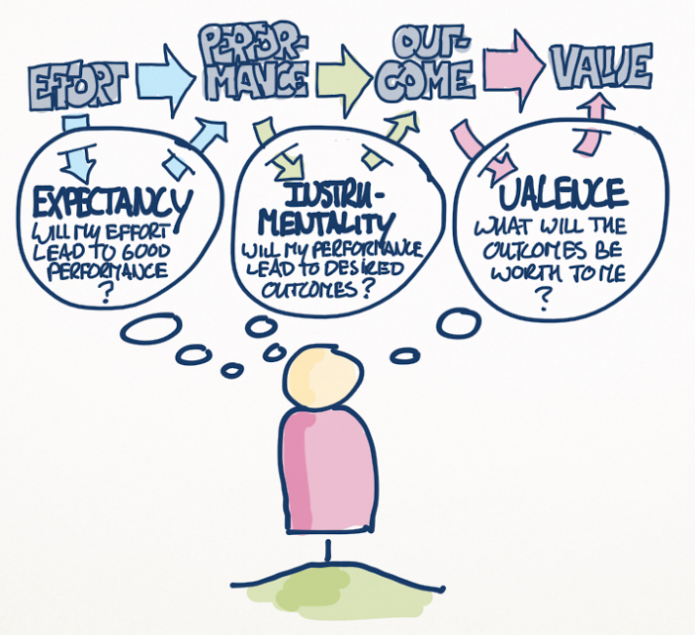
Background study.
Expectancy theory argues that a person will act or behave in a specific way because they are inclined or motivated to do so due to what they expect as a result of their choices.
Notes:
Different people have different expectancies. Expectancy theory argues that a person will act or behave in a specific way because they are inclined or motivated to do so due to what they expect as a result of their choices. That is, expectancy in the beliefs of individuals will lead to the intended performance. Effective cognitive performance is determined by the cognitive skills possessed by an individual. Cognitive skills represent the basic skills needed to acquire knowledge, understand it, information management, and effective reasoning. The research question for this research was What are the effects of expectancy on performance.

Slide 4
Methods.
This research utilized an intelligence tests known as TOGA. The Test of General ability was administered to different students.
Moreover, the teachers were told their students were being given the Harvard inflection acquisition,
Notes:
Cognitive performance can be tested using different methods. For example, the Montreal cognitive assessment, Mini-mental state exam, or the Mini-cog tests. However, this research utilized an intelligence tests known as TOGA. The Test of General ability was administered to different students. The school involved a non-verbal test to since reading were school-taught skills. Moreover, the teachers were told their students were being given the Harvard inflection acquisition, to determine how the teacher’s expectation would affect the performance of the students. The teachers were unknowingly participants in the research.

Slide 5
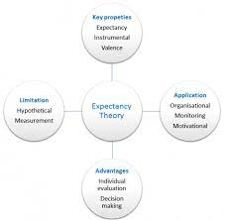
Results
The results showed that the expectancy hypothesis works well in laboratory settings then in the real world.
Research by (Tiraboschi et al, 2019) presented a lack of evidence that expectancy had any effect on attentional performance and the general cognitive process
Notes:
The results showed that the expectancy hypothesis works well in laboratory settings then in the real world. That is, expectancy has less effect on performance than previously thought. The results indicated these effects were non-existent in children. A research by (Watolla et al, 2020) argues that expectations did not affect performance. However, the results showed that age mattered when it came to determining who were more susceptible to psychological reactions that were related with the expectancy tests. Another research by (Tiraboschi et al, 2019) presented a lack of evidence that expectancy had any effect on attentional performance and the general cognitive process.

Slide 6
Discussion.
That when teachers expected that certain students would show great performance, they showed great performance on the tests.
Moreover, different teachers may have different ways of communicating regarding expectations of performance.
Notes:
However, the research by Rosenthal showed that expectancy affects performance. That when teachers expected that certain students would show great performance, they showed great performance on the tests. This was observed in younger children than the older ones since younger children are malleable, they have reputations that are less established, and they are easier to influence than others. Moreover, different teachers may have different ways of communicating regarding expectations of performance.

Slide 7
Conclusion.
Tiraboschi, G. A., Fukusima, S. S., & West, G. L. (2019). An expectancy effect causes improved visual attention performance after video game playing. Journal of Cognitive Enhancement, 3(4), 436-444.
Watolla, D., Mazurak, N., Gruss, S., Gulewitsch, M. D., Schwille-Kiuntke, J., Sauer, H., ... & Weimer, K. (2020). Effects of Expectancy on Cognitive Performance, Mood, and Psychophysiology in Healthy Adolescents and Their Parents in an Experimental Study. Frontiers in psychiatry, 11, 213.
Notes:
This last slide shows the credible sources that were used for research and to ensure successful presentation of this research. I hope the concepts of expectancy and the different factors expectancy, we will be able to understand how performance is affected. With all that said, thank you and have a nice day ahead.

