Slide 1
Chapter 13
Promotion– Introduction to Integrated Marketing Communication
Notes:
For use only with Perreault/Cannon/McCarthy.
© 2019 McGraw-Hill Companies, Inc.
CHAPTER THIRTEEN
Lecture Notes for
Essentials of Marketing 16e

Slide 2
At the end of this presentation, you should be able to:
know the advantages and disadvantages of the promotion methods a marketing manager can use in strategy planning.
understand the integrated marketing communications concept and why firms use a blend of different promotion methods.
understand the importance of promotion objectives.
know how the traditional communication process affects promotion planning.
understand how customer-initiated interactive communication is different.
Notes:
At the end of this presentation, you should be able to:
know the advantages and disadvantages of the promotion methods a marketing manager can use in strategy planning.
understand the integrated marketing communications concept and why firms use a blend of different promotion methods.
understand the importance of promotion objectives.
know how the traditional communication process affects promotion planning.
understand how customer-initiated interactive communication is different.

Slide 3
At the end of this presentation, you should be able to:
know how typical promotion plans are blended to get an extra push from wholesalers and retailers, as well as help from customers in pulling products through the channel.
understand how promotion blends typically vary over the adoption curve and product life cycle.
understand how to determine how much to spend on promotion efforts.
understand important new terms.
Notes:
At the end of this presentation, you should be able to:
know how typical promotion plans are blended to get an extra push from wholesalers and retailers, as well as help from customers in pulling products through the channel.
understand how promotion blends typically vary over the adoption curve and product life cycle.
understand how to determine how much to spend on promotion efforts.
understand important new terms.

Slide 4
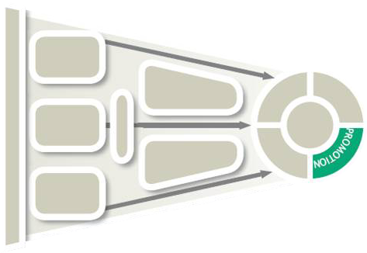
Promotion and Marketing Strategy Planning (Exhibit 13-1)
CH 13: Promotion: Intro to Integrated Marketing Communications
CH 14: Personal Selling and Customer Service
CH 15: Advertising and Sales Promotion
CH 16: Publicity: Promotion Using Earned, Owned, and Social Media
Promotion methods
Managing promotion
Effective communication
Blending promotion
Notes:
Summary Overview
There are many critical decisions that a marketing manager must make concerning
Promotion.
Key Issues
Marketing managers usually blend a variety of different promotion methods to achieve promotion objectives because each method has its own strengths and limitations. In this chapter, we introduce conventional promotion options and how to integrate them into an effective whole.
The discussion will consist of four main sections:
Promotion methods
Managing promotion
Effective communication
Blending promotion

Slide 5
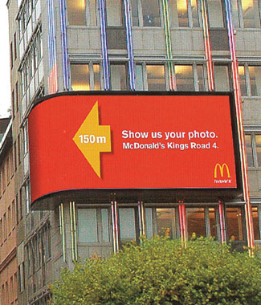
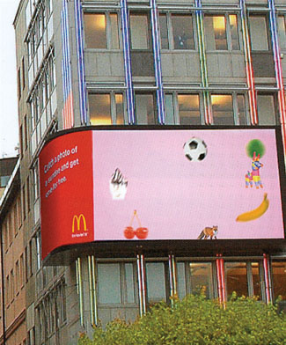
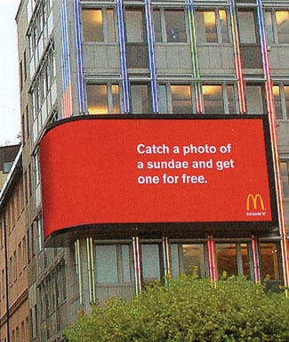
Personal selling—flexibility is its strength
Source: McDonald's
Notes:
Text Caption: Everyone loves free snacks, so it’s not surprising that many customers engaged with McDonald’s outdoor ad. Customers use their cell phone to snap a picture of a particular snack (on this day a sundae), then they bring the photo to the nearby McDonald’s for their reward. Sales promotion activities like this stimulate consumer interest and trial.

Slide 6
Several Promotion Methods Are Available
Personal Selling
Mass Selling
Different Methods of Promotion
Advertising
Publicity
Sales Promotion
Notes:
Summary Overview
Promotion is communicating information between a seller and a potential buyer or others in the channel to influence attitudes and behavior. A key part of modern marketing is the use of several promotion tools that work together to achieve a company’s overall promotion goals.
Key Issues
Personal selling: Direct spoken communication between sellers and potential customers.
Salespeople get quick feedback and can adapt the 4 Ps on the spot.
A sales force can be very expensive to build and maintain.
→ Mass selling: Communicating with large numbers of potential customers at the same time. Useful when the target market is large and geographically dispersed.
→ Advertising is any paid form of nonpersonal presentation of ideas, goods, or services by an identified sponsor. Media include television, radio, magazines, billboards, direct mail, and the Internet.
Publicity is any unpaid form of nonpersonal presentation of ideas, goods, or services. Publicity professionals try to get stories about their company’s products placed in mass media vehicles without having to pay media costs. Publicity also includes the use of social media tools like Facebook, Twitter and Instagram.
Discussion Question: Why do you think that consumers might believe publicity more readily than they would believe an ad?
Sales Promotion: Promotion activities—other than advertising, publicity, and personal selling—that stimulate interest, trial, or purchase by final customers or others in the channel.
Less is spent on advertising than personal selling or sales promotion.
May be aimed at consumers, at intermediaries, or even at a firm’s own employees. Examples include, contests and coupons aimed at consumers, trade shows or calendars for wholesalers or retailers, or sales contests and meetings aimed at a company’s own sales force.

Slide 7
Someone Must Plan, Integrate, and Manage the Promotion Blend
Sales Managers
Advertising Managers
Integrated
Marketing
Communications
Marketing Managers
Sales Promotion Managers
Notes:
Summary Overview
Each promotion method has strengths, weaknesses, and distinct techniques, so each requires a different type of expertise. Specialists develop and implement detailed plans for the various parts of the overall promotion blend.
Key Issues
Sales managers: Concerned with managing personal selling.
This may involve building and maintaining channels of distribution.
In smaller companies, the sales manager may double as the marketing manager.
→ Advertising managers: Manage the company’s mass selling effort, using in-house advertising departments or external agencies.
The advertising manager may also handle publicity or use an internal or external specialist in public relations (communication with noncustomers, such as labor, public interest groups, stockholders, and the government).
→ Sales promotion managers: Manage the sales promotion effort.
Marketing manager: Must determine the blend of promotional activities and coordinate them. Individual promotion specialists can then focus on the details of implementation.
Discussion Question: How is promotion management complicated in a “long” channel of distribution—one involving several levels of intermediaries?
Effective blending of promotion efforts is achieved through integrated marketing communications, so that the firm can send a consistent and complete message.

Slide 8
Which Method to Use Depends on Promotion Objectives
Informing
Overall Objective:
Affect Behavior
Persuading
Reminding
Notes:
Summary Overview
A marketing manager usually has to set priorities for the promotion objectives. This section will describe some specific objectives and how different promotion methods can help achieve them.
Key Issues
Informing, persuading, and reminding are basic promotion objectives. More specific promotion objectives should describe who the target is and why.
Informing is educating. Promotion helps customers learn about products. Informing is especially important for products that are really new.
Persuading usually becomes necessary in order to convince the market to buy the firm’s products instead of some other firm’s products.
Discussion Question: Can you give examples of informing and persuading for personal selling, advertising, sales promotion, and publicity?
→ A reminding objective might be suitable if target customers already have positive attitudes about a firm’s marketing mix.

Slide 9

Reminding May Be Enough
Click on play button to view video
Notes:
If customers already have positive attitudes about a firm’s offering, or a good relationship with a firm, a reminding objective might be appropriate. Even though customers have been attracted to the product or service before, they are still targets for competitors’ appeals. As shown in this ad for Edina Realty, reminding customers of their past satisfaction may keep them from shifting to a competitor.
Video Operation:
INTERNET CONNECTION REQUIRED
Clicking on the orange circle image will open a web browser and access this video. When the video is completed, you can close or minimize the browser and return to the PowerPoint slides.

Slide 10
Relation of Promotion Objectives, Adoption Process, AIDA Model, and Organizational Buying Model (Exhibit 13-2)
Promotion Objectives | Adoption Process | AIDA Model | Org. Buying Model
Informing | Awareness Interest | Attention Interest | Defining the problem
Persuading | Evaluation Trial | Desire | Making the decision
Reminding | Decision Confirmation | Action | Managing buyer–seller relationship
Notes:
Summary Overview
The basic promotion objectives are related to other marketing response models.
Key Issues
Adoption process: The process consumers go through in adopting a new idea or product.
Informing and persuading are related to the adoption process in that these objectives may be needed to affect the potential customer’s knowledge and attitudes about a product and then bring about an adoption.
Later, promotion can remind the customer about the favorable experience and confirm the adoption decision.
The AIDA model is a practical approach for looking at what promotion tries to accomplish. Its four promotion jobs include:
Attention: Promotion first seeks to break through the clutter of information in the marketplace and get the attention of a person in the target market.
Interest: Next, promotion seeks to arouse curiosity and stimulate greater interest in the product.
Desire: Promotion then seeks to get an emotional response—a “buy-in” whereby the customer has a strong desire for the product.
Action: Finally, promotion helps the customer take action—to “buy now.”
It is also consistent with the organizational buying model – where organizational customer need information to define the problem. When making a decision, buyer may need to be persuaded. Reminding relates to managing the ongoing buyer-seller relationship.
Discussion Question: Are some forms of promotion better suited to some stages of the AIDA model than are other forms? Explain.

Slide 11
The Traditional Communication Process (Exhibit 13-3)
Source
Feedback
Noise
Encoding
Message channel
Decoding
Receiver
Notes:
Summary Overview
The communication process consists of all the elements that go into the creation, transmission, reception, and interpretation of meaning from one party to another. Marketing managers must be aware of each element of the process and how obstacles to effective communication with target customers can be overcome.
Key Issues
The source is the sender of the message. In marketing communications, the source is the seller.
The receiver is the intended audience of the message, the target customer.
Discussion Question: Research shows that consumers evaluate the source of the message in terms of trustworthiness and credibility. How can sellers (sources) enhance their credibility and trustworthiness?
Of course there are other important elements of the communication process—elements with important implications for marketing managers.
→ Encoding is the process of deciding what to say and how to say it—translating the meaning the source has into words and symbols that will mean the same thing to the receiver.
→ A message channel is the carrier of the message. A marketing manager may choose advertising, a website, a salesperson, a sales brochure—or many other channels to deliver the message
→ Decoding is the process of the receiver translating the message sent by the source.
→ Noise is any distraction that reduces the effectiveness of the communication process.
Discussion Question: What are some possible distractions that could prevent the effective communication of a message via a television commercial?
For example, a customer listening to a presentation from a salesperson may be interrupted by a phone call—or the customer could be distracted. While watching a television commercial a conversation may distract a customer.
→ The communication model also recognizes feedback that a receiver might give to a source. Personal selling has the advantage of getting immediate feedback. Mass marketers may include toll-free numbers or web addresses to speed up feedback from customers.

Slide 12
This Same Message May Be Interpreted Differently (Exhibit 13-4)
Encoder
Common
frame of
reference
Decoder
Notes:
Summary Overview
The basic difficulty in the communication process occurs during encoding and decoding. People need a common frame of reference in order to communicate effectively.
Key Issues
An important, and sometimes overlooked, outcome of the communication process is that the same message may be interpreted differently by different people.
The meaning of various words and symbols may differ depending on the attitudes and experiences of encoders and decoders.
The causes include one’s ethnic, social, and educational background.
Marketers must understand the attitudes of the target market and how they would decode the message.
This understanding is particularly important in dealing with international markets. Sometimes, translation problems affect message decoding.
The message channel itself can also affect the impact of the decoded message—some channels are more powerful than others.
Discussion Question: How can marketers develop an understanding of the decoding processes among the consumers in the target market?

Slide 13
Checking Your Knowledge
Ron Popeil has been a pioneer in the use of direct-response television “infomercials.” Over the years, his infomercials have promoted many products, including the Showtime Rotisserie Barbecue, a food dehydrating machine, and the world-famous “Veg-O-Matic.” The chief advantage of the infomercial is that it provides plenty of time to describe and demonstrate a product’s benefits in detail. The choice of the infomercial is related mainly to the _________ element of the communication process.
A. message channel
B. encoding
C. decoding
D. feedback
E. noise
Notes:
Checking Your Knowledge
Answer: B
Feedback: The infomercial allows a much more detailed message than would be possible with other promotion choices (other than personal selling, which would be too expensive for the products involved here). In other words, it allows the use of full-motion demos and detailed explanations to be certain that the “benefits message” is encoded clearly. So, the best answer selection is B.
Some students may say that the infomercial is the message channel. That is in part correct. However, the use of TV, the use of spokespersons, and the vivid demonstrations are not what is most distinctive here. It is the extensiveness of the message—the abundance of details—that make an infomercial a good example of effective encoding.

Slide 14
Encoding and Decoding
Click on play button to view video
Notes:
The basic difficulty in the communication process occurs during encoding and decoding. People need a common frame of reference to communicate effectively. Meaning may differ depending on the attitudes and experiences of the sender and the receivers. However, this ad effectively provides a common frame of reference through visual symbols—including the phrase “Tested Tough” at the end.
Video Operation:
INTERNET CONNECTION REQUIRED
Clicking on the orange circle image will open a web browser and access this video. When the video is completed, you can close or minimize the browser and return to the PowerPoint slides.

Slide 15

Feedback
Direct Response Promotion
©Shutterstock / pathdoc
E-mail Can Be Low Cost and Targeted
Notes:
Summary Overview
Direct marketing is direct communication between a seller and an individual customer using a promotion method other than face-to-face personal selling. Most direct marketing efforts are designed to generate a direct response from consumers. This direct response promotion has grown in popularity because it makes targeting specific consumers easier.
Key Issues
Direct response promotion targets a customer directly. It includes telephone, print, e-mail, Internet, broadcast, and other media using a database that can contain information about past purchase behavior and other segmenting characteristics. A carefully selected mailing list—perhaps from the firm’s customer relationship management (CRM) database—allows advertisers to reach customers with specific interests.
E-mail can be low cost and targeted: Marketing managers can send personalized, creative messages to get customers’ attention.
Marketers must coordinate direct-response efforts with other promotion tactics.

Slide 16
A Model of Customer-Initiated Interactive Communication (Exhibit 13-5)
Receiver (customer)
Noise
Source’s message
Search
Select a topic
Message channel
Notes:
Summary Overview
Customer-initiated interactive communication is important because it shows that the customer is already very involved in the promotion and purchase of a product. A key for marketers is to make this search process easy for the customer and to distinguish the firm’s products from those of competitors.
Key Issues
The consumer initiates communication with a search process in a particular message channel, such as the Internet. The consumer actively controls where he/she goes for information.
After selecting a topic, the consumer decides how much information to get. A consumer can get as much or as little information as he/she needs. Marketers do not control all information.
Noise may still be a factor affecting the message transmission.
Discussion Question: When you observe consumers in the marketplace, can you distinguish passive receivers from active seekers? How are they different?
Custom communications will be more personalized. The Internet allows marketers to track requests for certain kinds of information and tailor new promotion efforts back to the seeker, often with a personalized address.
Because a customer now has so many options, it’s important for a marketer to be among the first to grab that customer’s attention.
Customer-initiated communication changes marketing practices.
Customers pay attention when the promotion is timely and relevant to a problem they are trying to solve.
When customers have the power to decide where to click next, marketing managers need to create a different kind of communication. Customers are inbound and are actively looking for information—so marketing managers need to understand what customers want.
Marketers don’t control all the information—marketing managers have to know that when customers search, they may find information posted by competitors or other customers.

Slide 17
Ethical Issues in Promotion
Source credibility
Promotion frequently dances on ethical boundaries
Exaggerated claims
Invading consumer privacy
Notes:
Summary Overview
Promotion is one of the most commonly criticized areas of marketing—many firms dance on the edge of ethical practices.
Key Issues
Targets of advertising have to make a judgment about the credibility of a marketing communication. For example, is it misleading when an actor plays a doctor and promotes a particular medicine? What if a restaurant asks its employees to post favorable reviews on Yelp?
How far should a salesperson go in persuading a customer to buy his or her product? Are they exaggerating when they say it is the “best on the market”? Or what if they lie to a customer and say that several competitors have already purchased the product?
New issues are arising with respect to consumer privacy. When you visit a website, should that site be allowed to place a “cookie” on your computer and track where else you go on the web?
Most marketers involved in promotion take steps to address these concerns.
Discussion Question: Which of these ethical issues—if any—concern you? Why? What responsibilities do marketers have for each?

Slide 18
Pushing in the Channel Focuses Promotion at Intermediaries (Exhibit 13-6)
Producer’s promotion blend
Personal selling, sales promotion, advertising,
and publicity
Promotion to channel members
Wholesalers’
promotion
push
Wholesalers’
promotion
push
Promotion
to business
customers
Promotion
to final
customers
Retailers’
promotion
push
Business
customers
request (pull)
product
Final
consumers
request (pull)
product
Customers
Notes:
Summary Overview
There is no one right promotion blend for all situations. Accordingly, marketing managers must constantly examine each situation and adapt promotion tools to best address the needs of target customers in each particular situation.
Key Issues
→ Pushing a product through a distribution channel means using normal promotion tools to help sell the whole marketing mix to possible channel members.
This helps build channel commitment and cooperation and can take several forms.
A producer can get a push in the channel with promotion to intermediaries.
This form of promotion emphasizes personal selling. The direct contact of this approach helps emphasize the importance of the promotion to the company.
The challenge for the producer’s sales rep is to show wholesalers and retailers that there is sufficient demand for the product and that it will be profitable.
Discussion Question: What product characteristics heighten the importance of personal selling in promotion to intermediaries? In other words, when is the push from personal selling needed most?
Pulling means getting customers to ask for the product. It involves promotion activities directed at final consumers or business customers.
Pulling involves use of mass selling tools to stimulate demand for a particular brand.
Customers, who are aware of and interested in the product look for it at retail stores. Ads may even encourage consumers to ask the retailer to carry the product if the store doesn’t have it in stock.
Resulting sales of the product encourage the intermediaries to order more or give the product more attention.
A manager may use either pushing or pulling exclusively, but a combination of the methods is much more common. For example, a producer may plan to send consumers coupons for discounts on a new product that is introduced with TV ads. Sales reps, in turn, visit buyers for retail stores to tell them about the consumer promotion, offer special trade promotions, and encourage buyers to carry the product.
Discussion Question: Based on this description, which of the elements are “pushing” and which ones are “pulling”?

Slide 19
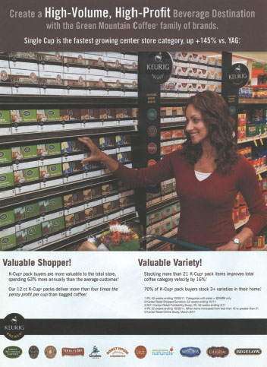
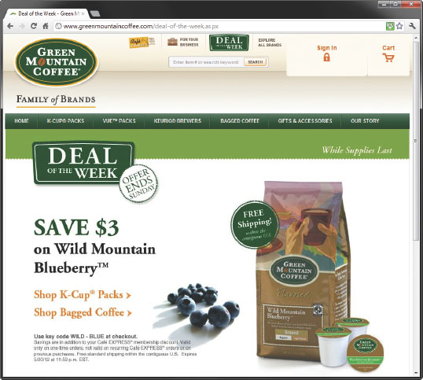
An Example of Pushing and Pulling
Source: Keurig Green Mountain, Inc.
Notes:
Text Caption: See below.
Summary Overview
There is no one right promotion blend for all situations. Each one must be developed as part of a marketing mix and should be designed to achieve the firm’s promotion objectives in each marketing strategy.
Key Issues
This ad for Green Mountain Coffee uses both push and pull to support its coffees.
Green Mountain’s website and membership program promote a “Deal of the Week” directly to consumers.
The ad on the right targets purchasing agents at grocery stores, letting them know that Green Mountain’s family of brands will bring volume and profits to their stores.
Discussion Question: What types of retailers place a heavy emphasis on personal selling?
Exacting technical specifications, large order sizes, and smaller numbers of customers are major reasons why personal selling is so common in business markets. However, the high costs of maintaining a sales force have led some producers to use mass selling techniques.
Each market segment may need a unique promotion blend. A “shotgun” mass marketing approach, as you have learned, may not be as effective as a more targeted one.

Slide 20
Checking Your Knowledge
Fido, Inc. is a producer of dog food and is getting ready to introduce a new brand. The firm’s marketing research department learns that a competitor is planning to launch another brand about two weeks after Fido’s launch. Fido’s marketing department quickly mails a set of dated coupons to several thousand consumers in a purchased database of dog owners, encouraging them to ask for the new Fido brand in their favorite store and to stock up on the new brand using the coupons. This is an example of:
A. pulling.
B. noise.
C. pushing.
D. encoding.
E. decoding.
Notes:
Checking Your Knowledge
Answer: A
Feedback: Pulling means getting customers to ask intermediaries for the product. Fido’s techniques are examples of a pulling policy. The best answer selection is A.

Slide 21
The Adoption Curve (Exhibit 13-7)
Innovators
(3–5%)
Early
adopters
(10–15%)
Early
majority
(34%)
Late
majority
(34%)
Laggards or
nonadopters
(5–16%)
Percent adoption
90
50
20
5
Time
Notes:
Summary Overview
The adoption curve shows when different groups accept ideas. Marketers have long observed that the rate of adoption of a new-product idea varies across these different groups. Promotion must vary for different adopter groups.
Key Issues
Innovators are the first to buy and don’t mind taking some risks. Innovators search out product information and rely on impersonal and scientific sources (or other innovators) when making decisions.
Early adopters are well respected by their peers and also often serve as opinion leaders for others. Of all groups, this one has the most contact with salespeople. High satisfaction among early adopters can aid word-of-mouth information about a product, which is highly credible.
The early majority group wants to avoid risk and waits to consider a new idea until many early adopters have tried a product and like it. This is a group of deliberate decision makers. They have extensive contact with salespeople, mass media, and early adopter opinion leaders.
Whereas the early majority group is deliberate in decision making, the late majority is downright cautious. People in this group are often older than the early majority group and are more set in their ways. This group makes little use of marketing sources of information.
Laggards or nonadopters hang on to tradition and are very suspicious of new ideas. They are older and less well educated than the other groups. Laggards tend to listen most to other laggards, making them very difficult to reach.
Discussion Question: How would promotional messages differ for each group?

Slide 22
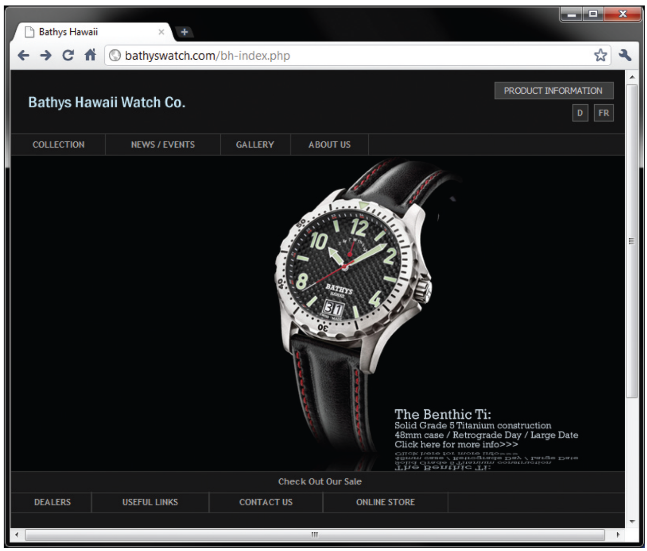
Opinion Leaders Matter
Source: Bathys Hawaii
Notes:
Text Caption: See below.
Summary Overview
Marketers know the importance of personal recommendations by opinion leaders.
Key Issues
The website for Bathys Hawaii Watch Co. was getting about 60 hits a day until Gizmodo.com, a blog on new consumer technology that appeals to technology opinion leaders, wrote about the Bathys watch designed especially for surfers.
After that, website hits jumped to 1,800 per day and sales increased by 300 percent!
Word of mouth and “word of mouse” are powerful influences.
Discussion Question: Who else could have delivered this same influence to Bathy’s?

Slide 23
Stimulating Adoption of an Image
Click on play button to view video
Notes:
A wrist watch is an example of a widely-adopted mature product. When thinking of an “upscale” or prestige watch, many people think of brands like Rolex, Omega, and Tag Heuer. It is likely that in the United States, fewer people are likely to think about the Raymond Weil brand. In this commercial, the group “Bond,” playing classical music, is used to help people associate Raymond Weil with “upscale” watches. In other words, this ad tries to get consumers to adopt the idea that Raymond Weil is in the same category as other upscale watches.
Video Operation:
INTERNET CONNECTION REQUIRED
Clicking on the orange circle image will open a web browser and access this video. When the video is completed, you can close or minimize the browser and return to the PowerPoint slides.

Slide 24
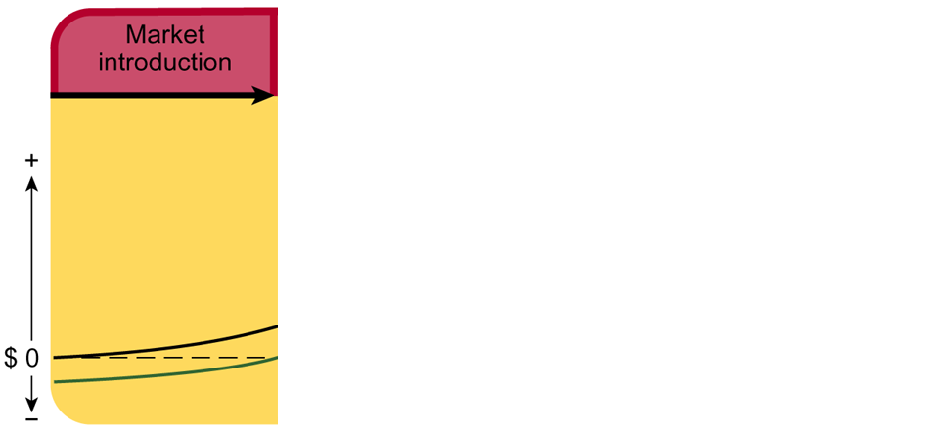
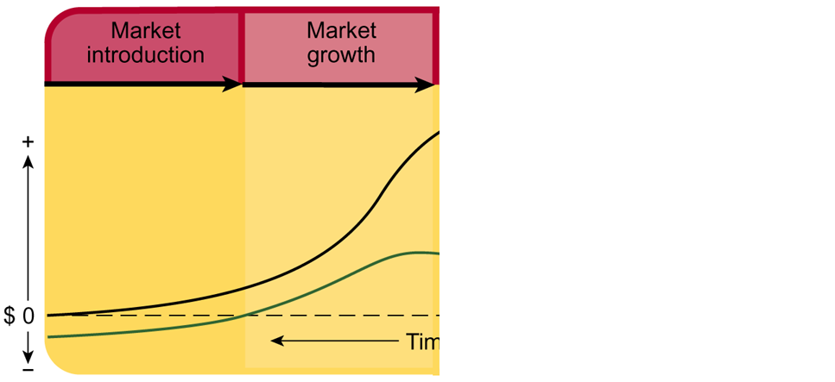
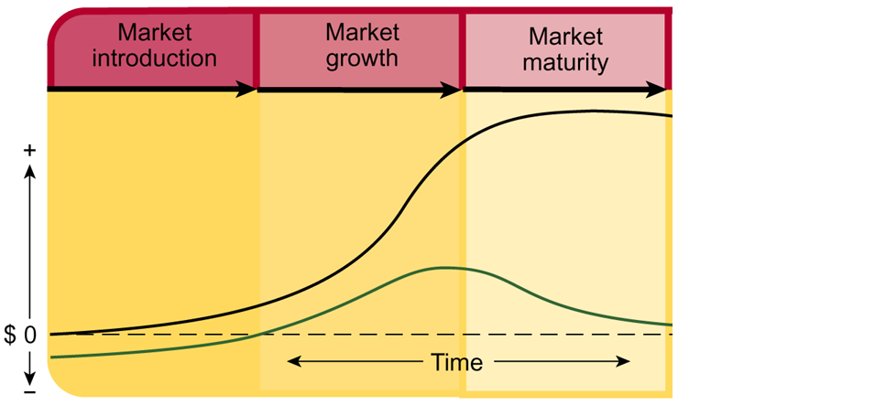
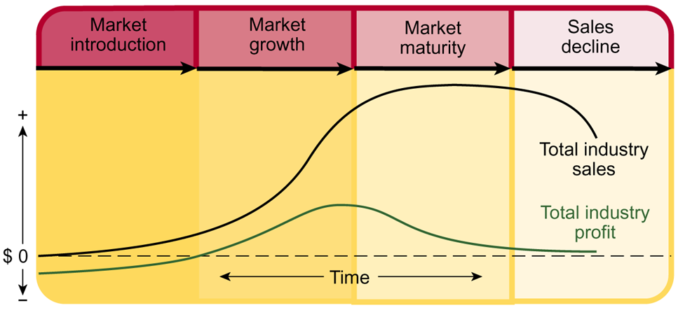
Promotion Varies Over the Life Cycle
“This new idea is good”
“Our brand is best”
“Our brand is better, really”
Reminder: “Stick with our brand.”
Notes:
Summary Overview
Depending on the stage of the product in its life cycle, promotion may have to change.
Key Issues
In market introduction, the basic promotion objective is informing. For really new product concepts, promotion focuses on building primary demand—demand for the general product idea. Promotion in market introduction says, “this new idea is good.” Appeals to final consumers tend to focus on personal selling, while both personal selling and sales promotion are useful in business markets.
→ In the market growth stage, the message changes to one of “our brand is best.” Promotion builds selective demand—demand for the company’s own brand. Mass selling becomes more feasible in this stage, especially among final consumers, but personal selling and sales promotion are still important in business markets.
→ In market maturity, persuasive promotion takes priority. The main message is, “our brand is better, really.” Mass selling and sales promotion may dominate the promotion mix for consumer products. Business products may benefit from more aggressive personal selling. Firms that have strong brands can use reminder-type promotion at this stage. Other communications and sales promotion may strengthen relationships with consumers.
→ In sales decline, the message is, “let’s tell those who still want our product.”
Discussion Question: Promotional expenditures typically decrease during sales decline. Why? Would there ever be a case in which a firm would want to increase promotion spending during decline?

Slide 25

Setting the Promotion Budget
Percentage of Sales
Task Method
Research Clarifies Estimates
Shutterstock / kckate16
Notes:
Summary Overview
In setting the promotion budget, marketing managers should consider first what promotion objectives they want to accomplish. An analysis of resources available should indicate whether these objectives are feasible. Total costs and per person costs should be considered for each alternative promotion tool.
Key Issues
The most common method of budgeting for promotion expenditures is to compute a percentage of past or anticipated future sales. This method is very straightforward. But it is also mechanical and does not consider situational variables or other market forces.
Discussion Question: This method is also criticized as being somewhat backward, or “putting the cart before the horse.” Why?
→ Task method: Sometimes called zero-based budgeting, this method links the promotion budget to a careful determination of what must be done to reach the promotion and sales objectives. This method most embodies the marketing concept and is customer-oriented.
→ Research clarifies estimates: Past projects can sometimes help marketing managers estimate the cost to achieve similar marketing objectives.

Slide 26
Key Terms
promotion
personal selling
mass selling
advertising
sales promotion
publicity
sales managers
advertising managers
sales promotion managers
public relations
integrated marketing communications
AIDA model
communication process
source
receiver
…..
Notes:
Summary Overview
These are key terms you should be familiar with based upon the material in this presentation.
Key Issues
Promotion: Communicating information between seller and potential buyer or others in the channel to influence attitudes and behavior.
Personal selling: Direct spoken communication between sellers and potential customers, usually in person but sometimes over the telephone.
Mass selling: Communicating with large numbers of potential customers at the same time.
Advertising: Any paid form of nonpersonal presentation of ideas, goods, or services by an identified sponsor.
Sales promotion: Those promotion activities—other than advertising, publicity, and personal selling—that stimulate interest, trial, or purchase by final customers or others in the channel.
Publicity: Any unpaid form of nonpersonal presentation of ideas, goods, or services.
Sales managers: Managers concerned with managing personal selling.
Advertising managers: Managers of their company's mass selling effort in television, newspapers, magazines, and other media.
Sales promotion managers: Managers of their company's sales promotion effort.
Public relations: Communication with noncustomers‑‑including labor, public interest groups, stockholders, and the government.
Integrated marketing communications: The intentional coordination of every communication from a firm to a target customer to convey a consistent and complete message.
AIDA model: Consists of four promotion jobs—(1) to get Attention, (2) to hold Interest, (3) to arouse Desire, and (4) to obtain Action.
Communication process: A source trying to reach a receiver with a message.
Source: The sender of a message.
Receiver: The target of a message in the communication process, usually a potential customer.

Slide 27
Key Terms
noise
encoding
decoding
message channel
pushing
pulling
adoption curve
innovators
early adopters
early majority
late majority
laggards
nonadopters
primary demand
selective demand
task method
Notes:
Summary Overview
These are additional key terms.
Key Issues
Noise: Any distraction that reduces the effectiveness of the communication process.
Encoding: The source in the communication process who decides what to say and then translates it into words or symbols that will have the same meaning to the receiver.
Decoding: The receiver in the communication process translating the message.
Message channel: The carrier of the message.
Pushing: Using normal promotion effort—personal selling, advertising, and sales promotion—to help sell the whole marketing mix to possible channel members.
Pulling: Using promotion to get consumers to ask intermediaries for the product.
Adoption curve: Shows when different groups accept ideas.
Innovators: The first group to adopt new products.
Early adopters: The second group in the adoption curve to adopt a new product; these people are usually well-respected by their peers and often are opinion leaders.
Early majority: A group in the adoption curve that avoids risk and waits to consider a new idea until many early adopters try it—and like it.
Late majority: A group of adopters who are cautious about new ideas—see adoption curve.
Laggards: Prefer to do things the way they have been done in the past and are very suspicious of new ideas—sometimes called nonadopters—see adoption curve.
Nonadopters: Prefer to do things the way they have been done in the past and are very suspicious of new ideas—sometimes called laggards—see adoption curve.
Primary demand: Demand for the general product idea, not just the company's own brand.
Selective demand: Demand for a company's own brand rather than a product category.
Task method: An approach to developing a budget—basing the budget on the job to be done.

