Slide 1
Chapter 16
Publicity: Promotion Using Earned Media, Owned Media, and Social Media
Notes:
For use only with Perreault/Cannon/McCarthy.
© 2019 McGraw-Hill Companies, Inc.
CHAPTER SIXTEEN
Lecture Notes for
Essentials of Marketing 16e

Slide 2
At the end of this presentation, you should be able to:
explain how publicity fits into the promotion blend.
understand the differences between paid, earned, and owned media.
explain how customers obtain information from search, pass-along, and experience.
describe different types of owned media.
describe how to use public relations to earn attention from the press.
Notes:
At the end of this presentation, you should be able to:
explain how publicity fits into the promotion blend.
understand the differences between paid, earned, and owned media.
explain how customers obtain information from search, pass-along, and experience.
describe different types of owned media.
describe how to use public relations to earn attention from the press.

Slide 3
At the end of this presentation, you should be able to:
describe how to earn word-of-mouth from customers.
explain what social media is and how it differs from traditional media.
compare and contrast the major social media platforms.
describe how firms use software to measure, manage, and automate online promotion.
understand important new terms
Notes:
At the end of this presentation, you should able to:
describe how to earn word-of-mouth from customers.
explain what social media is and how it differs from traditional media.
compare and contrast the major social media platforms.
describe how firms use software to measure, manage, and automate online promotion.
understand important new terms.

Slide 4

Strategy Planning for Publicity, Earned Media, Owned Media, and Social Media (Exhibit 16-1)
CH 13: Promotion: Intro to Integrated Marketing Communications
CH 14: Personal Selling and Customer Service
CH 15: Advertising and Sales Promotion
CH 16: Publicity: Promotion Using Earned, Owned, and Social Media
Advertising vs. Publicity
Customers obtain information
Publicity types
Social media
Software for online media
Notes:
Summary Overview
Publicity refers to any unpaid form of nonpersonal presentation of ideas, goods, or services.
Key Issues
Publicity works best when it is integrated into the entire marketing mix.
A marketing manager must understand how the right promotion moves a customer through the buying process.
As a customer moves through the process, different types of information are needed.

Slide 5
Paid, Owned, and Earned Media (Exhibit 16-2)
Type of
media
Message
source
Examples
Advertising
Paid
media
Selling
company
Advertising on television,
print, online, mobile devices,
billboards, radio, etc.
Mass
Selling
Branded websites, selling
company’s blog, selling
company social media
(Facebook, Twitter), email
newsletters, brochures
Owned
media
Selling
company
Publicity
Television or radio news
stories, magazine or
newspaper articles or
reviews
Independent
journalists
Earned
media
Word-of-mouth praise or
criticism, online customer
reviews, Facebook posts or
Twitter tweets about a brand
Other
customers
Notes:
Summary Overview
Media refers to the means used for mass communication.
Key Issues
Paid media: messages generated by a brand (or company or nonprofit organization) and communicated through a message channel the brand pays to access.
Publicity: uses unpaid media. There are two general types of unpaid media which will be the focus of this chapter.
Owned media: promotional messages generated by a brand (or company or nonprofit organization) communicated through a message channel the brand directly controls.
Earned media: promotional messages not directly generated by the company or brand, but rather by third parties such as journalists or customers.

Slide 6
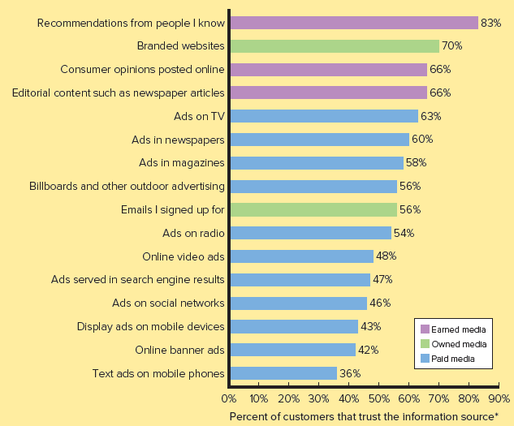
Customer Trust in Various Sources of Information (Exhibit 16-3)
Notes:
Summary Overview
A recent study of 30,000 Internet consumers from 60 countries found the four most highly trusted sources for buying information are forms of publicity, not advertising (see Exhibit 16-3). Consumers trust information from earned media sources most: 83 percent of respondents trust recommendations from people they know, 66 percent trust online consumer opinions (reviews), and 66 percent trust editorial content such as newspaper articles. Branded websites (a form of owned media) are trusted by 69 percent of respondents. These levels of trust are significantly higher than various types of advertising (paid) media. Among various advertising (paid) media, trust ranged from 36 percent for text ads on mobile phones to 63 percent for television advertising.
Discussion Question: Think about your own situation. Which sources of information would be most helpful if you were:
looking for a a restaurant in a town you were not familiar with?
wanted to buy a new pair of shoes?
wanted to buy a book for pleasure reading on an upcoming vacation?
wanted to purchase a new tennis racquet, skis, or some other recreational equipment?
Why would you feel more comfortable with those sources of information?

Slide 7
Benefits and Challenges of Advertising Media, Owned Publicity Media, and Earned Publicity Media (Exhibit 16-4)
Media Type | Benefits | Challenges
Paid media (advertising) | High message control More precise targeting Potentially large audience | Not trusted Customers easily avoid More costly, declining effectiveness
Notes:
Summary Overview
Paid media—high message control yet becoming less effective.
Key Issues
Most advertising is designed to target a large number of customers at once, whereas specialized media target fewer customers more precisely.
Customers are getting better at avoiding advertising messages

Slide 8
Benefits and Challenges of Advertising Media, Owned Publicity Media, and Earned Publicity Media (Exhibit 16-4)
Media Type | Benefits | Challenges
Owned media | High message control Relatively low cost Niche audiences Versatile in message content and format | Need to drive or attract customers to sites and create value to ensure their return Requires resources to manage and maintain
Notes:
Summary Overview
Owned media—high message control and lower cost.
Key Issues
Owned media allows a marketing manager to craft the precise message customers receive.
Marketing managers can choose what information is displayed on the company website, YouTube channel, Instagram, Pinterest page, or Twitter feed.
Challenges for marketing managers include maintaining owned media and making sure customers find their information when it is needed in the buying process.

Slide 9
Benefits and Challenges of Advertising Media, Owned Publicity Media, and Earned Publicity Media (Exhibit 16-4)
Media Type | Benefits | Challenges
Earned media | Most trusted information source Customers most likely to act on this information | Very little message control Can be negative toward brand Difficult to measure Difficult to create Difficult to target
Notes:
Summary Overview
Customers act on earned media, but it has risks.
Key Issues
Marketing managers are usually thrilled when positive articles are written about their products or customers post positive reviews on social media sites.
These influential message sources are out of a marketing manager’s control.

Slide 10
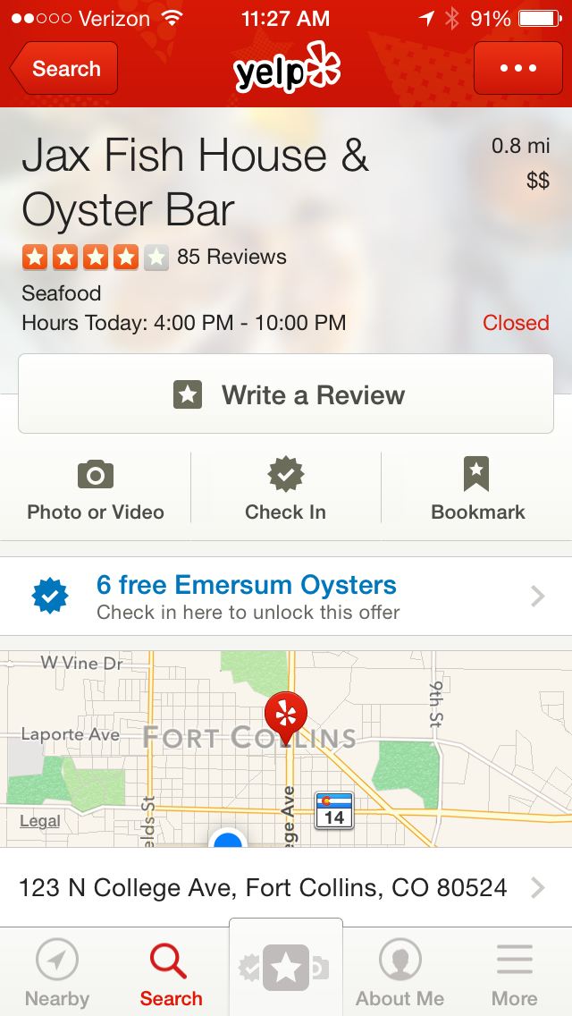
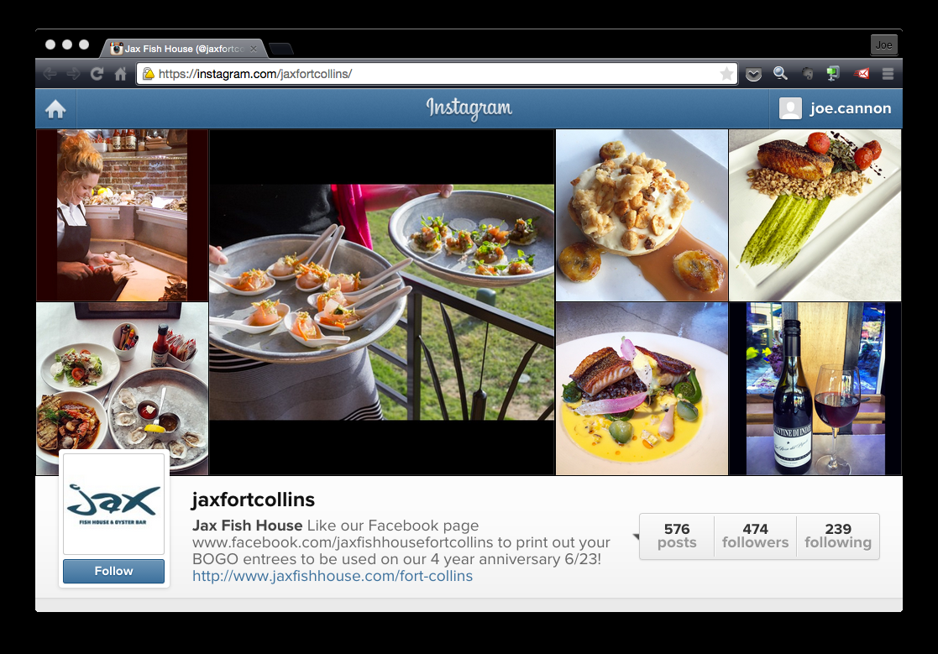
Customers act on earned media, but it has risks
Source: Big Red F Restaurant Group
Notes:
Summary Overview
Jax Fish House, a restaurant in Fort Collins, Colorado, maintains an Instagram page. Jax uses this form of owned media to post pictures of its delicious food and wine. Jax controls what gets posted on Instagram. On the other hand, Jax does not directly control what is said in the 85 reviews it has on Yelp. Fortunately, delivering a great dining experience helps the restaurant to earn high praise.

Slide 11
Customers Obtain Information from Search, Pass-Along, and Experience
Customers search offline, too
Marketers want to be found when customers search
Pass-along from trusted sources
Customers experience branded services
Notes:
Summary Overview
Because customers often search for information during the shopping process, marketing managers need to make sure that when target customers search, online material useful to them is “found.”
Key Issues
Most customers use a search engine such as Google, Bing, or Yahoo—and most favor the organic search results rather than the paid ads at the side or top of the search.
Marketing managers often use search engine optimization (SEO), which is the process of designing a website so that it ranks high in a search engine’s unpaid results.
Customers search offline, too.
Pass-along occurs when one customer makes a recommendation for (or against) a specific brand to another customer.
The ultimate in pass-along—going viral.
Discussion Question: Can you think of examples of campaigns that have gone viral recently?
Most often customers gain experience with a brand by using its product—its goods and/or services.
Branded services are valued services a brand provides that are not directly connected to a core product offering

Slide 12
Types of Owned Media—How Customers Find It and Typical Promotional Objectives (Exhibit 16-5)
Type of Owned Media
How Customers Typically Discover Each Type of Owned Media
Typical Promotion Objectives
Educational web pages
Customers searching for answers
Build awareness.
Educate/inform
Foster trust
White papers and case studies
Customers searching for solutions to problems
Build awareness
Educate/inform
Build reputation as thought leader
Foster trust
Landing pages
Advertising drives customers to landing pages
Customers searching for solutions
Build awareness
Start a relationship
Generate leads
Notes:
Summary Overview
Understanding how customers discover owned media helps a firm develop other promotional efforts which direct target customers to owned media.
Key Issues
Educational web pages—some companies will build an educational website to “teach customers” about its products. Home Depot’s website tells customers how to build a fence or a deck.
White papers are an authoritative report or guide that addresses important issues in an industry and offers solutions. Case studies are success stories that highlight how a company helped another customer.
Landing pages are customized web pages that logically follow from clicking on an organic search result, online advertisement, or other link.

Slide 13
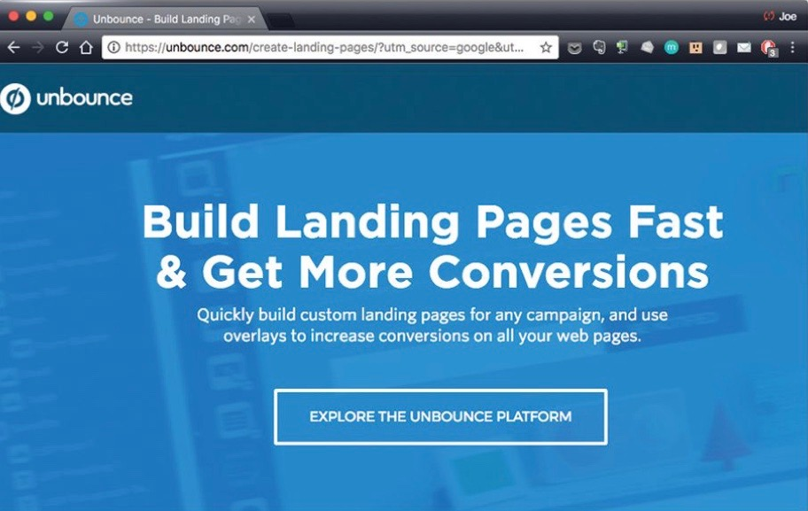
Landing pages to engage customers
Source: Unbounce
Notes:
Summary Overview
Unbounce is a collaborator that helps marketers create more effective websites and landing pages. When potential customers search Google for "landing pages," they see a search advertisement for Unbounce. Clicking on the ad brings them to this "Landing Page," which grabs their attention and interest, and encourages another click to learn more about the Unbounce platform.

Slide 14
Types of Owned Media—How Customers Find It and Typical Promotional Objectives (Exhibit 16-5)
Type of Owned Media
How Customers Typically Discover Each Type of Owned Media
Typical Promotion Objectives
Blogs
Pass-along from friends’ content on social media
Searching for solutions
Return or monitor a blog that user found valuable previously
Maintain interest
Build reputation as thought leader
Infographics
Searching for solutions
Practical value can motivate pass-along
Grab attention
Inform customers
Branded apps
Practical value can motivate pass-along
Support brand positioning
Notes:
Summary Overview
Understanding how customers discover owned media helps a firm develop other promotional efforts which direct target customers to owned media.
Key Issues
A blog is a regularly updated website, usually managed by one person or a small group and written in an informal, conversational style.
Infographics are a visual image such as a chart or diagram used to represent information or data.
Branded apps are sponsored software applications that benefit customers by providing entertainment, solving a problem, and/or saving time.

Slide 15
Types of Owned Media—How Customers Find It and Typical Promotional Objectives (Exhibit 16-5)
Type of Owned Media
How Customers Typically Discover Each Type of Owned Media
Typical Promotion Objectives
Brand communities
Discover through search
Return to communities where value was found previously
Practical value can motivate pass-along
Provide value for customers
Remind customers
E-mail newsletter
Subscribe to valuable e-mail content
Pass-along valuable content
Maintain relationship
Remind customers
Cross-sell to customers
Notes:
Summary Overview
Understanding how customers discover owned media helps a firm develop other promotional efforts which direct target customers to owned media.
Key Issues
Branded communities are a group of customers joined around a particular brand or common set of shared interests.
E-mail newsletters
Discussion Question: Are any of you members or regularly visit an online community? Do you receive any e-mail newsletters? [Remind them that many retailers send these out.]

Slide 16
Earned Media from Public Relations and the Press
Get coverage in the press
Get found when the press searches
Key
Issues
Online pressrooms
Bloggers are the new press
Ethics, the law and bloggers
Notes:
Summary Overview
Media coverage can be earned from customers—or from the press.
Key Issues
→ Some companies earn editorial coverage.
This kind of coverage doesn’t usually happen by luck or accident.
Southwest Airlines uses press releases to generate publicity in the popular press.
Independent bloggers often “publish” their own stories on topics of interest.
When a blogger (or someone posting on social media) offers an endorsement or testimonial for a product, it must be disclosed.
A public relations (PR) person or staff can make it easier for the press. Other firms will set up an online pressroom.

Slide 17
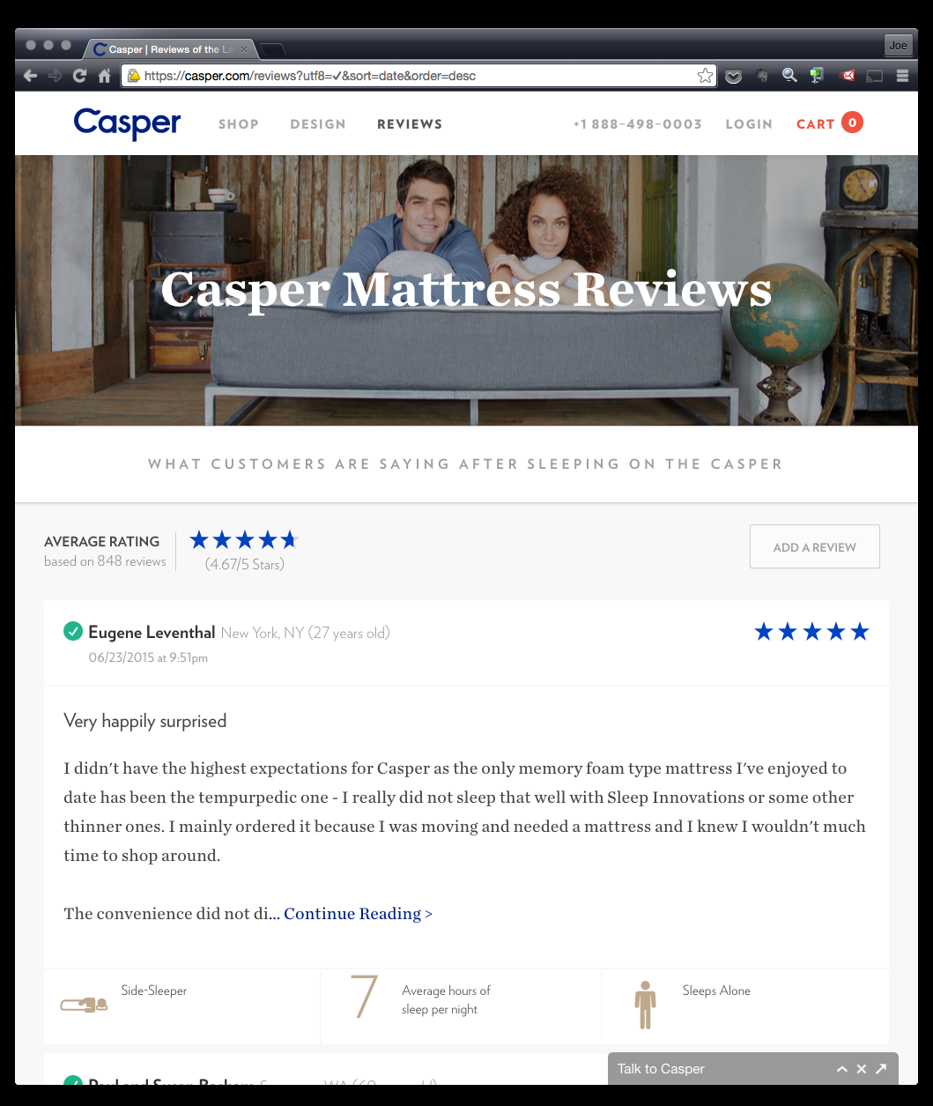
Earned Media from Customer Advocacy
Source: Casper Sleep, Inc.
Notes:
Text Caption: See below.
Summary Overview
Customers trust and act on recommendations from friends, family, and colleagues.
Key Issues
Although information from other customers is influential, it is much more difficult to control than the messages a marketing manager crafts for an advertisement, sales promotion, or owned media.
Opinion leaders help spread the word—good and bad.
Most customers are reluctant to recommend.
For customers to share their great experiences, they must see doing so as safe, fun, and worthwhile.
Referral programs give customers incentives to recommend.
Ratings and reviews let customers do the selling.
Marketing managers manage negative reviews when they come along.
Companies need to be careful they are not too zealous in seeking positive word-of-mouth.
Social media simplifies and amplifies pass-along.
Casper Mattress sells mattresses online. Reviews are an important part of its promotion mix. Customers usually like to lay down on a mattress before purchasing. Positive reviews and some explanations about the purchase can reduce the risk of buying without trying.

Slide 18
Social Media Differ from Traditional Media
Social media—paid, owned, and earned
Social media—many-to-many communication
social media vs. traditional media
Social media—no media placement cost but not free
Advertising plans, social media
Notes:
Summary Overview
The growth of the Internet led to a rise in different types of social media.
Key Issues
Most social media has no direct media cost, but that doesn’t mean social media is free.
Advertising is a one-to-many model of communication—a brand sends a message to many customers at once.
Advertising through paid media typically involves a relatively long planning cycle.

Slide 19
Major Social Media Platforms
Facebook
Twitter
Major
Platforms
LinkedIn
Instagram
Pinterest
Notes:
Summary Overview
There are many different social media platforms—and there seem to be new ones appearing weekly. In recent years, five social media sites have attracted considerable attention in the United States and around the world: Facebook, Twitter, Instagram, Pinterest, and LinkedIn. Each has more than 250 million users visiting their sites at least once a month.
Key Issues
Facebook—the king of social media.
Facebook is an online social networking website that allows registered users to create profiles, upload photos and video, and send messages to friends, family, and colleagues.
→Twitter microblogging service.
Twitter is a social networking microblogging service that allows registered users to send out short (140 characters or less) messages called “tweets.
→Instagram—when a picture is worth a thousand words
Instagram is a free online photo and video sharing service geared to mobile phones. Photos and videos can be taken with the Instagram smartphone app (or other camera app) and shared on other social networking sites including Facebook, Twitter, and Tumblr.
→Pinterest lets users share wish lists
Pinterest is a website that allows registered users to share ideas and images they find online with fellow users.
→Businesses get social on LinkedIn
LinkedIn is a social networking website for businesspeople who create personal or company profiles.

Slide 20
Software Can Manage, Measure, and Automate Online Media
Software can manage social media
Key
Issues
Software can manage social media
Use bounce rates to measure websites
Notes:
Summary Overview
For firms that have earned, owned, and social media online, new software helps manage, measure, and automate these media.
Key Issues
Because different types of earned, owned, and social media occur online, software can be used to monitor and manage the process.
→ One measure of a website’s success is bounce rate, which indicates the percentage of visitors who only visit a single page in a website.
→ Marketing automation software tracks individual customer’s behavior and triggers actions in response to specific customer actions.
For organizations with customers who spend a lot of time online, this software provides a low-cost way to learn more about customers and deliver the right messages at the right time.

Slide 21
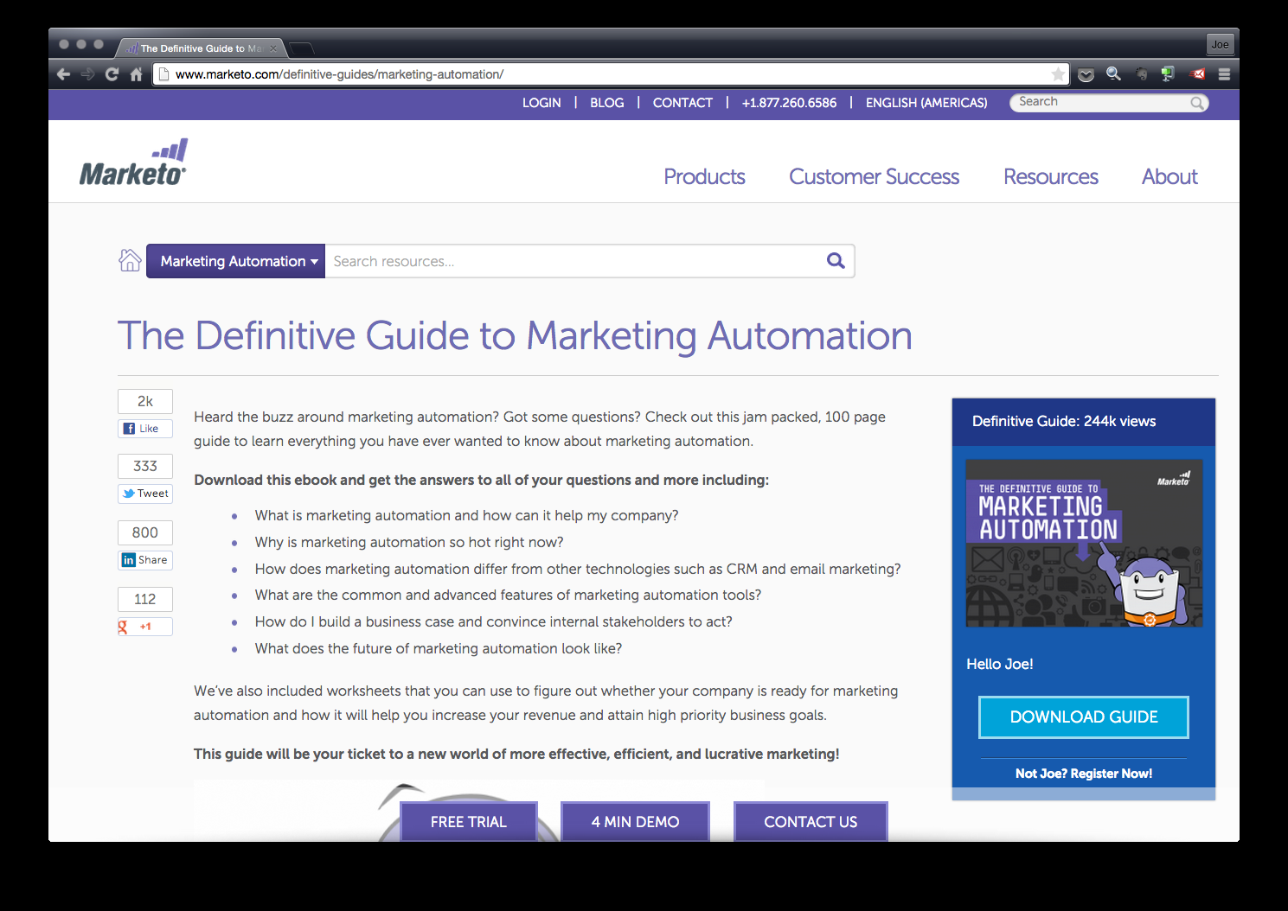
Measure results from online media
Source: Marketo, Inc.
Notes:
Text Caption: Companies like Marketo offer free e-book downloads to help customers better understand marketing automation. Marketo also sells marketing automation software.

Slide 22
Key Terms
paid media
owned media
earned media
user-generated content
search engine optimization (SEO)
pass-along
branded services
white paper
case studies
landing page
blog
infographic
branded apps
brand community
referral program
social media
Facebook
Twitter
Instagram
Pinterest
LinkedIn
marketing automation software
Notes:
Summary Overview
These are key terms you should be familiar with based upon the material in this presentation.
Key Issues
Paid media: Messages generated by a brand (or company or nonprofit organization) and communicated through a message channel the brand pays to access.
Owned media: Promotional messages generated by a brand (or company or nonprofit organization) communicated through a message channel the brand directly controls.
Earned media: Promotional messages not directly generated by the company or brand, but rather by third parties such as journalists or customers.
User-generated content: Any type of communication created by customers for other customers. User-generated content can take many forms.
Search engine optimization (SEO): The process of designing a website so that it ranks high in a search engine’s unpaid results.
Pass-along: When one customer makes a recommendation for (or against) a specific brand to another customer.
Branded services: Valued services a brand provides that are not directly connected to a core product offering.
White paper: An authoritative report or guide that addresses important issues in an industry and offers solutions.
Case studies: Success stories about how a company helped another customer.
Landing page: A customized web page that logically follows from clicking on an organic search result, online advertisement, or other link
Blog: A regularly updated website, usually managed by one person or a small group and written in an informal, conversational style
Infographic: A visual image such as a chart or diagram used to represent information or data.
Branded apps: Sponsored software applications that benefit customers by providing entertainment, solving a problem, and/or saving time.
Brand community: A group of customers joined around a particular brand or common set of shared interests.
referral program: Offers a current customer an incentive for recommending a new customer to a business.
Social media: Websites or software applications that allow users to create and share ideas, information, photos and videos, and interact in a social network.
Facebook: An online social networking website that allows registered users to create profiles, upload photos and video, and send messages to friends, family, and colleagues
Twitter: A social networking microblogging service that allows registered users to send out short (140 characters or less) messages called “tweets.”
Instagram: A free online photo and video sharing service geared to mobile phones.
Pinterest: A website that allows registered users to share ideas and images they find online with fellow users.
LinkedIn: A social networking website for businesspeople who create personal or company profiles
Marketing automation software: Software that tracks individual customer’s behavior and triggers actions in response to specific customer actions.
This slide refers to boldfaced terms appearing in Chapter 15.

