Slide 1
Chapter 18
Price Setting in the Business World
Notes:
For use only with Perreault/Cannon/McCarthy.
© 2019 McGraw-Hill Companies, Inc.
CHAPTER EIGHTEEN
Lecture Notes for
Essentials of Marketing 16e

Slide 2
At the end of this presentation, you should be able to:
understand how most wholesalers and retailers set their prices by using markups.
understand the advantages and disadvantages of average-cost pricing.
know how to use break-even analysis to evaluate possible prices.
understand the advantages of marginal analysis and how to use it for price setting.
Notes:
At the end of this presentation, you should be able to:
understand how most wholesalers and retailers set their prices by using markups.
understand the advantages and disadvantages of average-cost pricing.
know how to use break-even analysis to evaluate possible prices.
understand the advantages of marginal analysis and how to use it for price setting.

Slide 3
At the end of this presentation, you should be able to:
understand other demand-oriented factors that influence price setting.
explain full-line pricing and factors influencing such decisions
understand important new terms.
Notes:
At the end of this presentation, you should be able to:
5. understand other demand-oriented factors that influence price setting.
explain full-line pricing and factors influencing such decisions
understand important new terms.

Slide 4
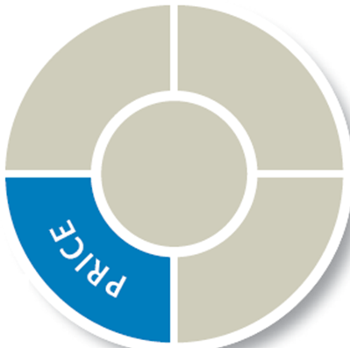
Price Setting and Strategy Planning (Exhibit 18-1)
CH 17: Pricing Objectives and Policies
CH 18: Price Setting in the Business World
Cost-oriented price setting approaches
Demand-oriented price setting approaches
Other price-setting issues
Notes:
Summary Overview
The previous chapter showed how pricing objectives and policies should guide pricing decisions, as well as how variations from list price affect customer value. This chapter focuses on how the list price is set in the first place.
Key Issues
There are two basic approaches to setting list prices:
Cost-oriented—the most common approach.
Demand-oriented—takes into account consumer demand in making price decisions.
The chapter concludes by discussing other price-setting issues such as:
Pricing full lines of products,
Bid pricing, and
Negotiated pricing.

Slide 5
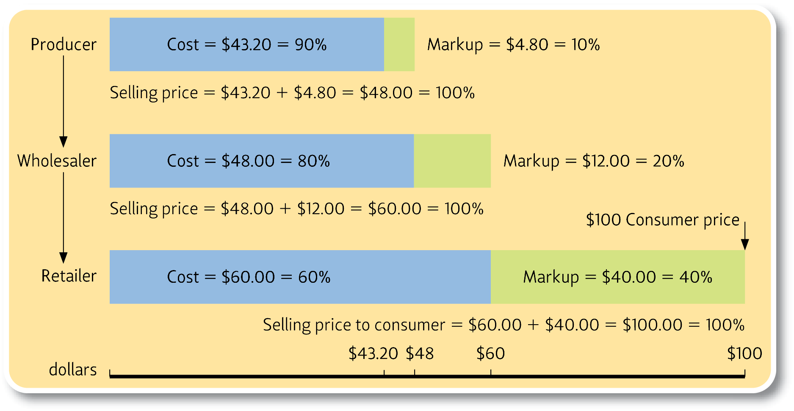
Markup Chain and Channel Pricing (Exhibit 18-2)
Notes:
Summary Overview
A markup is a dollar amount added to the cost of products to get the selling price. Markups guide pricing by intermediaries; they are necessary to cover the costs of distribution and allow intermediaries to make a profit.
Key Issues
Markup percent: The percentage of the selling price that is added to the cost to get the selling price.
This is a convenient rule, but tricky.
A 50-cent addition to a $1.00 item leading to a $1.50 price is a 33 1/3% markup (50 cents is a third of $1.50) even though it's 50% of the price paid by the intermediary.
Many intermediaries use a standard markup percentage.
Percentages often are the same within an industry, thus encouraging all players to increase efficiency and cut costs.
Markups are often related to the company’s desired or expected gross margin—net sales minus cost of goods sold.
Markup chain: the sequence of markups firms use in channel pricing.
Discussion Question: Consider the example shown in this exhibit. If the cost of making the product is $43.20, and the selling price is $48.00, what is the markup expressed in dollars and as a percentage?
What is the wholesaler’s cost? If the wholesaler’s selling price is $60.00, what is the markup expressed in dollars and as a percentage?
What are the cost price, selling price, and markup for the retailer?

Slide 6
Checking Your Knowledge
It costs the producer of a coffee maker $44 to make each one. The producer charges wholesale distributors $55 for each coffee maker purchased. The producer’s markup in dollars is ________, and in percentage terms, is ________.
A. $99; 44%.
B. $11; 20%.
C. $11; 25%.
D. $99; 20%.
E. $55; 25%.
Notes:
Checking Your Knowledge
Answer: B
Feedback: The markup is the dollar amount added to the cost of the product to get the selling price. The cost is $44 and the selling price is $55; therefore, the markup is $11. The markup percentage is the percentage of selling price that is added to the cost to get the selling price. So in this example, you would take $11 (markup) /$55(selling price) to calculate the markup percentage as 20%. The best answer selection is B.

Slide 7
Checking Your Knowledge
A clothing retailer charged $300 for a man’s suit after getting it from the wholesaler for $150. The retailer’s markup percentage is:
A. 33%.
B. 100%.
C. 133%.
D. 50%.
E. Cannot be determined from the information provided.
Notes:
Checking Your Knowledge
Answer: D
Feedback: The markup percentage is the percentage of the selling price that is added to the cost to get the selling price. If the retailer got the suit from the wholesaler for $150 and then charged $300, the markup is $150. Therefore, to determine the retailer markup percentage you would take $150 (markup)/$300 (selling price) to get 50%. The best answer selection is D.

Slide 8
High Markups Don’t Always Mean Big Profits
High markups may reduce demand for the product
Key
Issues
Lower markups can speed turnover and the stockturn rate
Notes:
Summary Overview
It is important to remember that high markups don’t always translate into high profits. A high markup may reduce demand for the product to a point where the seller actually loses money because too few items are sold.
Key Issues
Lower markups can speed turnover and the stockturn rate (the number of times the average inventory is sold in a year).
Low stockturn rates increase inventory carrying costs and tie up capital.
Discussion Question: How might a retailer increase the stockturn rate?
Mass-merchandisers run in fast company; they recognize the importance of stockturn rates and adjust their markups. Faster-moving items have lower markups while slower-moving items have higher ones.
Where does the markup chain start? The firm that brands a product is usually the one that sets its basic list price. It is most often the producer, but could be another channel member as well.
Some producers start with a cost figure and add a standard markup, or use a formula such as:
Selling price = Average production cost per unit x 3.
A producer using this approach might develop rules and markups related to its own costs and objectives.

Slide 9
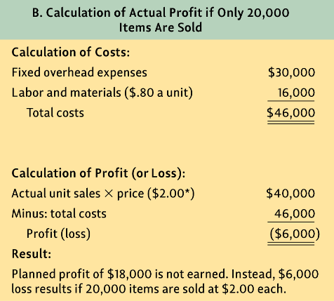
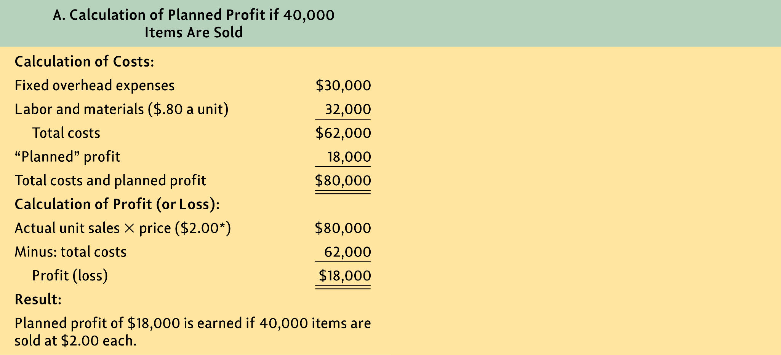
Results of Average-Cost Pricing
(Exhibit 18-3)
Notes:
Summary Overview
Average-cost pricing means adding a reasonable markup to the average cost of a product. A manager usually finds the average cost per unit by dividing the total cost for the year by all the units produced and sold in that period.
Key Issues
This exhibit gives an example of how average cost pricing works. In this example, the costs for the year include $30,000 in fixed overhead expenses and $32,000 in labor and materials.
If the company produced and sold 40,000 units, the total cost of $62,000 is divided by the 40,000 units to yield a cost of $1.55 per unit.
Discussion Question: If the company wants $18,000 in profit, how would one go about determining the markup needed, per unit, to achieve the desired profit?
→ In this case, $18,000 divided by 40,000 units yields a markup of 45 cents per unit. To get the selling price per unit, the company adds the 45 cents of markup to the cost of $1.55, so the price is $2.00 per unit.
→ In the second example, suppose the firm maintains a price of $2.00, but it only produces and sells 20,000 units. This change decreases the labor and materials costs, but fixed overhead expenses remain the same, so the total cost is $46,000. However, revenue from sales is only $40,000, so the firm loses $6,000.
Average cost pricing is simple, but it’s easy to lose money with average cost pricing, because it does not make allowances for cost variations as output changes.
Average cost tends to goes down as output increases due to economies of scale, but average cost pricing doesn’t consider this change.

Slide 10
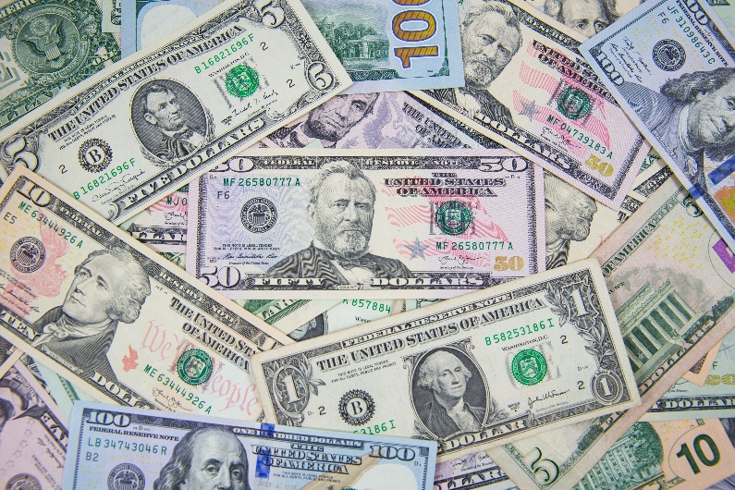
Marketing Managers Must Consider Various Kinds of Costs
Total Variable Cost
Total Fixed Cost
Total Cost
Average Variable Cost
Average Cost
Average Fixed Cost
©Shutterstock / kckate16
Notes:
Summary Overview
In light of the problem with average-cost pricing, it is important to understand six types of costs, because they each change in a different way as output changes.
Key Issues
There are three kinds of total cost:
→ Total fixed cost is the sum of those costs that are fixed in total, regardless of how much of something is produced. Things like rent, managers’ salaries, and insurance remain constant whether production goes up or down.
→ Total variable cost is the sum of expenses that change with the level of output. Variable costs include things like hourly wages, the cost of materials, packaging, shipping, and sales commissions.
→ Total cost is the sum of total fixed and total variable costs.
There are three kinds of average cost:
→ Average cost per unit is obtained by dividing total cost by the related quantity.
→ Average fixed cost per unit is obtained by dividing total fixed cost by the related quantity.
→ Average variable cost per unit is obtained by dividing total variable cost by the related quantity.
Discussion Question: If total fixed costs are $50,000 and total variable costs are $60,000, and 500 units are produced, what are: a) total cost; b) average cost; c) average fixed cost; and d) average variable cost?

Slide 11
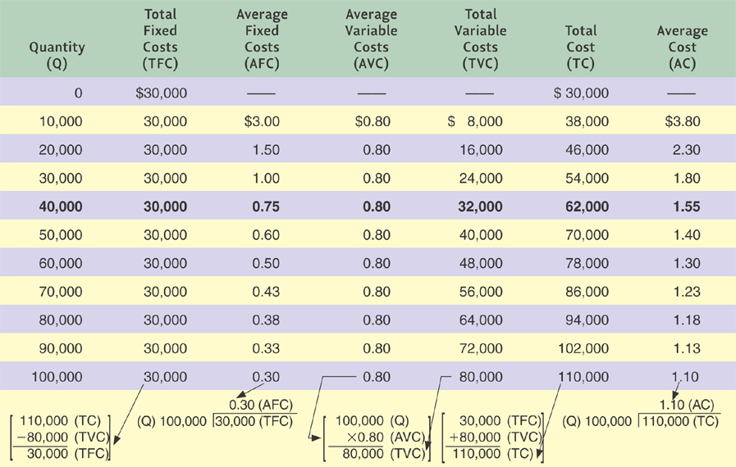
Cost Structure of a Firm
(Exhibit 18-4)
Notes:
Summary Overview
A good way to get a feel for the types of costs is to consider an example that shows cost relations.
Key Issues
On the left-hand side of the diagram, note that in the first column, the costs correspond to increasing output quantities—from no units produced to 100,000.
Discussion Question: Looking at the second column from the left, the costs don’t change with increasing output. Why?
→ In the third column, average fixed costs decline steadily with increasing output, as the fixed costs are spread over larger and larger numbers of units.
→ In the fourth column, average variable costs per unit remain constant but, → in the fifth and → sixth columns, total variable costs increase thus increasing total cost.
→ In the last column, average cost decreases, but by progressively smaller amounts.
In stable situations, average-cost pricing may yield profits—but not necessarily maximum profits. And such cost-based prices may be higher than a price that would be more profitable for the firm. Ignoring demand is the major weakness of average-cost pricing; it’s even riskier when demand conditions are changing.
Moreover, marketers should not ignore competitors’ costs, because a lower-cost provider may offer lower prices and still be able to make a profit.
Discussion Question: What price do you choose? Why? What happens if you sell more than anticipated? Less than anticipated?
→ Here is the big problem with average cost pricing, it only considers costs. In this case, the firm might expect to sell 40,000 units and would therefore anticipate average costs of $1.55 per unit. It might choose to charge a price of $2.00 assuming a margin of $0.45 per unit sold.
→ But what if it only sells 20,000 units. Now the costs are $2.30 per unit and they lose $0.30 per unit.

Slide 12
Summary of Relationships among Quantity, Cost, and Price Using Cost-Oriented Pricing(Exhibit 18–7)
?
Estimate quantity to be sold
Quantity demanded at selling price
Average
fixed cost per unit
Variable cost per unit
Cost-oriented selling price per unit
Average
Total cost per unit
Profit per unit
Notes:
Summary Overview
Cost-oriented pricing requires an estimate of the total number of units to be sold. That estimate determines the average fixed cost per unit and thus the average total cost. Then the firm adds the desired profit per unit to the average total cost to get the cost-oriented selling price. How customers react to that price determines the actual quantity the firm will be able to sell. But that quantity may not be the quantity used to compute the average cost!
Key Issues
Exhibit 18-7 provides a summary of what we have just covered – let’s use it as a review.
We begin by estimating the quantity to be sold
We use that estimate to calculate the average cost per unit and and variable cost per unit consequently…
The average total cost per unit and suggests the profit per unit.
Then, the company sets a desired level of profit per unit to get to a cost-oriented selling price per unit.
Of course the actual quantity sold depends on that selling price, and…
May result in a revised estimated quantity to be sold. But now, that NEW quantity may not be the quantity used to calculate average cost.
This is the problem with average-cost pricing.

Slide 13
Break-Even Analysis Can Evaluate Possible Prices
Total fixed cost
Fixed cost contribution per unit
Break-Even (in units) =
Fixed cost contribution per unit =
Price – variable cost per unit
Notes:
Summary Overview
Break-even analysis evaluates whether the firm will be able to break even—that is cover all its costs—with a particular price.
Key Issues
Break-even analysis requires a firm to figure out its total fixed costs and its fixed-cost contribution per unit.
For each unit sold, think about the fixed cost contribution per unit as the amount from each sale that can go toward paying off fixed costs.
So for example, a firm buying t-shirts for $5 each and selling them for $8 would have $3 from each sale to pay off fixed costs which might include store rent and employee salaries.

Slide 14
Break-Even Chart for a Particular Situation (Exhibit 18-8)
Total revenue curve
Profit area
Total cost curve
Total revenue and cost ($000)
100
Break-even point
90
80
Loss
area
Total variable costs
60
40
Total fixed costs
20
0
20
40
60
80
100
75
Units of production (000)
Notes:
Summary Overview
A graphic provides one visualization of break-even.
Key Issues
Break-even charts help find the break-even point (BEP): The point where the total revenue from the quantity sold just equals the firm’s total costs.
Discussion Question: If the selling price per unit is $1.20 and the variable cost per unit is 80 cents, what is the fixed-cost contribution per unit? If total fixed costs are $30,000, what is the break-even point in units?
The BEP can be stated in dollars. Multiplying the BEP in units times the selling price per unit yields the BEP in dollars.
Each possible price has its own BEP. Thus, break-even analysis allows the marketing manager to compare the ramifications of different prices on the BEP.
A target profit can also be included in computing the BEP; the desired profit is added to the total fixed costs.
Break-even analysis shows the effect of cutting costs in relation to increasing profits. It is helpful, but not a pricing solution.
Break-even analysis is a cost-oriented tool, not a demand-oriented one. Managers usually face downward sloping demand curves, and break-even analysis does not factor in the effect of price on demand.

Slide 15
Break-even in Action – Case Of The Lemonade Stand
FC contribution per unit (=$.60)
Selling price per unit
Sell each cup of lemonade for $1.00
Fixed costs =
$2.40
Buying a pitcher
Creating a sign
FC contribution per unit (=$.60)
FC contribution per unit (=$.60)
Variable cost = $.40
(cups, ice, mix)
FC contribution per unit (=$.60)
Profit = $.60
FC contribution per unit (=$.60)
FC contribution per unit (=$.60)
Profit = $.60
Notes:
Summary Overview
Walking through another simple example of break-even will help you explain this concept.
Key Issues
Let’s look at a lemonade stand: selling cups of lemonade for $1.00
If the variable costs were $.40, it would leave $.60 from each cup to pay off the fixed costs of buying a pitcher and creating a sign.
Our first sale contributes $.60 to fixed costs as does the
Second cup sold
Third cup sold
And fourth cup sold—at four cups, we break even.
The fifth cup contributes $.60 to profits.
As does the sixth and each subsequent sale.

Slide 16
Checking Your Knowledge
A company has total fixed cost of $500,000. Its per unit variable cost is $5.00, and its price per unit is $10.00. What is the break-even point in sales dollars?
A. $100,000
B. $2,500,000
C. $1,000,000
D. $33,000
E. Cannot be determined from the information provided.
Notes:
Checking Your Knowledge
Answer: C
Feedback: The BEP (in units) is calculated as follows:
BEP (in units) = Total fixed cost/Fixed cost contribution per unit.
BEP (in units) = $500,000/$5.00 (fixed cost contribution per unit) yields a result of 100,000 units.
To determine the break-even point in sales dollars, multiply the BEP (in units) by the sales price. In this example, BEP (in units) 100,000 units x $10 selling price yields a break-even point in sales dollars of $1,000,000. The best answer selection is C.

Slide 17
Revenue, Cost, and Profit at Different Prices for a Firm (Exhibit 18-9)
Price (P) | Qty (Q) | Rev (R = PxQ) | Total VC (TVC) | Fixed Cost (FC) | Total Cost (TC=TVC+FC) | Profit (P=R-TC)
$200 | 0 | $0 | $0 | $200 | $200 | -$200
175 | 1 | 175 | 60 | 200 | 260 | -85
160 | 2 | 320 | 120 | 200 | 320 | 0
145 | 3 | 435 | 180 | 200 | 380 | 55
135 | 4 | 540 | 240 | 200 | 440 | 100
125 | 5 | 625 | 300 | 200 | 500 | 125
115 | 6 | 690 | 360 | 200 | 560 | 130
105 | 7 | 735 | 420 | 200 | 620 | 115
95 | 8 | 760 | 480 | 200 | 680 | 80
85 | 9 | 765 | 540 | 200 | 740 | 25
75 | 10 | 750 | 600 | 200 | 800 | -50
65 | 11 | 715 | 660 | 200 | 860 | -145
Notes:
Summary Overview
Marginal analysis focuses on the changes in total revenue and cost from selling one more unit. Marginal analysis helps find the right price that maximizes profit. It is especially important when demand curves slope down.
Key Issues
Demand estimates involve “if-then” thinking: managers must estimate the quantity that will be sold at several different prices. The demand curve is the graph of all the price/quantity combinations. The price multiplied by the quantity sold is the total revenue generated at each price/quantity combination, as shown in the first three columns from the left in this exhibit.
Quantity: So for each price level, managers estimate the quantity they will sell. In this exhibit, we can see that as the price falls, management estimates greater sales.
Total revenue: The next column reveals total revenue, which is simply each row’s quantity sold multiplied by the price. After we have determined the revenue, we need to move next to calculating costs which will vary by each quantity sold.
Discussion Question: As quantity increases from 3 units to 4 units, what is the change in revenue? At what quantity are revenues maximized? What happens to revenue when the price goes from $85 to $75? Why does this happen?
Variable costs In this case, the variable costs are $60 per unit. Consequently, the variable costs increase as we sell more.
Fixed costs Fixed costs do not change over this range of sales, remaining at $200.
Total costs Calculated for each quantity sold, adding the total variable costs in column 4 and the total fixed costs in column 5.
Discussion Question: Looking at the exhibit, what happens to: a) total variable costs and b) total costs as quantity increases?
Profit Finally, profit can be determined, by subtracting the total costs (column 6) from the total revenue (column 3). We typically seek to maximize our profit.
In this case, a price of $115 creates the highest profit level of $130.

Slide 18
Graphic Determination of the Price Giving the Greatest Total Profit for a Firm (Exhibit 18-10)
Total cost
Total
revenue
Best profit = $130
for quantity = 6
at best price = $115
Quantity
Total profit
Notes:
Summary Overview
Here are the total revenue, total cost, and profit curves from the previous slide.
Key Issues
This graph provides a picture of the previous spread sheet. Total costs rise as the quantity increases, but as the price falls, revenue (blue line) rises and then falls.
Profits also rise before falling.
We can see the optimal profit where the profit line peaks—at six units and a price of $115.

Slide 19

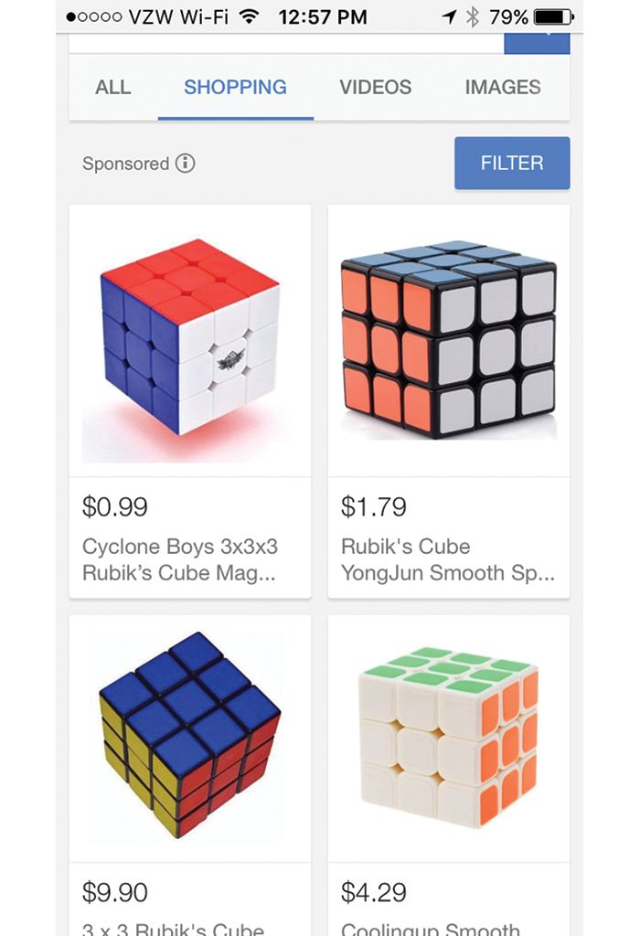
Demand-Oriented Approaches for Setting Prices
Left: ©The Advertising Archives/Alamy; Right: Source: Rubik’s Cube - Google
Notes:
Text Caption: Most marketing managers want to avoid price competition. To help reduce customers’ price sensitivity this Nescafé ad points out that its coffee is unique, there is “No substitute.” Comparison websites like Google Shopping make it easy for customers to compare products and prices, which makes customers more price sensitive.
Summary Overview
In order to estimate demand, marketers need to know how to evaluate a customer’s price sensitivity. Asking a series of questions may help.
Key Issues
Are there substitute ways of meeting a need? If there are, the consumer is more price sensitive.
Is it easy to compare prices? If so, the ease of comparison tends to increase price sensitivity.
Discussion Question: What affect does the Internet have in this regard?
Who pays the bill? People are less price sensitive if someone else pays or if they share the cost with someone else.
How great is the total expenditure? If it is large, marketers may try to break the expenditure into smaller pieces.
The total expenditure might seem larger—and consumers might be even more price sensitive—if rates were for a whole year instead of just a month.
How significant is the end benefit? Consumers will be less price sensitive if they perceive the end benefit from purchasing the product to be substantial.
How great are the switching costs? This question is especially important for business customers. The greater the initial investment, the less price sensitive customers are.
How great are the available alternatives? Customer demand depends on available alternatives. Marketing managers can improve pricing decisions and profitability by considering customer price sensitivity as part of a competitor analysis.

Slide 20

Focusing on Cost and Demand
Click on play button to view video
Notes:
This ad for the Energizer Titanium battery shows how price setting is dependent upon both cost and demand. In setting the price of a product, a firm must take into account various costs, such as materials, labor, and production equipment. At the same time, the firm must estimate the demand for the product in light of trends in the marketing environment.
Video Operation:
INTERNET CONNECTION REQUIRED
Clicking on the orange circle image will open a web browser and access this video. When the video is completed, you can close or minimize the browser and return to the PowerPoint slides.

Slide 21

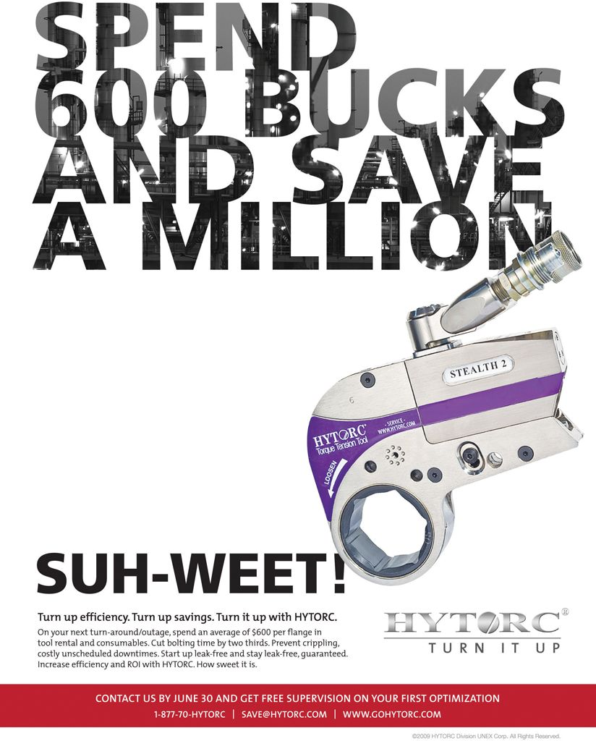
Value in use pricing—how much will the customer save?
Left: Source: ClimateMaster, Inc.; Right: Source: Hytorc Div Unex Corporation
Notes:
Text Caption: Value in use pricing considers what a customer will save by buying a product. Both ClimateMaster and Hytorc tout the savings realized by switching to their products.

Slide 22
More Demand-Oriented Methods
Value-in-Use
Types of
Demand-Oriented
Pricing
Types of
Demand-Oriented
Pricing
Auctions
Reference
Leader & Bait
Notes:
Summary Overview
Many other demand-oriented policies affect consumers’ reactions to price.
Key Issues
→ For business markets, value-in-use pricing sets prices at something less than the total savings the customer will receive for switching to the new product. The key is, how much will the customer save? Marketers must support their cost claims.
→ Auctions show what a customer will pay. Their use has increased due to the development of online auctions. This growth should continue in the future.
→ Some customers may have reference prices: What they expect to pay for a product. If a firm’s price is lower than the reference price, it can enhance the value perception and increase demand.
Leader pricing prices some products very low to attract customers into the retail store, in hopes that they will buy other full-price items on the same trip.
Bait pricing sets some prices very low but those products are strongly “de-marketed” once the customer is in the store. The salesperson offers a product that is a “steal,” but only sells it under protest as he/she tries to steer customers to more expensive items. There is no intent to sell large quantities of the “bait” item.
Is bait pricing unethical? In some cases, the FTC has held that bait pricing practices are illegal if they are deceptive or dishonest.
Discussion Question: What do you perceive to be the key distinctions between leader pricing and bait pricing?

Slide 23
Checking Your Knowledge
A store advertised a special sale on new, commercial quality sewing machines and offered an exceptionally low price. Jasmine Tetreault, who loves to sew, went to the store to purchase one of the machines. When she got there, the salesperson used high-pressure tactics to influence her to buy a higher-priced model. When Jasmine insisted on looking at the advertised machine, the salesperson said that the advertised machine was not in stock. Jasmine left the store, concluding that the store was engaged in:
A. leader pricing.
B. value-in-use pricing.
C. price lining.
D. odd-even pricing.
E. bait pricing.
Notes:
Checking Your Knowledge
Answer: E
Feedback: Bait pricing is setting some very low prices to attract customers but trying to sell more expensive models or brands once the customer is in the store. The sewing machine example is a good illustration of bait pricing. The best answer selection is E.

Slide 24
More Demand-Oriented Methods
Value-in-Use
Types of
Demand-Oriented
Pricing
Subscription
Types of
Demand-Oriented
Pricing
Auctions
Reference
Prestige
Demand-Backward
Leader & Bait
Price Lining
Psychological
Odd-Even
Notes:
Summary Overview
There are other demand-oriented approaches for determining prices.
Key Issues
Psychological pricing attempts to discover the price range a customer prefers for a given product. Price cuts within the range don’t affect demand very much.
→ Discussion Question: Odd-even pricing sets prices to end in certain numbers: $49 (not $50), $24.95 (not $25), or $99 (not $100). Why do marketers use it?
Price lining sets a few price levels for a product line and then marks all items at these prices, so a few prices cover the field. For example, groups of neckties may sell at $10, $15, or $20 each.
Demand-backward pricing involves setting an acceptable final consumer price and working backward to what a producer can charge. The keys to successful pricing are an accurate estimate of what constitutes an acceptable price and making sure that the firm can still cover its costs.
Prestige pricing sets a rather high price to indicate high quality or high status. Prestige pricing is common for luxury products, such as furs, jewelry, and perfume.
Another form of pricing is subscription pricing, where customers pay on a periodic basis for access to a product.

Slide 25
Checking Your Knowledge
Leonard Stevens, a senior citizen living in Florida, says that he always buys the highest-priced product in a given product category. “You get what you pay for,” he says. Leonard would appear to be a good target for:
A. prestige pricing.
B. price fixing.
C. price lining.
D. odd-even pricing.
E. value-in-use pricing.
Notes:
Checking Your Knowledge
Answer: A
Feedback: Prestige pricing sets a rather high price to indicate high quality or high status. Leonard would be a good target for prestige pricing. The best answer selection is A.

Slide 26
Prestige Pricing
Click on play button to view video
Notes:
This video clip (1:01) of Joy Perfume illustrates prestige pricing.
Video Operation:
INTERNET CONNECTION REQUIRED
Clicking on the orange circle image will open a web browser and access this video. When the video is completed, you can close or minimize the browser and return to the PowerPoint slides.

Slide 27
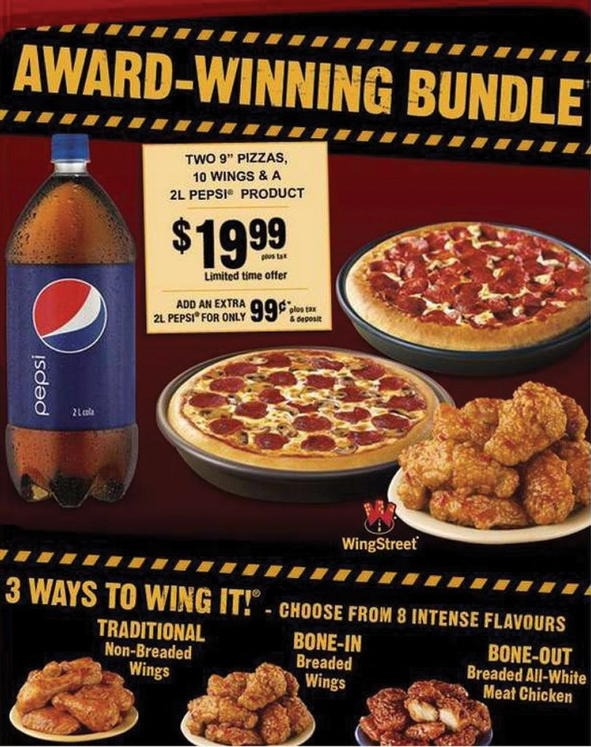
Pricing a Full Line
Market-Oriented
Full-Line Pricing
Firm-Oriented
Costs Are Complicated
Complementary Product Pricing
Source: Pizza Hut, Inc.
Notes:
Text Caption: Pizza Hut offers a bundle that includes pizza, wings, and Pepsi for a special price.
Summary Overview
Because most marketing managers are responsible for more than one product, it is important to understand how a full line of products is priced as part of the firm’s overall competitive strategy plan.
Key Issues
Full-line pricing is setting prices for a whole line of products. It may be market- or firm-oriented:
→ In market-oriented pricing, the firm makes a line of products that are all aimed at the same general target market. The differences in price should reasonably reflect the differences in the features for each version of the product.
→ In firm-oriented pricing, the firm makes a line of products where each product serves an entirely different target market. So there doesn’t have to be any relation between the various prices.
→ Costs are complicated in full-line pricing. The marketing manager must try to recover all costs on the whole line. However, estimating costs for each product is a challenge because there is no single right way to assign the company’s fixed costs to each product in the line. Managers must also consider the demand for each product in the line.
→ Complementary product pricing means setting prices on several products as a group, to increase sales for the group as a whole. One product may be priced very low so that profits from another product will increase.
Discussion Question: Some years ago, Gillette sent free samples of its Excel razor to millions of men, but included only one blade. How is this type of sales promotion related to complementary product pricing?

Slide 28
Product-Bundle Pricing
Click on play button to view video
Notes:
Summary Overview
Product-bundle pricing involves setting one price for a set of products.
Key Issues
It’s cheaper for the customer to buy the products at the same time than separately. This strategy may help stimulate demand for some products that are not as attractive to the consumer in isolation, but offer a reasonable increase in benefits when bundled with the other items.
In this example, Conrad’s wants its customers to know that when they buy tires from Conrad’s they get a lot more than just tires.
Discussion Question: How does this pricing approach add value to the product in the mind of the consumer?
Video Operation:
INTERNET CONNECTION REQUIRED
Clicking on the orange circle image will open a web browser and access this video. When the video is completed, you can close or minimize the browser and return to the PowerPoint slides.

Slide 29
Key Terms
markup
markup (percent)
markup chain
average-cost pricing
total fixed cost
total variable cost
total cost
average cost (per unit)
average variable cost (per unit)
break-even analysis
break-even point (BEP)
fixed-cost (FC) contribution per unit
marginal analysis
value in use pricing
.....
Notes:
Summary Overview
These are key terms you should be familiar with based upon the material in this presentation.
Key Issues
Markup: A dollar amount added to the cost of products to get the selling price.
Markup (percent): The percentage of selling price that is added to the cost to get the selling price.
Markup chain: The sequence of markups firms use at different levels in a channel—determining the price structure in the whole channel.
Average‑cost pricing: Adding a reasonable markup to the average cost of a product.
Total fixed cost: The sum of those costs that are fixed in total—no matter how much is produced.
Total variable cost: The sum of those changing expenses that are closely related to output—such as expenses for parts, wages, packaging materials, outgoing freight, and sales commissions.
Total cost: The sum of total fixed and total variable costs.
Average cost (per unit): The total cost divided by the related quantity.
Average fixed cost (per unit): The total fixed cost divided by the related quantity.
Average variable cost (per unit): The total variable cost divided by the related quantity.
Break‑even analysis: An approach to determine whether the firm will be able to break even—that is, cover all its costs—with a particular price.
Break‑even point (BEP): The sales quantity where the firm's total cost will just equal its total revenue.
Fixed‑cost (FC) contribution per unit: The selling price per unit minus the variable cost per unit.
Marginal analysis: Evaluating the change in total revenue and total cost from selling one more unit to find the most profitable price and quantity.
Value in use pricing: Setting prices that will capture some of what customers will save by substituting the firm's product for the one currently being used.

Slide 30
Key Terms
reference price
leader pricing
bait pricing
psychological pricing
odd-even pricing
subscription pricing
price lining
demand-backward pricing
prestige pricing
full-line pricing
complementary product pricing
product-bundle pricing
Notes:
Summary Overview
These are additional key terms.
Key Issues
Reference price: The price a consumer expects to pay.
Leader pricing: Setting some very low prices—real bargains—to get customers into retail stores.
Bait pricing: Setting some very low prices to attract customers but trying to sell more expensive models or brands once the customer is in the store.
Psychological pricing: Setting prices that have special appeal to target customers.
Odd‑even pricing: Setting prices that end in certain numbers.
Subscription pricing: Customers pay on a periodic basis for access to a product.
Price lining: Setting a few price levels for a product line and then marking all items at these prices.
Demand‑backward pricing: Setting an acceptable final consumer price and working backward to what a producer can charge.
Prestige pricing: Setting a rather high price to suggest high quality or high status.
Full‑line pricing: Setting prices for a whole line of products.
Complementary product pricing: Setting prices on several related products as a group.
Product-bundle pricing: Setting one price for a set of products.
Bid pricing: Offering a specific price for each possible job rather than setting a price that applies for all customers.
Negotiated price: A price that is set based on bargaining between the buyer and seller.

