Slide 1
Phytopathogenic Fungi
Name of Student:
Institutional Affiliation:
Dr

Slide 2
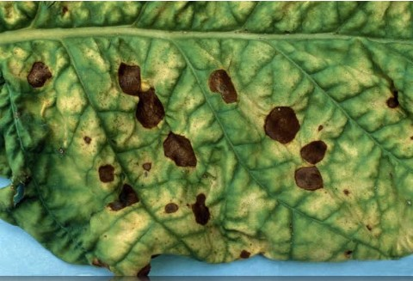
Phytopathogenic Fungi
The enzymes of the parasitic fungi usually
penetrate into the walls of the cells and
feed on its nutrients as the first
step of the breakdown (Jiang et al., 2017).
The enzymes are very active in some necrotrophic
parasites that they degrade a significant portion
of the wall of the cell (Gupta et al. 2020).
Notes:
Phytopathogenic fungi are known to have various enzymes that break down destroy the carbohydrate polymers that make up the building materials of the walls of cells.

Slide 3
Chemical Control Of Phytopathogenic Fungi
Phytopathogenic fungi should be controlled within a balanced framework to reduce their impact on plants and crops (Syrova et al., 2019).
Fungicides have been used to protect plants against disease attack by fungi for a very long period (Martínez et al., 2017).
Notes:
The work of parasitic functions in destroying plants and crops has a significant impact on the global population in terms of the environment and the economy.

Slide 4
Alternaria
Alternaria is also a genus belonging to the ascomycete fungi.
Alternaria are common allergens in human beings and sometimes lead to asthma by causing hypersensitivity reactions or hay fever (Gabriel et al., 2016).
The allergens usually cause opportunistic infections in immunocompromised individuals such as persons suffering from AIDS.
Notes:
Alternaria species are a major pathogen in plants and are known to have a significant impact within their ecosystem (Jaber & Ownley, 2018).

Slide 5
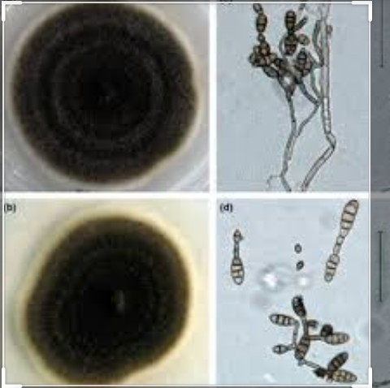
A Microscopic Image Of Altenaria Spp

Slide 6
Biological Control Of Phytopathogenic Fungi
In a more specific sense, biocontrol refers to the suppression of disease in plants through the application of biological agents to a host plant, crop or animal to prevent the development
of pathogen or disease (Jaber & Ownley, 2018).
Notes:
Biological controls refer to alternative approaches towards the systematic prevention, mitigation and treatment of the harmful effects of fungicides and other chemical agents on plants and crops.

Slide 7
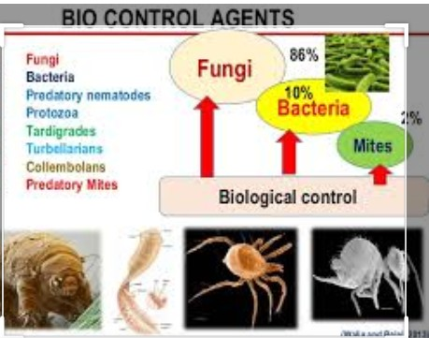

Slide 8
Bacteria As Biocontrol Agents Against Fungi
Sustainable plant disease control calls for the continued use of measures that are friendly
to the environment.
Efficient antagonists must be obtained, however, for biocontrol to be possible through such mechanisms.
Soil microorganisms coexist with plants and sometimes interfere with their performance
within the ecosystem.
Notes:
The reduced use of chemicals in pest control in agriculture has led to an increase in the use of biocontrol agents.
Bacterial biocontrol agents have played a critical role in reducing the adverse impact of chemicals on the environment.

Slide 9
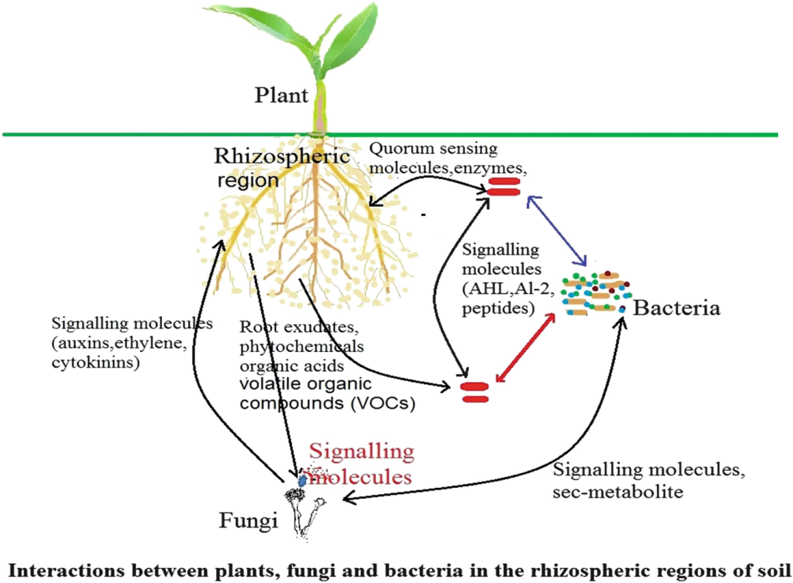
        A diagram of the soil ecosystem showing how plants and microorganisms coexist

Slide 10
Antagonistic Activity Of Bacteria Against Alternaria
The phylloplane is a source of antagonists in addition to rhizosphere (Hiruma et. al., 2010).
Bacteria from this area are still very underutilized, compared to rhizobacteria, as biological control agents for fungi.
Bacteria that colonize the shoots, in addition, have been observed to show a better chance of survival and multiplication
in an environment such as the soil where there is good nutrition.
Notes:
Antagonistic activity of bacteria against Alternaria has been an area of significant focus over the years.
These relationships have elicited a lot of interest because the genus is one of the most prevalent parasitic fungi affecting plants.

Slide 11
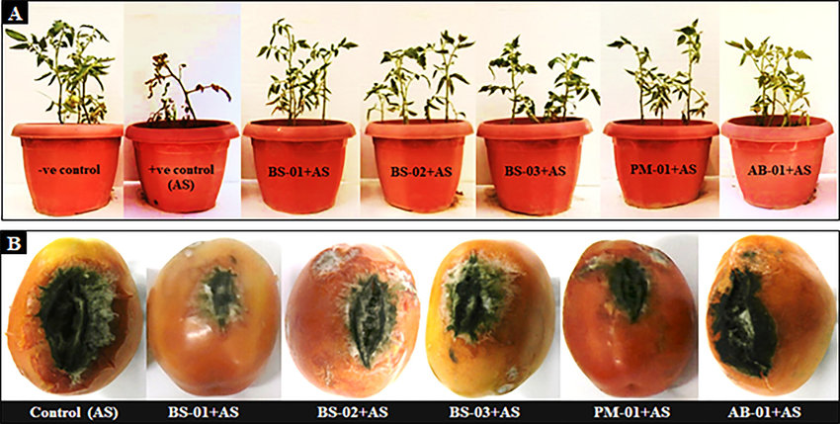
Antagonistic Activity Of Bacteria Against Alternaria

Slide 12
Mode Of Action Against Phytopathogenic Fungi
Some of these modes happen in complementarity with other mechanisms to allow for effective prevention of disease and growth of pathogens.
These various mechanisms suppress phytopathogen growth that impacts various plants and crops.
It becomes essential, therefore, for any approach in biological control to consider all factors to implement a framework that will not only give positive results but also ensure sustainability.
Notes:
There are various mechanisms of action that are exhibited by antagonistic bacteria including induction of plant resistance, biofilm formation, antibiosis, hydrolytic enzymes, suppression via sidephores, and competition for space and nutrients (Hiruma et. al., 2019).

Slide 13
Conclusion
There is a necessity for continued regulatory restrictions to reduce the use of chemical compounds to enhance agriculture.
The development of various alternatives to chemical prevention of pathogens is increasingly leading to the growth of the biological control of phytopathogenic fungi.
Notes:
In conclusion, the use of synthetic chemicals on curbing the spread of plant and crop disease as well as the growth of pathogens will remain one of the biggest threats to human health and the environment.

Slide 14
References
Gabriel, M. F., Postigo, I., Tomaz, C. T., & Martínez, J. (2016). Alternaria alternata allergens: markers of exposure, phylogeny and risk of fungi-induced respiratory allergy. Environment international, 89, 71-80.
Hiruma, K.; Onozawa-Komori, M.; Takahashi, F.; Asakura, M.; Bednarek, P.; Okuno, T.; Schulze-Lefert, P.;Takano, Y. Entry mode-dependent function of an indole glucosinolate pathway in Arabidopsis for nonhostresistance against anthracnose pathogens. Plant Cell 2010, 22, 2429–2443
Jiang, Y., Wang, W., Xie, Q., Liu, N., Liu, L., Wang, D., ... & Wang, E. (2017). Plants transfer lipids to sustain colonization by mutualistic mycorrhizal and parasitic fungi. Science, 356(6343), 1172-1175.

Slide 15
References
Martinez, P., Luo, A., Sylvester, A., & Rasmussen, C. G. (2017). Proper division plane orientation and mitotic progression together allow normal growth of maize. Proceedings of the National Academy of Sciences, 114(10), 2759-2764.
Syrova, D. S., Shaposhnikov, A. I., Makarova, N. M., Gagkaeva, T. Y., Khrapalova, I. A., Emelyanov, V. V., ... & Belimov, A. A. (2019). Prevalence of the ability to produce abscisic acid in phytopathogenic fungi. Микология и фитопатология, 53(5), 301-310.

