Slide 1
AFRICAN ART
African art refers to the reflection of the cultural heritage of the continent which dates back to decades in the past.
Its advancement is ironic since it has faced influence from the western culture.
The influences have been in most cases in the form of religious and missionary stripe.
But, the influences have been condemned by the natives of the African continent.

Slide 2
Types of Arts
Traditional Art. It refers to the most popular and studied types of African art that are found in museum collections.
Contemporary art. African has been a home to a thriving art fine culture, however, there has been a notable modern artist who include Marlene Dumas, and Kendell Geers among others.

Slide 3
Significance of Art
Religious and social events. African art is used during religious and social events where the participants put on certain art which are associated with that given event or religious practice.
Arts portray status where we have some particular arts being found with some specific people or families within the society.

Slide 4
Conclusion
African art is a reflection of the cultural heritage of the continent that dates back into centuries back.
There are two types of African arts;, the traditional and contemporary arts.
Traditional art refers to the most popular and studied types of African art which are stored in the museum collections.
Contemporary art. African has been a home to a thriving art fine culture, however, there has been a notable modern artist who include Marlene Dumas, and Kendell Geers among others
African arts can be used in religious, and social events among others.

Slide 5
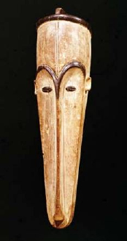

African Art Pictures
https://www.contemporary-african-art.com/
Fang mask, Dogon Nhlandhla Nsudwane Sculptor of ceramics Ardmore, SA

Slide 6
References
Andreae, C. (1996). African Art: Its Beauty, Form, And Function. The Christian Science Monitor.

