Slide 1
Plagiarism
Julie Oshiro, Librarian, WCU-LA
Danica Easley, Assistant Librarian, WCU-LA

Slide 2
Overview
Why do we cite?
Why it matters
WCU Academic Honor Code
What is plagiarism?
Types of plagiarism
Word plagiarism
Patchwriting
Paraphrasing
Idea plagiarism
Self plagiarism
Resources and Questions

Slide 3
Why do we cite?
Academic work is cooperative – and citation is giving credit to those works of others, with your unique analysis.
Shows how your argument is built upon the ideas of others and strengthens your position in this era of “fake news”; you become a better writer and mature thinker by engaging in the conversation.
Gives credit where credit is due.
Allows an interested reader to investigate your ideas and explore on their own, or for other scholars to be inspired by similar questions. (Bailey, 2017; Middlebury Libraries, 2020; University of North Carolina, n.d.; Yale, 2020)
Adapted from, (J. Rane, personal communication, 2020);

Slide 4
Why does it matter?
Science is a conversation. Citations are the roadmap back to the beginning of your conversation. (Harvard, 2020)
Good citations show that you know the process. Plagiarism is not copying what someone else said, it’s copying what someone else said without attribution. As long as you cite correctly there is no need to rephrase anything. To use an Open Source analogy, plagiarism is taking some software, renaming it and selling it as software you claimed you wrote entirely yourself. (Bailey, 2017)
Remember: Plagiarism is theft!
Adapted from, (J. Rane, personal communication, 2020);

Slide 5
Why does it matter?
“Graduating these students is bad for them and bad for the institution. I've always wished that more students could be made to see that the goal of assignments is not to produce something (a paper, code, proofs) but rather to get the experience working through producing the thing. All too often they seem to think of the situation as like a job where the instructor (boss) tells the student (worker) to do something and then they do it because that's what the instructor wants. With that mindset, it's easy to see why they think they're getting away with something when they plagiarize, when in fact they're mostly cheating themselves.” (Hacker News, 2015)
Adapted from, (J. Rane, personal communication, 2020);

Slide 6
WCU Honor Code
Plagiarism is a violation of the WCU Academic Honor Code: https://westcoastuniversity.edu/uploads/pdf/Student-Handbook.pdf
The WCU Academic Honor Code defines plagiarism as:
Representing the ideas, expressions, or materials of another without providing the author with due credit
Paraphrasing or condensing ideas from another person’s work without proper citation
Failing to document direct quotations and paraphrases with proper citation

Slide 7
What is Plagiarism?
“Plagiarism is the act of presenting the words, ideas, or images of another as your own; it denies authors or creators of content the credit they are due. Whether deliberate or unintentional, plagiarism violates ethical standards in scholarship” (American Psychological Association [APA], 2020b, para. 1).
“If you wish to reprint or adapt tables, figures, and images or to reprint long quotations or commercially copyrighted test items, you must provide more comprehensive credit in the form of a copyright attribution and may need permission from the copyright holder to use the materials” (APA, 2020b, para. 4).
Adapted from, American Psychological Association. (2020). Plagiarism. APA Style. https://apastyle.apa.org/style-grammar-guidelines/citations/plagiarism

Slide 8
Types of Plagiarism
1
10 TYPES OF PLAGIARISM ORDERED FROM MOST TO LEAST SEVERE
CLONE: An act of submitting another’s work, word-for-word, as one’s own.
CTRL-C: A written piece that contains significant portions of text from a single source without alterations.
FIND–REPLACE: The act of changing key words and phrases but retaining the essential content of the source in a paper.
REMIX: An act of paraphrasing from other sources and making the content fit together seamlessly.
RECYCLE: The act of borrowing generously from one’s own previous work without citation; To self plagiarize.
HYBRID: The act of combining perfectly cited sources with copied passages—without citation—in one paper.
MASHUP: A paper that represents a mix of copied material from several different sources without proper citation.
404 ERROR: A written piece that includes citations to non-existent or inaccurate information about sources.
AGGREGATOR: The “Aggregator” includes proper citation, but the paper contains almost no original work.
RE-TWEET: This paper includes proper citation, but relies too closely on the text’s original wording and/or structure. (TurnItIn, 2015, p. 4)
These types can be broken down into two categories: Word Plagiarism and Idea Plagiarism
Adapted from, (J. Rane, personal communication, 2020);

Slide 9
Word Plagiarism
“Word plagiarism occurs when you use another author’s exact words or phrases without quotation marks” (APA, 2020a, p. 1).
Try to paraphrase the material (put it in to your own words) as much as possible, instead of using direct quotations.
If you use a direct quotation (using the author’s exact words), you must include BOTH an in-text citation and a reference citation on your references page.
“…word plagiarism occurs when students mistakenly think they have paraphrased an author’s words because they added or removed a few words or replaced some of the words with synonyms. This is called patchwriting” (APA, 2020a, p. 1).
Adapted from, American Psychological Association. (2020). Avoiding plagiarism and self-plagiarism guide. APA Style. https://apastyle.apa.org/instructional-aids/avoiding-plagiarism.pdf

Slide 10
Patchwriting
Patchwriting is when “…your wording has a similar sentence structure and uses the same words and phrases of the original author…” (APA, 2020a, p. 1).
Original passage from Ward et al. (2006):
Findings indicate that media content is not uniformly negative. Information about sexual health, risks, and thoughtful decision-making is sometimes present.
Plagiarized (patchwritten) example:
According to Ward et al. (2006), media content is not all negative, and information is sometimes present concerning sexual health, risks, and thoughtful decision- making.
Adapted from, American Psychological Association. (2020). Avoiding plagiarism and self-plagiarism guide. APA Style. https://apastyle.apa.org/instructional-aids/avoiding-plagiarism.pdf

Slide 11
Avoiding Word Plagiarism
How do I avoid Word Plagiarism?
“…read a section of a work, and then put the work down and write notes in your own words” (APA, 2020a, p. 2).
“As a general rule, paraphrase when taking notes on a source. Do not write the author’s words verbatim without putting them in quotation marks…” (APA, 2020a, p. 2).
Adapted from, American Psychological Association. (2020). Avoiding plagiarism and self-plagiarism guide. APA Style. https://apastyle.apa.org/instructional-aids/avoiding-plagiarism.pdf

Slide 12
Paraphrasing Strategies
“Paraphrasing involves putting a passage from source material into your own words” (Purdue Owl, 2020, Paraphrasing is section).
Paraphrasing can be challenging. Use the following strategies to help you paraphrase accurately:
“Explain It Like I’m Five” (ELI5)
Break down complex ideas into smaller pieces
Use different vocabulary (Signal Words, Useful Verbs, etc.)
Purdue Owl. (2020). Paraphrasing. Purdue Writing Lab.
https://owl.purdue.edu/owl/research_and_citation/using_research/quoting_paraphrasing_and_summarizing/paraphrasing.html

Slide 13
Different Vocabulary
Signal Words
Useful Verbs
discovered accepts clarifies advances reinforces | concludes demonstrates displays explains illustrates
Asserts
Claims
Insists
Writes
Believes
Suggests
Thinks
Explains
Argues
Finds
Indicate
Adds
Contends
Declares
Observes
Reveals
Demonstrates
Shows
Proves
Illustrates
Expresses

Slide 14
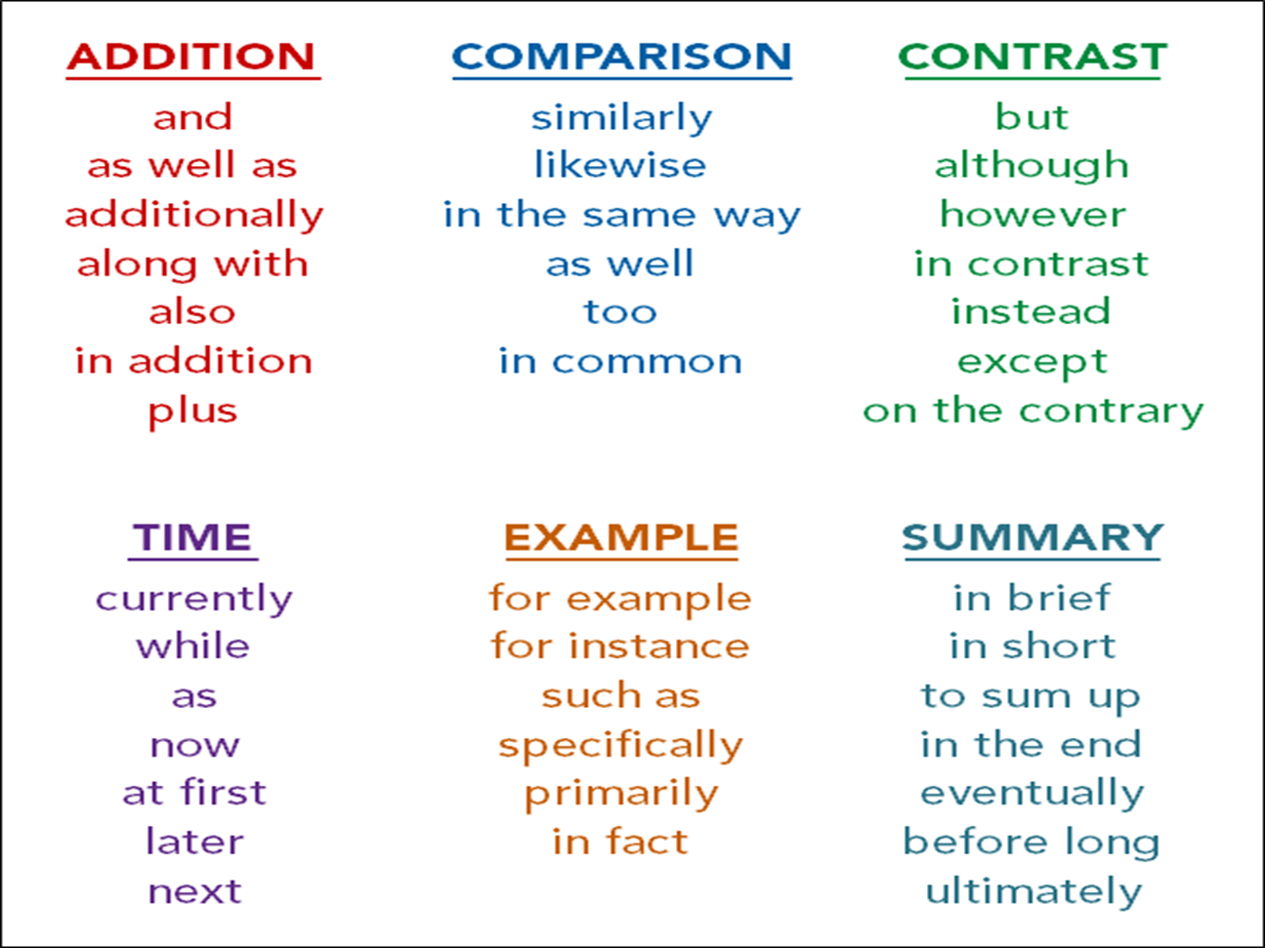
Different Vocabulary
In the text/article/passage…
The author states that…
According to the article/author…
In addition, the author also writes that…
The text also cites…
This proves…
This demonstrates…
As noted by the author…

Slide 15
Idea Plagiarism
“Idea plagiarism occurs when you present an idea from another source without citing the author and year” (APA, 2020a, p. 2).
“Any time you write about a concept or idea in a paper without including an in-text citation (or clearly linking it to a previous sentence containing an in-text citation), you are claiming the idea as your own…” (APA, 2020a, p. 2).
An example of idea plagiarism is “when students…write a whole paragraph about a study and then cite the study’s author and year in the last sentence in parentheses, thinking that citation covers the previous sentences. Instead, the in-text citation should appear at the beginning of the paraphrased passage, to establish its origin at the outset” (APA, 2020a, p. 2).
If you DON’T provide a citation for: 1. A random fact you know or 2. An idea that you assume is common knowledge…you are committing idea plagiarism.
Adapted from, American Psychological Association. (2020). Avoiding plagiarism and self-plagiarism guide. APA Style. https://apastyle.apa.org/instructional-aids/avoiding-plagiarism.pdf

Slide 16
Avoiding Idea Plagiarism
How do I avoid Idea Plagiarism?
If something is your own idea, use a signal phrase such as, “I believe that.”
If the idea came from someone else, use an in-text citation.
It’s always better to over cite. If the idea didn’t originally come from your brain, it needs a citation.
Adapted from, American Psychological Association. (2020). Avoiding plagiarism and self-plagiarism guide. APA Style. https://apastyle.apa.org/instructional-aids/avoiding-plagiarism.pdf

Slide 17
What counts as Plagiarism?
Counts as plagiarism: Using large pieces of text from outside sources without providing a citation and committing self-plagiarism (more on next slide).
Doesn’t usually count as plagiarism: Small errors in citations (missing italics, punctuation, capitalizations, etc.) if the errors seem unintentional and not an attempt to claim others’ work as your own.
However, these errors could cost you points on your assignment!
Plagiarism-checking software (ie. SafeAssign) checks the internet and previously submitted papers for whole paper matches, lengthy section matches, and patchwriting.
Adapted from, American Psychological Association. (2020). Plagiarism. APA Style.
https://apastyle.apa.org/style-grammar-guidelines/citations/plagiarism

Slide 18
What is Self-Plagiarism?
“Self-plagiarism is the presentation of your own previously published work as original; like plagiarism, self-plagiarism is unethical. Self-plagiarism deceives readers by making it appear that more information is available on a topic than really exists” (APA, 2020b, Self-Plagiarism section).
If you use a paper written for one class to complete an assignment for another class without permission from the instructor, you might be committing self-plagiarism.
However, building off of past work to contribute to a new paper (not copying it word-for-word) may be allowed.
Adapted from, American Psychological Association. (2020). Plagiarism. APA Style. https://apastyle.apa.org/style-grammar-guidelines/citations/plagiarism

Slide 19
In-Text Citations
In-text citations are short citations used within the text of a paper when we incorporate ideas from outside sources. This can be in the form of direct quotations or paraphrasing.
Direct Quotations: Author’s last name, year, and page number(p.) or paragraph number(para.) are required. (Author’s last name, Year, Page/Paragraph #)
“This is my amazing idea in a quotation” (Johnson, 2010, p. 10).
Johnson (2010) discovered “this amazing idea in less than 40 words” (p. 10).
Paraphrasing: Author’s last name and year are required. Page number(s) or paragraph number(s) are optional, but highly encouraged. (Author’s last name, Year, Page/Paragraph #)
The citation format for APA is complex (Wilson, 2012, p. 19).
According to Wilson (2012), the citation format for APA is complex (p. 19).

Slide 20
Parenthetical v. Narrative
Direct Quotations:
(Author, Year, Page or Paragraph Number)
Paraphrasing:
(Author, Year, Page or Paragraph Number*)
Parenthetical: when the citation comes at the end
Interventions in the community should encourage health and fitness within schools, organizations and churches (Courtenay, 2000, p. 174).
Narrative: when the citation is within the sentence or text
Courtenay (2000) stated that community intervention will promote physical activity (p. 174).

Slide 21
Reference citations
A reference citation is “… a notation that provides all the information readers need if they want to retrieve an article, book, or other source cited in your paper” (Purdue University Global, 2019, Reference List Entries section).
Electronic article: :
Author, A. A. (Year of publication). Title of article: Capitalize the first word in the subtitle also. Title of
Journal, Volume number(Issue number), page numbers. DOI or URL
Book:
Author, A. A. (Year of publication). Title of book: Capital letter also for subtitle. Publisher.
Website:
Author, A. A. (Year, Month, Day). Title of the work. Site Name. URL

Slide 22
Plagiarism Resources
WCU Library’s APA Help Guide
https://guides.westcoastuniversity.edu/apa
Plagiarism Guides
https://apastyle.apa.org/style-grammar-guidelines/citations/plagiarism
https://apastyle.apa.org/instructional-aids/avoiding-plagiarism.pdf

Slide 23
Questions?
Julie Oshiro, Campus Librarian joshiro@westcoastuniversity.edu
Danica Easley, Assistant Librarian deasley@westcoastuniversity.edu

