Slide 1
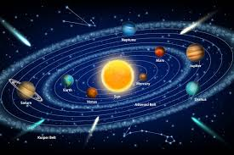
Planets

Slide 2

Introduction
What is a planet?
The International Astronomical Union (IAU) defines a planet as any celestial body which satisfied the following conditions:
Orbits around the sun
Has enough mass to create its own gravity which is enough to overcome rigid body forces such that the body assumes hydrostatic equilibrium.
Has cleared the neighborhood round its orbit

Slide 3
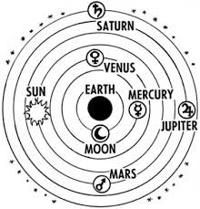
History of Planets
The earliest known definition of planets began in ancient Greek where the Earth’s Moon, Sun, Mercury, Venus, Mars, Jupiter, and Saturn were considered as planets (Xiao, Cai, Li & Qiao, 2018).
The Greek Scientists did not consider the earth as a planet, rather it was considered as a central body around which the planets and other celestial objects orbited.

Slide 4
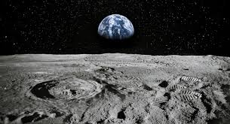
History of Planets
In the third century BCE, Aristarchus of Samos was the first person to develop a model of the solar system with the sun at the centre.
In the 16th century, Nicolaus Copernicus revived the idea and in the 17th century, astronomers accepted this model thanks to the invention of telescope (Ogihara, Kokubo, Suzuki & Morbidelli, 2018).
Astronomers made changes in the Greeks model of the solar system by declassifying the Moon as a planet.

Slide 5
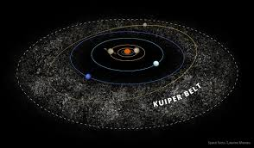
Planetary Events
1781- Uranus is added as a planet
1801- astronomers discover Ceres between Mars and Jupiter but was later classified as an asteroid.
1846- astronomers discover Neptune
1930- Pluto is discovered but was declassified as a planet in the 1990s following the discover of the Kuiper Belt. Thus Pluto was classified as a Kuiper Belt Objects (Ogihara, Kokubo, Suzuki & Morbidelli, 2018).

Slide 6
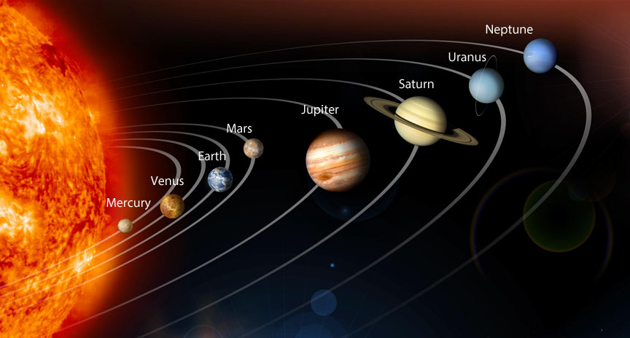
Planets
Our galaxy has eight planets.
Inner planets are also know as rocky planets and they are are Mercury, Venus, Earth and Mars.
The outer planets also known as gaseous planets are Jupiter and Saturn.
The Ice giants are Uranus and Neptune.

Slide 7
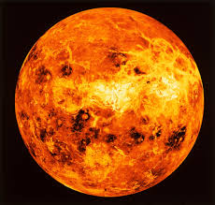
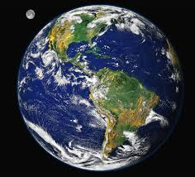
Planet Facts
Mercury – The smallest and fastest planet to orbit the sun.
Venus – Has a thick atmosphere which makes it the hottest planet in our solar system (NASA solar system exploration. (n.d.).
Earth– The only planet in our solar system that support life.

Slide 8
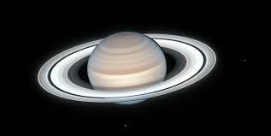
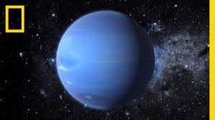
Planet Facts
Mars – Mars was a wet and warm planet billions of years ago.
Jupiter – The largest planet.
Saturn – Has the brightest gaseous ring system in the galaxy (Xiao, Cai, Li & Qiao, 2018).
Uranus – It’s tilted on its axis by almost 90-degrees.
Neptune – Was discovered through mathematical calculations, rather than observation.

Slide 9
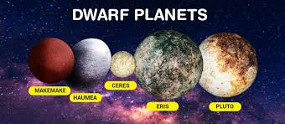
Dwarf Planets
According to the International Astronomical Union (IAU), a dwarf planet is a celestial body with the following features:
1. orbits around the sun
2. Is not a satellite
3. Has no clear path on its orbit
4. Has enough mass to create its own gravity which is enough to overcome rigid body forces such that the body assumes hydrostatic equilibrium (Xiao, Cai, Li & Qiao, 2018).

Slide 10
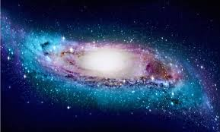
Conclusion
Astronomers are yet to agree on a standard to define a planet. Planetary scientists and astronomers are entangled in an ongoing debate in light of new technology and new discoveries in the galaxy.
The existing technology has already found exoplanets outside of the milky way galaxy.
The hunt for life in space continues. Although the idea seems far fetched, planetary scientists continue to look for planets with conditions that favour life.

Slide 11
Reference
Ogihara, M., Kokubo, E., Suzuki, T. K., & Morbidelli, A. (2018). Formation of the terrestrial planets in the solar system around 1 au via radial concentration of planetesimals. Astronomy & Astrophysics, 612, L5.
Xiao, J., Cai, S., Li, X., & Qiao, H. (2018, October). Assessing the Effectiveness of Augmented Reality Courseware" Eight Planets in the Solar System". In 2018 9th International Conference on Information Technology in Medicine and Education (ITME) (pp. 388-392). IEEE.
What is a planet? | Planets – NASA solar system exploration. (n.d.). NASA Solar System Exploration. https://solarsystem.nasa.gov/planets/in-depth/

