Slide 1

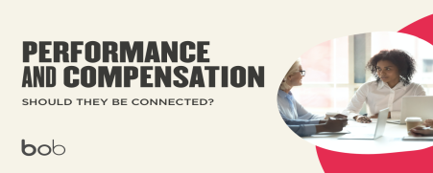
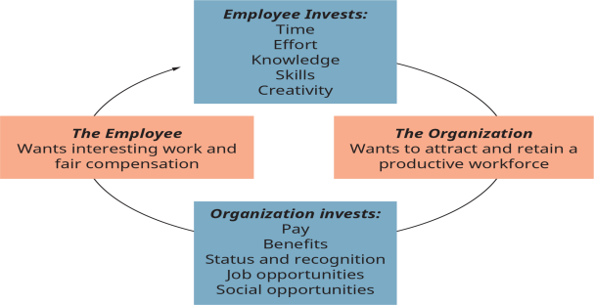

Business Paper
How Performance Relates to Employee Compensation
Extrinsic Rewards Related to Performance
How Performance Measurement and Compensation may be considered among a Diverse Team
Performance measurement and compensation are imperative in employee recruitment among diverse teams because they help in pinpointing entry barriers among diverse teams.
In addition, performance measurement and compensation in employee promotion may be helpful in recognizing bias while assessing and selecting employees from diverse teams.
Employee promotions
Better wages and salaries
Fringe benefits
In many business organizations, compensation has been tied to performance.
With the right approaches in place, organizations can bank on compensation so as to attract top talent and retain current workers, and create a pool of employees who rally behind an organization’s mission (Agusra et al., 2021).
The compensation strategy in any organization should be compatible with the conditions and necessities of its budget and workplace environment and the motivating factors behind its anticipated workforce.
Business leaders can connect performance and compensation through strategies like employee promotions, provision of incentives, goal-centered bonuses, and opportunities for professional development.
A workplace that recognizes diversity among its workforce is imperative because it allows each employee to exploit their strengths as well as the potential they bring into the organization.
Therefore, the concepts of performance measurement and compensation should be used to strengthen diversity among employees.
Performance measurement and compensation may be considered among a diverse workforce in the aspects of employee retention, recruitment, and promotion (Pešalj et al., 2018).
The strength of performance measurement and compensation in employee retention is that they help identify groups with less satisfaction or less commitment among the workforce.
Intrinsic Rewards Related to Performance
Respect from other workers and supervisors
Being proud in one’s workplace
Personal development
Gaining trust from organizational managers
A feeling of achievement (Emmanuel & Nwuzor, 2021)

