Slide 1
Health In Newark, NJ
Student’s Name
Institution

Slide 2
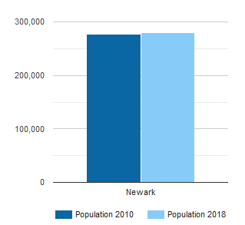
Demographic Details of Newark NJ
The population of Newark is 282,000
The population is mainly composed of people aged 33
Most households have an income of $37,642

Slide 3
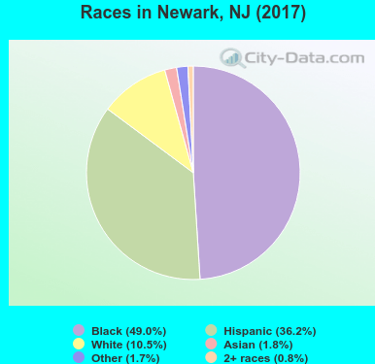
Racial Distribution
Blacks or African Americans comprise the largest racial group living in Newark NJ
There are various racial groups living in Newark NJ – Blacks, Whites, Hispanics, Asian and others.
Blacks make up to 49% of the population
Whites comprise 10.5% of the population
Hispanic consist of 36.2% of the population
Asians comprise 1.8% of the population

Slide 4
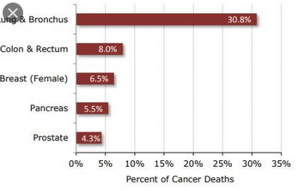
Health Status of people in Newark
The leading cause of deaths are chronic diseases like cancer, hypertension and diabetes.
Out of ten deaths, seven are caused by chronic or infectious diseases every year
Hospitalization rates of people suffering from chronic diseases are astronomical

Slide 5
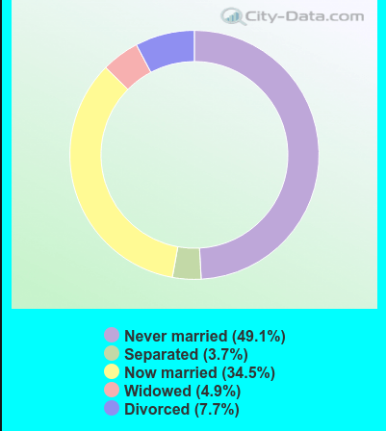
Marital Status in Newark, NJ
There are myriad people with different marital statuses living in Newark, NJ:
Those who are never married comprise 49.1% of the population.
Those separated make up to 3.7%
The divorced make up 7.7%
The widowed include 4.9%
The now married comprise 34.5%

Slide 6
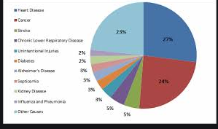
Health Problem: High prevalence of chronic and infectious diseases
The common chronic and infectious diseases in Newark include hypertension, tuberculosis, cancer, asthma and diabetes (Padmanaban et al., 2020).
There is lack of health insurance that is linked with insufficient access to healthcare services like primary care.
Many women are susceptible to developing breast cancer as they age.
The poverty level of people residing in Newark NJ is high and they cannot access better quality health care

Slide 7
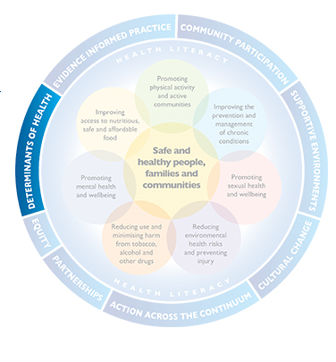
Social Determinants of Health
a. Positive
Appropriate social support
Provision of enough food
Well-developed transport systems
b. Negative
Discrimination
Low income levels
Drug addiction

Slide 8
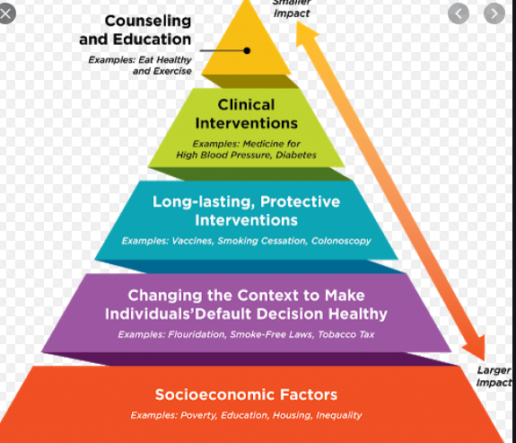
State Health Improvement Plan
The state will equip health facilities with better medical equipment (Zha et al., 2020).
Highly trained medical personnel will be recruited in medical facilities
The state will seek to ensure health equity for every people to access
The quality of care administered by health facilities will be enhanced
New hospital facilities will be developed to meet the high number of patients

Slide 9
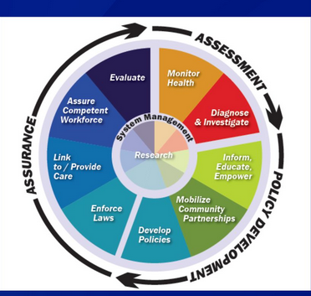
Action Plan
There are various action plans intended to address the health problem:
i. Ensuring health equity (DallaPiazza et al., 2020).
ii. Building more mental health facilities
iii. Promotion of immunization of infants
iv. Chronic disease prevention by erecting more hospitals with adequate facilities

Slide 10
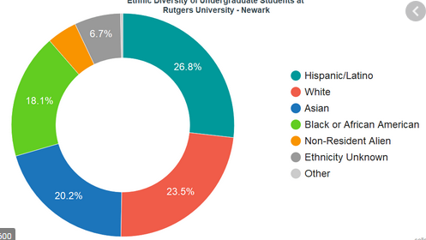
Signs of Diversity and Inclusivity
Newark recognizes the rights of the LGBT community like the African American Office of Gay Concerns (AAOGC).
Also, people from different multicultural backgrounds live within Newark such as Hispanics, African Americans, Chinese and the Whites.
Schools have rolled out LGBT curriculum program

Slide 11
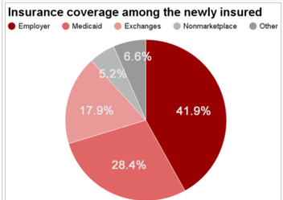
Health Policy: Adopting health insurance plans
Some of the health insurance plans to be adopted include:
Care health plan
Health companion individual
Health maintenance organization
Affordable Care Act
Implications
Quality care to patients
Increased access to health care services

Slide 12
References
Zha, P., Qureshi, R., Porter, S., Chao, Y. Y., Pacquiao, D., Chase, S., & O’Brien-Richardson, P. (2020). Utilizing a mobile health intervention to manage hypertension in an underserved community. Western Journal of Nursing Research, 42(3), 201-209.
DallaPiazza, M., Ayyala, M. S., & Soto-Greene, M. L. (2020). Empowering future physicians to advocate for health equity: A blueprint for a longitudinal thread in undergraduate medical education. Medical Teacher, 1-7.
Padmanaban, V., Fallah, P., Jayaraman, S., Peck, G. L., & Sifri, Z. (2020). Integrating a Novel Global Surgery and Health Inequity Course to the Surgical Clerkship. Journal of Surgical Education.

