Slide 1


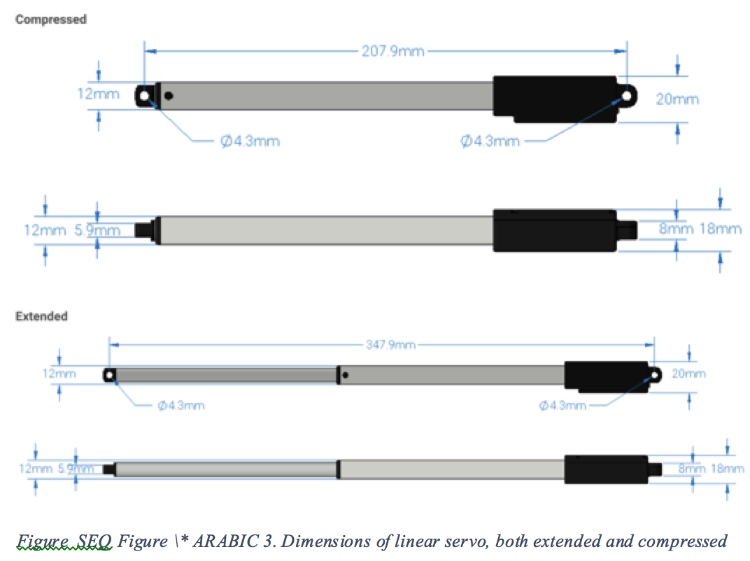
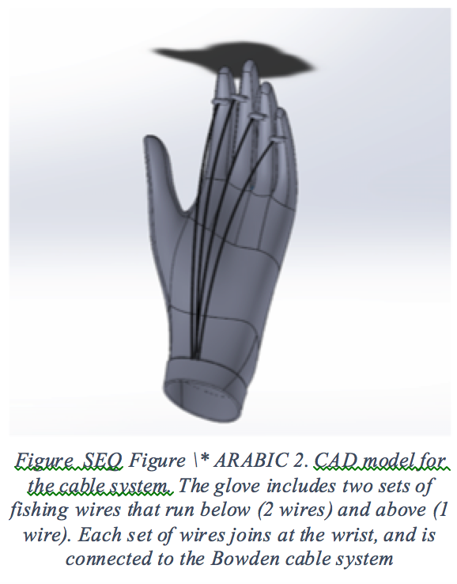
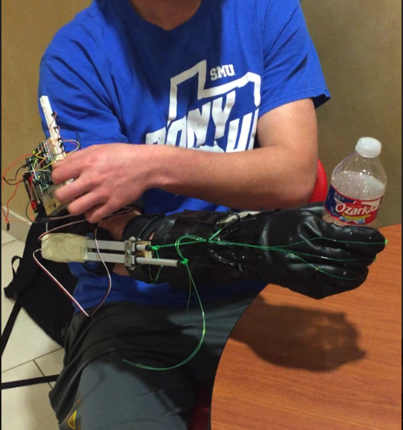
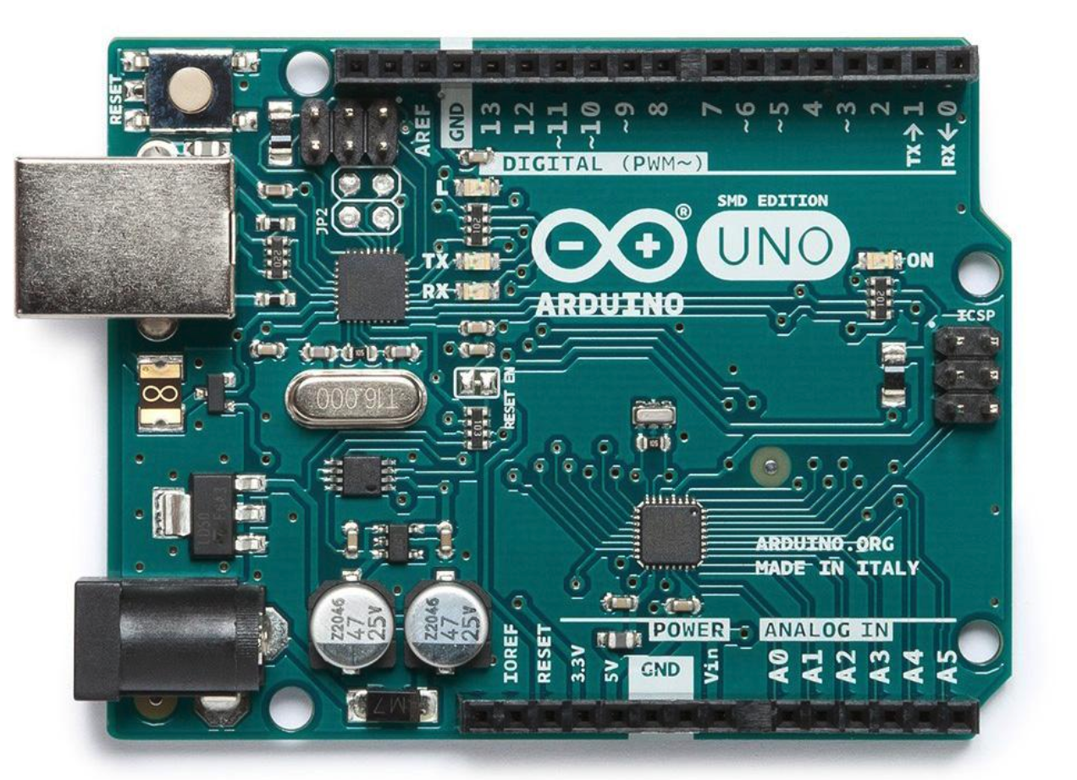
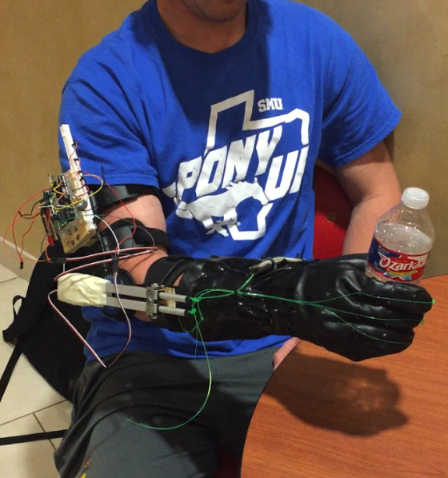
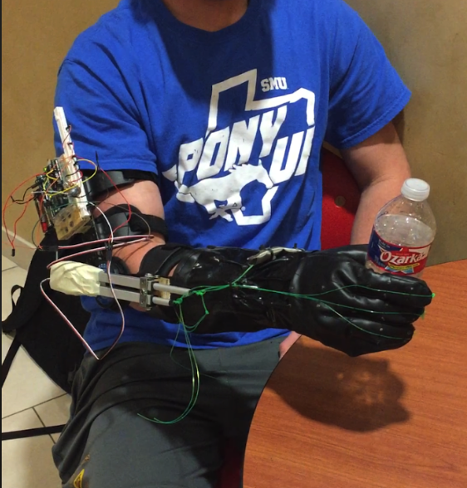
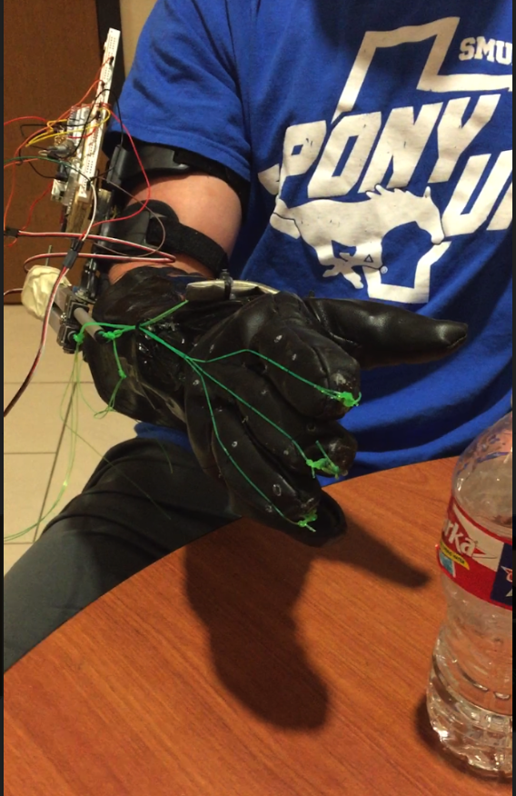
Power Grip Glove
Team: Power Hands
Names: Adam Alsadek, Kishan Soni, Danny Nguyen, Mohammed Alafaisan, Ahmed Aljishi
Project Summary
The main goal of this project is to develop a power grip glove to help those who are unable to transmit force through their hands due to a medical condition. The glove’s main components are: Leather glove, wires, arm brace, linear servos and arduino.
Performance Requirements Met:
Mechanical
  Glove must be able to grip a 5lb object through friction alone
  Power losses from motors to glove should be minimal
  Glove should me of minimal weight for user comfort
Electrical
  Glove must operate in response to user input
  Glove must have enough energy capacity to operate comfortably on a day to day basis
Design Components
Leather Glove
Arm/elbow Brace
PCB
Arduino Uno
Linear Servos
Breadboard
Fishing wire
Glove Functionality
The User is adjusting the grip/release using the potentiometer
*The wires are attached to the fingertips
and are pulled by the Linear Servos.
2. Both servos are moving in tandem. One for gripping, and the other for opening.
*The servos are controlled by a potentiometer
for better guidance.
3. The figure below shows how the servos switched positions to go from gripping to fully releasing.
*All of the electrical components are placed on the
elbow brace for convenience.
4. The grip is fully released.
*The grip is fully released when one servo is fully
compressed and the other is extended.
Engineering Specifications
1. Glove
1.1 Uriel Universal Size Wrist/Thumb Splint (Part 24-9029)
1.2 The wrist is held in a functional position at an angle of 35°
1.3 Total weight: 3 pounds
1.4 Material: Neoprene
1.5 Cost: $35.00
2. Motors
3.1 Two ServoCity140mm Stroke 44lb Thrust Light Duty Linear Servos (Part L16-R-140-150-6)
3.2 Rated voltage: 4.5 to 7.5 V.
3.3 Drain current: 650 mA at stall.
3.4 Dynamic thrust: 200 N (approximately 44 pounds)
3.5 Stroke length:140 mm.
3.6 Maximum speed: 8 mm per second
3.7 Servo motors, controlled through a potentiometer
3.8 Weight: 3.50 oz
3.9 Cost: $69.00 each
3. Battery
3.1 Double AA Batteries
3.2 Voltage: 1.6 V
4. Microcontroller Board
5.1 Arduino Uno Rev3 (Part A000066)
5.2 Microcontroller: ATmega328P
5.2.1 Clock speed: 16 MHz
5.2.2 Memory: 32 kB Flash, 2 kB SRAM, 1kB EEPROM
5.3 Operating voltage: 5 V
5.4 Recommended input voltage: 7 to 12 V
5.5 Pins: 14 digital (6 with PWM output) I/O pins, 6 analog input pins
5.5.1 DC current per I/O pin: 20 mA
Notes:
https://www.njsbjc.org/cms/lib/NJ02226125/Centricity/Domain/43/Using%20Google%20Slides%20to%20Design%20a%20poster.pdf

