Slide 1
MANAGING TRAFFIC AND CONGESTION IN CITIES
A RESEARCH ON PARKING LOTS AND PARKING SPACES

Slide 2
Rationale and Goals
Finding a parking space can be time-consuming and can contribute to high traffic and congestion.
Investing infrastructure to count and report parking spaces via a mobile app to motorists through the city can help them find the parking spaces easily and reduce congestion.
This research is conducted to investigate if it makes sense or not to invest in parking spaces.
Notes:
Making it easier for motorists to find parking spaces will imply that the motorists will leaving the streets easily and therefore help reduce high traffic and congestion in cities.

Slide 3
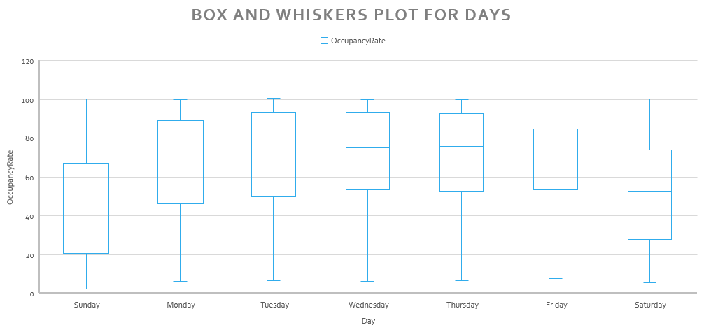
Box Plot of Occupancy Rates on Days of the Week

Slide 4
Box plot of Occupancy rate on the days of the week
The median occupancy rates are not the same throughout the week.
Weekdays have a high occupancy rate as compared to weekends.
This is the expected result, because, people are busy working and business trips on weekdays, therefore, high occupancy rates on weekdays. On weekends, most people stay home with their families, and therefore, low occupancy rates on parking lots.
Notes:
Weekdays have approximately a 70% occupancy rate on parking lots while on weekends, the occupancy rates are approximately 40% and 55% on Sundays and Saturdays respectively.

Slide 5
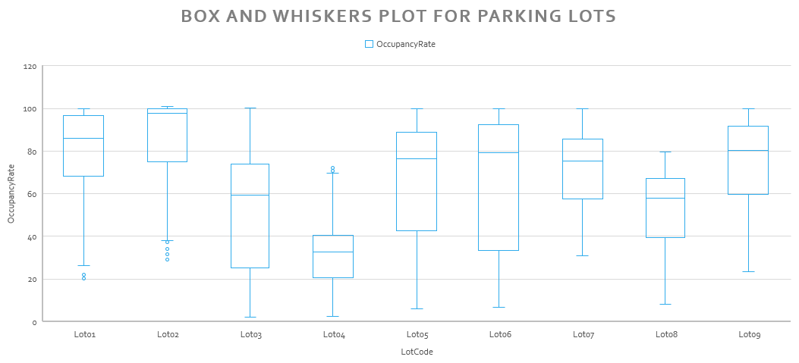
Box Plot of Occupancy Rates on Different Parking Lots

Slide 6
Box plot of Occupancy rate on Different Parking Lots
The box plot shows that median occupancy rates differ across the parking lots.
Parking lot 2 has the highest median occupancy rate and parking lot 4 has the least median parking occupancy rate.
This result is expected because, the occupancy rates differ depending on the location of the parking lot.
Notes:
Parking lot 2 has an approximate occupancy rate of 100% while parking lot 4 has a meadian occupancy rate of approximately 36%. Parking lot 2 maybe located close to a shopping mall and parking lot 4 located close to a private manufacturing company which is not a busy location.

Slide 7
Scatterplot of Occupancy Rate on Tome for Parking Lot 1

Slide 8
Scatterplot of Occupancy rate on Time for Parking Lot 1
The occupancy rates on parking lot 1 are time dependent, i.e. occupancy rates increase as the time of the day increase to a peak at around afternoon hours.
This is an expected result because, during morning hours, very few people travel and need parking spaces but as time moves, more people move around and therefore more parking spaces required.
Notes:
At around noon, the occupancy rate at parking lot 1 is approximately 100% for almost all the dates studies, i.e. 20/11/2016 to 26/11/2016

Slide 9
Scatterplot of Occupancy Rate on Time for Parking Lot 2

Slide 10
Scatterplot of Occupancy Rate on Time for Parking Lot 2
The occupancy rates of parking lot 2 are time dependent, i.e. parking occupancy increase as the time increase.
The lowest occupancy rates are experience during morning hours and the highest at around midday.
This result is expected due to the busy nature of cities as time moves
Notes:
The maximum occupancy rates are 100% for all the days between 20/11/2016 and 26/11/2016 except for 21/11/2016 which has a maximum occupancy rate of approximately 95%. 20/11/2016 and 26/11/2016 have the minimum occupancy rates of approximately 30% each day, which is morning hours.

Slide 11
Conclusion
Most parking lots are highly occupied during weekdays.
The occupancy rate of a parking lot depends on the location of the parking lot.
There is a high occupancy rate of parking rates during midday hours while minimal during morning hours.

Slide 12
Recommendations
There should be more parking spaces built around busy places to cater for the high number of motorists at those areas.
A mobile app should be developed to guide motorists to the closest parking spaces so that they do not cause high traffic and congestion in the streets.
Measures should also be put in place to control congestion during midday hours, because most parking spaces are full during this time of the day.

