Slide 1
Institutional affiliation
Hunting and gathering
Student name
Date

Slide 2
Hunting and gathering
Morality is an attempt of the human being to define what's wrong and right about our thoughts and actions, as well as what's wrong and right about being who we are.
Philosophers have been severally tried to provide a various definition of Morality for thousands of years.
Possibly if we discuss at least three specific examples of hunting/gathering cultures based on given videos for this week, we can find the meaningful definition of Morality.

Slide 3
Hunting and gathering
Communities that primarily rely or exclusively on gathering wild berries, fruits, vegetables, nuts, and hunting wild animals to support their living and diet.
Till human beings started to domesticate animals and plants about twenty years ago, all ancient human societies depended on hunting and gathering.
Unlike today where only a small proportion of the word's populations support themselves in this manner, and mostly these tiny populations survive in inhospitable and isolated areas like tundra, dense rain forests, and deserts.

Slide 4
Hunting and gathering
Given the close correlation between hunting and gathering and the natural environment, gathering and hunting communities such as Pygmies and Bushmen might provide valuable information that anthropologists use to study the development of human social morality and social structures.
They used simple tools such as sharpened stones for cutting things.
Controlled use of fire for warding off predators and cooking marked a significant turning point in the ancient history of hunters and gatherers.

Slide 5
Hunting and gathering
The rectification or rather correction of someone behavior by his or her peers in an inventive or informal way is an example of decentralized execution of social norms that governs our way of contact.
Social norms are accepted way of contacts in the society that persons are accepted to obey.
Such norms usually create strong foundations for good behaviors.
Purposely, this paper develops a philosophy of Morality, where morals are considered as decentralized communal or social control

Slide 6
Hunting and gathering
Decentralized enforcement of social norms was majorly practiced in the past, especially during hunting and gathering activities to control the behaviors of the youths by training them to be responsible adults.
Unlike mode era where the control of social norms and conducts are mainly are controlled by strong force under a centralized command.
Such centralized authorities include the authoritative power of the state manifested in military and police to maintain peace and order by controlling and regulating people's way of contact

Slide 7

Hunting and gathering

Slide 8
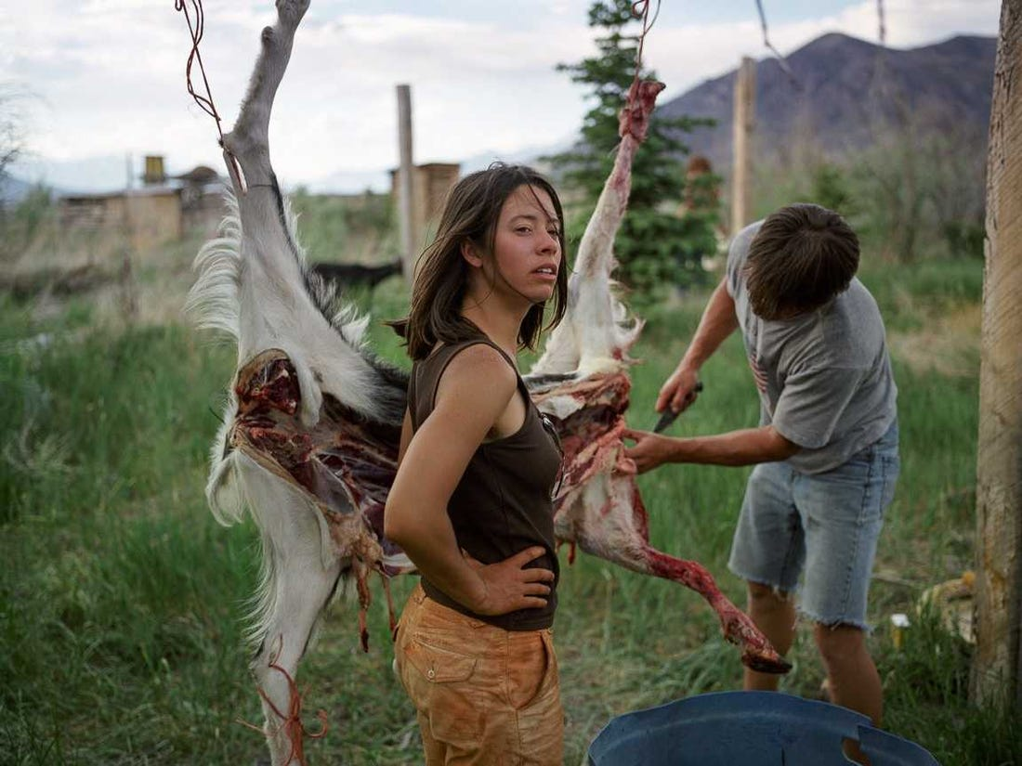
Hunting and gathering

Slide 9
Hunting and gathering
The research shows that some communities can live peacefully even without centralized command power.
These communities lived in the prehistoric period before records of human beings were documented.
A perfect example of communities that have exhibited how decentralized social control can create order includes the Mbuti pygmies of Ituri forest, the Kung San of the Northern, western Kahari Desert, the communities of warm weather nomadic foragers, that is, hunters and gathers.

Slide 10
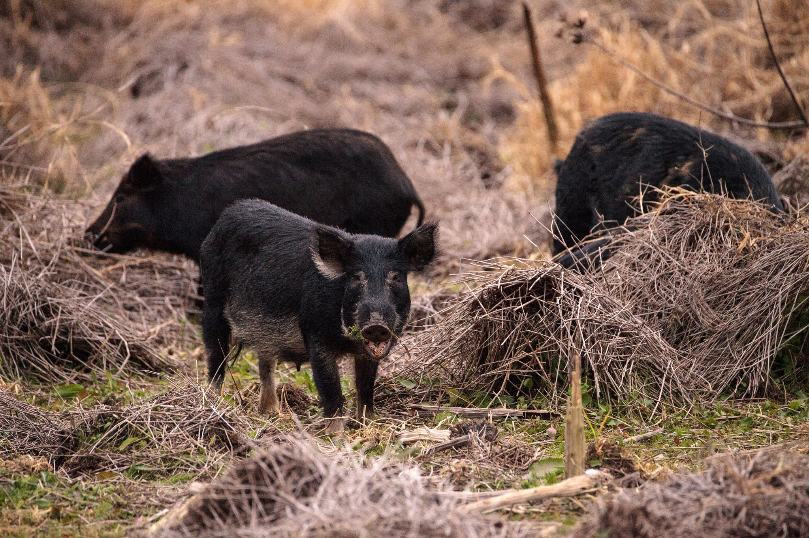
Hunting and gathering
Almost these communities shared some characteristics since they were nomadic and communal.
They could peacefully move from one place to another in search of pasture to graze their animals in communal lands.

Slide 11
Hunting and gathering
No one privately owned the piece of the land.
Therefore, the land was communally owned, and each member of the society had the right to use the lands.
In this sense, such communities were egalitarian since they saw each community member as equal in their moral status by giving them equal opportunities and rights to use communal lands and resources

Slide 12
Hunting and gathering
Besides, some communities in ancient’s times were matrilineal.
In such societies, the land was inherited from the mother to daughter.
Also, these communities were associated with the paleo diet.
Paleo diet typically included foods that could be obtained through gathering and hunting.
Moreover, such societies were dominated by a few botanists who studied the plants and impacts of human activities on the environment.

Slide 13
Hunting and gatheringReferences
https://youtu.be/-X5cD6jd914
https://youtu.be/OODnFvYXqYM
https://youtu.be/QRBMdS4t36c
Gomberg, P. (1997). How morality works and why it fails: On political philosophy and moral consensus. Journal of social philosophy, 28(3), 43-70.

