Slide 1
Presentation
Reproductive system

Slide 2
organ system’s location
Primary organs in human are the careers of both gender genetics that are transferred to the offspring.
These organs comprise the ovaries in females and testicles in male.
Primary organs in women are located below the kidneys right and left of the body.
In men the they are housed in the scrotum which is an external organ in the abdomen
Notes:
It is vital to orders, and the roles performed by the primary reproductive organs in human beings. The nature of offspring depends on the quality of sex cells produced in these organs. Their activities are regulated by hormones and must therefore coordinate with other secondary organs for successful reproduction. Gonads stimulate the production of hormones that triggers control the overall reproduction process of sex cells. Organs such as penis, fallopian tubes, uterus vagina provide an environment for the development of the fused male and female cells to yearning to reproduce. The hormones communicate with other reproductive structures and also yield a child.

Slide 3
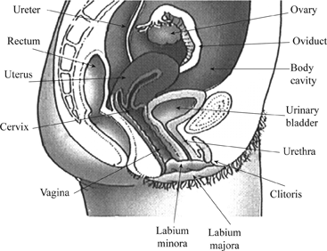
Organs location in both sexes

Slide 4
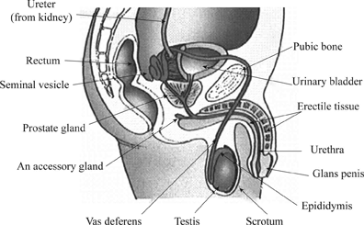

Slide 5
organs and structures
Ovaries are oval pinkish and oval.
They measure approximately 1.5 inches.
They are connected to other secondary organs through a fallopian tube that links ovaries and the uterus.
Testes in males are also oval.
They are protected by spermatic code and are responsible for testosterone and sperms that are deposited in the Vagina during intercourse.
Penis, seminal vesicle, oviducts testicles, ovaries are some critical organs in the reproductive system.
Notes:
Different reproductive organs occur in various structures and are adapted to their specific functions. The organs are interconnected and depend on one each other for successful reproduction. The organs are made of tissues such as the vagina, penis testis, vulva, uterus, and oviduct and are all perform unique role during production. For instance, oviduct provides a suitable environment for fertilization to take place and allows the movement of the fertilized egg into the uterus where it develops into an offspring. Penis releases sperm into the vagina. Also, testes are positioned externally to ensure that the temperature does not tamper with the quality of sperms and semen produced.

Slide 6
The physiology of the organ system
There are critical psychological functions performed by both female and male reproductive systems;
Sperm productions.
Deposition of sperms in the vagina for fertilization.
The output of ovum in females.
Protection and nourishment of fertilized ova to the ultimate offspring
Notes:
Male reproductive system manufacturers the male cells that are the sperms and prepares a liquid that protects, ie, semen. The male system coordinates and deposits these cells into female reproductive tract during intercourse. Semen neutralizes the virginal fluid and allows the sperms to swim until they reach in the fallopian tube where they fuse with the ovum. On the other hand, the female reproductive system plays two crucial roles; It produces female cells that carries the female genes into the offspring. Ovum is produced periodically and release into the fallopian tube where fertilization takes place. The fertilized eggs are protected and cared for in the uterus until birth.

Slide 7
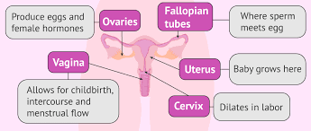
Functions of female reproductive organ

Slide 8
The relationship of the primary organ system to a secondary organ
Primary and secondary reproductive
They complement each other despite having different functionality.
Primary organs produce gametes while secondary produces a platform for the gametes to due and give rise to an offspring.
Primary organs discharge hormones while secondary stimulates these organs to secrete the hormones. organs work in hand in hand towards the reproduction of new creatures.
Notes:
Both primary and secondary organs perform specific functions independently. However, they complete each other when it comes to reproduction. Primary organs are the ones that produce gametes both male and female that carries the genes of the individuals. Once the gametes are provided in both the ovaries and testes, secondary creates a mechanism for the two gametes to fuse. The penis which is a secondary organ plays a pivotal role during sex and deposits the semen and the sperms in the vagina which is a secondary organ in females. Hormones allow both secondary and primary organs to communicate and be able to respond positively to the changes when there is a need to procreate.

Slide 9
The interactions between the two systems and dependence in human body
Fertilization of female gamete in the system.
Hormonal balance in both sexes.
Health and functionality of each element of the reproductive system.
Notes:
Procreation is a two-way process where different gender interacts and complete the reproduction process. For fertilization to take place, the two individual must have hormone balance that stimulates the release of the gametes at an appropriate time to increase the chances of conception. Both primary and secondary organs must coordinate effectively and efficiently and ensure that the process is complete. Male organs must produce strong and healthy sperms and be able to deliver them into the female reproduction track. The female system must respond positively and create a conducive environment for fusion to take place as well as taking care of the features till birth.

Slide 10
Medical issues and diseases
Ovarian cancer.
Testicular cancer
Orchitis
Abnormal hormone production
Infertility
Notes:
These are common primary organs diseases and disorders. However, there are those that are gender specific while others are common in both sexes. Abnormal hormone production can affect either gender where there is excessive or limited hormone production changing the rate of gamete production. Also, infertility affects both genders, and this is where there is low sperm count in males and low ovum production in female making reproduction almost impossible. Ovarian cancer as the effects women and result in the growth of extra cells in ovaries that produces the female gametes hindering the production of more female reproductive cells and mostly affect those above the age of 21yrs. Testicular cancer results to overgrowth of cells in the testis in males of age between 15 and 35yrs.

Slide 11
Nature, implications and preference of diseases
Low fertility rate due to damage of the gamete-producing organs.
STIs causes cells to grow abnormally resulting in testicular and ovarian cancer
Lower abdominal pains. This results from viral and bacterial infection affecting the organs.
Imbalanced diet.
Dry ejaculation that results from little or no sperm at all during intercourse. This affects those who have testicular cancer.
Youths and commercial sex workers are at a higher risk of contracting these diseases.
Notes:
It's important to understand the causes, implication and the population at higher risk is essential in finding the remedy as well as developing strategies to counter the effects. Commercial sex workers and those who have more than one mate have high chances of contracting sexually transmitted infections that affect both primary and secondary reproductive organs human. Poor diet more so low protein intake affects the production of sperms. High level of protein may also affect the sperm count. Health practitioners in corroboration with national health management should educate the society and provide adequate guidance to the victims to safeguard the future generation.

Slide 12
References
Sherwood, L. (2015). Human physiology: from cells to systems. Cengage learning.
Ross, A. C., Caballero, B., Cousins, R. J., Tucker, K. L., & Ziegler, T. R. (2014). Modern nutrition in health and disease(No. Ed. 11). Lippincott Williams & Wilkins.
Shier, D., Butler, J., & Lewis, R. (2015). Hole's essentials of human anatomy & physiology. New York: McGraw-Hill Education.
Sherwood, L. (2015). Human physiology: from cells to systems. Cengage learning.

