Slide 1


Slide 2
Introduction
Starbucks coffee company is my selected company from my previous assignment. It is a global company, and many people into it for a cup of coffee, although it is more than the overpriced coffee (Austin and Reavis, 2002). Many customers love Starbucks due to its services; they offer an encouraging environment and friendly and helpful staff who assist the customer in any problem encountered with the coffee or service. Therefore, the principle and structure of Starbucks is an excellent model to follow due to its national and global success.
Notes:
Therefore, challenges are facing the corporation both internally and globally. Since the company is global, it focuses on financially succeeding through the complex economy and competitive environment. This essay will focus on the challenges in these business environments and the measures taken to overcome them for social responsibility.

Slide 3
Mission
Starbuck's mission is "to inspire and nurture the human spirit – one person, one cup, and one neighborhood at a time." And its vision is to "treat people like family, and they will be loyal and give their all." Therefore the company is stick to its responsible values of ensuring the company is committed to its mission.
Notes:
Creating a culture of warmth and belonging, where everyone is welcome, does the company use another value to maintain and bring more customers. The company management deals with competition and high pricing challenges by ensuring customers receive the highest services ever with high-quality coffee (Austin and Reavis, 2002).

Slide 4
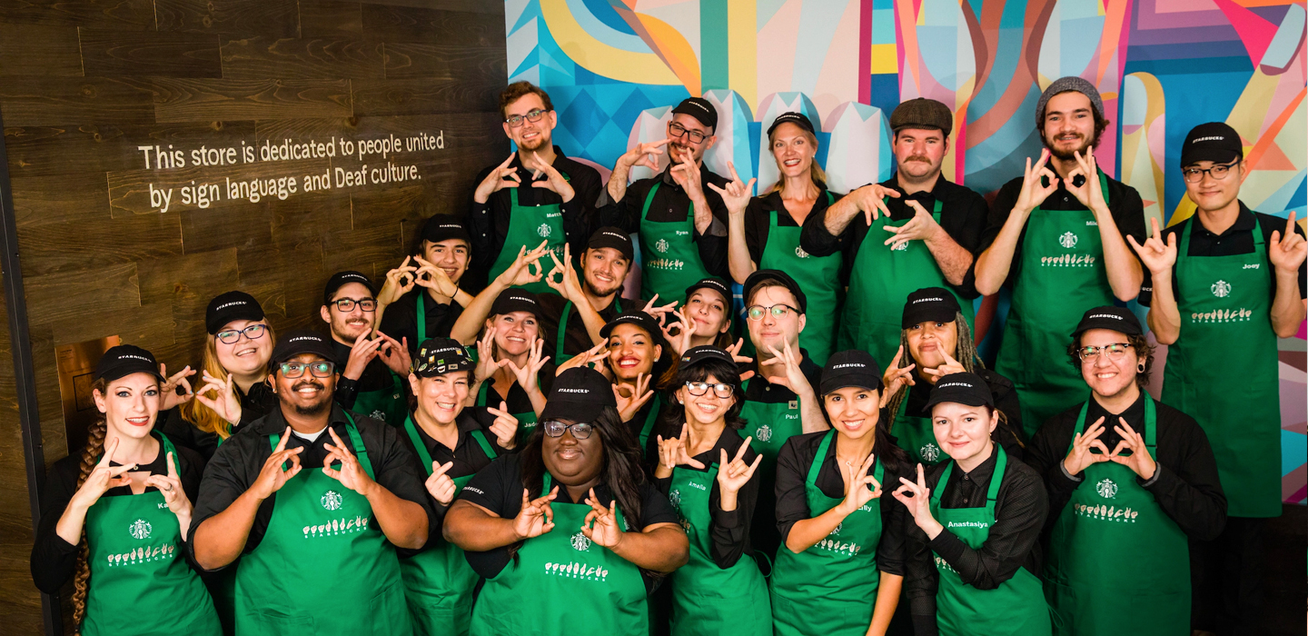
Empowering Workers
Starbucks is focused on achieving its goals through business practices such as empowering workers. The corporation empowers workers by giving them enough training, rewarding them based on performance, and improving their health environments.
Notes:
These practices help the workers serve the customers with the highest dignity for social responsibility. Staff who works against the business values and mission are held accountable that helps the company in maintaining their customers (Mayes, 2010).

Slide 5
Labor and Human Rights
Starbucks is a global coffee company with branches in all corners of the world. Therefore the company management ensures human rights are honored and discourages excess labor to workers (Wirawan, 2018). For instance, back in 2018, two men entered their business, they were arrested. The company's CEO ordered an immediate close of the location, released the two black men, and took staff for racial biases.
Notes:
This practice gave more customers hope for the company's future relationship with the people through fighting for violation of human rights. The company made a significant achievement on social responsibility and attracted more customers.

Slide 6

Health and Safety
The company is also focused on in health and safety of its staff and customers. For instance, during the Covid-19 pandemic, the company gave its staff a holiday that ensured they worked from home to reduce the spread of covid-19.
Notes:
Customers were also not left aside by the company to assess all the information they required from the website and order the product online (Wirawan, 2018). Ideally, these approaches helped the company is introducing innovations that helped in competing with their competitors.

Slide 7
The Environment and Accountability
The environment is another company's supplier responsibility that is critical in the business and society relationship.
The environment includes external forces, factors, and institutions beyond the control of the business and affects the functioning of a business enterprise.
Notes:
Therefore Starbucks coffee company ensured that customers, competitors, suppliers, government, and the social, political, legal, and technological factors are dealt with to improve the performance of the business for social responsibility. The company included innovation to produce quality commodities far from their competitors (Mayes, 2010). Finally, they ensured views of the customers are given priority on social relationship between the company, and the society is improved.

Slide 8
References
Austin, J. E., & Reavis, C. (2002). Starbucks and conservation international. Harvard Business School Publishing.
Mayes, P. (2010). 21. Corporate culture in a global age: Starbucks’“Social Responsibility” and the merging of corporate and personal interests. In Pragmatics across languages and cultures (pp. 597-628). De Gruyter Mouton.
Wirawan, R. S. (2018). The efforts by Starbucks Coffee Graha Pena to improve the quality of employee performance. Russian Journal of Agricultural and Socio-Economic Sciences, 9(81), 401-407.

