Slide 1
Anxiety Disorders Author Institutional Affiliation Instructor Course code Date of submission

Slide 2
Description of the practice problem
Evidence drawn from a plethora of past research has considered anxiety disorders as a serious and common mental health problem among children.
Observably, these disorders present a variety of significant changes in the child’s behaviour.
In the understanding of the relationship between emotional and social functioning in children with anxiety disorders.
It is essential to understand that due to the changes in the observable behaviours, these children may find it difficult to effectively cope with their peers.

Slide 3
For instance, some may prefer to isolate themselves or rather feel distracted from their normal activities.
The following is a description that represents a real case description drawn from my internship.
Gad, a young boy aged 8 approaches me. He seems normal however his breathing is rapid and shallow.
He says he struggles not to panic. I tell him not to panic and calm down, but he says he thinks he is going to die if I don’t help him.
I start talking to him in a kind of reassuring manner for close to 20 minutes to help in calming him down.
After this, he tells me that he thinks he is now fine and ready to go back to go. I assure him that all will be well and he can surely come back anytime if he wants to.

Slide 4
It is essential to note that the presented case scenario is representative of panic disorders that are usually characterized by repeated episodes of sudden, unexpected, intense fear that come with symptoms like heart pounding, experiencing problems with breathing and being sweaty.
Some anxious children may not exhibit these symptoms because they prefer to keep their worries to themselves.
Ideally, this can make it difficult to determine effective intervention strategy for their emotional challenges.

Slide 5
Research question
The question for this current study revolves around whether Individualized Education Plans can be effective for students with anxiety disorders.
Panic disorders such as the one presented in this scenario are associated with a particular known cause.
School attendance is a known major cause of panic disorders among students.
Even though total avoidance of school may help alleviate the anxiety symptoms, psychologists are advised to devise strategies to get the student back to school as quickly as possible.
This is because extended periods out of school due to anxiety might significantly affect their academic performances.
For this reason, appropriate measures and strategies should act to ensure measurable outcomes such as ensuring that the affected students return to school and are appropriately engaged with their education (Bhatia & Goyal, 2018).

Slide 6
Literature review
The evidence presented for this paper was particularly drawn from MEDLINE sources.
The sources were individually read and their individual articles indexed.
It is essential to note that MEDLINE is considered a great source for medical information because it is authoritative and peer-reviewed.
The information presented here is not only complete but also publish the original research done by the researchers.
Search terms such as childhood anxiety and social functioning were used to select the most reliable sources.
Additionally, to determine the best intervention method for similar cases, searches for individual therapies were initiated on the MEDLINE database, from which numerous results emerged.
The exclusion criterion applied to select the most appropriate was the use of age, particularly focusing on data on lower primary school children.

Slide 7
Selected plan intervention
After an initial analysis of the client’s situation, it was evident that the immediate social environment significantly impacted his mental health.
McLeod (2004) argued that students with high anxiety levels due to unpleasant environments were more inclined to avoid the situations rather than face them and plan on how to effectively approach them.
In the understanding that this case scenario seemed to have developed primarily because of the school environmental problems.
For this reason, I realized that it is important for teachers and other relevant stakeholders to create an accommodative atmosphere at school for students presenting school-related anxiety.
In this sense, it is stated that the teachers must be supportive to effectively address the intimidating learning environment particularly for students with anxiety (Hanie & Stanard, 2009).

Slide 8
The level of school support offered to these students would believably make a difference to help them thrive instead of shutting down and avoiding school completely.
IEP plans have been recommended as effective support programs that schools can implement for such students to help them see the school environment as a safe place (Creed et al. 2016).
Chansky & Wagner, (2005) observed that a safe place in this context referred to any non-threatening location that made students feel comfortable and from where they could be assisted to establish and achieve personal goals.

Slide 9
Single-subject Design
Believably, the chosen intervention plan represents a promising option to address anxiety among lower-grade students in elementary schools.
This plan utilized the A-B-A design to determine the effectiveness of this mindfulness-based intervention plan designed to alleviate the intimidating situations at school for the young learners.
Three elementary students with similar symptoms of anxiety were enrolled on this study. The episodes of anxiety were measured on 10 occasions at baseline, during the intervention and even after for follow-ups.
Using visual observation to determine improvements after the intervention, 2 of the research participants showed improvements in anxiety.
To effectively measure the amplitude of change for the observably small number of participants in this study, the n-of-1 trial strategy was applicable in this context.
The hypothesis stated that the students would exhibit reduced anxiety levels at the end of the intervention compared to the baseline scores.

Slide 10
The variables that were measured in this study included: the behaviour assessment that was used to evaluate internalizing symptoms in the participating students.
The scores obtained from the behavior assessment presented good interrater agreement (r = 0.53-0.74) and test-retest reliability (r = 0.7-0.8) and high internal consistencies of (α = 0.8-0.9).

Slide 11
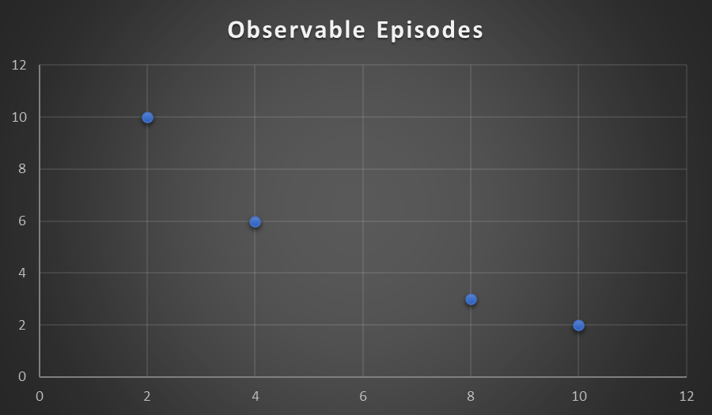
Graphical representation of the observable changes

Slide 12
Conclusion
With the above intervention plan, it was observed that the problematic behaviour significantly deteriorated through the period of intervention.
The participants recorded low levels of anxiety as the treatment progressed and remained quite stable even after the follow-up.
The suggested intervention seemed somewhat helpful in alleviating the anxiety.
Statistical evidence was observed in this study and the study consequently concluded that major depressive disorders among elementary school children can be addressed through mindfulness-based intervention strategies.
The x-y graph for single design subjects indicated numerous episodes of anxiety and panic disorder during the baseline phase and a significant decrease as the treatment progressed.

Slide 13
References
Hanie, E. H., & Stanard, R. P. (2009). Students with Anxiety: The Role of the Professional School Counselor. Georgia School Counselors Association Journal, 16(1), 49-55.
Chansky, T. E. (2004). Freeing your child from anxiety: Powerful, practical strategies to overcome your child's fears, phobias, and worries. Harmony Books.
Dickson, J. M., & MacLeod, A. K. (2004). Approach and avoidance goals and plans: Their relationship to anxiety and depression. Cognitive Therapy and Research, 28(3), 415-432.
Masia-Warner, C., Klein, R. G., Dent, H. C., Fisher, P. H., Alvir, J., Albano, A. M., & Guardino, M. (2005). School-based intervention for adolescents with social anxiety disorder: Results of a controlled study. Journal of abnormal child psychology, 33(6), 707-722.
Wagner, A. P. (2002). Worried no more: Help and hope for anxious children. Lighthouse Press.
Bhatia, M. S., & Goyal, A. (2018). Anxiety disorders in children and adolescents: Need for early detection. Journal of postgraduate medicine, 64(2), 75.
A Creed, T., H Waltman, S., A Frankel, S., & A Williston, M. (2016). School-based cognitive behavioural therapy: Current status and alternative approaches. Current Psychiatry Reviews, 12(1), 53-64.

