Slide 1
Irish American
Author
Institutional Affiliation
Instructor
Course code
Date of submission

Slide 2
Introduction
Social customs refer to shared actions and behaviours that a particular culture is expected to follow.
Essentially, it is these social customs and conventions that make people from different cultures behave differently from others.
Social customs cut across a number of issues which include naming conventions, religion, communication styles, taboos, greeting styles and personal space.
Ideally, social customs play a significant role in influencing how people of different cultures and backgrounds express themselves.
The following is a representation of the social customs and protocols associated with the Irish-American people.

Slide 3
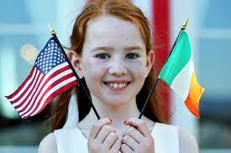
Ideally, social customs play a significant role in influencing how people of different cultures and backgrounds express themselves.

Slide 4
Naming conventions
Irish naming conventions are similar to American conventions. Most of the people are given names followed by surnames.
Irish-Americans have surnames that are observably of Gaelic origin.
These names have been significantly influenced by English consequently leading to the anglicization of many Irish names besides the adoption of English names as well (Clancy et al. 1995).
It is important to note that not all Irish-American have conformed to the English influence.
For this reason, several surnames have emerged within a single-family.
The use of epithets has been common among Irish-Americans.
The first name can be modified by an adjective to particularly distinguish the bearer from other people.
For instance, Mór and Óg can be used to distinguish between two people with similar names like father and son.

Slide 5
Cont..
Some people still have Irish Gaelic names while others have anglicized names.
Surnames are usually patronymic and are passed down through generations.
Irish-American children usually take on their father’s surnames.

Slide 6
Space
Space has been considered an important aspect in a cultural framework.
Terms such as personal space have been used to describe this phenomenon.
In Irish-American culture, space has been used in the elaboration of culture.
For instance, 6-8 inches of space may be indicative of intimate relations.
Most Irish-Americans have been found to present social distancing in public spaces.
Some authors have observed that Irish individuals are less likely to be physically affectionate in both their interpersonal and family relationships.

Slide 7
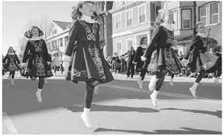
Irish individuals are less likely to be physically affectionate in both their interpersonal and family relationships

Slide 8
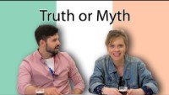
Stereotypes about the Irish people
Concerning the stereotypes against the Irish people, firstly, the people of this culture have been largely labelled as drunks.
Arguably, based on these stereotypes, Ireland has been argued to have the highest proportion of drinkers.
Another stereotype is that Irish are violent.

Slide 9
Cont..
There have been arguments stating that Ireland is a remarkably a violent country with an observably high rates of assaults.
For this presentation, the last stereotype associated with Irish people is the idea that all Irish have red hair.
Yes, noticeably, a majority of the Irish are ed-haired and for this reason, this has continued to become a major stereotype.

Slide 10
Communication
Irish-Americans place a lot of emphasis on their communication styles.
In this culture, telling jokes and being witty is very common.
Verbal communication is an art in this culture with an increased tendency to be poetic and lyrical consequently resulting in verbal eloquence.
Acts of bragging and exaggeration during communication may be looked on with suspicion.
In this culture, it is courteous to remain polite during conversations with so much focus on avoiding conflicts when disagreements occur.
Irish-Americans may find the English language more convenient during conversations, however, Irish Gaelic is also used in a majority of the conversations involving people of this culture.

Slide 11
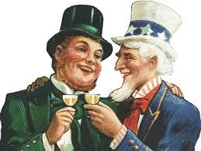
In this culture, telling jokes and being witty is very common.

Slide 12
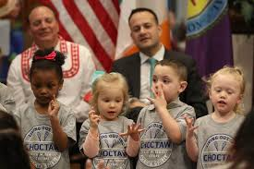
Verbal communication is an art in this culture with an increased tendency to be poetic and lyrical consequently resulting in verbal eloquence

Slide 13
Meeting and greeting
Irish-Americans usually prefer to shake hands during their meetings. In such situations, a firm handshake with eye contact is expected.
Similarly, they are expected to shake hands with everyone present at a social gathering or in a business meeting as a form of greeting, an act they are expected to do when leaving (Clancy et al. 1995).
While greeting, Irish-Americans are expected to put a smile on their faces.
Meetings may involve the engagement in verbal banters, and taking pride in themselves during their discussions.
In contrast to the Americans, Irish-Americans may conduct their meetings in several venues, not necessarily the office.
This allows the participants to be on an equal footing.

Slide 14
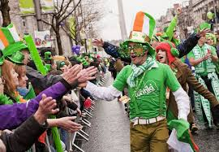
Irish-Americans usually prefer to shake hands during their meetings. In such situations, a firm handshake with eye contact is expected.

Slide 15
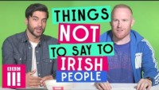
Don’ts
It is important not to refer to those from the Republic of Ireland as British. This may offend many individuals from Northern Ireland.
Avoid stereotyping Irish individuals. Irish may perceive well stereotypes relating to alcohol and drunkenness (Howe, 1995).
Lastly, it is important to try not to dominate conversations as this can be interpreted as pretentious and impolite.

Slide 16
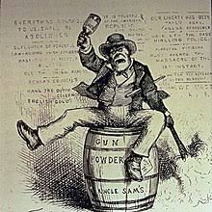
Avoid stereotyping Irish individuals. Irish may perceive well stereotypes relating to alcohol and drunkenness

Slide 17
References
Clancy, P., & Drudy, S. Kathleen Lynch, Liam O'Dowd (Eds.) (1995). Irish Society: Sociological Perspectives. Dublin: Institute of Public Administration.
Howe, L. (1995). Curtin, Chris, Hastings Donnan and Thomas M. Wilson (eds) Irish urban cultures. INTERNATIONAL JOURNAL OF URBAN AND REGIONAL RESEARCH, 19, 170-170.
Gaelic Matters. (2011). Irish Pub Culture - more than drinking. Retrieved from http://www.gaelicmatters.com/irish-pub-culture.html.
BBC Three. (2017). Things Not To Say To Irish People. Retrieved from: https://www.youtube.com/watch?v=ZwioxJLW02s
Dating Beyond Boarders. (2018). TRUTH or MYTH: Irish React to Stereotypes. Retrieved from: https://www.youtube.com/watch?v=Rrco4b7vrL0

