Slide 1
Country Comparison
Author
Institutional Affiliation
Instructor
Course code
Date of submission

Slide 2
The Federal Republic of Nigeria
The Federal Republic of Nigeria is one of the sovereign states in Africa, located in the western part of Africa, the country covers a total land area of about 910, 768 square kilometres.
It is essential to note that a significant portion of the country’s policies were drafted by the colonial master Britain during the 19th century.
Initially, following the country’s attainment of self-rule, Nigeria has been under military rule for nearly 16 years before transitioning to a civilian government in 1999 (Rebolledo, 2009).
Notes:
Nigeria is a west-African country with an approximate population of 202 million people.
The country is blessed with various mineral resources and boasts of being the leading exporter of petroleum oil in Africa.
Similarly, the country is also one of the largest reserves of natural gas on the African continent.

Slide 3
Even though the country has made significant steps in terms of development since attaining independence, it is worth noting that run away corruption is still a major issue in the petroleum-based economy.
Similarly, the government continues to face a daunting task in attempting to unite a country that is largely divided along religious and ethnic lines.
Nigeria is considered a key player in the economy of West Africa. The country boasts of extensive oil fields and natural gas reserves in Africa (World Bank, 2020).
Notes:
Just like any other African country, Nigeria is ethnically diverse and consists of 36 autonomous states.
For this reason, the government has continued to face an uphill task in its attempt to unite the country that is divided along the Christian south and the Islamic north.
As, a leading exporter of crude oils, the country’s economy is fairly stable save for the issue of unending corruption.

Slide 4
Consisting of 36 autonomous states, the country can be considered diverse, however much of the political landscape is dominated by the ruling party APC consequently helping in fulfilling most of the federal economic policies across the Nigerian states.
In terms of economy, close to 40 % of the national population live below the poverty line in a country whose economy largely depends on petroleum which accounts for approximately 80 % of the total exports (Kavalsky et al. 2010).
Unemployment in Nigeria is influenced by education levels whereby individuals who have acquired education are more likely to be employed as compared those without education who constitute a large fraction of the poor living below the poverty line.
Notes:
Poverty rates in the country currently stands at 40%, an indication that close to 83 million people live below the poverty index.
Although the government has initiated various efforts aimed at mitigating poverty, a significant percentage of the population are observably poor because of low education levels especially in the rural areas.
Experts at the world bank have argued that the country’s rising poverty rates can be attributed to a significant rise in the national population against a slow growth in the economy.
The government has observably been unable to create sufficient opportunities for the growing population.

Slide 5
In the 1990s, to reduce the overreliance on the government and to particularly improve the quality of life, the federal government privatized many state-run organizations, especially in the communications, power and transportations.
Besides agriculture, the country’s economy greatly relies on the international oil prices which have continued to result in very unsteady revenue flow which the government counters by accessing loan facilities from international lenders such as the IMF.

Slide 6
Besides crude oil, the country also exports cocoa beans and rubber to India, the United States and the European Union accounting for over 70% of national annual GDP.
Currently, the country’s national debt amounts to 30 % of the national GDP requiring the federal government to set aside 1.31 billion dollars annually to service external debts. (UDEH et al. 2016).
For this reason, the country has a huge national debt which requires a share of the national budget annually for debt repayment.
Notes:
Besides crude oil, the country also exports cocoa beans and rubber to India, the United States and the European Union accounting for over 70% of national annual GDP.
Currently, the country’s national debt amounts to 30 % of the national GDP requiring the federal government to set aside 1.31 billion dollars annually to service external debts.
For this reason, the country has a huge national debt which requires a share of the national budget annually for debt repayment.

Slide 7
In Nigeria, trade accounts for over 30% of the national GDP annually. As observed, the country’s main foreign exchange earner is the petroleum oils; exported to India, China and the United States.
In international trade, Nigeria seeks to promote and diversify its exports by reinforcing national competitiveness through the reduction of subsidies. However, this is usually hampered by the global decline in oil prices.
Notes:
The country’s main export is the petroleum oil that accounts for over 70% of the exports annually. However, the country largely depends on the international market forces for good returns on oil.
In this note, it is important to understand that the government’s attempt to promote and diversify exports has been hampered due to frequent decline in global oil prices.
Institutions must be strengthened and the government should intervene by improving infrastructure and education in order to reduce chronic poverty and stimulate growth.

Slide 9
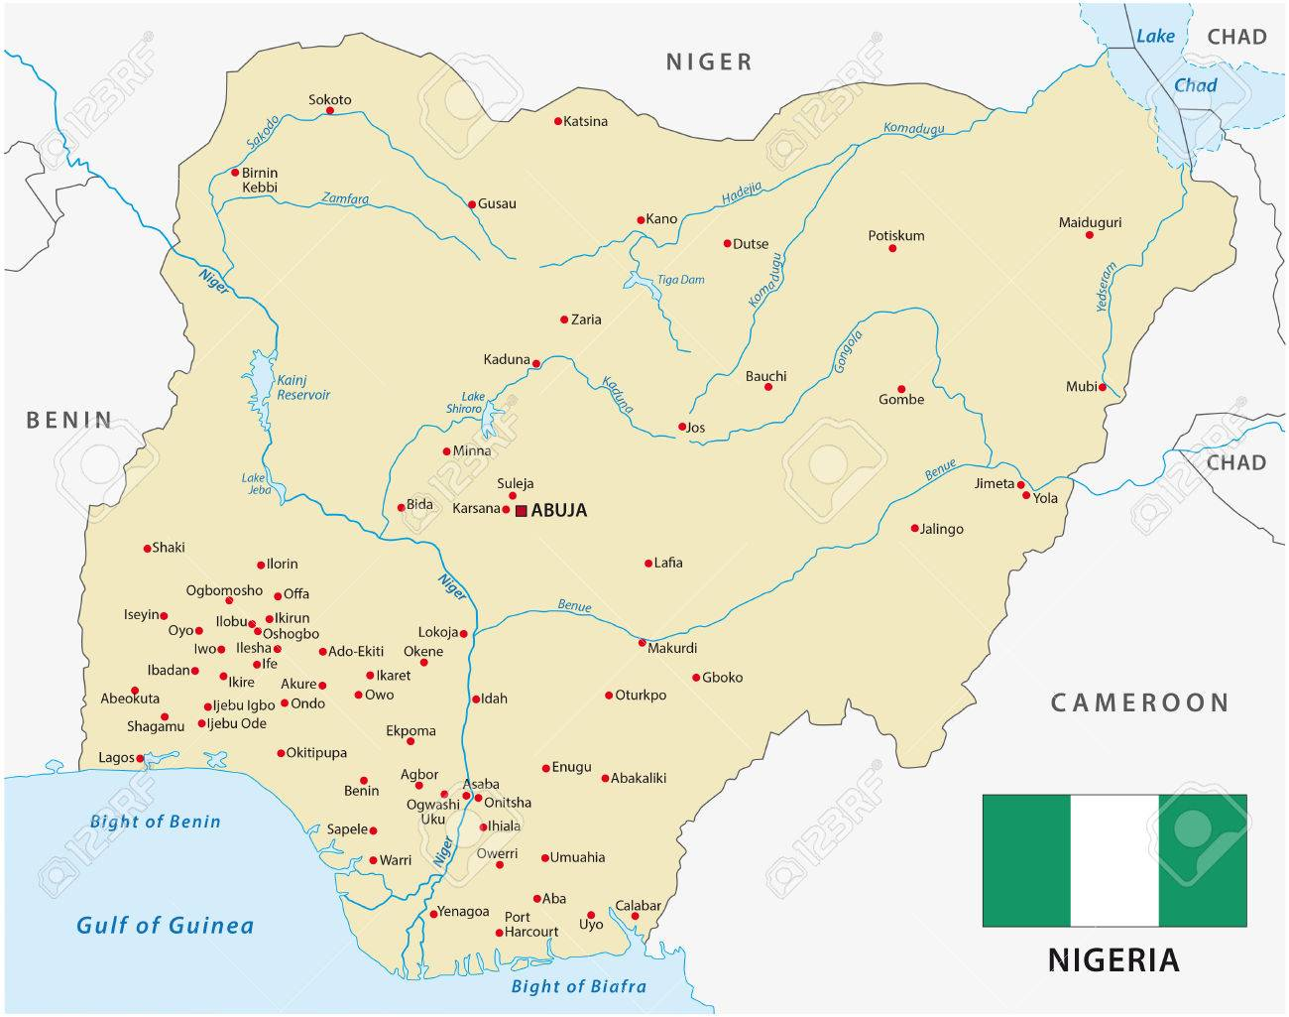
An image showing the position of Nigeria in Africa

Slide 10
The Democratic Republic of Congo
The Democratic Republic of Congo is an African sovereign state located in central Africa in the region bordering the Atlantic Ocean. The country covers a total land area of approximately 2, 344, 858 square kilometres.
Even though the Democratic Republic of Congo gained her independence from Belgium in 1960, the early years of self-rule were characterized by political and social instabilities.
Colonel Mobutu seized the country’s leadership through a coup in 1965 consequently ruling the country for nearly 32 years during which were marred by electoral malpractices.
The history of the DRC is one of political instability and dismal economic performance despite a remarkably rich resource base.
Notes:
DRC is a country in Central Africa where despite gaining independence in 1960, approximately 80% of the population live in poverty due to political instabilities.

Slide 11
Although the country has gone through various elections, most of them have resulted in significant civil and political unrest in the central African nation. In this view, it can be understood that the failure to hold credible elections in the country has led to the creation of several armed opposition groups, particularly in the eastern region.
Even though Mobutu’s government received considerable support from the US government and was fairly stable, the Rwandan genocide and disenfranchisement led to its decline due to the development of the first Congo war.
Notes:
The Democratic Republic of Congo is yet to recover from a series of conflicts that broke out in the 1960s after disputed elections.
Wars in the region have been the major contributor to regions underdevelopment.

Slide 12
Matamba (2011) argues that the second Congo war that occurred between 1998 to 2003 negatively impacted the country’s economic development.
During this period of war, the country’s economy was devastated with the death of nearly 6 million people.
Additionally, human rights were frequently abused with stringent restrictions on civil liberties. The Democratic Republic of Congo is generally a mining economy; however, the unending political instability has been considered a major setback to development besides corruption.
The political turmoil and the tense social climate has made almost impossible for any form of tangible development and growth to take place in the region.

Slide 13
Due to the unending corruption in the country with very little economic development, the country’s public debt currently stands at 6, 098 million euros.
In 2018, the national debt amounted to nearly 15% of the GDP. As of 2020, the country’s unemployment rate stood at 4.3%, representing a 0.1% increase from the year before.
Approximately 72% of the overall population observably live below the poverty line an indication that the country is one of the poorest in Africa.
The country’s economic situation largely depends on the international prices for cobalt and copper. For instance, the country registered a decline in economic growth from 5.8% in 2017 to 4.4% in 2018 due to a decline in global prices of these commodities.
Notes:
Even though, the country’s economy is not doing well, there is high government expenditure besides revenue stagnation which has consequently resulted in high inflation rates in the central African country.
The country’s success in international greatly depends on the global prices of cobalt and copper, a decline in the global prices significantly affects the country’s economic growth.

Slide 14
As a member state of the SADC, the country’s major exports include copper, cobalt, diamonds and gold. It is essential to understand that the major trading partners for this country include China, Zambia and South Korea.
The country’s major imports include drugs, machinery, fuel and equipment. Based on a report by the World Bank, DRC has a potential becoming a leading exporter of land resources and driver of African growth, however, corruption and the unending wars in the eastern Kivu region have made this seem impossible.
The country arguably has a bright future in terms of development, however it is yet to fully recover from the series of conflicts that broke out in the 1990s.
Also, the country’s debt risk remains moderate, however the government is observably struggling to implement most of its policies due to the fairly weak revenues.
Notes:
It has been argued that inefficient tax collection, underdeveloped domestic capital markets, insufficient access to external capital markets and political instability are the major barriers in the country’s way of becoming a leading exporter and a driver of African growth.

Slide 15
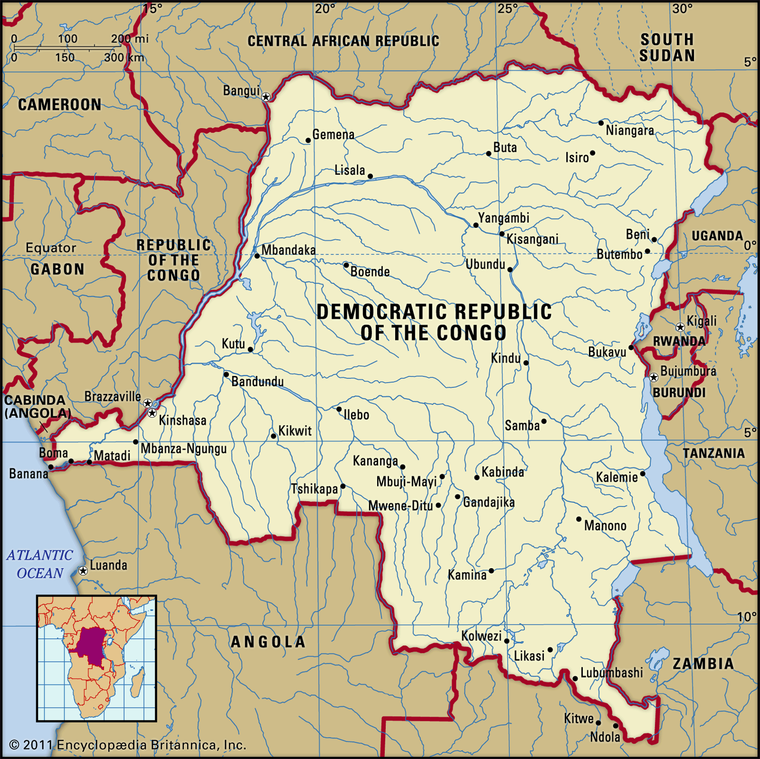
An image showing the position of the DRC

Slide 16
Gross Domestic Product

Slide 18
Notes:
Nigeria’s inflation has been observably higher most of the countries within the sub-Saharan Africa because of high unemployment rate and unsteady global oil prices which continue to fluctuate over the years.
Because of the high inflation, prices of goods have shot up in the meantime with banks also raising their interest rates to maintain their profit margins.
The inflation rates in DRC are observably high due to heavy external borrowing followed by high government spending.
The country’s economy has remained generally unstable because of the unending conflicts in the Eastern regions especially in the Kivu District.

Slide 20
Similarities
Both countries are developing economies with significant portion of their populations still living in poverty.
Both countries are struggling to address the issues of insecurity.
Corruption is still a major issue in both countries
The governments of these countries still lack the ability to create capacity for their populations.
Both countries depend on the exportation of land resources for the sustenance of the economy.
The management of external debt is still a problem for both countries.

Slide 21
References
Pletcher. (2020). National debt in relation to gross domestic product (GDP). Retrieved from: https://www.statista.com/statistics/1044558/national-debt-of-democratic-republic-of-congo-in-relation-to-gross-domestic-product-gdp/
Pletcher. (2020). National debt from 2015 to 2025 in relation to gross domestic product. Retrieved from: https://www.statista.com/statistics/383195/national-debt-of-nigeria-in-relation-to-gross-domestic-product-gdp/
The World Bank in DRC. (2020). Retrieved from: https://www.worldbank.org/en/country/drc/overview
Rebolledo Dellepiane, M. A. (2009). IFC in Nigeria: 1998-2007-an independent country impact review (No. 53846, pp. 1-151). The World Bank.
Kavalsky, B. G., Gwin, C., Pearce, D., Sud, I. K., & Lyasse, O. (2010). Nigeria-Country assistance evaluation, 1998-2007 (No. 100006, pp. 1-120). The World Bank.

Slide 22
Litwack, J. (2013). Nigeria economic report (No. 77684, pp. 1-43). The World Bank.
Kobia, R. (2002). European union commission policy in the DRC. Review of African Political Economy, 29(93-94), 431-443.
Matamba, H. (2011). Proposal of Solution on the Chaotic Political Situation in Drc. Xlibris Corporation.
UDEH, S. N., UGWU, J. I., & Onwuka, I. O. (2016). External debt and economic growth: The Nigeria experience. European Journal of Accounting Auditing and Finance Research, 4(2), 33-48.
Moki, M. (2012). An analysis of the relationship between public debt and economic growth in Africa (Doctoral dissertation).

