Slide 1
Lizzie’s century
Author
Institutional affiliation
Instructor
Course code
Date of submission

Slide 2
Abstract
The first section of the article that would arguably benefit our social, cognitive and physical development is the chapter on the cure for everything.
As presented, experts and professionals in the medical field have highlighted the inescapable developments to take place during this period around 2055 when lizzie would be about 50 years.
These developments would be beneficial in the sense that they would provide remedies to every kind of unspeakable pain.
However, chapter three around 2035 does not present much effect on our social and physical development.
Much of the developments at this point are believed would negatively impact on the development of humans. Super intelligent computers may engage in unspecified tasks that may harm humans.

Slide 3
The first beneficial section, the cure for everything
This section highlights a period where there exists a cure for everything, every person would have their genetic codes stored in microchips that would determine various aspects of an individual’s health.
For instance, the chip would help in determining if an individual has been predisposed to heart or Alzheimer's diseases.
These new developments are believed would be very essential in creating a society full of babies born with the certainty of not having a single gene-defect.
Additionally, as time goes, humans will also have to guess how to make vaccines against any disease that might evolve.
Tissue engineering at this point would virtually make complex treatments easy, for instance, little robots would be cleaning our arteries.

Slide 4
Thoughts and insights
Humans would begin to drive evolution consequently determining the direction it takes. Women will store their eggs when they are young, freeze them and take them out when they are ready to be mothers.
For this reason, the idea of marrying would solely be on the aspect of companionship not because of the need to have children.
It is a future in which moms can be dads, every newborn is perfect, and every child is adopted. Parents would be able to choose their children from a marketplace of desirable genes.
. In my view, i believe these new developments would positively our lives. Women would be able to compete favourably with their men counterparts at the workplace since they would no longer be held back by child siring

Slide 5
Secondary research
Tai (2020) argues that the expected developments in the near future would illuminate the path to better health.
Artificial intelligence intended to be used extensively around 2055 would offer a number of advantages over the traditional analytics and clinical decision making.
Through the use of algorithms, ai provides healthcare providers with the most precise and accurate data that significantly influence treatment variabilities and patient outcomes.
Believably, as observed in the article when lizzie would be about 50 years, brain implants on all persons would monitor the body’s health and consequently notify a doctor on the onset of an illness.
In this view, the use of complex ai in the form of brain implants would be primarily destined to drastically change the roles of clinicians and everyday practice in healthcare.
The advanced systems observably improve patient outcomes by constantly monitoring and analyzing warning signs and alerting both the patient and healthcare professionals earlier enough (Muro et al. 2020)

Slide 6
Importance to our physical, cognitive and social development
Admittedly, humans would have better physical development.
Tissue engineering would be essential in constructing new hearts for individuals with heart diseases. Similarly, little robots would travel through the bloodstream cleaning our arteries.
Conditions such as diabetes and kidney diseases would be efficiently managed. Generally, the provision of better healthcare due to advanced technology during this period would result in better physical development in the absence of pain and unexpected death.
Arguably, good health ensures better brain development in young children. Also, people would begin to have children with the certainty of not having any single gene-defect.

Slide 7
CONT..
It is predicted that women would be able to store their eggs only taking them when they are ready to be mothers.
Tellingly, this would affect our social engagement significantly since marriage wouldn’t be the same again. Individuals would marry primarily because of love not because of the desire to sire babies.
And again, adoption would be a commonplace and mothers would become dads at will because everyone would be able to select their desirable genes from a marketplace of children.
In terms of cognitive development, the section presents a social significance because parents, due to the selection of genetic codes, would be able to match the most desirable genes to give birth to children with unusually high levels of intelligence.
Because of this, children born during this period are expected to have a higher success in academics and most jobs.

Slide 8
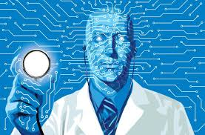
Doctors will use AI to determine the first signs of an illness

Slide 9
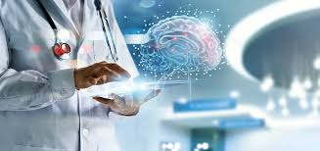
Brain implants will provide essential data regarding an individual’s health status

Slide 10
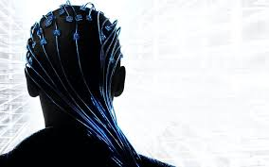
External computerized devices would help doctors in diagnosis

Slide 11
Introduction to least Beneficial
This section attempts to highlight what would happen to humans just in case computers reach human awareness.
It is around 2035 and lizzie is at age 30. Computer microprocessors are expected to calculate faster and cogitate more deeply than even the most brilliant human brain.
The section is referred to as independence day. Scientists perceive that if the trend of making microchips smaller and with greater abilities continues, then eventually computers would be able to perform more than 20 million computations each second to exceed the though the speed of any blood and flesh mastermind.
The section highlights that when that period comes, humans would be left in digital dust as computers would invent more intelligent machines through the use of super-intelligence achieved over the period.

Slide 12
Thoughts and insights
With the super-intelligent computers taking over, some experts have predicted the end of the world.
Some people argue that intelligent computers and machines would try to take over the world consequently wiping out the human race.
However, in my view, these expectations are based on false analogies because intelligent machines will not have the emotions and the personal ambitions that humans do.
Similarly, the intelligent machines will not have the desire for wealth and sensual gratification, for this reason, i believe in case they become more intelligent than humans, they would only continue to perform what they were originally designed to do unless we design to resemble humans.
However, i think if their capabilities surpass that of humans, the resulting impact may be devastating on the human race.

Slide 13
Secondary research
As we move into the future, smart and intelligent machines are expected to drastically replace and enhance human capabilities.
However, if the computers exceed their current form, it would present a catastrophe for the human race.
Russel (2019) argues that it is important to note that computers only perform the functions that we instruct them to do, however when it gets to a point, we can no longer specify the objectives for them, then destruction is inevitable.
With super-human capabilities, computers globally would be performing unspecified objectives and actions which would negatively affect human existence.
In this sense, super-intelligent computers may destroy humans rather enhance our development.

Slide 14
Impact on physical, cognitive and social development
Admittedly, intelligent computer systems are only beneficial if we are able to effectively control them.
Computers with super-human abilities wouldn’t be able to receive any command from humans consequently engaging in incorrect objectives.
Such machines would present very negative impacts on democratic systems globally through the manipulation of human preferences.
Grace et al. (2018) observe that switching the machines would not be a solution for the simple reason that a super-intelligent entity will already have thought of that possibility and taken steps to prevent it.
For this reason, social systems would continue to suffer at the hands of the super-intelligent machines.
Similarly, in healthcare, the machines may not generate the correct data as needed by physicians consequently resulting in disastrous impacts on patient outcomes.

Slide 15
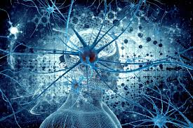
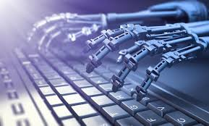
Computers might begin to perform unspecified tasks due to superintelligence

Slide 16
Conclusion
As we move into the future, various developments are expected to take place as highlighted in the article.
Observably, some of the developments would be beneficial in enhancing the development of the human race while others may result in disastrous consequences to human existence.
For instance, as observed, better healthcare through the use of machines and artificial intelligence is the major aim as humans go into the future.
However, based on the observations from the article, computers would significantly assist humans in achieving their main objective of the cure for everything, however, researchers have demonstrated that if the computers too intelligent, their existence may produce harm to the harm.

Slide 17
References
Computer scientists: we wouldn't be able to control super-intelligent machines: new findings from theoretical computer science. (2021). Retrieved 31 January 2021, from https://www.Sciencedaily.Com/releases/2021/01/210111112218.Htm
Russell S. (2019). Many experts say we shouldn’t worry about super intelligent AI. They’re wrong. Retrieved from: https://spectrum.Ieee.Org/computing/software/many-experts-say-we-shouldnt-worry-about-superintelligent-ai-theyre-wrong
Muro, M., Maxim, R., & Whiton, J. (2019). Automation and artificial intelligence: how machines are affecting people and places.
Opria, d. I. Benefits & risks of artificial intelligence. In збірник наукових матеріалів ХХІ міжнародної науково-практичної інтернет-конференції el-conf. Com. Ua (p. 66).
Tai, m. C. T. (2020). The impact of artificial intelligence on human society and bioethics. Tzu-chi medical journal, 32(4), 339.
Grace, k., Salvatier, J., Dafoe, A., Zhang, B., & Evans, O. (2018). When will AI exceed human performance? Evidence from AI experts. Journal of artificial intelligence research, 62, 729-754.
Lizzie’s century. Retrieved from: https://archive.Macleans.Ca/issue/20051010#!&Pid=86

