Slide 1
BRINGING BACK OLD AMERICANS INTO THEIR HOMELAND
INSTITUTION AFFILIATION
STUDENT’S NAME
DATE

Slide 2

Bringing back old Americans back to their land
During the colonial period, most of the Americans dispersed to many parts of the world. This article, therefore, presents the need for bringing back a group of Americans to support the activities to their homeland.

Slide 3
Importance of modern elders
https://encore.org/ (Links to an external site.)
They help in the economic advancement of the country because they also make significant contributions especially in taxations
Most of them have experience in working thereby can pass their skills and knowledge to others who are new in the job.

Slide 4
They also help in maintaining the balance primarily in the supply of goods to various age groups.
Most of them have complete life experience, and they advise the growing population on various life challenges and how they can overcome them.
They provide volunteering activities easily than another age group of the population.

Slide 5
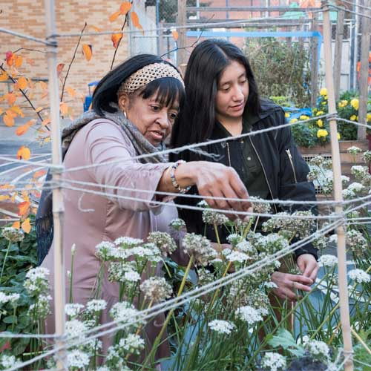
Elderly mobilizes young to thrive in their adulthood life by encouraging them to engage in various activities such as farming.

Slide 6
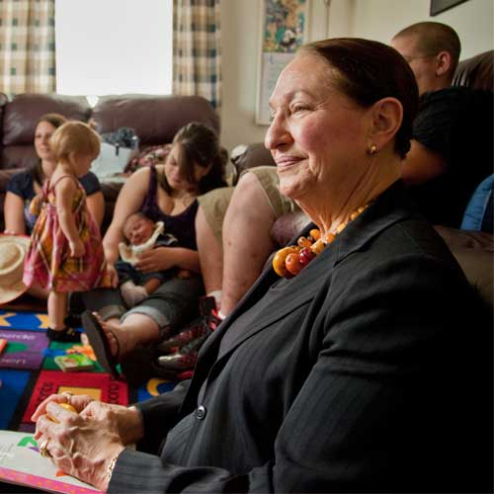
Participates in extra performance of duties with respect to their professionalism because of their experience and technical skills.

Slide 7
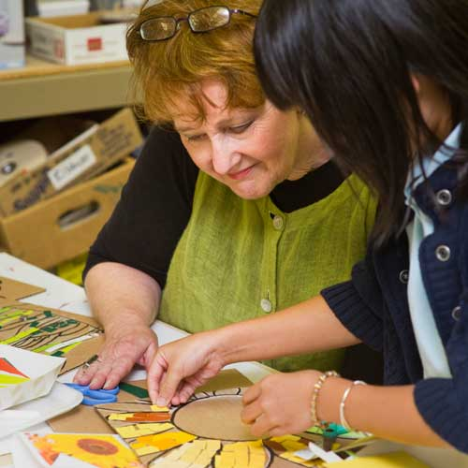
Pass cultural transmission from old generation to new generation, impart them with creativity, innovation and leadership skills.

Slide 8
REFERENCES
https://encore.org/ (Links to an external site.)

