Slide 1
Popular culture in Sri Lanka
Name
Institution
Date

Slide 2
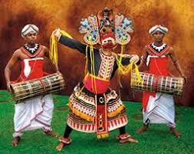
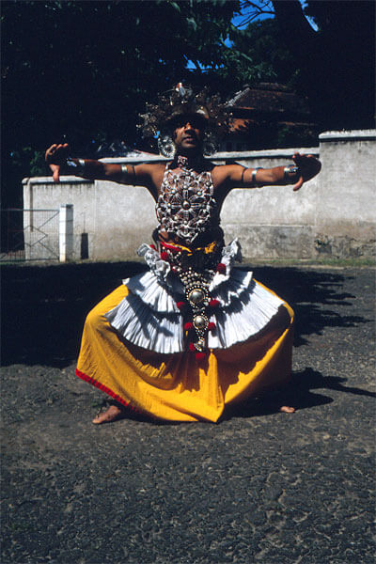
The Kandyan dance in Sri Lanka
Images of Sri Lanka Traditional dances
The Kenyan dance is the most popular dance in sir lance. This is the dance that is considered as a traditional classical dance in sir lance. This dance involves mostly male dancers. This particular dancing style was derived from southern India. In this great dance, footwork is engaged alongside leaping and whirling. It has the repertoire which is vast which originated from an indigenous ritual dance of ancient times. Traditionally, Kandy, a dance was taught by gurus and guru lineage, and it allowed some changes in dancing techniques. However, it was not until the 1950s when formulated dancing and method of teaching the dancers were used. The dance has a bent as one of the basic poses with legs in a much-opened position with the arms at the shoulder, and the fingers stretched forward.

Slide 3
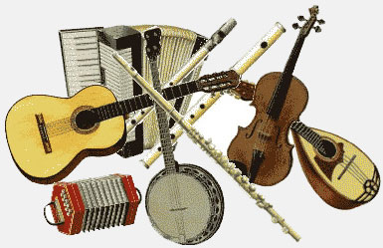
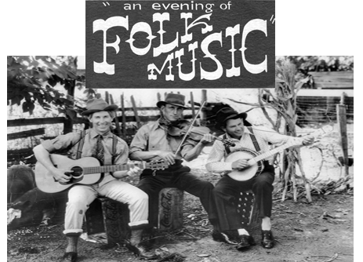
Sri Linaka Folk music
The music in Sri Lanka forms its roots in folk rituals, traditional religion for the Buddhist, European colonization legacy and the commercial influence from the Indian culture.
The music in this country is considered as indigenous music which stands as folk and traditional music. This music focuses on the use of drums and singing aspects. The music is mostly associated with melodies of local origin. The songs here share similar repertoire like those of themes. There is no fixation of either a verse or melody. One song can be made used in different tunes from different musicians and at different times. The music takes the form of Sinhala folk poetic recitation. One theme can use in different songs. Little adjustments fortune is made for the words and rhythm to fit a given song.

Slide 4
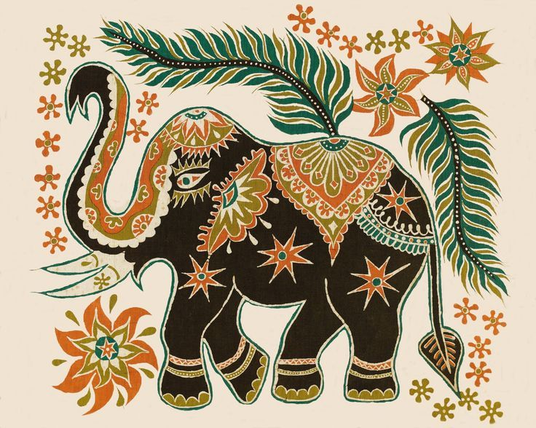
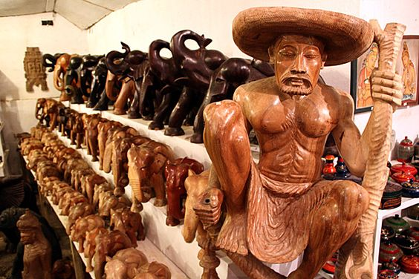
Sculpture and Sainting in Sri Lanka
This art is mostly characterized by woodwork, carving and painting. The artist makes use of a wooden material and curves it to the desired object. The size of the curving material is what determined the size of the curving. Use of different colors paints the curving. In Sri, Lanka arts has been evolving with time. It is considered as the crossroad for trade, and cultural exchange of east and west of this country with India and China proved to be the political and exuberance that influences art as Sri Lanka as pop culture.
22

Slide 5
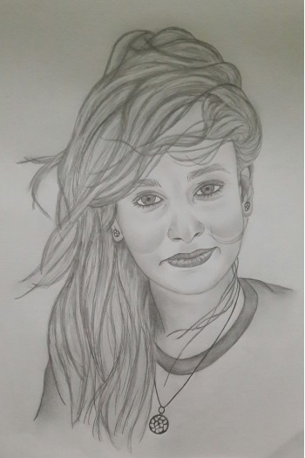
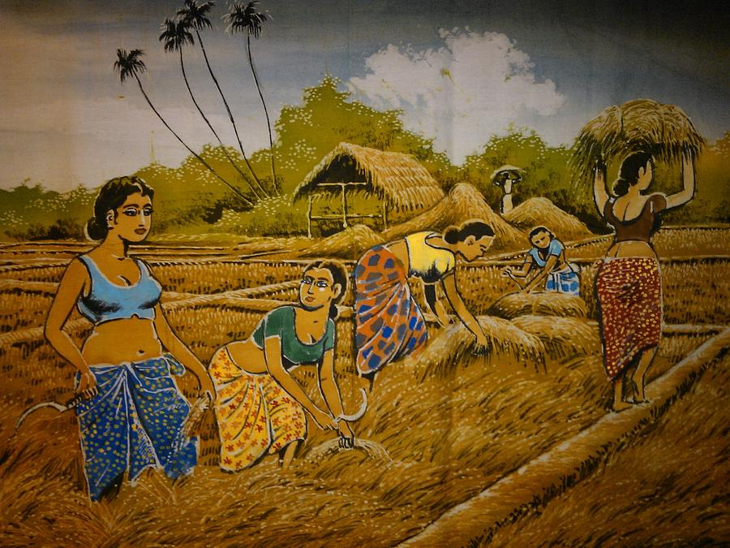
The Sri Lanka Art of drawing
The art of drawing is more pronounced in Sri Lanka. The picture is done by use of original pencils and an ugly piece of paper. The movie is mostly drawn to show most of the economic activities done by the people in the country as shown in the second image (Wijesinghe and Brewer, 2018). The drawing is done about the required size and orientation where the artist uses a brush, pen, and dyestuff. The artist endeavors pen drawing artwork which is executed in part within and pen on a plain paper. The artist, in this case, focuses on using pen drawing as a linear technique in image making. In Sri Lanka, most of the artist do pen drawing in supplementing their outline alongside tonal suggestion about three dimensions.

Slide 6
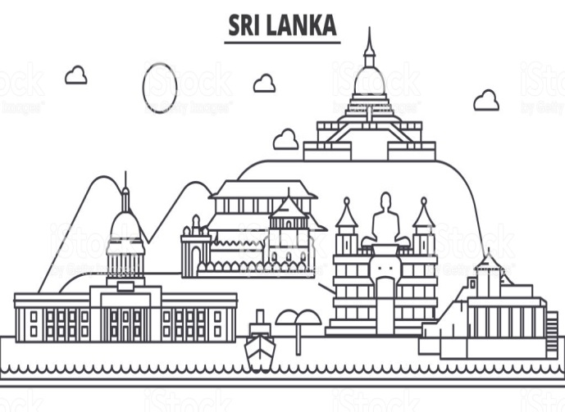
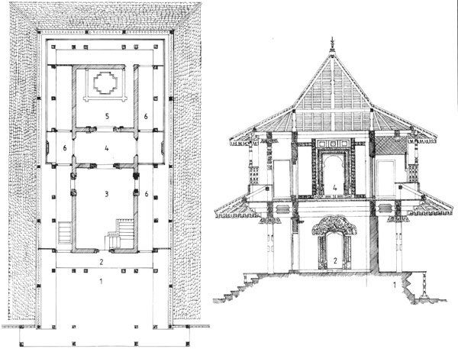
The Architectural art in Sri Lanka
Image 1
Image 2
Image 2
  The architectural art of Sri Lank is revolved around the culture of Indians which has majorly impacted the arts and crafts in Sri Lanka as Country. The Indians who were Buddhist in 3rd century B.C are the ones Buddhism which turned to be of culture in this country. The architecture in Sri Lanka is based on the religious beliefs. Most of the architecture like image one and two shows a representation of place of worship which are temples and shrines of Hindu Tamils.The architecture as art in Sri Lanka has developed and influenced by the occupation of Portuguese, Dutch and British in their land. The legacy of colonization left the ancient building which affected and enhanced the art of architecture in Sri Lanka. In this country, different culture has been intertwined in the creation of its cultural heritage as evident in their architectural design.

Slide 7
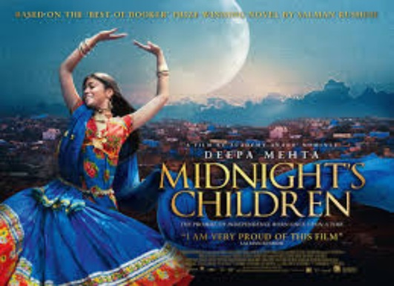
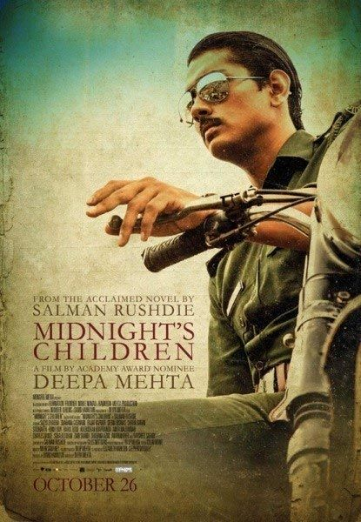
Movie as a pop culture in Sri Lank
Image 1
Image 2
The two images are the covers of the midnight children movies in Sri Lanka. In Sri Lanka, the film has stood one of the popular cultures. Mid-night children, Sinhala and Gemini movie, is a sample movie in this country which is a recent release.
The film in Sri Lanka focuses on real stories. Besides, there is a couple of action series that shows how Movie as pop culture is full of humor (Wijesinghe and Brewer,2018). The movies present both cultural and historical events in Sri Lanka. The art of film in Sri Lanka has followed most of the conventional Indian cinema. The filmmaking in this country is accompanied with some paramount storyline adopted from Indian culture.

Slide 8

Clothing an popular culture in Sri Lanka
An Image of a weeding clothing
In Sri Lanka
Clothing is a popular culture that is linked to the lifestyle, and it is done in fulfilling the needs of people. Different types of clothing have various meanings.
In Sri Lanka, clothing is considered as one way of communication and as such people in Sri Lanka holds a belief that, people’s body and clothes always speak (Malaviya, 2018). Different costumes are used in various events. Clothing as and popular culture in Sri Lanka has been adopted and designed to meet changed circumstances. This culture has defined clothing for occasions like wedding and burial ceremonies.

Slide 9
References
Malaviya, S. (2018). Madurika Rasaratnam. Tamils and the Nation: India and Sri Lanka Compared.
Wijesinghe, S. L., & Brewer, J. D. (2018). Peace Religiosity and Forgiveness Among War Victims in Sri Lanka. In The Sociology of Compromise after Conflict (pp. 129-155). Palgrave Macmillan, Cham.

