Slide 1
Chapter 15: Health, Population, and Environment

Slide 2
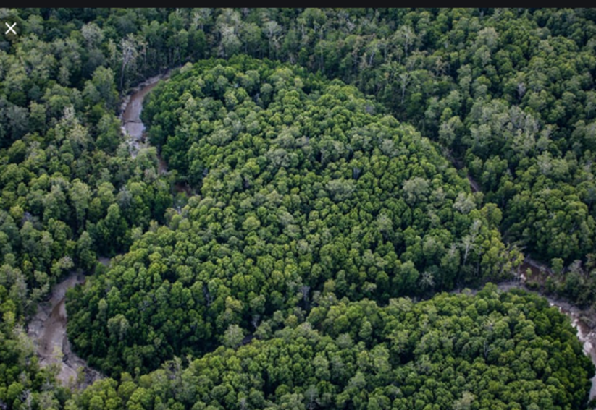
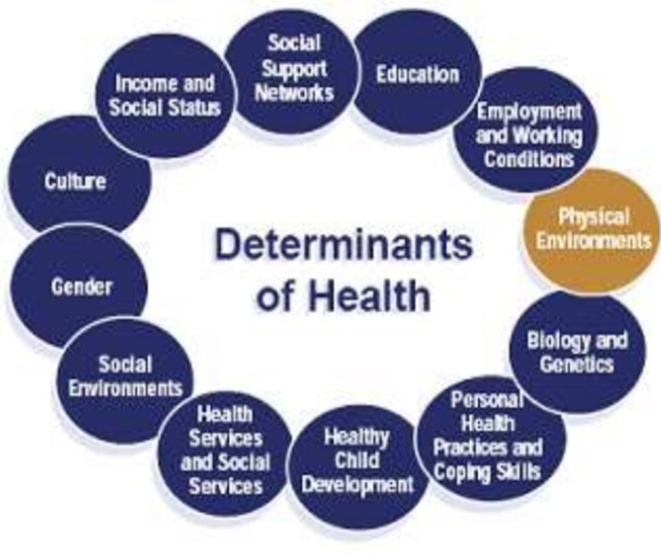
Introduction
Health
Health is a state of full mental, physical, and social well-being and just the infirmity disease absences.
It has concentrated on all health elements
It consists of social adaptability, physical fitness, and mental alertness.
Population
Environment
In environmental health, population is all living things of similar species or classes that have the interbreeding capability and live in a specific geographic location.
Everything around us is environment
It can be non-living (abiotic) things and living (biotic) things
Abiotic and biotic things interact constantly
Notes:
There are deep relationships between health, environment, and population. The topics are not only associated with one another but also to other significant elements, which are essential for keeping health, population, and environment in close-knit relationships. Over one billion people dwell in environmental hotspots, the majority of which are rural communities of crucially significant biodiversity under extreme pressures from human activities. Usually, conversation work is situated in remote regions to safeguard the surviving biodiversity. The communities in remote places in developing countries typically suffer from poor health due to limited access to family planning or health services.

Slide 3
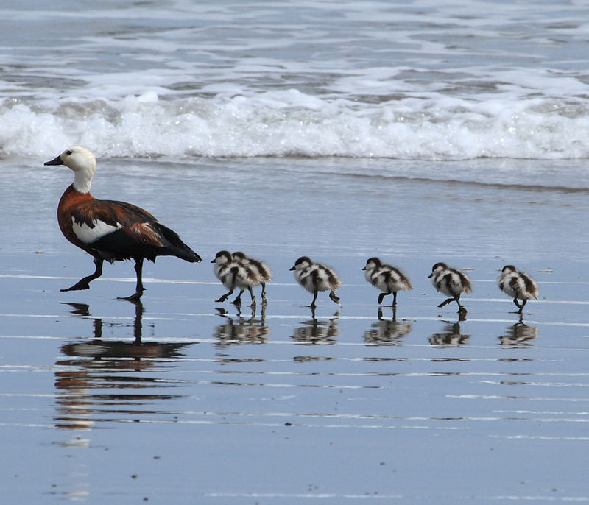
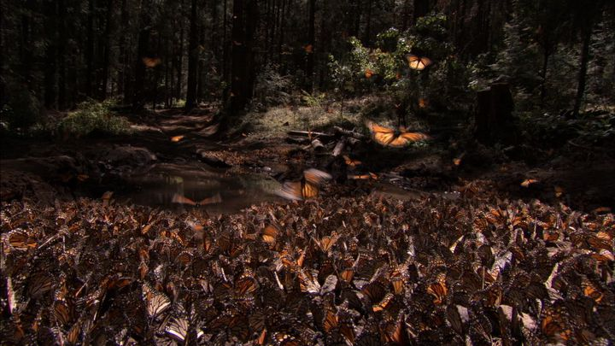
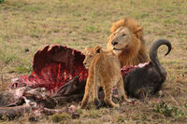

Animal behavior;
is everything that animals do including movements, underlying mental processes and other activities
Such behaviors help animals to survive, interact in social groups, avoid predators and to reproduce
Some of the animal behavior include;
Imprinting
Migration
Predation
Epigenesis
Its a form of learning in which very young animals fixes on the first object that it sees. it has been intensively studied in birds.
This is a long-distance movement of individual animals usually on a seasonal movement. This is found in in all major animal groups.
it is an animal behavior which capture and killing of animals for food. predatory animals are mainly carnivorous.
it is a type of behavior which shows how nurture shapes nature where nature is the biological hereditary
Notes:
Also, the villages seem to suffer from poor sanitation, nutrition as well as water supplies. Livelihoods in remote areas rely on small-scale agriculture and natural resources that can compel the communities to unsustainably using natural resources due to pressure like health issues and the rapid growth of population. This can be damaging to biodiversity and ecosystems in remote areas. The health people conversely depend on their environmental health. The ecosystems of their surroundings offer them services and products like building materials, fuelwood, medicine, food, water, and other resources. The disruption or damage to natural services and goods can have extreme implications for human health.

Slide 4
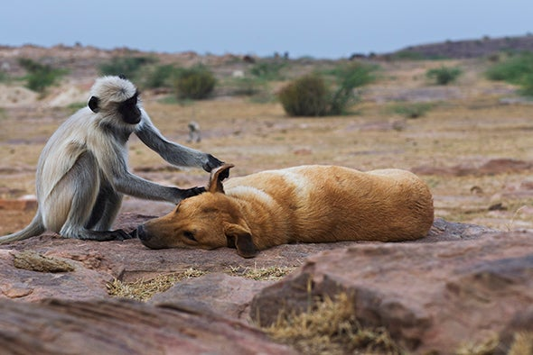
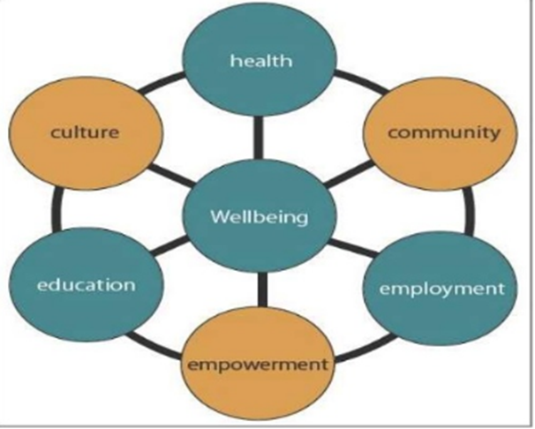
Importance
Areas of Study
The Health, Population, and Environment importance
Health, Population, and Environment is an approach to human developments
It integrates health and family planning with efforts of conservations
It seeks synergetic success for higher results of human well-being and conversation than a single-sector approach
Sociological viewpoints on health and diseases
Social epidemiology and health
Healthcare in the U.S
Definition of mental illness
Population
Migration
Sociological views on the environment
Environmental issues
Environmentalism: Social policies and environment
Positive health attainment
Environment preservations
Superstition beliefs eradication
Mortality rate reduction
Productions of efficient and capable human resources
Notes:
Projects which take health, population, and environment approaches operate to establish healthier ecosystems and communities. To improve participation in the efforts of conservations, the projects aim to bring better services of health to rural areas. Besides, the projects of health, population, and environment foster services of family planning to assist in reducing the growth of the population, which can place pressures on natural resources. That implies approaches of health, population and environment strive to concurrently enhance health services access while assisting the areas in managing their natural resources in ways that improve livelihood and health even as they conserve the ecosystem.

Slide 5

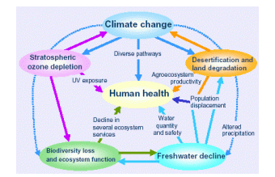
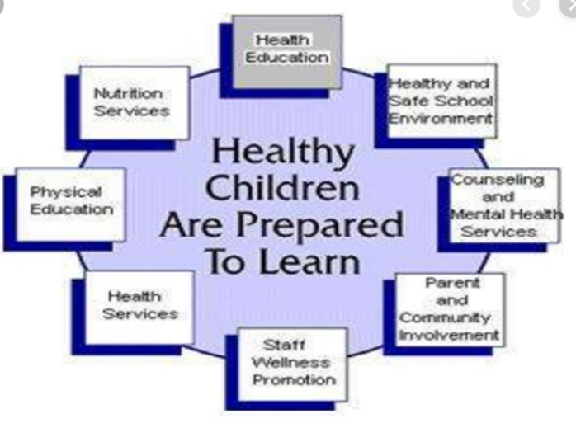
The different elements of health, population, and environment
The following are the various elements of health, populations, and environments that indicate the relationships among them
Psychological
Political
Science and technology
Socio-cultural
Economical
Biological
Physical
In environmental health,
Notes:
The health, population, and environment approach beyond this target synergies between environmental and human health that include conservation and broad development spectra like restoring and maintaining ecosystem and habitats functions, food nutrition and security, enhancing livelihoods, and sustainable natural resources management. The approaches of health, population, and environment conserve biodiversity by focusing the synergies between the communities and their habitats while at the same time enhancing the conditions of the setting for the rural people. Health, population, and environment are effective at achieving a wide variety of positive outcomes over various industries.

