Slide 1
1) In your own words, what was the key conclusion of the article?
2) Do you believe the conclusions? Why or why not?
3) Do you approach major decisions in your own life in a similar manner?
4) Will this research impact your approach to major decisions moving forward?

Slide 2
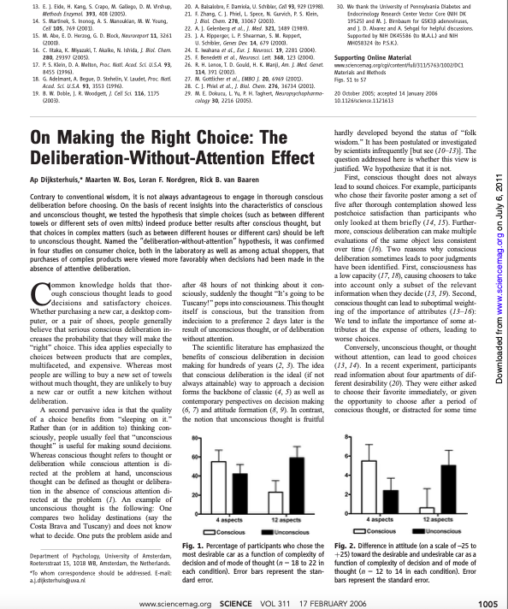

Slide 3
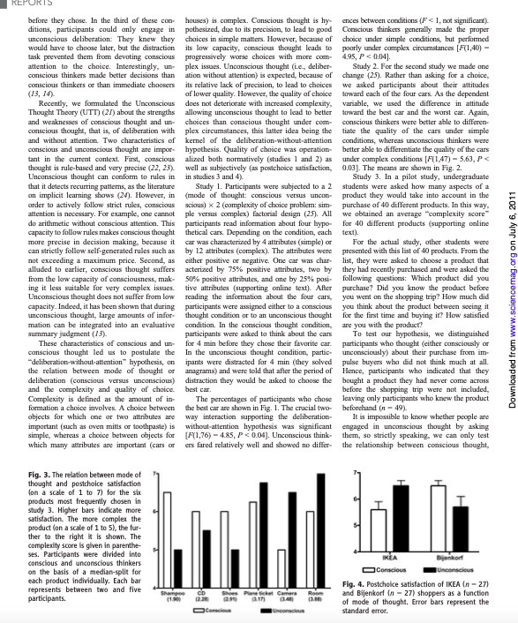

Slide 4
