Slide 1
Presentation
Civil Engineering

Slide 2
Communication
Definition of Communication
Two-way process
Delivering of the message
Sender and receiver
Notes:
Communication is a two-way process, and in case any stage in the process breaks down, there shall be the failure in communication. Communication refers to the act of relaying intended messages and information and the comprehension of the information from one party to another (Castells, 2013). The term communication originates from the Latin word “Communis” that simply to share. Communication is a two-way process where the information and messages in the form opinions, feelings, thoughts, and ideas are transferred between two or more parties with the intention of establishing a mutual understanding. Communication is said to be effective and efficient when the messages and information relayed by the sender are decoded and comprehended by the receiver in the exact way the sender intended.

Slide 3
Communication process
Definition of communication process
Dynamic process
Signal
Channel of communication
Notes:
Communication is a dynamic process which starts with the conceptualization of the ideas, thoughts, feelings, and opinions by the sender who then sends the information or messages through appropriate channel to the receiver. Upon receiving the information or message, the receiver decodes the information and provides a feedback to the sender in form of a signal or some of the message within a stipulated period of time. Therefore, communication process has seven major elements as shown the flow diagram below:

Slide 4
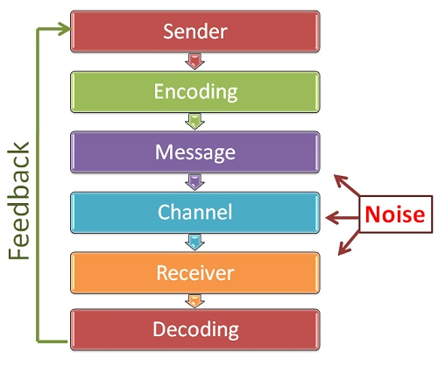
Communication process
Notes:
The communicator or the sender is the individual who conceptualizes the idea and initiates the conversation that he /she intend to pass to others. The sender encodes the message in form words or non-verbal methods such as body gestures, signs and symbols, in translating the information to the message (Castells, 2013). The success of the message depends on the competencies, background, perception, skills, and knowledge of the sender. The message is obtained by the sender once the encoding process is completed. The message can be non-verbal, oral or written and should trigger the response of the receiver. The message is then relayed using appropriate communication channel or medium such mobile phones, gesture, face to face communication, written emails. The medium must be chosen carefully to ensure the effectiveness of the message and the correct interpretation of the message by the recipient. The receiver is the individual whom the message is targeted or intended to. Upon receiving the message the recipient tries to decode or interpret the message so that he/she can understand the meaning of the message in the best way possible (Ruggiero and Vos, 2014). Once the receiver understands the message, he or she gives feedback to the sender as a response.

Slide 5
Emails, phone calls, text messages
Tone of voice
Facial expression
Interpreting the information
Notes:
Emails and phone cells text messages are often misunderstood. First and foremost, the lack cues such as tone of voice and facial expression that makes it difficult for the receiver to interpret the meaning of the message as required. Secondly, the instantaneous communication prospect develops an urgency which pressures the senders to imagine and write faster that can result in carelessness (Biocca and Levy, 2013). Finally, the inability to create personal over e-mails and phone cells text messages makes the relationship between the sender and receiver fragile in the conflict face.
Text messages and emails can easily get lost in translation because of misreading the emails and text messages. Some emails and texts are misunderstood because some feelings get misconstrued and other thoughts get humorously twisted. It is also possible that some people react quickly to text messages and emails without taking their time to read and interpret the information. Some react without considering how the texts or emails may be read or what meaning may come out from the message if it is correctly decoded and therefore it is improper to simply react before we think and interpret the information or messages in the emails or texts.

Slide 6
Emails, phone calls, text messages
CONTI
Digital platforms
Vital verbal clues
Interpretation of the messages
Notes:
The texts and emails, for all purposes as well as intents, have become their own language. When people communicate via the digital platforms such the emails or texts rather than voice to voice or face to face, the vital verbal cues that assist us in understanding, processing, and responding correctly to what is being communicated to us is missed out (Ruggiero and Vos, 2014). Texts and emails lack human senses, body language to read, and frowns or smiles to acknowledge and clue us into the way the individual relaying information to us may be feeling or what the intended meaning of the communication may be. The emails and texts interpretation may rely on the circumstances, experiences, emotional attitude and the day of the recipient of the message. The interpretation of the message would, therefore, depend and rely on the receiver because direct human contact is lacking.
It can be very easy to make assumptions and jump to conclusions as the receivers struggle to interpret emails and texts (Castells, 2013). The receiver may read into an email or a text with a mind that the sender meant one thing, when, maybe, the sender may have implied another meaning altogether. The receiver may misread the meaning simple comments, may be initially intended as a joke.

Slide 7
References
Biocca, F., & Levy, M. R. (Eds.). (2013). Communication in the age of virtual reality. Routledge.
Castells, M. (2013). Communication power. OUP Oxford.
Ruggiero, A., & Vos, M. (2014). Social media monitoring for crisis communication: process, methods, and trends in the scientific literature. Online Journal of Communication and Media Technologies, 4(1), 105.

