Slide 1
Advanced Spreadsheet Modelling & Programming for Business
Stock Price and Price Path Simulation

Slide 2
Simulation
Simulation is a modeling tool which is used to imitate a real-world process in order to understand system behavior.
The true behavior of a system is estimated using distributions.
Random numbers from these distributions can be generated to evaluate multiple strategies and predict future performance.

Slide 3
Defining Simulation
Simulation is a software-generated display of a process which one wants to observe.
Simulation is a useful tool for analyzing how a set of actions functions under different parameters or settings.
It benefits from trial and error without the cost of materials, labor and time that would be necessary to observe the same results on the original process.
Simulation differs from optimization in that it does not aim to find the best result for some given inputs.
Rather, it seeks to find the best inputs given a desired result by running several trials of a particular scenario.

Slide 4
Working with Distributions
Simulation is useful because it can handle variability of parameters in a model.
That is, we cannot know many settings in a process with full certainty; there is usually some range of numbers into which values fall but we can not know exact numbers.
Thus, we use distributions and random numbers.

Slide 5
Generating Random Numbers
Some Excel functions can be used to generate various input data values for several scenarios, or runs of a simulation.
Once we know the distribution of a certain parameter, we can generate random numbers within this distribution create the simulation.

Slide 6
Generating Random Numbers (cont)
The RAND and RANDBETWEEN functions are used to generate random numbers in Excel.
The RAND function does not have any parameters; it returns a randomly chosen fractional number between 0 and 1.
  =RAND()
You can manipulate this RAND value if you want to generate values outside the interval between 0 and 1.
  =RAND()*(n-1) + 1

Slide 7
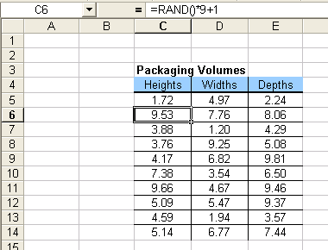
RAND Example
To generate heights, widths, and depths to calculate some probable packaging volumes, we create random numbers between 1 and 10.
  =RAND()*9 + 1

Slide 8
Generating Random Numbers (cont)
To generate a random integer, use the INT function with the RAND function.
The INT function rounds a number down to the nearest integer.
  =INT(number)
  =INT(range_name)
  =INT(cell_referenced)
To generate random integers, we would apply the INT function to the RAND function by typing:
  =INT(RAND())
  =INT(RAND()*(n-1) + 1)

Slide 9
Generating Random Numbers (cont)
The RANDBETWEEN function takes two parameters, which are the lower and upper limits of a range.
  =RANDBETWEEN(lower_limit, upper_limit)
To create random numbers between 1 and 10, you could type
  =RANDBETWEEN(1,10)

Slide 10
Generating Random Numbers (cont)
To generate a random number from a particular distribution, we can use Excel’s inverse distribution functions.
The general distribution Excel function is
  =DIST(x_value, distribution_parameters, cumulative_value)
The general inverse distribution Excel function is
  =DISTINV(probability, distribution_parameters)

Slide 11
Generating Random Numbers (cont)
We will use the RAND function as our value for the probability parameter to generate some number between 0 and 1.
For example, to generate random numbers from the Normal distribution, we would follow the format:
  =NORMINV(RAND(), mean, std dev)
This inverse distribution function can be similarly used for other distributions:
  BETAINV
  BINOMINV
  LOGINV

Slide 12
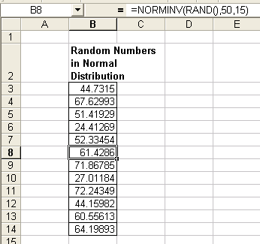
NORMINV Example
We generate a set of numbers from the Normal distribution with mean 50 and standard deviation 15.
  =NORMINV(RAND(), 50, 15)

Slide 13
Random Numbers and Distributions
We use the RAND function in Excel to generate random numbers.
The general distribution functions in Excel have the following format
  =NORMDIST(x_value, mean, std_dev, cumulative_value)
The x-value is the number for which we are calculating the distribution.
The cumulative value is TRUE if we use the cumulative distribution function (cdf), or FALSE if we use the probability mass function (pmf).

Slide 14
Rand Num and Dist (cont)
To generate a random number within a given distribution, we must use the inverse distribution functions.
The format of these inverse distribution functions is the following
  =NORMINV(probability, mean, std_dev)
The probability parameter is a number between 0 and 1 associated with the given distribution.

Slide 15
Rand Num and Dist (cont)
We will use the RAND function as our value for this parameter to generate some numbers between 0 and 1.
For example, to generate ten random numbers in the Normal distribution, we would follow the format.
  =NORMINV(RAND(), mean, std dev)

Slide 16
Simulating Future Stock Prices
The stock price Pt at any time t in the future is related (via Ito’s lemma) to the current price P0 by
Pt = P0 * exp[( μ - .5σ^2)*t + σ * Z * √t]
μ ~ mean percentage growth rate of the stock
σ ~ standard deviation of the growth rate
μ and σ are expressed as decimals (i.e. 6% => 0.06)
Z ~ N(0,1) i.e. standard normal random variable
- all units are measured with respect to a common time unit (i.e a year)
When simulating future stock prices, the growth rate, μ, is the stock’s growth rate

Slide 17
Stock Price Simulation
Construct a dynamic histogram of the simulated stock prices.
1) In cells H3 and H4 put the respective values “20.00” and “22.50” and change their dollars to percent.
2) Select both cells, put the cursor on the bottom right corner until it turns to a “+”, and drag down until the series reaches “75.00”.
3) Now place an array formula into cells I3:I25. Click into cell I3 and drag down through I25. In I3 enter the formula: “=Frequency(B20:B4019,H3:H25)”,
BUT DO NOT PRESS THE ENTER KEY
Holding down, simultaneously, the “Ctrl”+ “ Shift” now hit the “Enter” key to enter the array formula into the range

Slide 18
Stock Price Simulation
Now, every time you press the F9 key to re-run the Data Table, the updated frequencies will be reflected in the table.
Now add a histogram figure to visualize this output.
1) In the “Insert" ribbon, “Charts" section, select “Column” and “Clustered Column”
2) Either right click on the chart and choose Select Data or Design Ribbon>Data>Select Data.

Slide 19
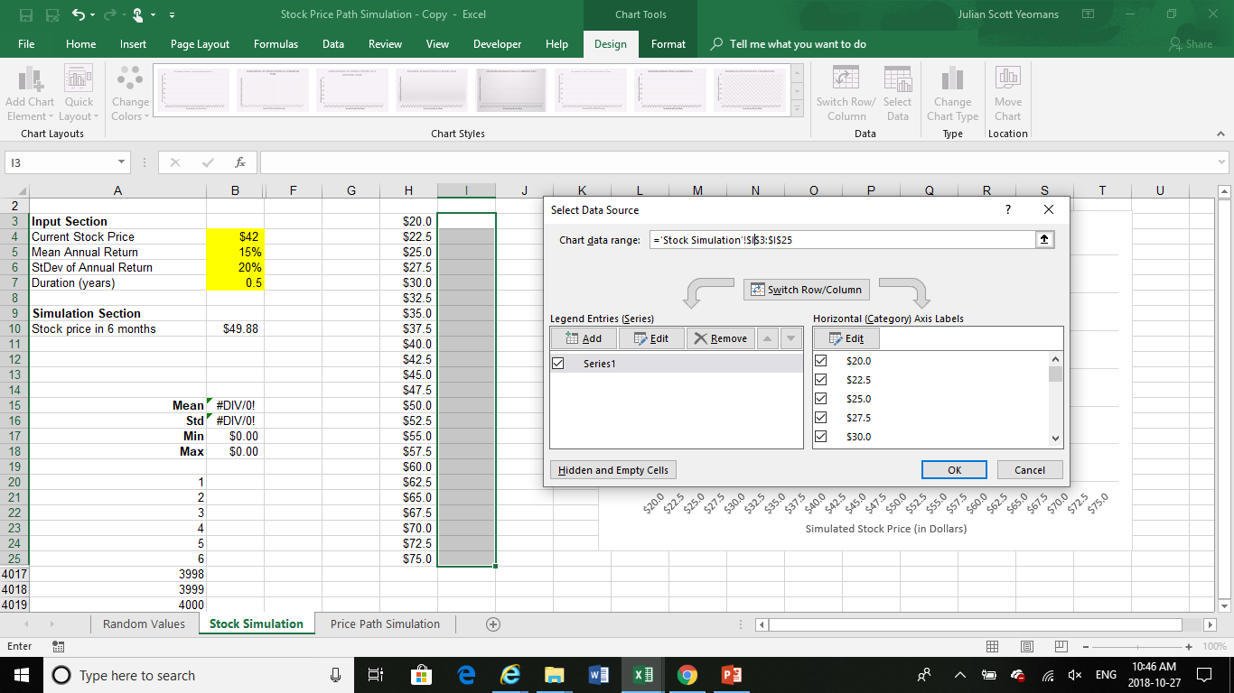
Stock Price Simulation
3) Enter the range I3:I25 as the Legend Entries (Series)

Slide 20

Stock Price Simulation
4) Edit the Horizontal (Category) Axis Labels and enter the range H3:H25

Slide 21
Stock Price Simulation
5) Layout Ribbon>Labels and enter appropriate title and axis labels.
Chart Title> Above Chart. “Simulation of Stock Prices in 6 Months Time”
Axis Title>Primary Horizontal Axis Title>Title Below Axis. “Simulated Stock Price (in Dollars)”
Axis Title>Primary Vertical Axis Title>Rotated Title. “Stock Price Frequency in 4000 Simulations”

Slide 22
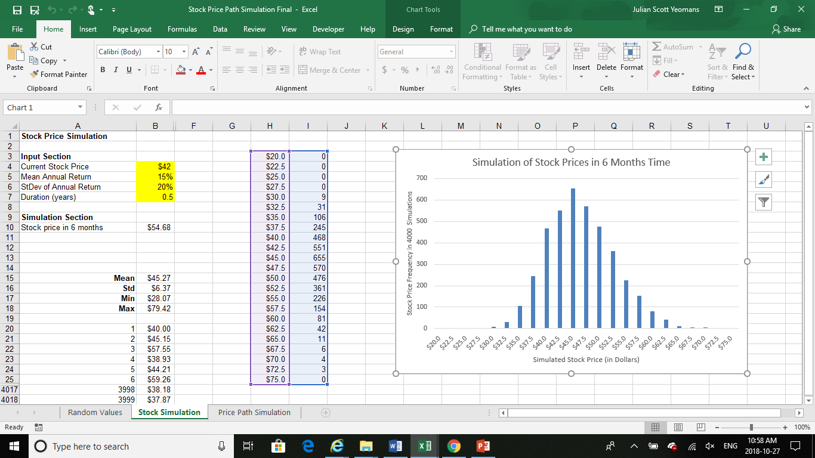
Stock Price Simulation
6) Your dynamic chart should now look like (F9 key):

Slide 23
Stock Price Path Simulation
In evaluating securities, you may require a knowledge of the price throughout the entire period of the security
(not just at one future point in time)
Note that the security price at any point in time will logically depend upon the price at the point in time immediately preceding it
This implies the “path dependent” nature of the security pricing

Slide 24
Path Dependent Stock Price Simulation
In generating a path of stock prices, again use the formula:
Pt = P0 * exp[( μ - .5σ^2)*t + σ * Z * √t]
For path dependent stock pricing,
the stock price at time t, Pt,
is generated using
the stock price at time t-1 instead of P0
Namely:
Pt = Pt-1 * exp[( μ - .5σ^2)*t + σ * Z * √t]

