Slide 1
Social Responsibility and Ethics in Marketing
Chapter 4

Slide 2
Learning Objectives
LO 4-1 Define the four dimensions of social responsibility.
LO 4-2 State the importance of marketing ethics.
LO 4-3 Describe the three factors of ethical decision making.
LO 4-4 Comment on the requirements for improving ethical decision making.
LO 4-5 Critique the role of social responsibility and ethics in improving marketing performance.

Slide 3
The Nature of Social Responsibility
Social responsibility – An organization’s obligation to maximize its positive impact and minimize its negative impact on society
Social responsible activities can:
  Improve employee performance
  Improve customer loyalty to the organization
  Generate positive publicity
  Boost sales
  Socially responsible efforts:
  Attract goodwill, publicity, and potential customers and employees
  Generate indirect long-term benefits such as greater employee commitment and improved business performance

Slide 4
Table 4.1 – Best Corporate Citizens
 | Best Corporate Citizens
1 | Hasbro, Inc.
2 | Intel Corp.
3 | Microsoft Corp.
4 | Altria Group Inc.
5 | Campbell Soup Co.
6 | Cisco Systems, Inc.
7 | Accenture plc
8 | Hormel Foods Corp.
9 | Lockheed Martin Corp.
10 | Ecolab, Inc.

Slide 5
The Dimensions of Social Responsibility (slide 1 of 3)
Marketing citizenship – The adoption of a strategic focus for fulfilling the economic, legal, ethical, and philanthropic social responsibilities expected by stakeholders
Stakeholder orientation – Understanding and addressing the needs of all stakeholders, including communities and special-interest groups
At the most basic level, all companies have an economic responsibility to be profitable so they can:
  Provide a return on investment to their owners and investors
  Create jobs for the community
  Contribute goods and services to the economy
  Engage in fair competition
  Build ethical customer relationships
Economic responsibilities require finding a balance in stakeholder interests while recognizing that a firm must make a profit to be sustainable in the long run

Slide 6
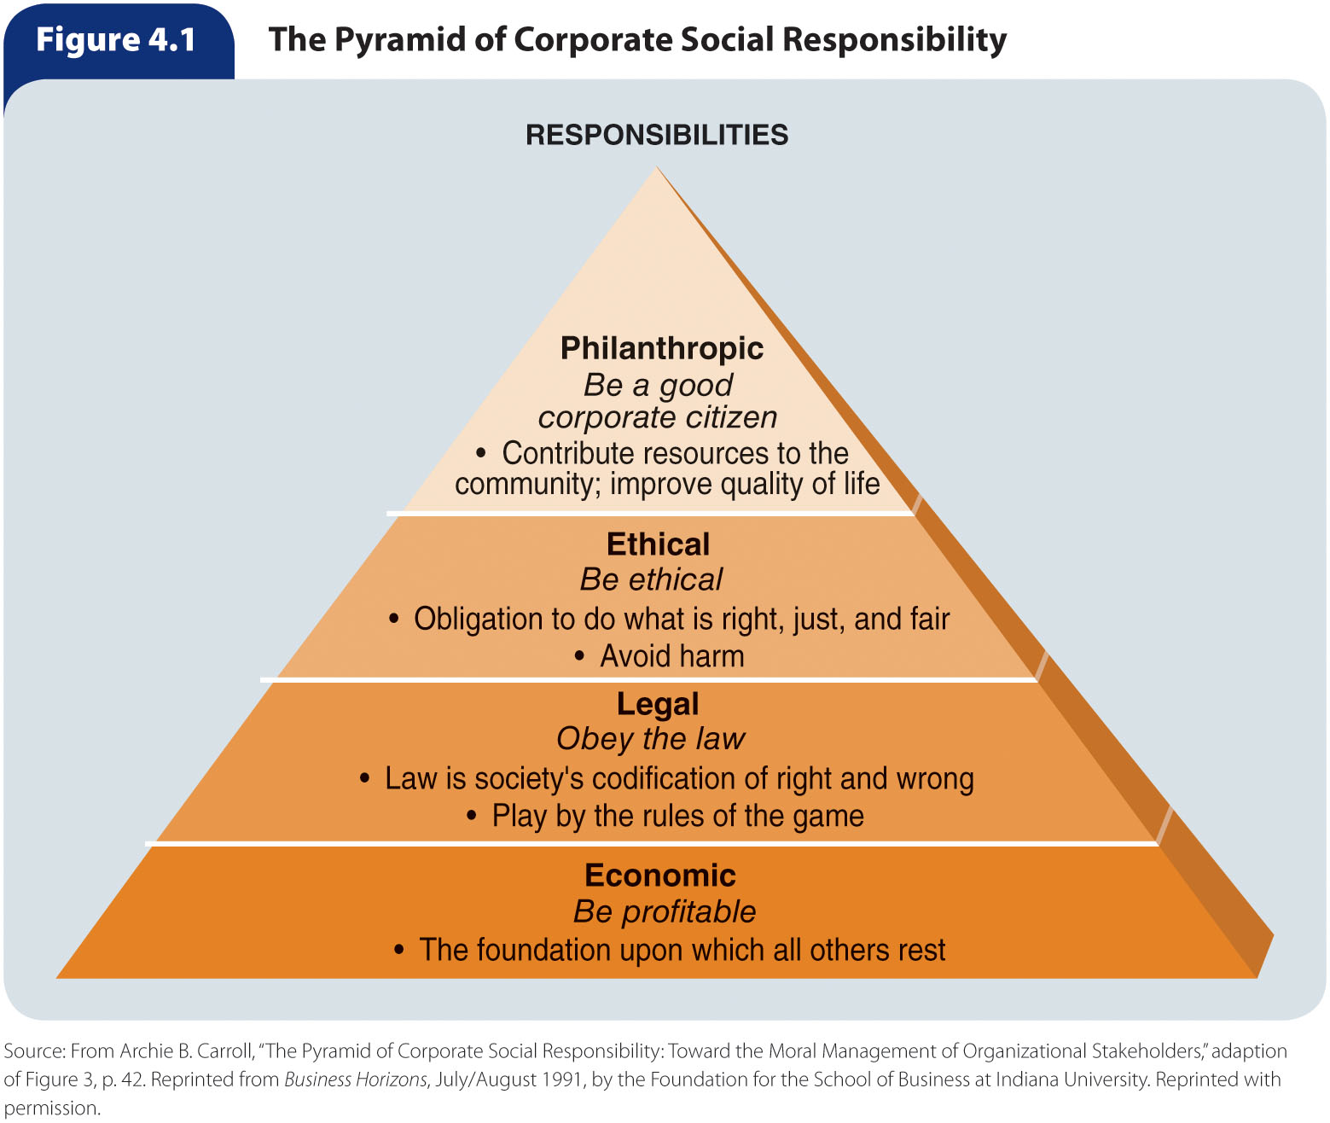
Figure 4.1 – The Pyramid of Corporate Social Responsibility

Slide 7
The Dimensions of Social Responsibility (slide 2 of 3)
Marketers are expected to follow all laws and regulations designed to keep U.S. companies’ actions within the range of acceptable conduct and fair competition
Economic and legal responsibilities are the most basic levels of social responsibility for a good reason
  Failure to consider them may mean a marketer does not operate long enough to engage in ethical or philanthropic activities
Marketing ethics – Principles and standards that define acceptable marketing conduct as determined by various stakeholders
  Stakeholders include:
    The public
    Government regulators
    Private-interest groups
    Consumers
    Industry
    The organization itself

Slide 8
The Dimensions of Social Responsibility (slide 3 of 3)
Philanthropic responsibilities are not required of a company, but they promote human welfare or goodwill
  Cause-related marketing – The practice of linking products to a particular social cause on an ongoing or short-term basis
  Strategic philanthropy – The synergistic use of organizational core competencies and resources to address key stakeholders’ interests and achieve both organizational and social benefits

Slide 9
Table 4.2 – Social
Responsibility Issues
Issue | Description | Major Social Concerns
Sustainability | Consumers insisting not only on a good quality of life but also on a healthful environment so they can maintain a high standard of living during their lifetimes | Conservation Water pollution Air pollution Land pollution
Consumerism | Activities undertaken by independent individuals, groups, and organizations to protect their rights as consumers | The right to safety The right to be informed The right to choose The right to be heard
Community relations | Society eager to have marketers contribute to its well-being, wishing to know what marketers do to help solve social problems | Equality issues Disadvantaged members of society Safety and health Education and general welfare

Slide 10
Sustainability
Sustainability – The potential for the long-term well-being of the natural environment, including all biological entities, as well as the interaction among nature and individuals, organizations, and business strategies
  Many companies are adopting eco-friendly business practices and/or supporting environmental initiatives
  Many products have been certified “green” by environmental organizations
Some environmentalists and marketers believe companies should work to protect and preserve the natural environment by implementing the following goals:
  Eliminate the concept of waste
  Reinvent the concept of a product
    Consumables
    Durable goods
    Unsalables
  Make prices reflect the cost
  Make environmentalism profitable

Slide 11

Figure 4.2 – The EU Ecolabel

Slide 12
Consumerism
Consumerism is the efforts of independent individuals, groups, and organizations to protect the rights of consumers
  Ralph Nader and others pushed for legislation requiring many car safety features such as seat belts, air bags, padded dashboards, and collapsible steering columns
  The Federal Trade Commission provides a wealth of consumer information at its website (www.consumer.ftc.gov/)
Of great importance to the consumer movement are four basic rights spelled out in a consumer “bill of rights” that was drafted by President John F. Kennedy
  The right to safety means marketers are obligated not to market a product that they know could harm consumers
  The right to be informed means consumers should have access to and the opportunity to review all relevant information about a product before buying it
  The right to choose means consumers should have access to a variety of products at competitive prices
  The right to be heard ensures that consumers’ interests will receive full and sympathetic consideration in the formulation of government policy

Slide 13
Community Relations
Being a good community citizen means avoiding harmful actions that could damage the community
A marketer can significantly improve a community’s quality of life through:
  Employment opportunities
  Economic development
  Financial contributions to educational, health, cultural, and recreational causes

Slide 14
Marketing Ethics
Marketing ethics is a dimension of social responsibility that involves principles and standards that define acceptable conduct in marketing
  These standards are determined by various stakeholders and the organization’s ethical climate
  Marketers must also use their own values and knowledge of ethics to act responsibly and provide ethical leadership for others
When marketing activities deviate from accepted standards, the exchange process can break down, resulting in customer dissatisfaction, lack of trust, and lawsuits
Trust is an important concern for marketers because it is the foundation for long-term relationships
  Consumer lack of trust has increased in recent years due to the financial crisis and deep recession
  Once trust is lost, it can take a lifetime to rebuild
The way to deal with ethical issues is proactively during the strategic planning process, not after major problems materialize

Slide 15
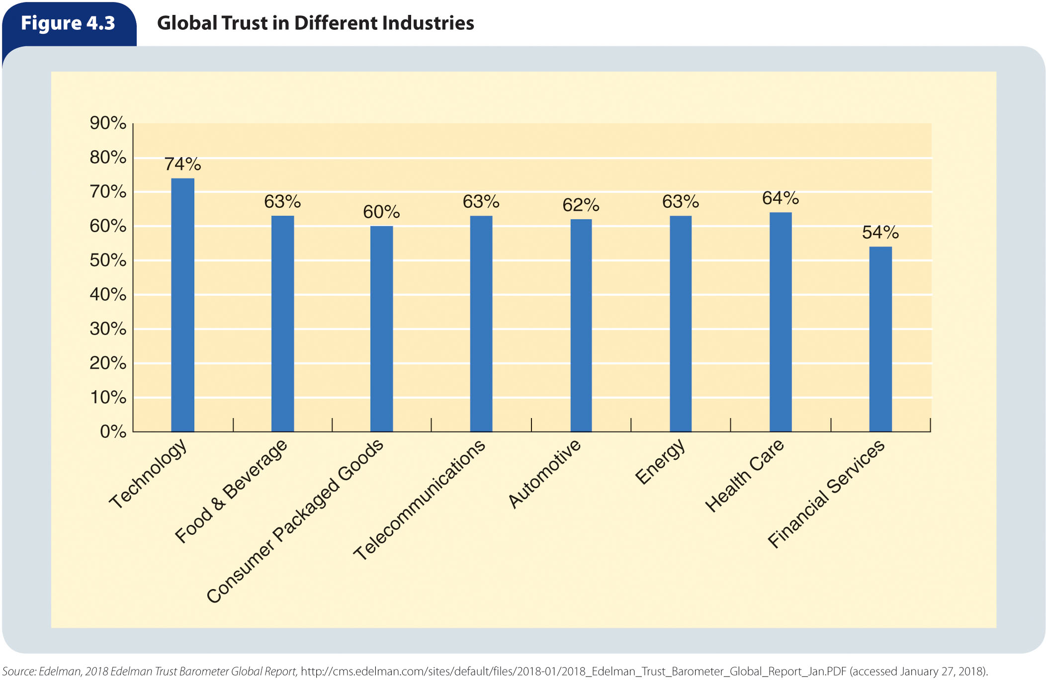
Figure 4.3 – Global Trust in Different Industries

Slide 16
Ethical Issues in Marketing (slide 1 of 4)
Ethical issue – An identifiable problem, situation, or opportunity requiring a choice among several actions that must be evaluated as right or wrong, ethical or unethical
  Any time an activity causes marketing managers or customers in their target market to feel manipulated or cheated, a marketing ethical issue exists, regardless of the legality of that activity
  Regardless of the reasons behind specific ethical issues, marketers must be able to identify and resolve these issues

Slide 17
Table 4.3 – Sample Ethical Issues Related to the Marketing Mix
 | Sample Ethical Issues Related to the Marketing Mix
Product Issue Product Information | Covering up defects that could cause harm to a consumer; withholding critical performance information that could affect a purchase decision
Distribution Issue Counterfeiting | Counterfeit products are widespread, especially in the areas of computer software, clothing, and audio and video products. The internet has facilitated the distribution of counterfeit products
Promotion Issue Advertising | Deceptive advertising or withholding important product information in a personal-selling situation
Pricing Issue Deceptive Pricing | Indicating that an advertised sale price is a reduction below the regular price when in fact that is not the case

Slide 18
Ethical Issues in Marketing (slide 2 of 4)
Product-related ethical issues arise when marketers fail to:
  Disclose risks associated with a product
  Disclose information regarding the function, value, or use of a product
  Inform customers about existing conditions or changes in product quality
    Such failure is a form of dishonesty about the nature of the product
    Product recalls occur when companies ask customers to return defective products
Promotion can create ethical issues in a variety of ways:
  False or misleading advertising
  Manipulative or deceptive sales promotions, tactics, and publicity
    Greenwashing – Occurs when products are promoted as being more environmentally friendly than they really are
  Promoting products that might be construed as harmful to children
  Bribery – Occurs when an incentive is offered in exchange for an illicit advantage

Slide 19
Ethical Issues in Marketing (slide 3 of 4)
In pricing, common ethical issues are:
  Price fixing
  Predatory pricing
  Failure to disclose the full price of a purchase
  Examples:
    Price gouging – Pricing products at exorbitant levels
    Bait and switch – A pricing scheme attempt to gain consumer interest with a low-priced product but then switching the buyer to a more expensive product or add-on service
    Quantity surcharges – Occur when consumers are effectively overcharged for buying a larger package size of the same grocery product

Slide 20
Ethical Issues in Marketing (slide 4 of 4)
Ethical issues in distribution involve relationships among producers and marketing intermediaries
  Manipulating a product’s availability for purposes of exploitation
  Using coercion to force intermediaries to behave in a specific manner
  Channel surfing – Shipping surplus inventory to wholesalers and retailers at an
  excessive rate
  Counterfeiting

Slide 21
Ethical Dimensions of Managing
Supply Chain Relationships
Managing supply chains responsibly is one of the greatest difficulties of marketing ethics
  Supply chains require constant vigilance on the part of marketers
  Marketers need to anticipate unforeseen circumstances
  Managing supply chain ethical decision making is important because many stakeholders hold the firm responsible for all ethical conduct related to product availability
Good supply chain ethics is important because it ensures the integrity of the product and the firm’s operations in serving customers
It is essential for all companies that work with global suppliers to adopt a Global Supplier Code of Conduct and ensure that it is effectively communicated to suppliers
Companies should encourage compliance and procurement employees to work together to find ethical suppliers at reasonable costs
Marketers must also work to make certain that their company’s supply chains are diverse
Companies must perform regular audits on its suppliers and, if necessary, discipline those found to be in violation of company standards

Slide 22
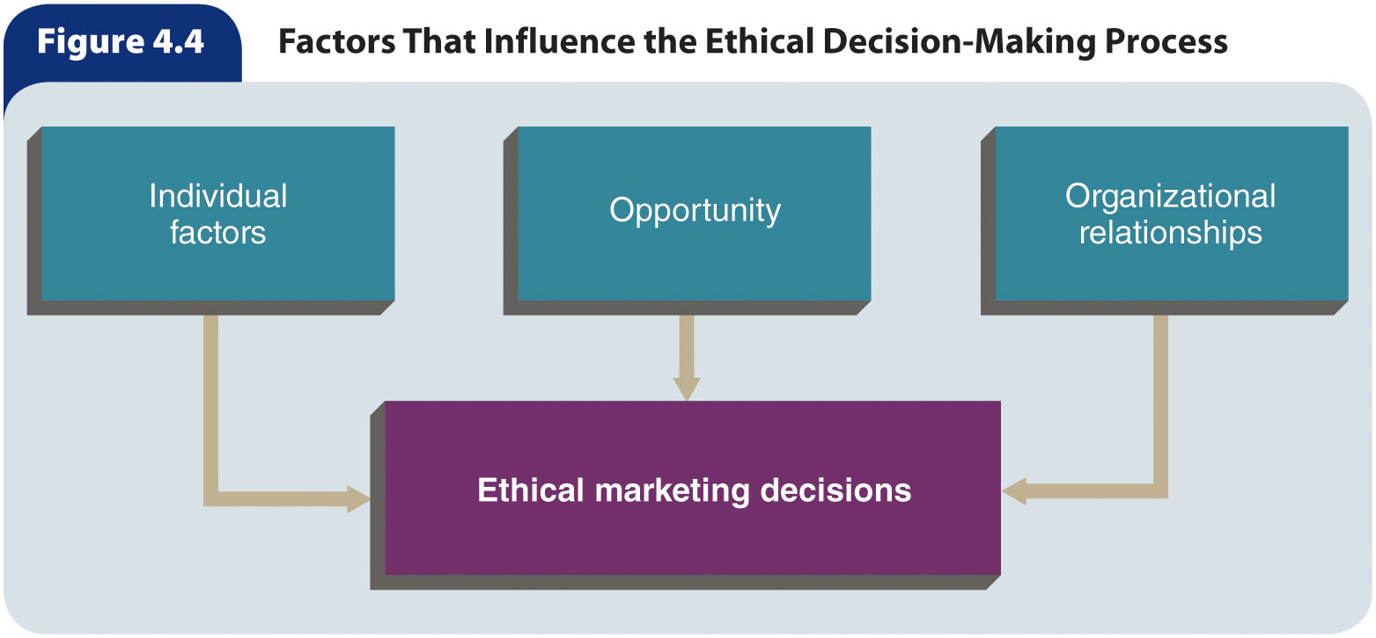
Figure 4.4 – Factors That Influence the Ethical Decision-Making Process

Slide 23
Individual Factors
People learn values and principles through:
  Socialization by family members
  Social groups
  Religion
  Formal education
Because of different levels of personal ethics in an organization, there will be significant ethical diversity among employees
An organization’s culture often has more influence on marketing decisions than an individual’s own values

Slide 24
Organizational Relationships (slide 1 of 3)
Marketing employees resolve ethical issues based not only on what they learned from their own backgrounds but also on what they learn from others in the organization
  The outcome of this learning process depends on the:
    Strength of each individual’s personal values
    Opportunity for unethical behavior
    Exposure to others who behave ethically or unethically
Organizational (corporate) culture – A set of values, beliefs, goals, norms, and rituals that members of an organization share
An organization’s culture gives members meaning and suggests rules for how to behave and deal with problems within the organization

Slide 25
Organizational Relationships (slide 2 of 3)
Formally expressed | Informally conveyed
Codes of conduct | Work habits
Memos | Extracurricular activities
Manuals | Stories
Dress codes
Ceremonies
The interaction between corporate culture and executive leadership helps determine the firm’s ethical value system
Most marketing employees take their cues from coworkers in learning how to solve problems, including ethical problems

Slide 26
Table 4.4 – Observed Ethical
Conduct in the United States
Misconduct Facts | Percentages
Observed misconduct | 30%
Abusive behavior | 22%
Lying to stakeholders | 22%
Conflict of interest | 19%
Pressure to compromise standards | 22%
Report observed misconduct | 76%
Experience retaliation for reporting | 53%

Slide 27
Organizational Relationships (slide 3 of 3)
Organizational pressure plays a key role in creating ethical issue
  Pressure to meet a schedule
  Pressure to meet a sales quota
Nearly all marketers face difficult issues whose solutions are not obvious or that present conflicts between organizational objectives and personal ethics

Slide 28
Opportunity
Another factor that may shape ethical decisions in marketing is opportunity—conditions that limit barriers to provide rewards
A marketing employee who takes advantage of an opportunity to act unethically and is rewarded or suffers no penalty may repeat such acts as other opportunities arise
The larger the rewards and the milder the punishment for unethical conduct, the greater is the likelihood that unethical behavior will occur
Research suggests that most marketing managers refrain from taking advantage of unethical opportunities

Slide 29
Table 4.5 – Actions Associated with Bullies
 | Actions Associated with Bullies
1. | Spreading rumors to damage others
2. | Blocking others’ communication in the workplace
3. | Flaunting status or authority to take advantage of others
4. | Discrediting others’ ideas and opinions
5. | Using email to demean others
6. | Failing to communicate or return communication
7. | Insults, yelling, and shouting
8. | Using terminology to discriminate by gender, race, or age
9. | Using eye or body language to hurt others or their reputation
10. | Taking credit for others’ work or ideas

Slide 30
Improving Marketing Ethics (slide 1 of 2)
It is possible to improve ethical conduct in an organization by:
  Hiring ethical employees
  Eliminating unethical employees
  Improving the organization’s ethical standards
Codes of conduct (codes of ethics) – Formalized rules and standards that describe what the company expects of its employees
  Not all codes are effective if implemented improperly
  Codes must be periodically evaluated to identify and eliminate weaknesses in the company’s ethical standards and policies
  Codes of conduct do not have to be so detailed that they take every situation into account, but they should provide guidelines that enable employees to achieve organizational objectives

Slide 31
Improving Marketing Ethics (slide 2 of 2)
A well-implemented ethics program and a strong corporate culture result in the greatest decrease in ethical risks for an organization
Ethics programs that include written standards of conduct, ethics training, and hotlines increase the likelihood that employees will report misconduct observed in the workplace
It is unacceptable for managers to punish those who report ethical misconduct
  However, research shows that approximately one-third of whistle-blowers experience some type of retaliation

Slide 32
Table 4.6 – Code of Ethics of the American Marketing Association (slide 1 of 7)
Ethical Norms and Values for Marketers
PREAMBLE
The American Marketing Association commits itself to promoting the highest standard of professional ethical norms and values for its members (practitioners, academics, and students). Norms are established standards of conduct that are expected and maintained by society and/or professional organizations. Values represent the collective conception of what communities find desirable, important and morally proper. Values also serve as the criteria for evaluating our own personal actions and the actions of others. As marketers, we recognize that we not only serve our organizations but also act as stewards of society in creating, facilitating and executing the transactions that are part of the greater economy. In this role, marketers are expected to embrace the highest professional ethical norms and the ethical values implied by our responsibility toward multiple stakeholders (e.g., customers, employees, investors, peers, channel members, regulators, and the host community).

Slide 33
Table 4.6 – Code of Ethics of the American
Marketing Association (slide 2 of 7)
Ethical Norms and Values for Marketers
ETHICAL NORMS
As Marketers, we must:
Do no harm. This means consciously avoiding harmful actions or omissions by embodying high ethical standard and adhering to all applicable laws and regulations in the choices we make.
Foster trust in the marketing system. This means striving for good faith and fair dealing so as to contribute toward the efficacy of the exchange process as well as avoiding deception in product design, pricing, communication, and delivery of distribution.
Embrace ethical values. This means building relationships and enhancing consumer confidence in the integrity of marketing by affirming these core values: honesty, responsibility, fairness, respect, transparency, and citizenship.

Slide 34
Table 4.6 – Code of Ethics of the American Marketing Association (slide 3 of 7)
Ethical Values
Honesty – to be forthright in dealings with customers and stakeholders. To this end, we will:
Strive to be truthful in all situations and at all times.
Offer products of value that do what we claim in our communications.
Stand behind our products if they fail to deliver their claimed benefits.
Honor our explicit and implicit commitments and promises.
Responsibility – to accept the consequences of our marketing decisions and strategies. This end, we will:
Strive to serve the needs of customers.
Avoid using coercion with all stakeholders.
Recognize our special commitments to vulnerable market segments such as children, seniors, the economically impoverished, market illiterates and others who may be substantially disadvantaged.
Consider environmental stewardship in our decision making.

Slide 35
Table 4.6 – Code of Ethics of the American
Marketing Association (slide 4 of 7)
Ethical Values
Fairness – to balance justly the needs of the buyer with the interests of the seller. To this end, we will:
Represent products in a clear way in selling, advertising, and other forms of communication; this includes the avoidance of false, misleading, and deceptive promotion.
Reject manipulations and sales tactics that harm customer trust. Refuse to engage in price fixing, predatory pricing, price gouging, or “bait-and-switch” tactics.
Avoid knowing participation in conflicts of interest. Seek to protect the private information of customers, employees, and partners.

Slide 36
Table 4.6 – Code of Ethics of the American Marketing Association (slide 5 of 7)
Ethical Values
Respect – to acknowledge the basic human dignity of all stakeholders. To this end, we will:
Value individual differences and avoid stereotyping customers or depicting demographic groups (e.g., gender, race, sexual orientation) in a negative or dehumanizing way.
Listen to the needs of customers and make all reasonable efforts to monitor and improve their satisfaction on an ongoing basis.
Make every effort to understand and respectfully treat buyers, suppliers, intermediaries, and distributors from all cultures.
Acknowledge the contributions of others, such as consultants, employees, and coworkers, to marketing endeavors.
Treat everyone, including our competitors, as we would wish to be treated.

Slide 37
Table 4.6 – Code of Ethics of the American
Marketing Association (slide 6 of 7)
Ethical Values
Transparency – to create a spirit of openness in marketing operations. To this end, we will:
Strive to communicate clearly with all constituencies.
Accept constructive criticism from customers and other stakeholders.
Explain and take appropriate action regarding significant product or service risks, component substitutions or other foreseeable eventualities that could affect customers or their perception of the purchase decision.
Disclose list prices and terms of financing as well as available price deals and adjustments.
Citizenship – to fulfill the economic, legal, philanthropic, and societal responsibilities that serve stakeholders. To this end, we will:
Strive to protect the ecological environment in the execution of marketing campaigns.
Give back to the community through volunteerism and charitable donations. Contribute to the overall betterment of marketing and its reputation.
Urge supply chain members to ensure that trade is fair for all participants, including producers in developing countries.

Slide 38
Table 4.6 – Code of Ethics of the American Marketing Association (slide 7 of 7)
Implementation
We expect AMA members to be courageous and proactive in leading and/or aiding their organizations in the fulfillment of the explicit and implicit promises made to those stakeholders. We recognize that every industry sector and marketing subdiscipline (e.g., marketing research, e-commerce, Internet selling, direct marketing, and advertising) has its own specific ethical issues that require policies and commentary. An array of such codes can be accessed through links on the AMA Web site. Consistent with the principle of subsidiarity (solving issues at the level where the expertise resides), we encourage all such groups to develop and/or refine their industry and discipline-specific codes of ethics to supplement these guiding ethical norms and values.

Slide 39
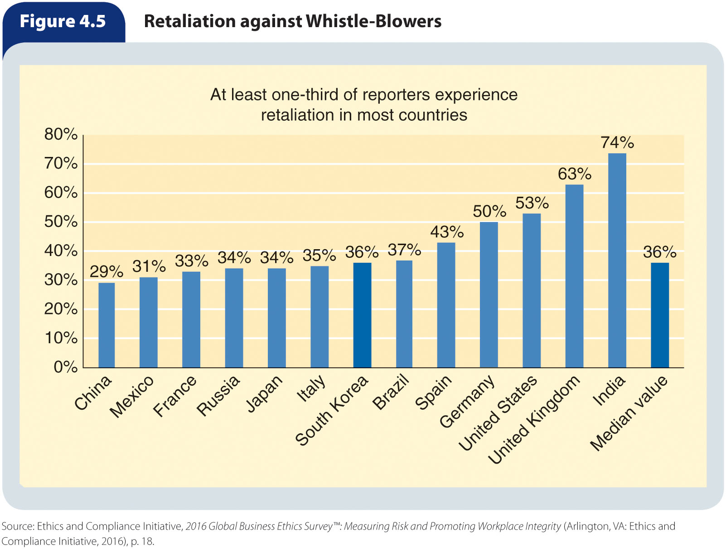
Figure 4.5 – Retaliation Against Whistle-Blowers

Slide 40
Incorporating Social Responsibility and
Ethics Into Strategic Planning
It is important to distinguish between ethics and social responsibility
  Ethics relates to individual and group decisions—judgments about what is right and wrong in a particular decision-making situation
  Social responsibility deals with the total effect of marketing decisions on society
  The two concepts are interrelated because a company that supports socially responsible decisions and adheres to a code of conduct is likely to have a positive effect on society
  Because ethics and social responsibility can be profitable as well, an increasing number of companies are incorporating them into their overall strategic market planning
Many of society’s demands impose costs
  Companies must carefully balance the cost of providing low-cost products against the costs of manufacturing, packaging, and distributing those products in an environmentally responsible manner
In trying to satisfy the desires of one group, marketers may dissatisfy others
  Balancing society’s demands to satisfy all members of society is difficult, if not impossible

Slide 41
Social Responsibility and Ethics
Improve Marketing Performance
Increasing evidence indicates that being socially responsible and ethical results in increased profits
The evidence is strong that a broad stakeholder view of the firm can help improve marketing practices that contribute to improved financial, social, and ethical performance
  This relationship implies that being ethically and socially concerned is consistent with meeting the demands of customers and other stakeholders
A direct association exists between corporate social responsibility and customer satisfaction, profits, and market value
Recognition is growing that the long-term value of conducting business in an ethical and socially responsible manner far outweighs short-term costs

