Slide 1
Target Markets: Segmentation and Evaluation
Chapter 6

Slide 2
Learning Objectives
LO 6-1 Explain what markets are and how they are generally classified.
LO 6-2 List the five steps of the target market selection process.
LO 6-3 Compare three targeting strategies.
LO 6-4 Identify the major segmentation variables.
LO 6-5 Explain what market segment profiles are and how they are used.
LO 6-6 Explain how to evaluate market segments.
LO 6-7 Identify the factors that influence the selection of specific market segments for use as target markets.
LO 6-8 Discuss sales forecasting methods.

Slide 3
What Are Markets?
A market is a group of individuals and/or organizations that have:
  A desire or need for products in a product class
  The ability, willingness, and authority to purchase such products
To truly be a market, consumers must possess all four characteristics
  Teenagers may have the desire, willingness, and ability to buy liquor, but they do not have the authority to do so because teenagers are prohibited by law from buying alcoholic beverages
Markets fall into one of two categories:
  Consumer market – Purchasers and household members who intend to consume or benefit from the purchased products and do not buy products to make profits
    Also referred to as business-to-consumer (B2C) markets
    Each of us belongs to numerous consumer markets for all the purchases we make
  Business market – Individuals, organizations, or groups that purchase a specific kind of product for resale, direct use in producing other products, or use in general daily operations
    Also referred to as business-to-business (B2B), industrial, or organizational markets
    Can be sub-classified into producer, reseller, government, and institutional markets

Slide 4
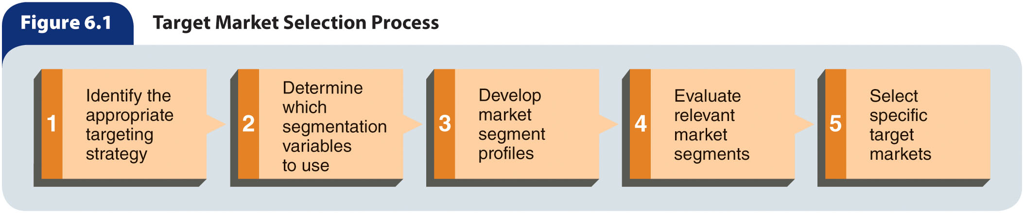
Figure 6.1 – Target Market Selection Process

Slide 5
Step 1: Identify the Appropriate Targeting Strategy
A target market is a group of people or organizations for which a business creates and maintains a marketing mix specifically designed to satisfy the needs of group members
The strategy used to select a target market is affected by:
  Target market characteristics
  Product attributes
  The organization’s objectives and resources

Slide 6
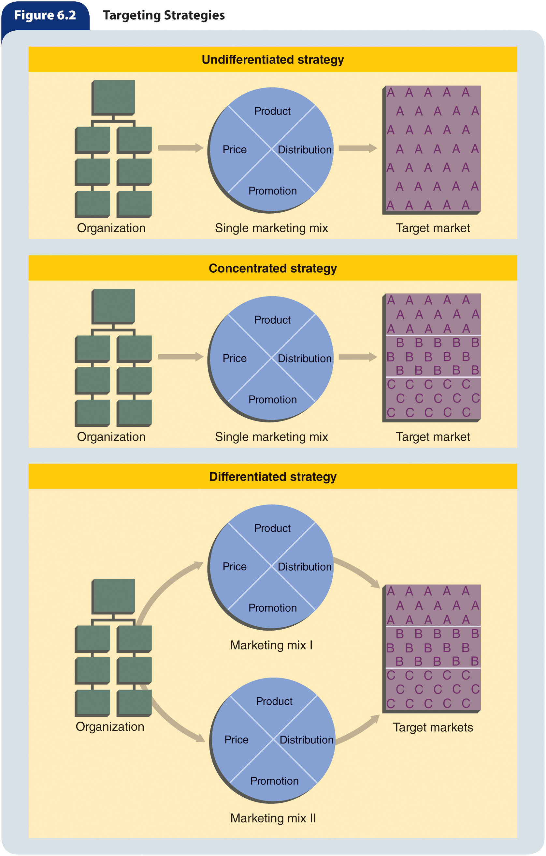
Figure 6.2 – Targeting Strategies (slide 1 of 3)

Slide 7
Figure 6.2 – Targeting Strategies (slide 2 of 3)

Slide 8
Figure 6.2 – Targeting Strategies (slide 3 of 3)

Slide 9
Undifferentiated
Targeting Strategy
Undifferentiated targeting strategy – A strategy in which an organization designs a single marketing mix and directs it at the entire market for a particular product
  Effective for homogeneous markets where a large proportion of customers in a target market have similar needs for a product

Slide 10
Concentrated Targeting Strategy through Market Segmentation (slide 1 of 3)
Market segmentation – The process of dividing a total market into groups with relatively similar product needs to design a marketing mix that matches those needs
  Used for heterogeneous markets of individuals or organizations with diverse needs for products in a specific product class
Market segment – Individuals, groups, or organizations sharing one or more similar characteristics that cause them to have similar product needs
The majority of organizations use market segmentation to best satisfy their customers

Slide 11
Concentrated Targeting Strategy through Market Segmentation (slide 2 of 3)
For market segmentation to succeed, five conditions must exist:
  Customers’ needs for the product must be heterogeneous
  Segments must be identifiable and divisible
  Marketers must be able to compare the different market segments with respect to estimated sales potential, costs, and profits
  At least one segment must have enough profit potential to justify developing and maintaining a special marketing mix for it
  The company must be able to reach the chosen segment with a particular marketing mix

Slide 12
Concentrated Targeting Strategy through Market Segmentation (slide 3 of 3)
Concentrated targeting strategy – A market segmentation strategy in which an organization targets a single market segment using one marketing mix
Advantages
  Allows specialization
  A small firm can compete
Disadvantages
  Profits fall with demand
  Difficult to diversity

Slide 13
Differentiated Targeting Strategy through Market Segmentation
Differentiated targeting strategy – A strategy in which an organization targets two or more segments by developing a marketing mix for each segment
Advantages
  Could mean increased sales
  Uses excess production capacity
Disadvantages
  Production costs are higher

Slide 14
Step 2: Determine Which
Segmentation Variables to Use
Segmentation variables – Characteristics of individuals, groups, or organizations used to divide a market into segments
  Several variables are often used in combination when segmenting a market
  When selecting a segmentation variable, several factors are considered:
    The segmentation variable should relate to the customers’ needs for, uses of, or behavior toward the product
    The segmentation variable must be measurable
    A company’s resources and capabilities
    The type of product and degree of variation in customers’ needs

Slide 15
Variables for Segmenting Consumer Markets
Segmentation variables can be grouped into four major categories:
  Demographic
  Geographic
  Psychographic
  Behavioristic

Slide 16
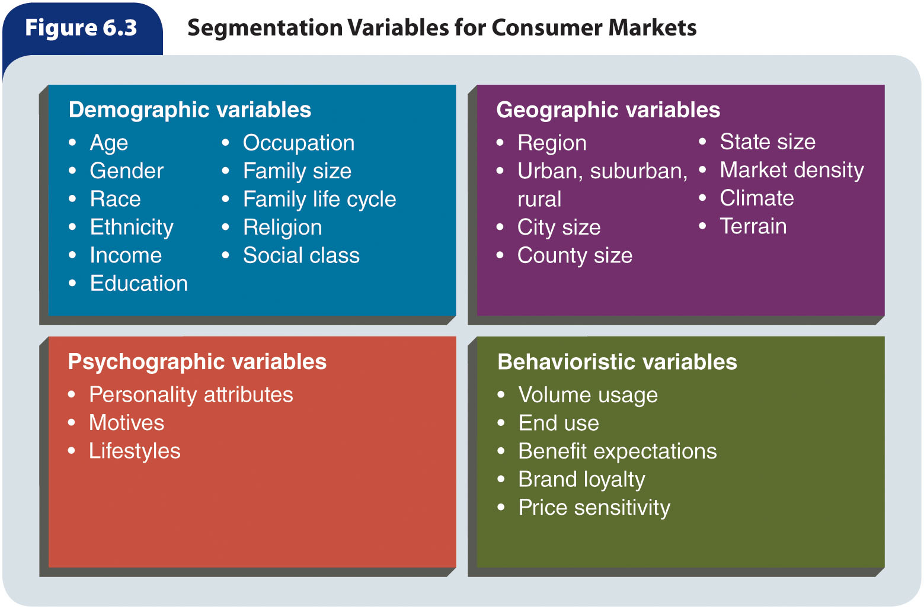
Figure 6.3 – Segmentation Variables for Consumer Markets

Slide 17
Demographic Variables (slide 1 of 5)
Age
  If considering segmenting by age, marketers need to be aware of:
    Age distribution
    How the age distribution is changing
    How the age distribution will affect the demand for different types of products
  Americans in different age groups have different product needs because of their different lifestyles and health situations

Slide 18
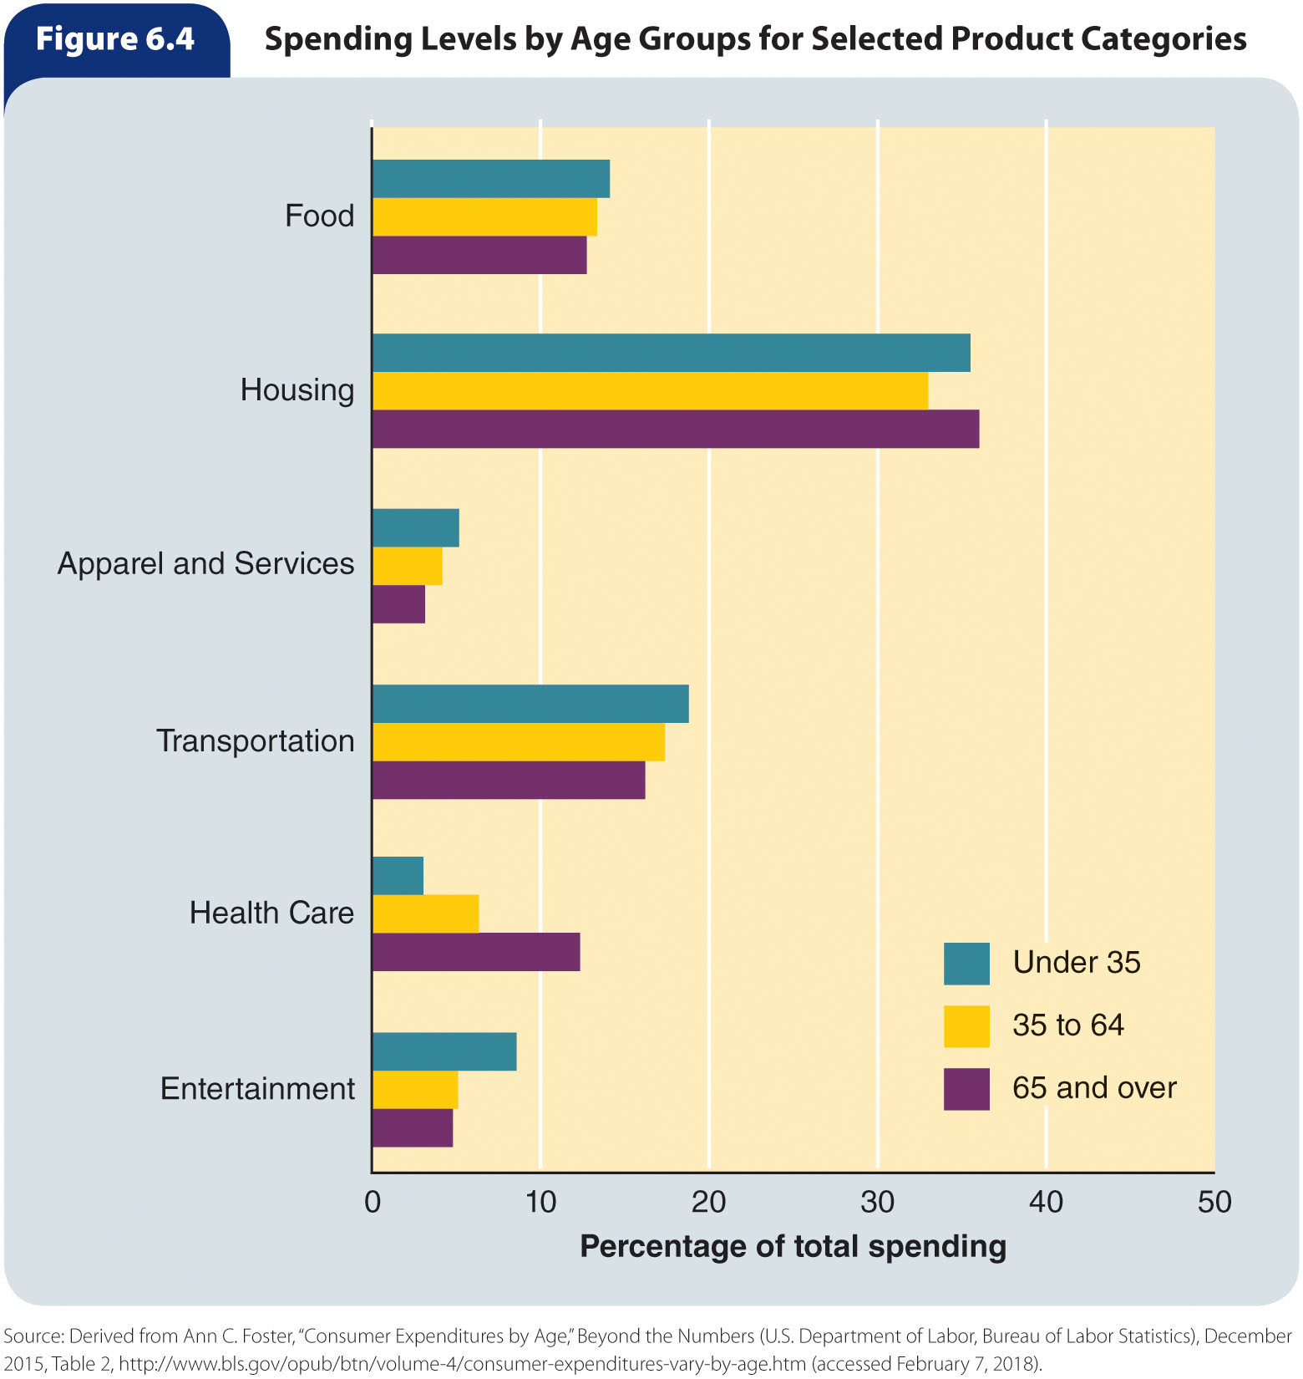
Figure 6.4 – Spending Levels by Age Groups for Selected Product Categories

Slide 19
Demographic Variables (slide 2 of 5)
Gender
  Although they represent only slightly more than half of the population, women disproportionately influence buying decisions
    It is estimated that women account for 85 percent of all consumer purchases, causing many marketers to consider female customers when making marketing decisions
  Gender is a demographic variable that is commonly used to segment markets, including: clothing, magazines, soft drinks, nonprescription medications, food items, personal care products

Slide 20
Demographic Variables (slide 3 of 5)
Race and ethnicity
  Marketers use race and ethnicity as variables for segmenting markets for such products as: food, music, clothing, cosmetics, banking, and insurance.

Slide 21
Demographic Variables (slide 4 of 5)
Income
  Income strongly influences people’s product purchases, often provides a way to divide markets, and affects customers’ lifestyles and what they can afford to buy
  Product markets segmented by income include: sporting goods, housing, furniture, cosmetics, clothing, jewelry, home appliances, automobiles, electronics.

Slide 22
Demographic Variables (slide 5 of 5)
Marital status and the presence and age of children influence household income and product needs
  These characteristics, often combined and called the family life cycle, affect needs for: housing, appliances, food and beverages, automobiles, recreational equipment.

Slide 23
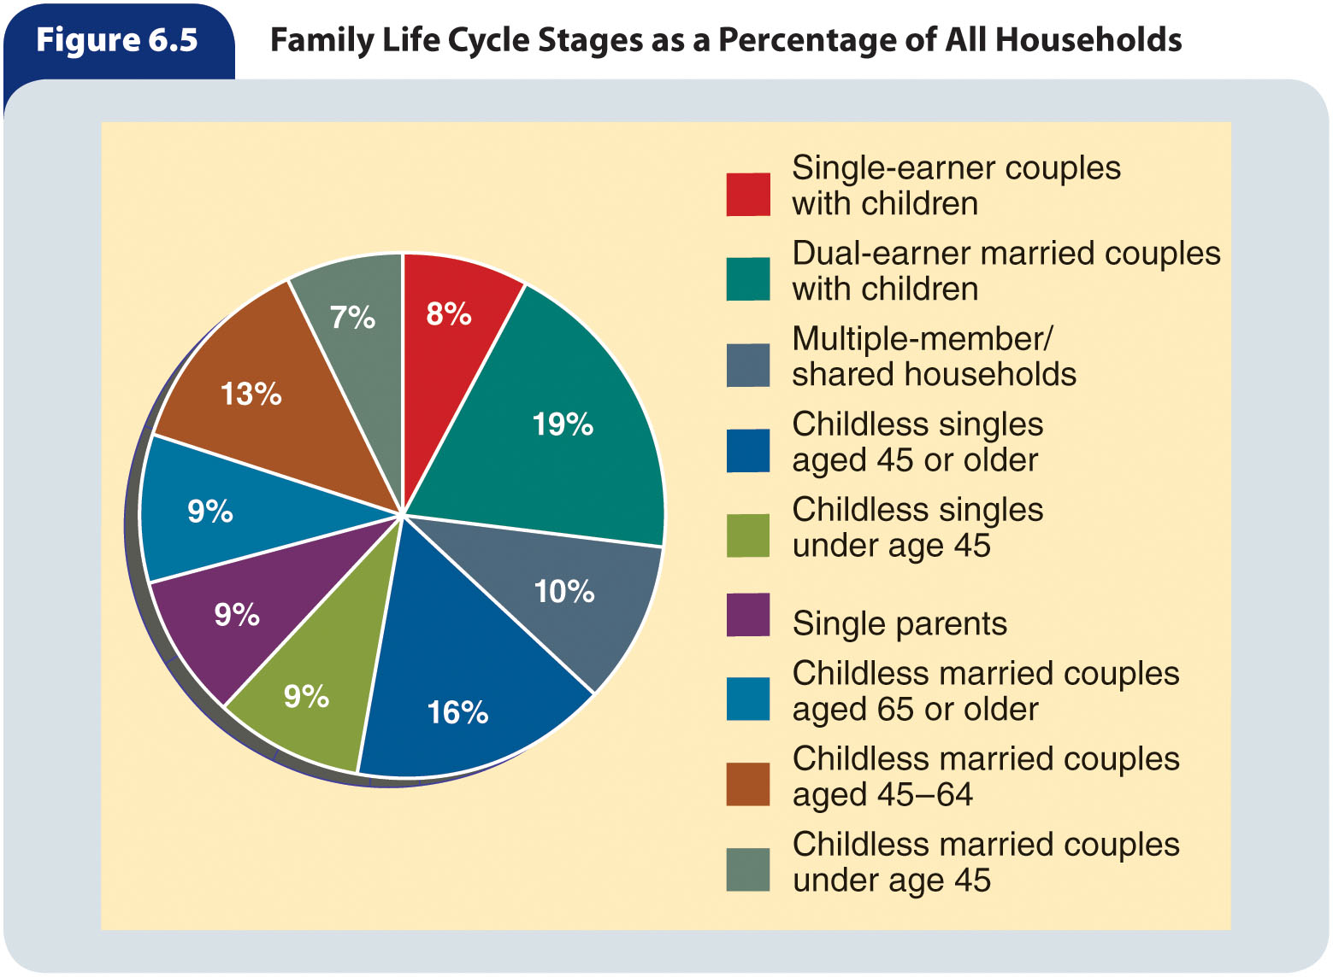
Figure 6.5 – Family Life Cycle Stages as a Percentage of All Households

Slide 24
Geographic Variables (slide 1 of 2)
Consumer product needs are influenced by geographic variables, such as: climate, terrain, city size, population density, urban/rural areas.
Market density – The number of potential customers within a unit of
land area
  Is not the same as population density

Slide 25
Geographic Variables (slide 2 of 2)
Geodemographic segmentation – An approach to market segmentation that clusters people by zip codes or neighborhood units based on lifestyle and demographic information
Micromarketing – An approach to market segmentation in which organizations focus precise marketing efforts on very small geographic markets
  Can be as small as communities or even individual neighborhoods
  Many retailers use micromarketing to determine the merchandise mix for
  individual stores
  Increasingly, firms can engage in micromarketing in online retailing
    The wealth of consumer information available online allows marketers to appeal efficiently and effectively to very specific consumer niches

Slide 26
Psychographic Variables (slide 1 of 3)
Psychographic variables, such as personality characteristics, motives, and lifestyles, are sometimes used to segment markets
Personality characteristics
  When appealing to a personality characteristic, a marketer almost always selects one that many people view positively
    Individuals with this characteristic, as well as those who aspire to have it, may be influenced to buy that marketer’s brand
    Marketers taking this approach do not worry about measuring how many people have the positively valued characteristic but rather assume a sizable proportion of people in the target market either have it or aspire to have it

Slide 27
Psychographic Variables (slide 2 of 3)
Motives
  When motives are used to segment a market, the market is divided according to consumers’ reasons for making a purchase
  Examples of motives affecting the types of products purchased and the choice of stores in which they are bought include: personal appearance, affiliation, status, safety, health.

Slide 28
Psychographic Variables (slide 3 of 3)
Lifestyles
  Lifestyle segmentation groups people according to:
    How they spend their time
    The importance of things in their surroundings
    Beliefs about themselves and broad issues
  Lifestyle analysis provides a broad view of buyers because it encompasses numerous characteristics related to people’s:
    Activities (e.g., work, hobbies, entertainment, sports)
    Interests (e.g., family, home, fashion, food, technology)
    Opinions (e.g., politics, social issues, education, the future)

Slide 29
Behavioristic Variables
Firms can divide a market according to consumer behavior toward a product, which commonly involves an aspect of product use
  Such as heavy, moderate, or light use, and nonusers
Benefit segmentation – The division of a market according to benefits that consumers want from the product
  The effectiveness of such segmentation depends on three conditions:
    The benefits sought must be identifiable
    Using these benefits, marketers must be able to divide people into
    recognizable segments
    One or more of the resulting segments must be accessible to the firm’s
    marketing efforts

Slide 30
Variables for Segmenting Business Markets
Like consumer markets, business markets are frequently segmented for marketing purposes
Marketers segment business markets according to:
  Geographic location
  Type of organization
  Customer size
  Product use

Slide 31
Step 3: Develop Market
Segment Profiles (slide 1 of 2)
A market segment profile:
  Describes the similarities among potential customers within a segment
  Explains the differences among people and organizations in different segments
  May cover aspects such as:
    Demographic characteristics
    Geographic factors
    Product benefits sought
    Lifestyles
    Brand preferences
    Usage rates

Slide 32
Step 3: Develop Market
Segment Profiles (slide 2 of 2)
Market segment profiles:
  Assess the degree to which marketers’ products fit potential customers’ product needs
  Help marketers understand how a business can use its capabilities to serve potential customer groups
  Help a marketer determine which segment or segments are most attractive relative to the firm’s strengths, weaknesses, objectives, and resources
  Help a firm make marketing decisions relating to a specific market segment or segments

Slide 33
Step 4: Evaluate Relevant Market Segments
After analyzing the market segment profiles, a marketer should be able to narrow his or her focus to several promising segments that warrant further analysis
Several factors associated with each of these segments should be analyzed, including:
  Sales estimates
  Competition
  Estimated costs

Slide 34
Sales Estimates (slide 1 of 2)
Potential sales for a market segment can be measured along several dimensions, including:
  Product level
  Geographic area
  Time
  Level of competition
Market potential – The total amount of a product that customers will purchase within a specified period at a specific level of industry-wide marketing activity
  Affected by economic, sociocultural, and other environmental forces
  The specific level of marketing effort will vary from one firm to another, and each firm’s marketing activities together add up to the industry-wide marketing effort total
  Marketers must also estimate whether and to what extent industry marketing efforts will change over time

Slide 35
Sales Estimates (slide 2 of 2)
Company sales potential – The maximum percentage of market potential that an individual firm within an industry can expect to obtain for a specific product
  Influencing factors:
    The market potential places absolute limits on the size of a company’s sales
    The magnitude of industry-wide marketing activities has an indirect but definite impact on the company’s sales potential
    The intensity and effectiveness of a company’s marketing activities relative to competitors’ activities affect the size of the company’s sales potential
Two general approaches that measure company sales potential are:
  Breakdown approach – Measuring company sales potential based on a general economic forecast for a specific period and the market potential derived from it
  Buildup approach – Measuring company sales potential by estimating how much of a product a potential buyer in a specific geographic area will purchase in a given period, multiplying the estimate by the number of potential buyers, and adding the totals of all the geographic areas considered

Slide 36
Competitive Assessment (slide 1 of 2)
Without competitive assessment, sales estimates can be misleading
  The following questions need to be answered for a competitive assessment:
    How many competitors exist?
    What are their strengths and weaknesses?
    Do several competitors already have major market shares and together dominate the segment?
    Can our company create a marketing mix to compete effectively against competitors’ marketing mixes?
    Is it likely that new competitors will enter this segment? If so, how will they affect our firm’s ability to compete successfully?

Slide 37
Cost Estimates
To fulfill the needs of a target segment, an organization must develop and maintain a marketing mix that precisely meets the wants and needs of that segment, which can be expensive
Factors affecting costs include:
  Distinctive product features
  Attractive package design
  Generous product warranties
  Extensive advertising
  Attractive promotional offers
  Competitive offers
  High quality personal service

Slide 38
Step 5: Select Specific Target Markets
An important initial consideration in selecting a target market is whether customers’ needs differ enough to warrant the use of market segmentation
  If segmentation analysis shows customers’ needs to be homogeneous, the firm’s management may decide to use an undifferentiated targeting strategy
  However, if customers’ needs are heterogeneous, marketers must select one or more target markets
Assuming one or more segments offer significant opportunities to achieve organizational objectives, a marketer must decide which offers the most potential at reasonable costs
  The firm’s management must investigate whether the organization has sufficient financial resources, managerial skills, employee expertise, and facilities to compete effectively in selected segments
  The firm must also consider the possibility that the requirements of some market segments are at odds with the firm’s overall objectives, and that possible legal problems, conflicts with interest groups, and technological advancements will render certain segments unattractive
  Marketers must consider long-term versus short-term growth

Slide 39
Developing Sales Forecasts (slide 1 of 2)
Sales forecast – The amount of a product a company expects to sell during a specific period at a specified level of marketing activities
  Differs from the company sales potential in that it concentrates on what actual sales will be at a certain level of company marketing effort, whereas the company sales potential assesses what sales are possible at various levels of marketing activities, assuming certain environmental conditions exist
Businesses use the sales forecast for planning, organizing, implementing, and controlling activities
Overly ambitious sales forecasts can lead to overbuying, overinvestment, and higher costs that weaken a firm’s strength and position

Slide 40
Developing Sales Forecasts (slide 2 of 2)
To forecast sales, a marketer can choose from a number of forecasting methods
  A firm’s choice of method or methods depends on:
    Costs involved
    Type of product
    Market characteristics
    Time span and purpose of the forecast
    Stability of the historical sales data
    Availability of required information
    Managerial preferences
    Forecasters’ expertise and experience
  Common forecasting techniques fall into five categories: executive judgment, surveys, time series analysis, regression analysis, market tests.

Slide 41
Executive Judgment
Executive judgment – A sales forecasting method based on the intuition of one or more executives
  This approach is unscientific but expedient and inexpensive
  It is not a very accurate method but may work well when product demand is relatively stable and the forecaster has years of market-related experience
  Such forecasts may be too optimistic or pessimistic
  The forecaster has only past experience as a guide for deciding where to go in the future

Slide 42
Surveys
Customer forecasting survey – A survey of customers regarding the types and quantities of products they intend to buy during a specific period
  May be useful to a business with relatively few customers
Sales force forecasting survey – A survey of a firm’s sales force regarding anticipated sales in their territories for a specific period
  The sales staff is the company personnel closest to customers on a daily basis and, therefore, have first-hand knowledge about customers’ product needs
Expert forecasting survey – Sales forecasts prepared by experts outside the firm, such as economists, management consultants, advertising executives, or college professors
  Using experts is a quick way to get information and is relatively inexpensive, but outsiders may be less motivated than company personnel to do an effective job
Delphi technique – A procedure in which experts create initial forecasts, submit them to the company for averaging, and then refine the forecasts
  The ultimate goal in using this technique is to develop a highly reliable sales forecast

Slide 43
Time Series Analysis
Time series analysis – A forecasting method that uses historical sales data to discover patterns in the firm’s sales over time and generally involves trend, cycle, seasonal, and random factor analyses
In a time series analysis, a forecaster performs four types of analyses:
  Trend analysis – An analysis that focuses on aggregate sales data over a period of many years to determine general trends in annual sales
  Cycle analysis – An analysis of sales figures for a 3- to 5-year period to ascertain whether sales fluctuate in a consistent, periodic manner
  Seasonal analysis – An analysis of daily, weekly, or monthly sales figures to evaluate the degree to which seasonal factors influence sales
  Random factor analysis – An analysis attempting to attribute erratic sales variations to random, nonrecurrent events

Slide 44
Regression Analysis
Regression analysis – A method of predicting sales based on finding a relationship between past sales and one or more independent variables, such as population or income
  Simple regression analysis uses one independent variable
  Multiple regression analysis includes two or more independent variables

Slide 45
Market Tests (slide 1 of 2)
Market test – Making a product available to buyers in one or more test areas and measuring purchases and consumer responses to marketing efforts
Advantages:
  Effective for forecasting sales of new products or of existing products in new geographic areas
  Gives a marketer an opportunity to test the success of various elements of the
  marketing mix
  Disadvantages:
  Time-consuming and expensive
  Uncertainty that customer response represents the total market response or that such a response will continue in the future

Slide 46
Using Multiple Forecasting Methods
Most firms use several forecasting techniques for a variety of reasons:
  Is forced to use multiple methods when marketing diverse product lines
  May use multiple methods for a single product line when the product is sold in different market segments
  Variation in the length of forecasts may call for using several forecasting methods
  Sometimes a marketer verifies results of one method by using one or more other methods and comparing outcomes

