Slide 1
Product Concepts, Branding, and Packaging
Chapter 11

Slide 2
Learning Objectives
LO 11-1 Define the concept of a product.
LO 11-2 Discuss how products are classified.
LO 11-3 Explain the concepts of product line and product mix and how they
are related.
LO 11-4 Explore the product life cycle and its impact on marketing strategies.
LO 11-5 Discuss the product adoption process.
LO 11-6 Explain the major components of branding, including brand types, branding strategies, and brand protection.
LO 11-7 Describe the major packaging functions, design considerations, and how packaging is used in marketing strategies.
LO 11-8 Identify the functions of labeling and legal issues related to labeling.

Slide 3
What Is a Product?
A product is a good, a service, or an idea received in an exchange
Good – A tangible, physical entity
Service – An intangible result of the application of human and mechanical efforts to people or objects
Idea – A concept, philosophy, image, or issue
A product can be either tangible or intangible and includes functional, social, and psychological utilities or benefits
A total product offers three independent elements:
  The core product
  Its supplemental features
  Its symbolic or experiential benefits

Slide 4
The Core Product
Consists of a product’s fundamental utility or main benefit
Is usually a fundamental need of the consumer

Slide 5
Supplemental Features
Provide added value or attributes that are in addition to the product’s core utility or benefit
Often include perks such as:
  Free installation
  Guarantees
  Product information
  Promises of repair or maintenance
  Delivery
  Training
  Financing
Are not required to make the core product function effectively
Help differentiate the product brand from another

Slide 6
Symbolic or Experiential Benefits
Customers receive benefits based on their experiences with the product, which give symbolic meaning to many products (and brands) for buyers
  For some consumers, the simple act of shopping gives them pleasure, which lends to its symbolic value and improves their attitudes about the products they consider buying
Buyers purchase the benefits and satisfaction they think the product will provide
  Services, in particular, are purchased on the basis of expectations
  Often, symbols and cues are used to make intangible products more tangible, or real, to the customer

Slide 7
Classifying Products
Products fall into one of two general categories:
  Consumer products – Products purchased to satisfy personal and family needs
  Business products – Products bought to use in a firm’s operations, to resell, or to make other products
    Purchased to satisfy the goals of the organization

Slide 8
Categories of
Consumer Products
Convenience products
Unsought products
Shopping products
Specialty products

Slide 9
Consumer Products
Convenience products – Relatively inexpensive, frequently purchased items for which buyers exert minimal purchasing effort
  Examples: Bread, soft drinks, chewing gum, gasoline, newspapers
Shopping products – Items for which buyers are willing to expend considerable effort in planning and making purchases
  Examples: Appliances, bicycles, furniture, stereos, cameras, shoes
Specialty products – Items with unique characteristics that buyers are willing to expend considerable effort to obtain
  Examples: Fine jewelry, limited-edition collector’s items
Unsought products – Products purchased to solve a sudden problem, products of which customers are unaware, and products that people do not necessarily think of buying
  Examples: Emergency medical services, automobile repairs

Slide 10
Categories of
Business Products
Installations
Accessory equipment
Raw materials
Component parts
Process materials
MRO supplies
Business services

Slide 11
Business Products (Slide 1 of 2)
Installations – Facilities and nonportable major equipment
  Examples: Buildings, factories, warehouses, production lines, very large machines
Accessory equipment – Equipment that does not become part of the final physical product but is used in production or office activities
  Examples: File cabinets, fractional-horsepower motors, calculators, tools
Raw materials – Basic natural materials that become part of a physical product
  Examples: Minerals, chemicals, agricultural products, materials from forests and oceans
Component parts – Items that become part of the physical product and are either finished items ready for assembly or items that need little processing before assembly
  Examples: Spark plugs, brakes, tires, headlights

Slide 12
Business Products (slide 2 of 2)
Process materials – Materials that are used directly in the production of other products but are not readily identifiable
  Example: An ingredient in salad dressing
MRO supplies – Maintenance, repair, and operating items that facilitate production and operations but do not become part of the finished product
  Examples: Paper, pencils, cleaning supplies, paints
Business services – Intangible products that many organizations use in their operations
  Examples: Financial services, legal services, marketing research services, information technology services, janitorial services

Slide 13
Product Line and Product Mix
Product item – A specific version of a product that can be designated as a distinct offering among a firm’s products
Product line – A group of closely related product items viewed as a unit because of marketing, technical, or end-use considerations
Product mix – The composite, or total, group of products that an organization makes available to customers
Width of product mix – The number of product lines a company offers
Depth of product mix – The average number of different products in each product line

Slide 14
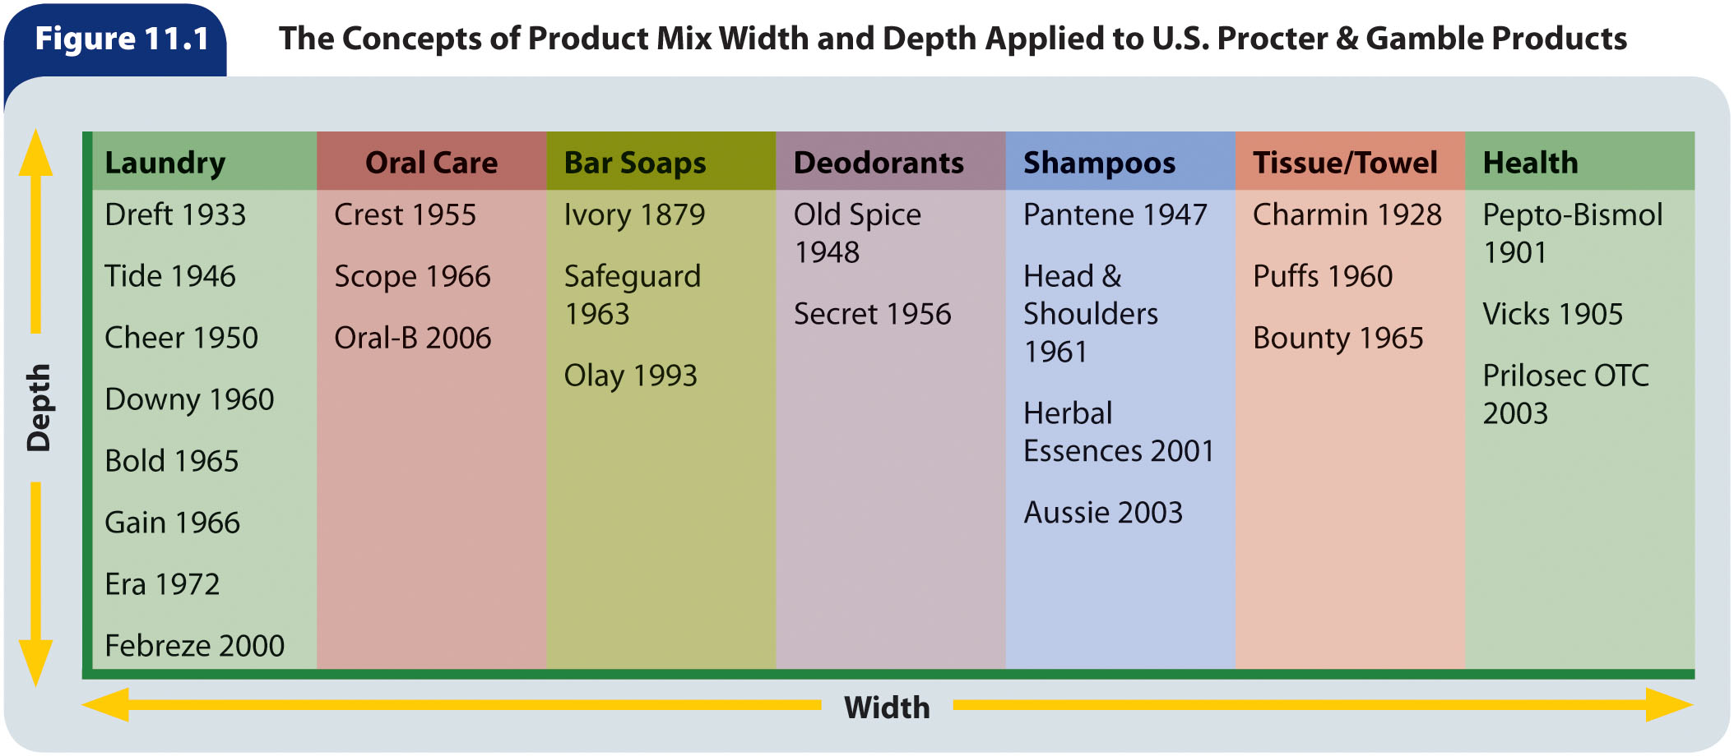
Figure 11.1 – The Concepts of Product Mix Width and Depth Applied to U.S. Procter & Gamble Products

Slide 15
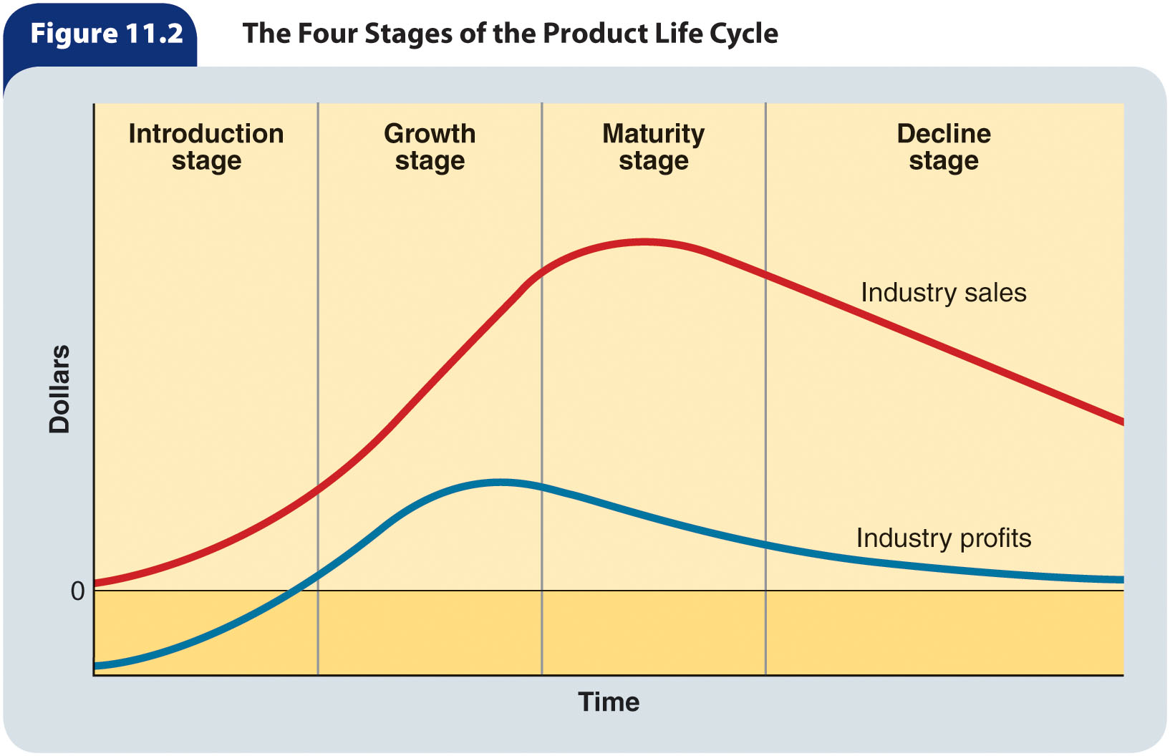
Figure 11.2 – The Four Stages of the Product Life Cycle

Slide 16
Product Life Cycles and Marketing Strategies
Product life cycle – The progression of a product through four stages
  Introduction
  Growth
  Maturity
  Decline
As a product moves through each cycle, the strategies relating to competition, pricing, distribution, promotion, and market information must be evaluated and possibly adjusted

Slide 17
Introduction (slide 1 of 2)
Introduction stage – The initial stage of a product’s life cycle; its first appearance in the marketplace, when sales start at zero and profits are negative
Two difficulties may arise during the introduction stage
  Sellers may lack the resources, technological knowledge, and marketing expertise to launch the product successfully
  The initial product price may have to be high to recoup expensive marketing research or development costs, which can depress sales
Most new products start off slowly and seldom generate enough sales to bring immediate profits
  It is estimated that only 15 to 25 percent of new products succeed in the marketplace
  Even among established and successful companies, new-product success rates are rarely above 50 percent

Slide 18
Introduction (slide 2 of 2)
As buyers learn about the new product and express interest, the firm should constantly monitor the product and marketing strategy for weaknesses and make corrections quickly to prevent the product’s early demise
  Marketing strategy should be designed to attract the segment that is most interested in, most able, and most willing to buy the product

Slide 19
Growth (slide 1 of 2)
Growth stage – The product life-cycle stage when sales rise rapidly, profits reach a peak, and then they start to decline
The growth stage is critical to a product’s survival because competitive reactions to the product’s success during this period will affect the product’s life expectancy
A typical marketing strategy should seek to strengthen market share and position the product favorably against aggressive competitors by emphasizing product benefits
Marketers should analyze competing brands’ product positions relative to their own and adjust the marketing mix in response to their findings

Slide 20
Growth (slide 2 of 2)
Aggressive pricing, including price cuts, is also typical during this stage as a means of gaining market share—even if it means short-term loss of profits
The goal of the marketing strategy in the growth stage is to establish and fortify the product’s market position by encouraging adoption and brand loyalty
As a product gains market acceptance, new distribution outlets usually become easier to secure
Marketers must make sure the physical distribution system is running efficiently so that customers’ orders are processed accurately and delivered on time
Production expenditures in the growth stage may be slightly lower than during the introductory stage, but are still large
  As sales continue to increase, promotion costs should drop as a percentage of total sales, which contributes significantly to increased profits
Advertising messages should stress brand benefits

Slide 21
Maturity (slide 1 of 2)
Maturity stage – The stage of a product’s life cycle when the sales curve peaks and starts to decline, and profits continue to fall
This stage is characterized by intense competition because many brands are now in the market
  Competitors emphasize improvements and differences in their versions of the product
During the maturity phase, the producers who remain in the market are likely to change their promotional and distribution efforts
  Advertising and dealer-oriented promotions are typical during this stage of the product life cycle
Marketers must take into account that as it reaches maturity, buyers’ knowledge of the product is likely to be high
Marketers of mature products sometimes expand distribution into global markets, in which case products may have to be adapted to fit differing needs of global customers more precisely

Slide 22
Maturity (slide 2 of 2)
Because many products are in the maturity stage of their life cycles, marketers must know how to deal with them and be prepared to adjust their marketing strategies
  To increase the sales of mature products, marketers may suggest new uses for them
  As customers become more experienced and knowledgeable about products during the maturity stage, the benefits they seek may change as well, necessitating product modifications
During the maturity stage, marketers actively encourage resellers to support the product
Maintaining market share during the maturity stage requires promotion expenditures, which can be large if a firm seeks to increase a product’s market share through new uses

Slide 23
Decline (slide 1 of 2)
Decline stage – The stage of a product’s life cycle when sales fall rapidly
When this happens, the marketer must consider eliminating items from the product line that no longer earn a profit
The marketer also may cut promotion efforts, eliminate marginal distributors, and finally, plan to phase out the product
Usually a declining product has lost its distinctiveness because similar competing or superior products have been introduced
  Competition engenders increased substitution and brand switching among consumers as they become increasingly insensitive to minor product differences
    For these reasons, marketers do little to change a product’s style, design, or other attributes during its decline

Slide 24
Decline (slide 2 of 2)
New technology or social trends, product substitutes, or environmental considerations also play a huge role in the decline stage of the product life cycle
During a product’s decline, spending on promotion efforts is usually reduced considerably
As sales decline, the product becomes harder for consumers to find, but loyal buyers will seek out retailers who still carry it
  As the product continues to decline, the sales staff at outlets where it is still sold will shift emphasis to more profitable products

Slide 25
Product Adoption Process (slide 1 of 2)
Product adoption process – The five-stage process of buyer acceptance of a product:
  Awareness: The buyer becomes aware of the product
  Interest: The buyer seeks information and is receptive to learning about the product
  Evaluation: The buyer considers the product’s benefits and decides whether to try it, considering its value versus the competition
  Trial: The buyer examines, tests, or tries the product to determine if it meets his or her needs
  Adoption: The buyer purchases the product and can be expected to use it again whenever the need for this product arises

Slide 26
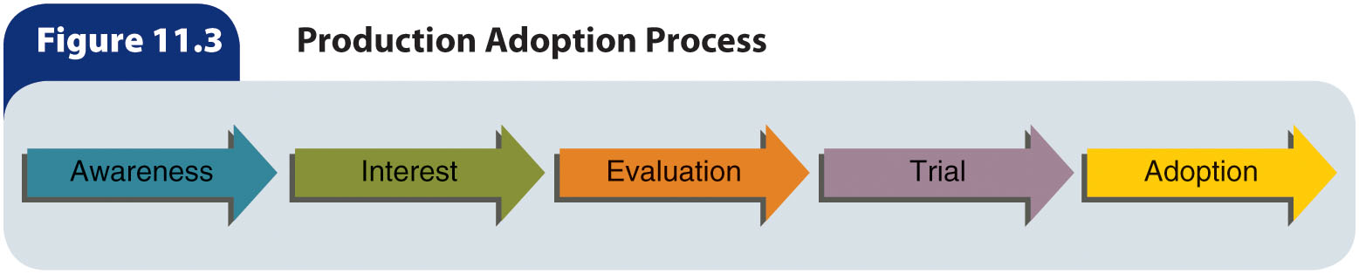
Figure 11.3 – Product
Adoption Process

Slide 27
Product Adoption Process (slide 2 of 2)
When an organization introduces a new product, consumers in the target market enter into and move through the adoption process at different rates
  For most products, there is also a group of non-adopters who never begin the process
Depending on the length of time it takes them to adopt a new product, consumers tend to fall into one of five major adopter categories:
  Innovators – First adopters of new products
  Early adopters – People who adopt new products early, choose new products carefully, and are viewed as “the people to check with” by later adopters
  Early majority – Individuals who adopt a new product just prior to the average person
  Late majority – Skeptics who adopt new products when they feel it is necessary
  Laggards – The last adopters, who distrust new products

Slide 28
Branding
Brand – A name, term, design, symbol, or other feature that identifies one seller’s product as distinct from those of other sellers
Brand name – The part of a brand that can be spoken, including letters, words, and numbers
Brand mark – The part of a brand that is not made up of words, such as a symbol or design
Trademark – A legal designation of exclusive use of a brand
Trade name – The full legal name of an organization

Slide 29
Value of Branding (slide 1 of 2)
Buyers benefit from branding in the following ways:
  Brands help buyers recognize specific products that meet their criteria for quality, which reduces the time needed to identify and purchase products by facilitating identification of products that satisfy consumer needs
    Without brands, product selection would be more difficult because buyers would have fewer guideposts indicating quality and product features
  For many consumers, brand is a form of self-expression
  A brand indicates a quality level and image to the customer and reduces a buyer’s perceived risk of purchase
  Customers might receive a psychological reward from purchasing and owning a brand that symbolizes status

Slide 30
Value of Branding (slide 2 of 2)
The value of branding for sellers are:
  Brands are identifiers that make repeat purchases easier for customers, thereby fostering brand loyalty
  Branding helps a firm introduce a new product by carrying the name and image of one or more existing products—buyers are more likely to experiment with the new product because of familiarity with products carrying the firm’s existing brand names
  Branding facilitates promotional efforts because the promotion of each branded product indirectly promotes all products bearing the same brand
  As customers become loyal to a specific brand, the company’s market share will achieve a level of stability, allowing the firm to use its resources more efficiently

Slide 31
Brand Equity (slide 1 of 3)
Brand equity – The marketing and financial value associated with a brand’s strength in a market
Four major elements underlie brand equity:
  Brand name awareness
  Brand loyalty
  Perceived brand quality
  Brand associations

Slide 32
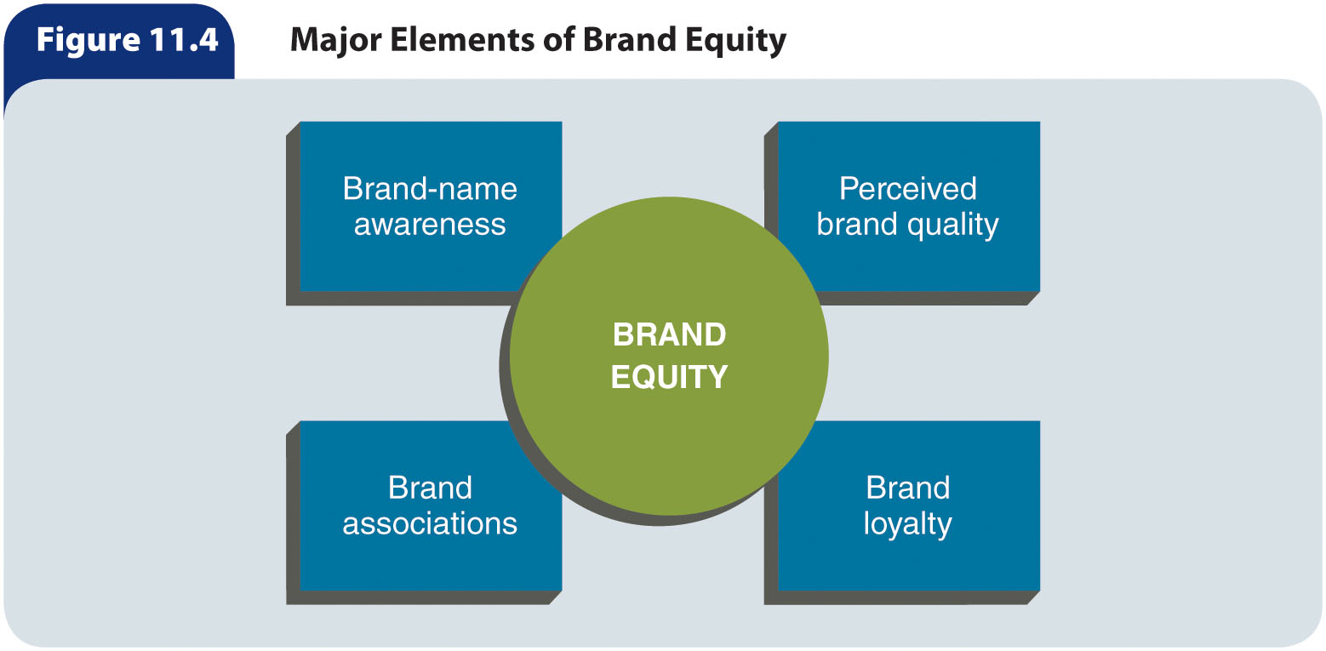
Figure 11.4 – Major Elements of Brand Equity

Slide 33
Brand Equity (slide 2 of 3)
Brand loyalty – A customer’s favorable attitude toward a specific brand
There are three degrees of brand loyalty:
  Brand recognition – The degree of brand loyalty in which a customer is aware that a brand exists and views the brand as an alternative purchase if their preferred brand is unavailable
  Brand preference – The degree of brand loyalty in which a customer prefers one brand over competitive offerings
  Brand insistence – The degree of brand loyalty in which a customer strongly prefers a specific brand and will accept no substitute

Slide 34
Brand Equity (slide 3 of 3)
Brand loyalty is an important component of brand equity because it reduces a brand’s vulnerability to competitors’ actions
It allows an organization to retain existing customers and avoid expending significant resources to gain new ones
Loyal customers help to promote a brand by providing visibility and reassuring potential new customers of the brand’s quality
Customers frequently use a brand name as a proxy for an actual assessment of a product’s quality

Slide 35
Table 11.1 – The 10 Most Valuable
Brands in the World
Rank | Brand | Brand Value ($ Billions)
1 | Google | 245.6
2 | Apple | 234.7
3 | Microsoft | 143.2
4 | Amazon | 139.3
5 | Facebook | 129.8
6 | AT&T | 115.1
7 | Visa | 111.0
8 | Tencent | 108.3
9 | IBM | 102.1
10 | McDonald’s | 97.7

Slide 36
Types of Brands
There are three categories of brands:
  Manufacturer brands – A brand initiated by producers to ensure that producers are identified with their products at the point of purchase
  Private distributor brands – A brand initiated and owned by a reseller
    Also called private brands, store brands, or dealer brands
  Generic brands – A brand indicating only the product category

Slide 37
Selecting a Brand Name
Marketers consider several factors when selecting a brand name:
  The name should be easy for customers to say, spell, and recall
  The name should indicate in some way the product’s major benefits and, if possible, suggest the product’s uses and special characteristics
  The brand should be distinctive
    If a marketer intends to use a brand for a product line, the brand must be compatible with all products in the line
  A brand should be designed to be used and recognized in all types of media
To avoid terms that have negative connotations, marketers sometimes use fabricated words that have absolutely no meaning when created
Brand names are generally created by individuals or a team within the organization
  At times, outside consultants and companies that specialize in brand-name development are used

Slide 38
Protecting a Brand (slide 1 of 2)
A marketer should design a brand that can be easily protected through registration
A series of court decisions has created a broad hierarchy of protection based on brand type
  From most protectable to least protectable:
    Fanciful – Exxon
    Arbitrary – Dr Pepper
    Suggestive – Spray ‘n Wash
    Descriptive – Minute Rice
    Generic, not protectable – aluminum foil
Surnames and descriptive, geographic, or functional names are difficult
to protect

Slide 39
Protecting a Brand (slide 2 of 2)
To guard its exclusive rights to a brand, a company must ensure the brand is not likely to be an infringement on any brand already registered with the U.S. Patent and Trademark Office
  Infringement is determined by the courts
A marketer must guard against allowing a brand name to become a generic term because they cannot be protected as exclusive brand names
  Examples: Aspirin, escalator, and shredded wheat
  To keep a brand name from becoming a generic term, the firm:
    Should spell the name with a capital letter and use it as an adjective to modify the name of the general product class and include the word brand after the brand name
    Can indicate that the brand is a registered trademark by using the symbol ®

Slide 40
Branding Strategies
An organization can use one or both of the following branding strategies:
  Individual branding – A branding strategy in which each product is given a different name
  Family branding – Branding all of a firm’s products with the same name or part of a name
Branding strategy is influenced by the:
  Number of products and product lines the company produces
  Number and types of competing products available
  Size of the firm

Slide 41
Brand Extensions
Brand extension – An organization uses one of its existing brands to brand a new product in a different product category
Successful branding strategies for new product categories depend largely on how they fit with the product categories of the parent brand, as well as how the positioning of the new product is similar to how the parent brand is positioned

Slide 42
Table 11.2 – Worst Brand Extensions
Brand Name | Core Product | Failed Brand Extension
Smith & Wesson | Firearms | Mountain Bikes
BIC | Pens | BIC Underwear
Cosmopolitan | Magazine | Yogurt
Wrigley | Candy | Life Savers Soda
Coors | Beer | Rocky Mountain Spring Water
Colgate | Consumer products | Colgate Kitchen Entrees
Frito-Lay | Snack foods | Lemonade
Harley-Davidson | Motorcycles | Perfume

Slide 43
Co-Branding
Co-branding – Using two or more brands on one product
Effective co-branding capitalizes on the trust and confidence customers have in the brands involved
To gain customer acceptance, the brands involved must represent a complementary fit in the minds of buyers

Slide 44
Brand Licensing
Brand licensing – An agreement whereby a company permits another organization to use its brand on other products for a licensing fee
Royalties may be as low as 2 percent of wholesale revenues or higher than 10 percent
The licensee is responsible for all manufacturing, selling, and advertising functions and bears the costs if the licensed product fails

Slide 45
Packaging
Packaging involves the development of a container to hold a product
A package can be a vital part of a product, making it:
  More versatile
  Safer
  Easier to use
It also conveys vital information about the product and is an opportunity to display interesting graphic design elements
Like a brand name, a package can influence a customers’ attitudes toward a product and their decisions to purchase

Slide 46
Packaging Functions
Functions of packaging:
  Protects and preserves the product, prevents damage, or may even prevent tampering or deter shoplifting
  Offers convenience to consumers
    Example: Single-serving containers
  Can prevent product waste, make storage easier for retailers and for consumers, and even promote greater consumption
  Can promote a product by communicating its features, uses, benefits, or image
  Can be used to communicate symbolically the quality or premium nature of a product
Packaging can be used to evoke an emotional response

Slide 47
Major Packaging Considerations
Marketers must take many factors into account when designing and producing packages:
  Cost – Marketers should conduct research to determine exactly how much consumers are willing to pay for effective and efficient package designs
  Regulations – All packaging must comply with the Food and Drug Administration’s packaging regulations, and packaging should also make any product tampering evident to resellers and consumers
  Consistency – Marketers should consider how much consistency is desirable between the package designs of different products produced by an organization
    Family packaging – Using similar packaging for all of a firm’s products or packaging that has one common design element
  Promotional role – Packaging can create desirable images and associations by its color, design, shape, and texture
  Needs of retailers – Wholesalers and retailers consider whether a package facilitates transportation, storage, and handling
  Environmental responsibility – Marketers must carefully balance society’s desire to preserve the environment against customers’ desire for convenience

Slide 48
Packaging and Marketing Strategy (slide 1 of 3)
Packaging can be a major component of a marketing strategy
The right type of package for a new product can help it gain market recognition very quickly
When considering the strategic uses of packaging, marketers must analyze the cost of packaging and package changes
Altering the package
  Marketers sometimes alter a package because:
    The existing design is no longer in style compared to competitive products
    New product features need to be highlighted
    New packaging materials have become available
    New packaging may make a product safer or more convenient to use

Slide 49
Packaging and Marketing Strategy (slide 2 of 3)
Secondary-use packaging
  Customers often see added value in a package that can be reused for purposes other than its initial function
Category-consistent packaging
  With category-consistent packaging, a product is packaged in line with the packaging practices associated with a particular product category, such as peanut butter
    Marketers often use traditional package shapes and color combinations to ensure that customers will recognize the new product as being in that specific product category
Innovative packaging
  Marketers may use innovative or unique packages that are inconsistent with traditional packaging practices to make the brand stand out from its competitors

Slide 50
Packaging and Marketing Strategy (slide 3 of 3)
Multiple packaging
  Offering products in twin packs, tri-packs, six-packs, or other forms of multiple packaging is useful for some products as it may increase consumption and make them easier to handle and store
Handling-improved packaging
  A product’s packaging may be changed to make it easier to handle in the distribution channel

Slide 51
Labeling (slide 1 of 2)
Labeling – Providing identifying, promotional, or other information on package labels
Is very closely interrelated with packaging; information on the label may include: brand name and brand mark, the registered trademark symbol, package size and content, product features, nutritional information, presence of potential allergens, type and style of the product, number of servings, care instructions, directions for use, safety precautions, the name and address of the manufacturer, expiration dates, and seal of approval

Slide 52
Labeling (slide 2 of 2)
Several federal laws and regulations specify information that must be included on the labels of certain products
  Garments must be labeled with the name of the manufacturer, country of manufacture, fabric content, and cleaning instructions
  Labels on nonedible items, such as shampoos and detergents, must include both safety precautions and directions for use
  The Nutrition Labeling Act of 1990 requires the FDA to review food labeling and packaging for nutrition content, label format, ingredient labeling, food descriptions, and health messages
  The Federal Trade Commission requires that “all or virtually all” of a product’s components be made in the United States if the label says “Made in USA”

