Slide 1
Developing and Managing Products
Chapter 12

Slide 2
Learning Objectives
LO 12-1 Explain how companies manage existing products through line extensions and product modifications.
LO 12-2 Explore how businesses develop a product idea into a commercial product.
LO 12-3 Discuss the importance of product differentiation and the elements that differentiate one product from another.
LO 12-4 Explain how businesses position their products.
LO 12-5 Discuss how product deletion is used to improve product mixes.
LO 12-6 Describe organizational structures used for managing products.

Slide 3
Developing and Managing Products
To provide products that satisfy target markets and achieve the firm’s objectives, a marketer must develop, alter, and maintain an effective product mix
A organization’s product mix may require adjustment for a variety of reasons
  Because customers’ attitudes and product preferences change over time, their desire for certain products may wane
  A company may need to alter its product mix for competitive reasons
    A marketer may have to delete a product from the mix because a competitor dominates the market for that product
    A firm may have to introduce a new product or modify an existing one to compete more efficiently
  A marketer may expand the firm’s product mix to take advantage of excess marketing and production capacity

Slide 4
Managing Existing Products
By assessing the composition of the current product mix, a marketer can identify weaknesses and gaps which can lead to improving the product mix through:
  Line extensions
  Product modifications

Slide 5
Line Extensions
Line extension – Development of a product that is closely related to
existing product in the line but is designed specifically to meet different customer needs
  Are less expensive and less risky than introducing a new product
  May focus on a different market segment or attempt to increase sales within the same market segment by more precisely satisfying the needs of people in that segment
  The success of a line extension is enhanced if the parent brand has a high-quality brand image and if there is a good fit between the line extension and its parent
  Line extensions, when successfully applied, can take market share from competitors

Slide 6
Product Modifications
Product modification – Changes in one or more characteristics of a product
  Differs from a line extension in that the original product does not remain in the product line
  Certain conditions must exist for the modification for work
    The product must be modifiable
    Customers must be able to perceive that a modification has been made
    The modification should make the product more consistent with customers’ desires so it provides greater satisfaction
There are three major types of product modifications:
  Quality modifications – Changes relating to a product’s dependability and durability
  Functional modifications – Changes affecting a product’s versatility, effectiveness, convenience, or safety
  Aesthetic modifications – Changes relating to the sensory appeal of a product

Slide 7
Developing New Products (slide 1 of 2)
A firm develops new products as a means of enhancing its product mix and adding depth to a product line
  Developing and introducing new products is fairly expensive and risky
  Failing to introduce new products is also risky
    Companies can lose market share with failure to innovate and keep up with competitive products
The term new product can have more than one meaning
  A new product can be an innovative product that has never been sold by any organization
  A new product can be a modified product that existed previously
  A new product may be a product that a given firm has not marketed previously, although similar products are available from other companies
  A product can be viewed as new when it is brought to one or more markets from another market

Slide 8
Developing New Products (slide 2 of 2)
Disruptive innovation – Identifies old technologies that can be exploited in new ways or develops new business models to give customers more than they’ve come to expect from current products in a specific market
New-product development process – A seven-phase process for introducing products:
  Idea generation
  Screening
  Concept testing
  Business analysis
  Product development
  Test marketing
  Commercialization

Slide 9
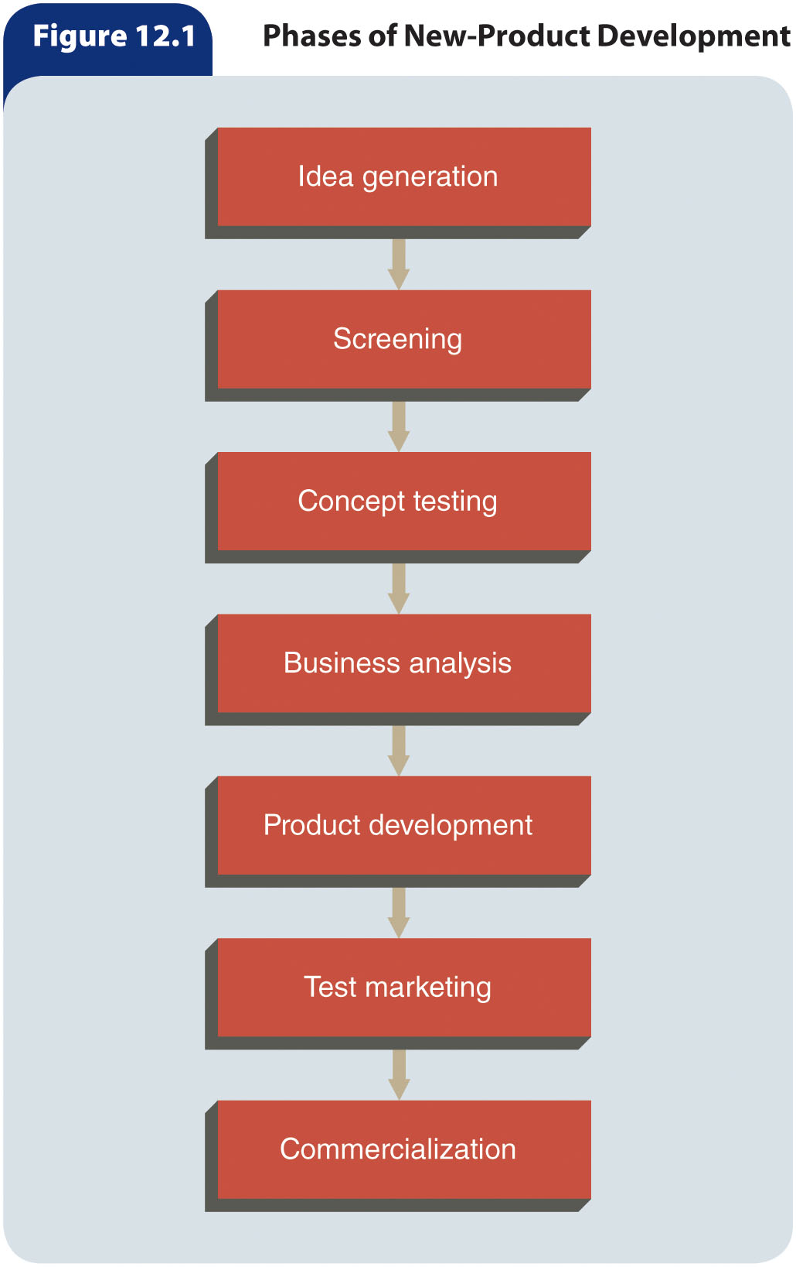
Figure 12.1 – Phases of New-Product Development

Slide 10
Idea Generation
Idea generation – Seeking product ideas to achieve organizational objectives
  New product ideas can come from several sources
    Internally through marketing managers, researchers, sales personnel, engineers, franchisees, or other organizational personnel
    Externally through customers, competitors, advertising agencies, management consultants, and private research organizations
      Increasingly, firms are bringing consumers into the product idea development process through online campaigns

Slide 11
Screening
Screening – Selecting the ideas with the greatest potential for further review
  Product ideas are analyzed to determine if they match the organization’s mission, objectives, and resources
  A firm’s overall abilities to produce and market the product are also analyzed
  At times, a checklist of new-product requirements is used when making screening decisions
  Most new product ideas are rejected during the screening phase

Slide 12
Concept Testing
Concept testing – Seeking a sample of potential buyers’ responses to a product idea
  May be necessary in order to evaluate ideas properly
  Is a low-cost procedure that allows a company to determine customers’ initial reactions to a product idea before it invests considerable resources in research and development

Slide 13
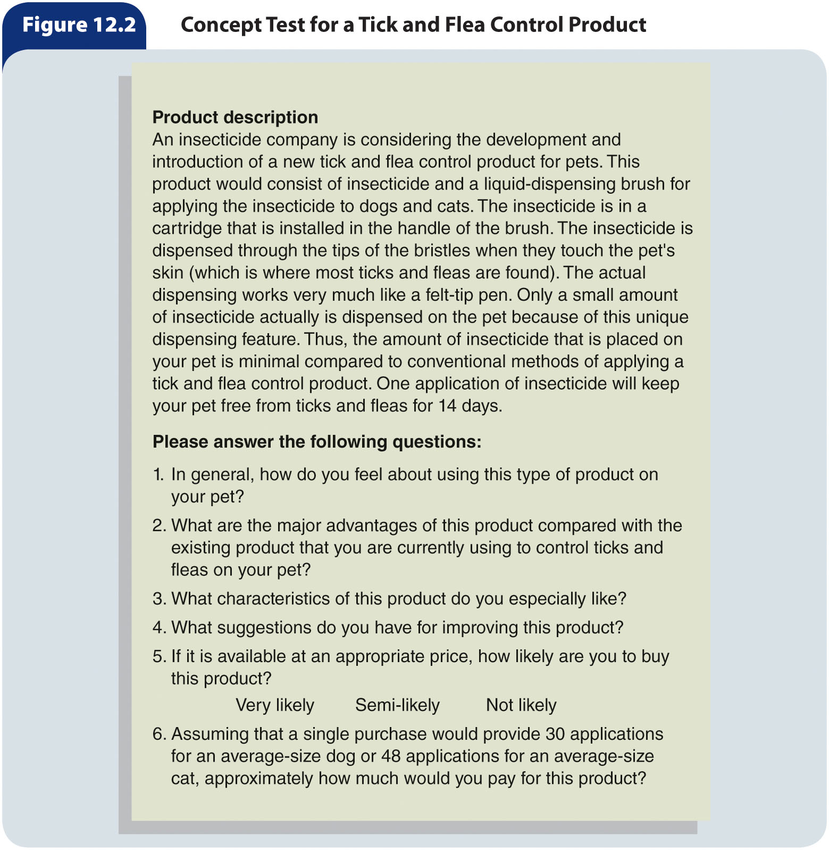
Figure 12.2 – Concept Test for a Tick and Flea Control Product

Slide 14
Business Analysis
Business analysis – Evaluating the potential impact of a product idea on the firm’s sales, costs, and profits
  Marketers ask a series of questions and attempt to answer them through market information
  The results of customer surveys, along with secondary data, supply the specifics needed to estimate potential sales, costs, and profits
  To forecast sales, organizations sometimes employ break even analysis to determine how many units they would have to sell to begin making a profit or payback analysis to compute the time period required to recover the funds that would be invested in developing the new product
    Because break even analysis and payback analyses are based on estimates, they are usually viewed as useful but not particularly precise tools

Slide 15
Product Development (slide 1 of 2)
Product development – Determining if producing a product is technically feasible and cost-effective
  To test its acceptability, the idea or concept is converted into a prototype, or working model
    After a prototype is developed, its overall functioning is assessed
      Its performance, safety, convenience, and other functional qualities are tested both in a laboratory and in the field

Slide 16
Product Development (slide 2 of 2)
A crucial question that arises during product development is how much quality to build into the product
  In determining the specific level of quality that is best for a product, a marketer must:
    Ascertain approximately what price the target market views as acceptable
    Set a quality level consistent with that of the firm’s other products
    Consider the quality of competing brands
The development phase of a new product is often a lengthy and expensive process
  As a result, only a relatively small number of products of product ideas are put into development

Slide 17
Test Marketing (slide 1 of 3)
Test marketing – A limited introduction of a product in geographic areas chosen to represent the intended market
  The aim is to determine the extent to which potential customers will buy the product
  Companies use test marketing to lessen the risk of product failure
Test marketing provides several benefits
  It lets marketers expose a product in a natural marketing environment to measure its sales performance
  The company can strive to identify weaknesses in the product or in other parts of the marketing mix
  Test marketing allows marketers to experiment with variations in advertising, pricing, and packaging in different test areas and to measure the extent of brand awareness, brand switching, and repeat purchases resulting from these alterations in the marketing mix

Slide 18
Test Marketing (slide 2 of 3)
Selection of appropriate test areas is very important because the validity of test marketing results depends heavily on selecting test sites that provide accurate representations of the intended target market
  The criteria used for choosing test cities depend upon the:
    Product’s attributes
    Target market’s characteristics
    Firm’s objectives and resources

Slide 19
Table 12.1 – Popular Test Markets in the United States
Rank | City
1 | Columbus, Ohio
2 | Peoria, Illinois
3 | Albany, New York
4 | Jacksonville, Florida
5 | Lexington, Kentucky
6 | Des Moines, Iowa
7 | Battle Creek, Michigan
8 | Greensboro, North Carolina
9 | Cleveland, Ohio
10 | Phoenix, Arizona

Slide 20
Test Marketing (slide 3 of 3)
Test marketing is expensive, and competitors may try to interfere by:
  Increasing their own advertising or promotions
  Lowering prices
  Offering special incentives
  Copying the product in the testing stage and rushing to introduce a similar product
Simulated test marketing
  Consumers at shopping centers are asked to view an advertisement for a new product and are given a free sample to take home, then are subsequently interviewed over the phone or through online panels and asked to rate the product
  Advantages:
    Greater speed
    Lower costs
    Tighter security
    Not all products that are test marketed are launched

Slide 21
Commercialization (slide 1 of 3)
Commercialization – Refining and finalizing plans and budgets for full-scale manufacturing and marketing of a product
  Early in this stage:
    Marketing management analyzes the results of test marketing to find out what changes in the marketing mix are needed before introducing the product
    Marketers must make decisions about warranties, repairs, and replacement parts
The product enters the market during the commercialization phase
  When introducing a product, a firm may spend enormous sums for advertising, personal selling, and other types of promotion, as well as on manufacturing and equipment costs
    Such expenditures may not be recovered for several years
Products are not usually launched nationwide overnight, but are introduced in stages through a process called a rollout
  With a rollout, a product is introduced starting in one geographic area or set of areas and gradually expands into adjacent ones

Slide 22
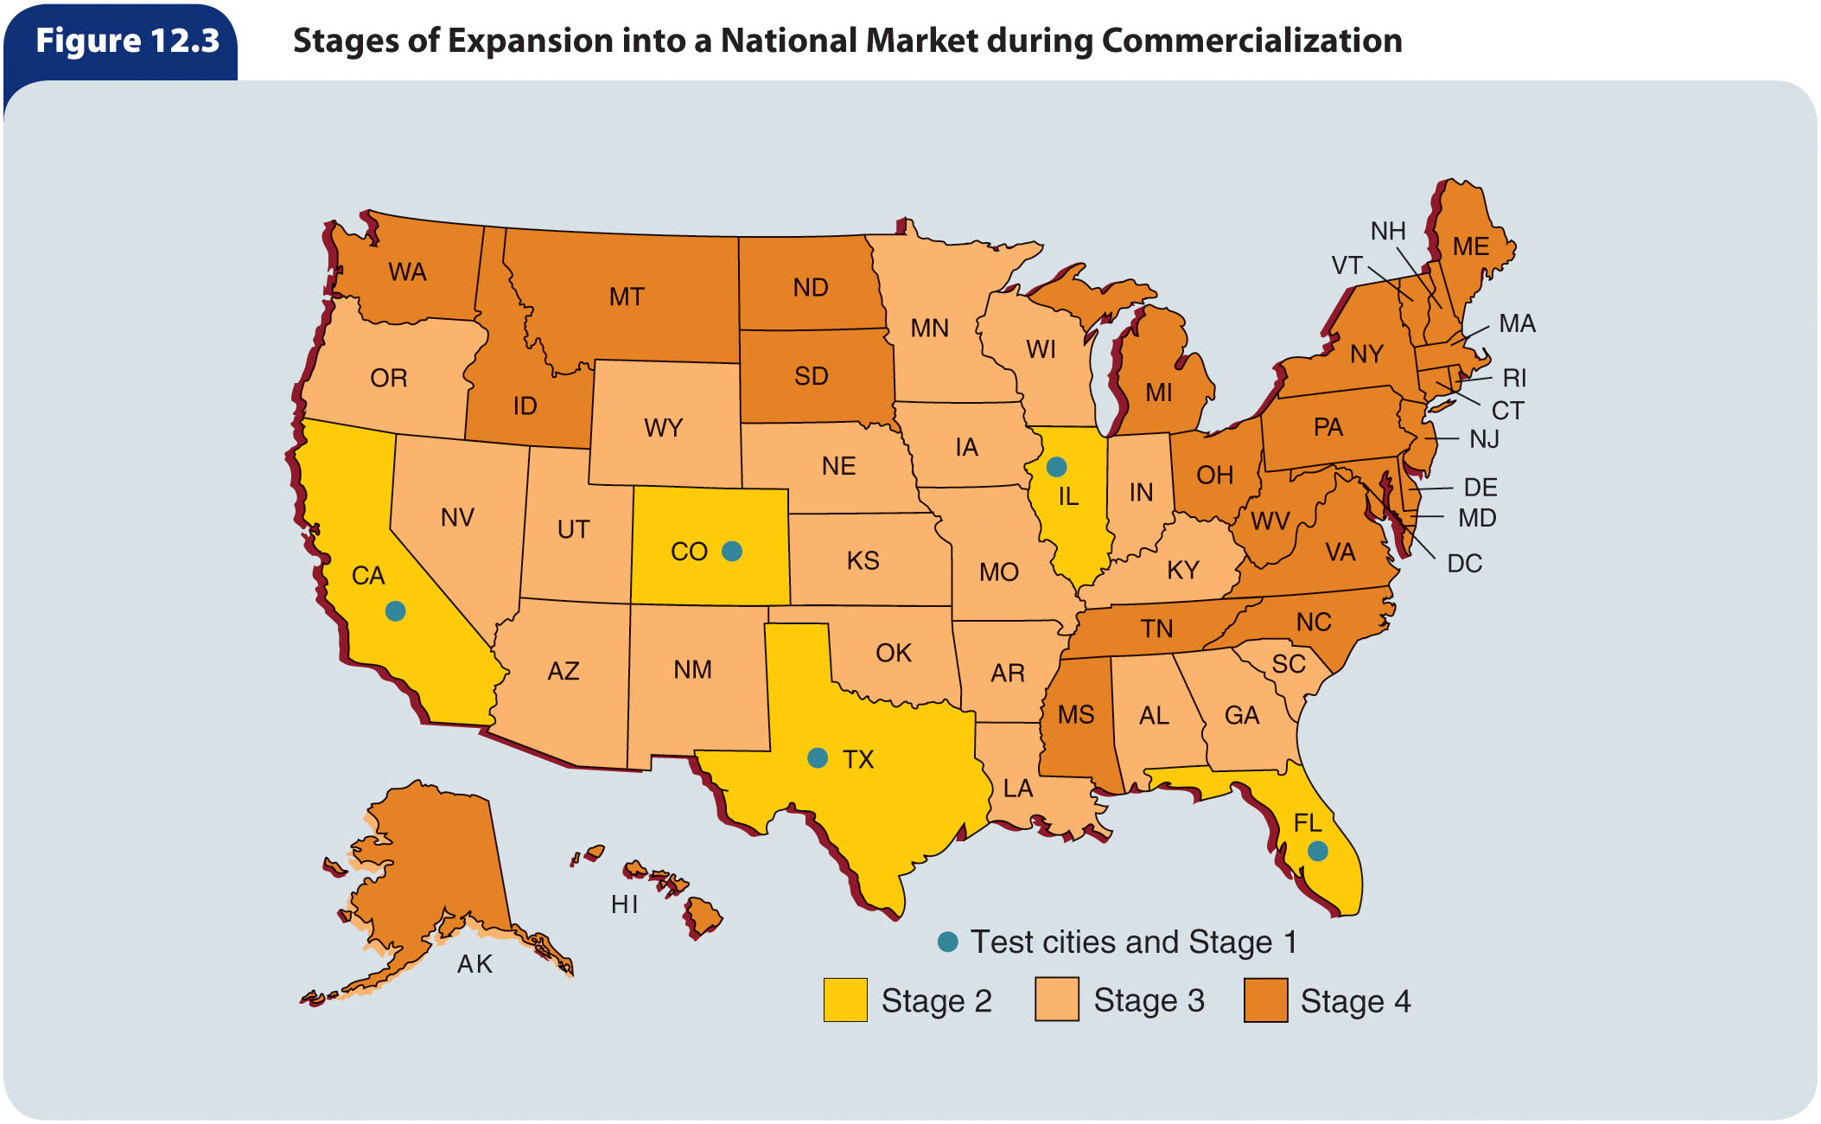
Figure 12.3 – Stages of Expansion into a National Market during Commercialization

Slide 23
Commercialization (slide 2 of 3)
Gradual product introduction is desirable for several reasons
  It reduces the risks of introducing a new product
    If the product fails, the firm will experience smaller losses if it introduced the item in only a few geographic areas than if it marketed the product nationally
  A company cannot introduce a product nationwide overnight, because a system of wholesalers and retailers to distribute the product cannot be established so quickly
  If the product is successful from launch, the number of units needed to satisfy nationwide demand for it may be too large for the firm to produce in a short time
  General introduction allows for fine-tuning of the marketing mix to satisfy target customers

Slide 24
Commercialization (slide 3 of 3)
Gradual product introduction can also create problems
  A gradual introduction allows competitors to observe what the firm is doing and monitor results just as the firm’s own marketers are doing
    If competitors see that the newly introduced product is successful, they may quickly enter the same target market with similar products
  As a product is introduced region by region, competitors may expand their marketing efforts to offset promotion of the new product
  Too much delay in launching a product can cause the firm to miss out on seizing market opportunities, creating competitive offerings, and forming cooperative relationships with channel members

Slide 25
Product Differentiation through Quality,
Design, and Support Services
Product differentiation – Creating and designing products so that customers perceive them as different from competing products
  Consumer perception is critical in differentiating products
  Three aspects of product differentiation companies must consider when creating and offering products for sale:
    Product quality
    Product design and features
    Product support services

Slide 26
Product Quality
Quality – The overall characteristics of a product that allow it to perform as expected in satisfying customer needs
  Two dimensions of quality:
    Level of quality – The amount of quality a product processes
    Consistency of quality – The degree to which a product has the same level of quality over time

Slide 27
Product Design and Features
Product design – How a product is conceived, planned, and produced
  Components of design:
    Styling – The physical appearance of a product
    Functionality
    Usefulness
Product features – Specific design characteristics that allow a product to perform certain tasks
  For a brand to have a sustainable competitive advantage, marketers must determine the product designs and features that customers desire
  Information from marketing research helps assess customers’ product design and feature preferences

Slide 28
Product Support Services
Customer services – Human or mechanical efforts or activities that add value to a product
Examples include: delivery and installation, financing arrangements, customer training, warranties and guarantees, repairs, layaway plans, convenient hours of operation, adequate parking, toll-free numbers, and websites.

Slide 29
Product Positioning
Product positioning – The decisions and activities intended to create and maintain a certain concept of the firm’s product, relative to competitive brands, in customers’ minds

Slide 30
Perceptual Mapping
To simplify buying decisions and avoid a continuous reevaluation of numerous products, buyers tend to group, or “position,” products in their minds
Rather than allowing customers to position products independently, marketers often try to influence and shape consumers’ concepts or perceptions of products through advertising
Marketers sometimes analyze product positions by developing perceptual maps
  Perceptual maps are created by questioning a sample of customers about their perceptions of products, brands, and organizations with respect to two or more dimensions

Slide 31
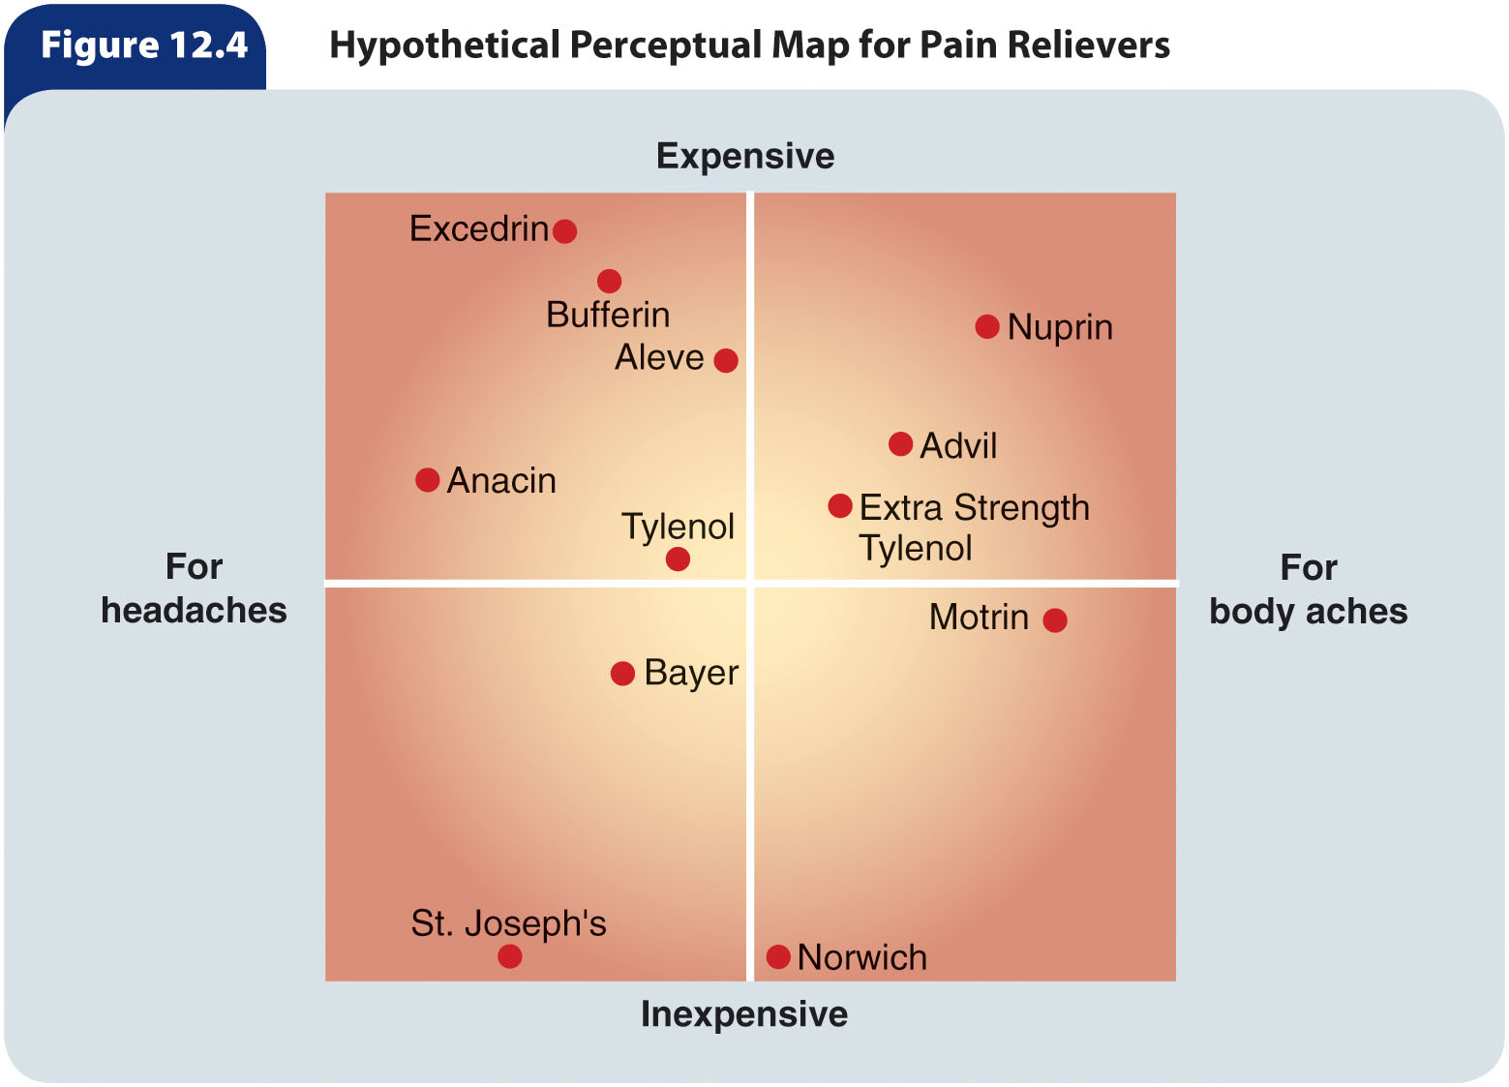
Figure 12.4 – Hypothetical
Perceptual Map for Pain Relievers

Slide 32
Bases for Positioning
Marketers can use several bases for product positioning
  Head-to-head
    Is best when the product’s characteristics are at least equal and if the product is priced lower
  Avoid competition
    Is critical when introducing a brand into a market in which the company already has one or more brands
A product’s position can be based on specific product attributes or features
  Other bases for product positioning include price, quality level, benefits provided by the product, and target market

Slide 33
Repositioning
A brand’s market share and profitability may be strengthened by product repositioning of existing products
Repositioning requires changes in perception and usually changes in product features
Repositioning can be accomplished physically by changing the product, its price, or its distributors
A marketer may reposition a product by aiming it at a different target market

Slide 34
Product Deletion (slide 1 of 2)
Product deletion – Eliminating a product from the product mix when it no longer satisfies a sufficient number of customers
  A declining product reduces an organization’s profitability and drains resources that could be used to modify other products or develop new ones
  A marginal product may require shorter production runs, which can increase per-unit production costs
  When a dying product loses favor with customers, the negative feelings may transfer to some of the company’s other products
  Product deletions may be met with opposition by management, salespeople, and other employees

Slide 35
Product Deletion (slide 2 of 2)
A systematic review allows an organization to improve product performance and ascertain when to delete products
There are three basic ways to delete a product:
  Phase-out – Allows a product to decline without a change in the marketing strategy
  Run-out – Exploits any strengths left in the product
  Immediate drop – Used when losses are too great to prolong the product’s life

Slide 36
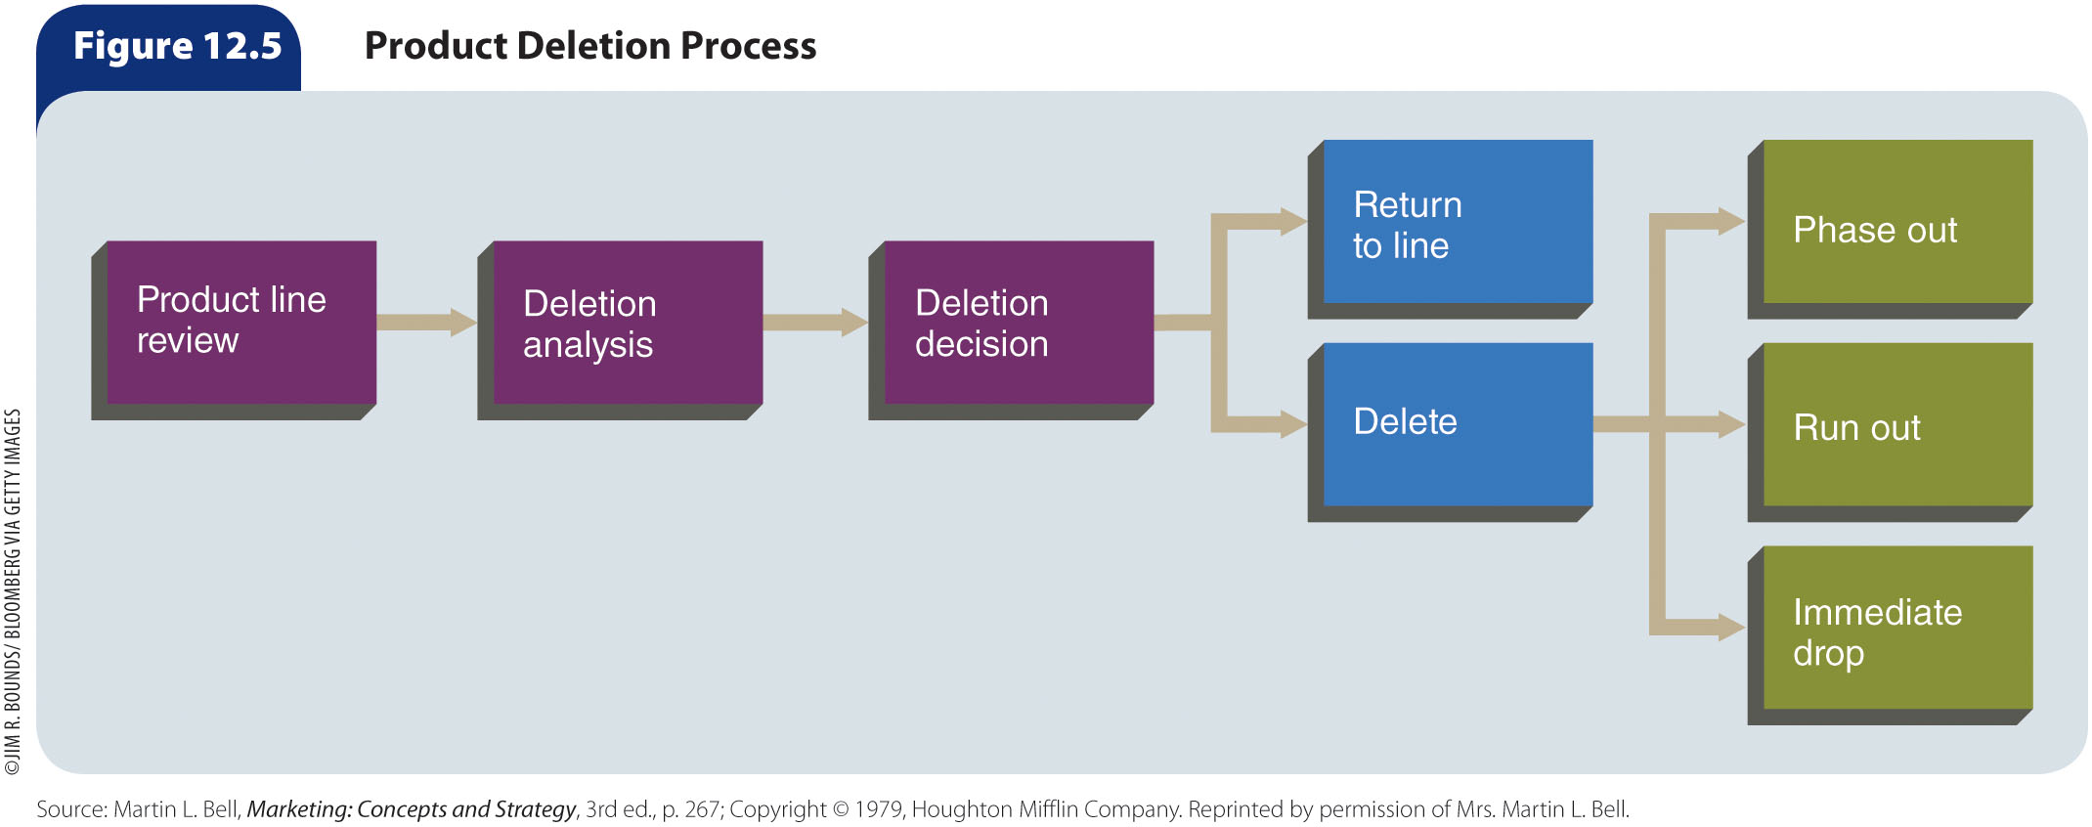
Figure 12.5 – Product
Deletion Process

Slide 37
Organizing to Develop and Manage Products
Product manager – The person within an organization who is responsible for a product, a product line, or several distinct products that make up a group
Brand manager – The person responsible for a single brand
Market manager – The person responsible for managing the marketing activities that serve a particular group of customers
Venture team – A cross-functional group that creates entirely new products that may be aimed at new markets

