Slide 1
Service Marketing
Chapter 13

Slide 2
Learning Objectives
LO 13-1 Discuss the growth and importance of services.
LO 13-2 Identify the characteristics of services that differentiate them from goods.
LO 13-3 Analyze how the characteristics of services influence the development of marketing mixes for services.
LO 13-4 Explain the importance of service quality and explain how to deliver exceptional service quality.
LO 13-5 Describe the nature of nonprofit marketing.

Slide 3
The Growth and Importance of Services (slide 1 of 2)
A service is an intangible product that involves a deed, a performance, or an effort that cannot be physically performed
Services are usually provided through the application of human and/or mechanical efforts that are directed at people or objects
More than one-half of new businesses in the United States are service businesses, and service employment is expected to continue to grow
  Homesourcing – A practice whereby customer contact jobs are outsourced into
  workers’ homes
Long-term economic growth, lifestyle changes, and technology have been major catalysts in the growth of consumer services

Slide 4
The Growth and Importance of Services (slide 2 of 2)
The growth in business services can be attributed to the increasingly complex, specialized, and competitive business environment
Services as products should not be confused with the related topic of customer service
  Customer service involves any human, mechanical, or electronic activity that adds value to the product
  Although customer service is a part of the marketing of goods, service marketers also provide customer services

Slide 5
Characteristics of Services
Intangibility
Inseparability of production and consumption
Perishability
Heterogeneity
Client-based relationships
Customer contact

Slide 6
Intangibility
Intangibility – The characteristic that a service is not physical and cannot be perceived by the senses
  Is the major characteristic that distinguishes a service from a good
    Services cannot be physically possessed
  The level of intangibility of a service increases the overall importance of the brand image when a consumer is deciding which to purchase

Slide 7
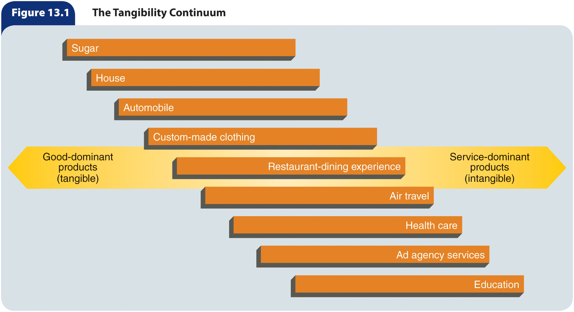
Figure 13.1 – The
Tangibility Continuum

Slide 8
Inseparability of Production and Consumption (slide 1 of 2)
Inseparability – The quality of being produced and consumed at the same time
Production of a service cannot be separated from its consumption by customers
Customers must be present at the consumption of the service and cannot take the service home
Implies a shared responsibility between the customer and service provider

Slide 9
Perishability
Perishability – The inability of unused service capacity to be stored for future use
Service marketers face several hurdles in trying to balance supply and demand
  Goods marketers can handle the supply–demand problem through production scheduling and inventory techniques

Slide 10
Heterogeneity
Heterogeneity – Variation in quality
Because of the nature of human behavior, it is very difficult for service providers to maintain a consistent quality of service delivery
  Although many service problems are one-time events that cannot be predicted or controlled ahead of time, employee training and the establishment of standard procedures can help increase consistency and reliability
Heterogeneity usually increases as the degree of labor intensiveness increases
  Equipment-based services have greater homogeneity than people-based services

Slide 11
Client-Based Relationships
Client-based relationships – Interactions that result in satisfied customers who use a service repeatedly over time
  It is important for service providers to maintain customers/clients over the long-term
    Build trust
    Demonstrate customer commitment
    Satisfy customers
Word-of-mouth communication is a key factor in creating and maintaining client-based relationships

Slide 12


Customer Contact (slide 1 of 2)
Customer contact – The level of interaction between provider and customer needed to deliver the service
  The physical appearance of the facility is an important component of the customer’s overall evaluation of the service
Low
Tax preparation
Auto repair
Dry cleaning
High
Health care
Real estate
Legal services
Level of
Contact

Slide 13
Customer Contact (slide 2 of 2)
Employee satisfaction is one of the most important factors in providing high service quality to customers
  Service organizations must take steps to understand and meet the needs of
  employees by:
    Training them adequately
    Empowering them to make decisions
    Rewarding them for customer-oriented behavior

Slide 14
Table 13.1 – Service Characteristics and Marketing Challenges (slide 1 of 2)
Service Characteristics | Resulting Marketing Challenges
Intangibility | Difficult for customer to evaluate. Customer does not take physical possession. Difficult to advertise and display. Difficult to set and justify prices. Service process is usually not protectable by patents.
Inseparability of production and consumption | Service provider cannot mass-produce services. Customer must participate in production. Other consumers affect service outcomes. Services are difficult to distribute.
Perishability | Services cannot be stored. Balancing supply and demand is very difficult. Unused capacity is lost forever. Demand may be very time sensitive.

Slide 15
Table 13.1 – Service Characteristics and Marketing Challenges (slide 2 of 2)
Service Characteristics | Resulting Marketing Challenges
Heterogeneity | Service quality is difficult to control. Service delivery is difficult to standardize.
Client-based relationships | Success depends on satisfying and keeping customers over the long term. Generating repeat business is challenging. Relationship marketing becomes critical.
Customer contact | Service providers are critical to delivery. Requires high levels of service employee training and motivation. Changing a high-contact service into a low-contact service to achieve lower costs is difficult to achieve without reducing customer satisfaction.

Slide 16
Development of Services
A service offered by an organization is generally a package, or bundle, of services consisting of a core service and one or more supplementary services
  Core service – The basic service experience or commodity that a customer expects to receive
  Supplementary service – Supports the core service used to differentiate the service bundle from those of competitors
Heterogeneity allows for service marketers to customize their services to match the specific needs of individual customers, which creates a competitive advantage
Because customized services can be expensive, some service marketers offer standardized packages in order to provide service at an acceptable level of quality in an efficient and economic manner and still satisfy individual customer needs
To cope with the problem of intangibility, marketers employ tangible cues to assure customers about the quality and professionalism of the service
  Well-groomed, professional-appearing contact personnel
  Clean, attractive physical facilities

Slide 17
Distribution of Services
Marketers deliver services in various ways
  Customers go to the service provider’s facility
  Services may be provided at the customer’s home or business
  Services may be delivered at “arm’s length,” meaning no face-to-face contact occurs between the customer and service provider
Marketing channels for services usually are short and direct
  Some services use intermediaries
Inventory management, especially balancing supply and demand for services, is a serious concern for service marketers
To make delivery more accessible to customers and increase the supply of a service, as well as reduce labor costs, some service providers have replaced some contact personnel with equipment
  In other words, they have changed a high-contact service into a low-contact one

Slide 18
Promotion of Services
The intangibility of services results in several promotion-related challenges to service marketers
Promotion of services typically includes tangible cues that symbolize the service
Compared with goods marketers, service providers are more likely to promote: price, guarantees, performance documentation, availability, and training and certification of personnel.
Personal selling can help customers visualize the benefits of a given service
Word-of-mouth communication is important in service promotion

Slide 19
Pricing of Services (slide 1 of 3)
Pricing should consider:
  Consumer price sensitivity
  The nature of the transaction
  Its costs
Prices can be based on the:
  Performance of specific tasks
  Time spent on the task
  Level of demand
Demand-based pricing
  When demand for a service is high, the price is also high
  When demand for a service is low, so is the price
Off-peak pricing – The practice of reducing prices of services used during slow periods in order to boost demand

Slide 20
Pricing of Services (slide 3 of 3)
In cases where customers tend to purchase services in a bundle, marketers must decide whether to offer the services at one price, price them separately, or use a combination of the two methods
Consumers sometimes rely heavily on price as an indicator of service quality
Market conditions may limit how much can be charged for a specific service
  Especially if the services in this category are perceived as generic in nature
State and local government regulations may reduce price flexibility in some industries

Slide 21
Service Quality
Service quality – Customers’ perceptions of how well a service meets or exceeds their expectations
Customers evaluate service quality
It is important for service organizations to determine what customers expect and then develop service products that meet or exceed those expectations

Slide 22
Customer Evaluation of
Service Quality (slide 1 of 3)
Search qualities – Tangible attributes that can be judged before the purchase of a product
Experience qualities – Attributes that can be assessed only during purchase and consumption of a service
Credence qualities – Attributes that customers may be unable to evaluate even after purchasing and consuming a service

Slide 23
Customer Evaluation of
Service Quality (slide 2 of 3)
The biggest obstacle for customers in evaluating service quality is the intangible nature of the service
Service quality is sometimes the only way customers can choose one service over another
  For this reason, successful service marketers must understand how customers judge service

Slide 24
Table 13.2 – Dimensions of Service Quality (Slide 1 of 2)
Dimension | Evaluation Criteria | Examples
Tangibles: Physical evidence of the service | Appearance of physical facilities Appearance of service personnel Tools or equipment used to provide the service | A clean and professional-looking doctor’s office A clean and neatly attired repairperson The freshness of food in a restaurant The equipment used in a medical exam
Reliability: Consistency and dependability in performing the service | Accuracy of billing or recordkeeping Performing services when promised | An accurate bank statement A confirmed hotel reservation An airline flight departing and arriving on time

Slide 25
Table 13.2 – Dimensions of Service Quality (Slide 2 of 2)
Dimension | Evaluation Criteria | Examples
Responsiveness: Willingness or readiness of employees to provide the service | Returning customer phone calls Providing prompt service Handling urgent requests | A server refilling a customer’s cup of coffee without being asked An ambulance arriving within 3 minutes
Assurance: Knowledge/ competence of employees and ability to convey trust and confidence | Knowledge and skills of employees Company name and reputation Personal characteristics of employees | A highly trained financial advisor A known and respected service provider A doctor’s bedside manner
Empathy: Caring and individual attention provided by employees | Listening to customer needs Caring about customers’ interests Providing personalized attention | A store employee listening to and trying to understand a customer’s complaint A nurse counseling a heart patient

Slide 26
Customer Evaluation of
Service Quality (slide 3 of 3)
Except for the tangibles dimension, the criteria customers use to judge service quality are intangible
  Because these dimensions cannot be examined with the senses, customers must rely on other ways of judging service
    One of the most important factors in customer judgments of service quality is service expectations
      Service expectations are influenced by:
        Past experiences with the service
        Word-of-mouth communication from other customers
        The service company’s own advertising

Slide 27
Delivering Exceptional Service Quality
Providing high-quality service consistently is very difficult
Four factors that affect service quality:
  Analysis of customer expectations
  Service quality specifications
  Employee performance
  Management of service expectations

Slide 28
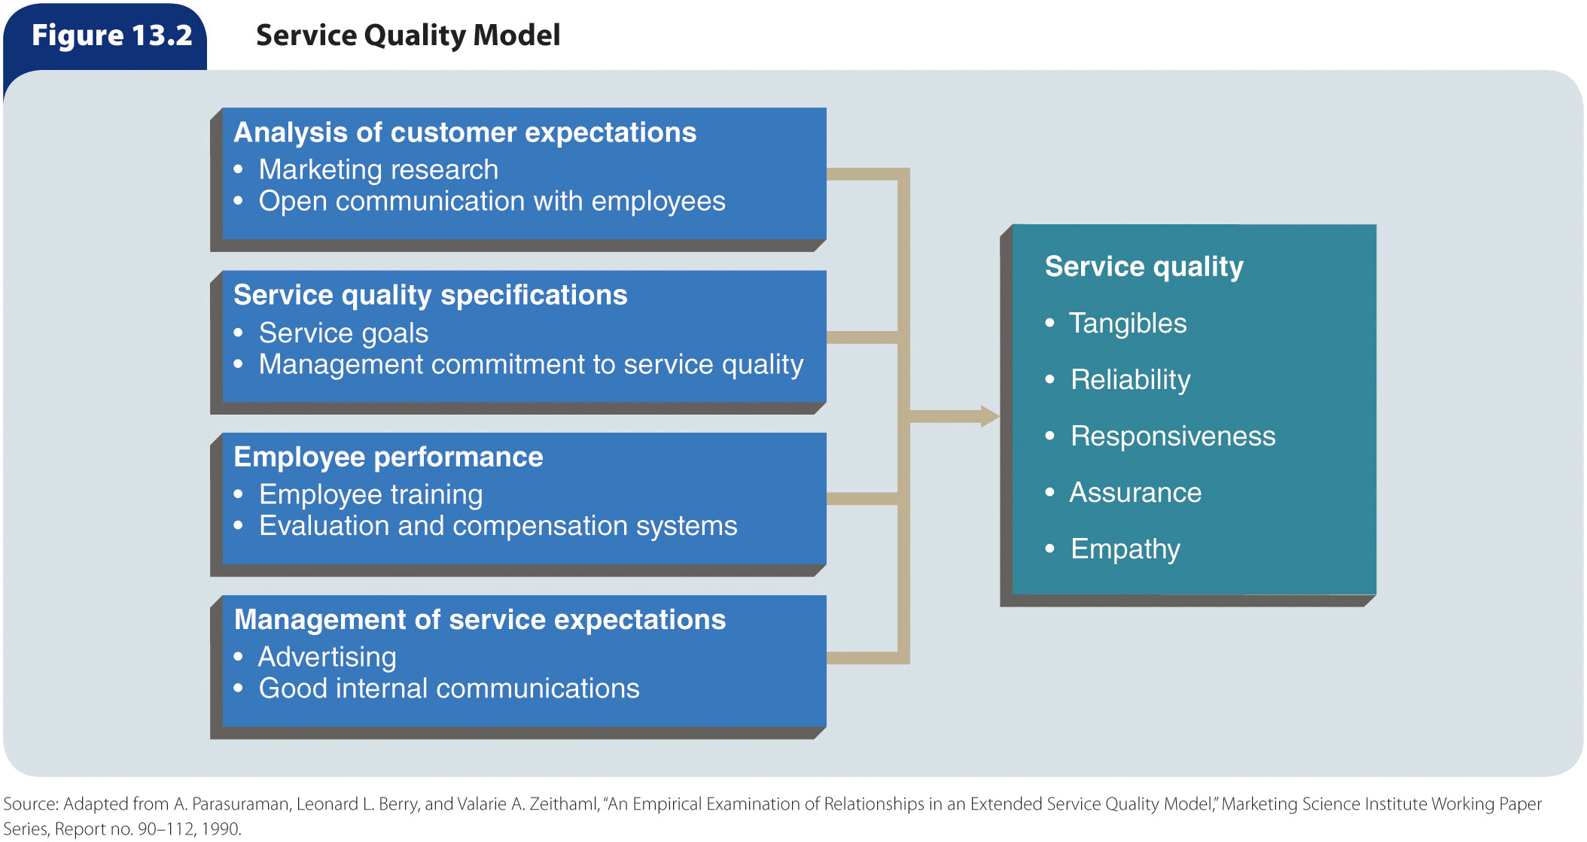
Figure 13.2 – Service Quality Model

Slide 29
Analysis of Customer Expectations
Customers usually have two levels of expectations:
  Desired
    What the customer really wants
  Acceptable
    What the customer views as adequate
Zone of tolerance – The difference between the two levels of expectations
Because customer-contact employees interact daily with customers, they are in good positions to learn what consumers want from the company

Slide 30
Service Quality Specifications
Once an organization understands its customers’ needs, it must establish goals to help ensure good service delivery
  These goals, or service specifications, are typically set in terms of employee or machine performance
The most critical aspect of service quality specifications is managers’ commitment to service quality
  Service managers who are committed to quality become role models for all employees in the organization

Slide 31
Employee Performance
Customer-contact employees in most service industries are often the least-trained and lowest-paid members of the organization
There is a direct relationship between the satisfaction of a company’s contact employees, which is manifested in a positive attitude and a good work ethic, and the satisfaction of its customers
  Employee and customer satisfaction levels also have a direct relationship with customer retention and loyalty
The way to ensure that employees perform well is to train them effectively so they understand how to do their jobs
The evaluation and compensation system the organization uses also plays a part in employee performance

Slide 32
Management of Service Expectations
Service companies must set realistic expectations about the services they provide and deliver on promises made
  Advertising
  Good internal communication
Word-of-mouth communication from other customers shapes expectations
  Because service companies cannot manage this “advertising” directly, the best way to ensure positive word-of-mouth communication is to provide exceptional service quality

Slide 33
Nonprofit Marketing
Nonprofit marketing – Marketing activities conducted to achieve some
goal other than ordinary business goals such as profit, market share, or return on investment
Divided into two categories:
  Nonprofit-organization marketing
    The use of marketing concepts and techniques by organizations whose goals do not include making profits
  Social marketing
    Promotes social causes

Slide 34
How Is Nonprofit
Marketing Different?
Activities benefit clients, members, or public
Greater opportunities for creativity
Goal is not profit-driven
More difficult to judge performance
Sometimes controversial

Slide 35
Nonprofit Marketing Objectives
The basic aim of nonprofit organizations is to obtain a desired response from a target market
  Change in values
  Financial contribution
  Donation of services
Nonprofit marketing objectives are shaped by the nature of the exchange and goals of the organization

Slide 36
Developing Nonprofit
Marketing Strategies
Nonprofit organizations develop marketing strategies by defining and analyzing a target market and creating and maintaining a total marketing mix that appeals to that market

Slide 37
Target Markets
Target public – A collective of individuals who have an interest in or a concern about an organization, a product, or a social cause
Client publics – Direct consumers of a product of a nonprofit organization
General publics – Indirect consumers of a product of a nonprofit organization

Slide 38
Developing Marketing Mixes (slide 1 of 2)
A marketing strategy should include a blueprint for making decisions about product, distribution, promotion, and price
Organizations must define what they are providing
  Nonprofit organizations usually deal with ideas and concepts, which require more effort to present benefits than the marketing of tangibles
Distribution decisions in nonprofit organizations relate to how ideas and services will be made available to clients
  In a nonprofit setting, marketers may need to revise the traditional concept of the marketing channel
Nonprofits use advertising and publicity to communicate with clients and the public

Slide 39
Developing Marketing Mixes (slide 2 of 2)
Nonprofit organizations must determine pricing in user and donor markets
  May have fixed fees for users
  Variable fees change depending on the user’s ability to pay
Opportunity cost – The value of the benefit given up by choosing one alternative over another

