Slide 1
Professor
Name
Institution
Video Games

Slide 2
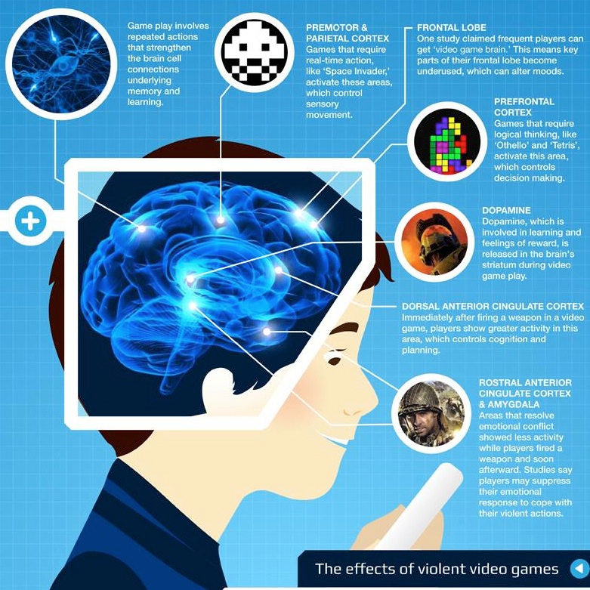
Video game
Technological improvement has come up the majority of the factors regarding our everyday routine has become more comfortable and sufficient
Recent developments have caused the growing number of risk factors in regard to humans’ mental and physical health.
There are negative consequences caused video game.
Video game development of addiction and behavior issues, like parental control over the children’s interests in gaming
Implementation of outdoor activities in schools will result in the overall improvement of the youth’s behaviors.
Notes:
With the process of technological improvement, the majority of the factors regarding our everyday routine has become more comfortable and sufficient; however, the recent developments have also caused the growing number of risk factors in regard to humans’ mental and physical health. One of the threats to become more noticeable in the modern society is interwoven with the growing popularity of video games, especially among the youth, and the negative consequences caused by the process. There are a plethora of potential minor adjustments to reduce the negative effects of video games and thus, improve the overall state of mental health of the society. Despite the fact that the negative effects video games may have on the youth, including the development of addiction and behavior issues, such solutions as parental control over the children’s interests in gaming and implementation of outdoor activities in schools will influence the tendencies positively and result in the overall improvement of the youth’s behaviors.

Slide 3

Video game
One of the most crucial issues caused by the growing popularity of video games is the developing addiction to them.
According to the study conducted by Douglas Gentile, over 3 million Americans between the ages of 8 and 18 play video games (597)
The fact that video games affect a vast audience of the modern youth is evident
negative consequences occur because of not implementing any changes with the purpose of improving the current situation
Most evident results of video games being popular among the youth
There is probability of the developed addiction to the activity among a certain number of individuals among the vast population involved in gaming.
Notes:
First of all, one of the most crucial issues caused by the growing popularity of video games is the developing addiction to them. According to the study conducted by Douglas Gentile, over 3 million Americans between the ages of 8 and 18 play video games (597). Thus, the fact that video games affect a vast audience of the modern youth is evident, and the possibility of the multiplicity of negative consequences occurring is apparent in case of not implementing any changes with the purpose of improving the current situation. One of the most evident results of video games being popular among the youth is the probability of the developed addiction to the activity among a certain number of individuals among the vast population involved in gaming.

Slide 4
Video game
There is an issue potential skepticism of certain people regarding the issue being fictitious
skepticism result from the older generation being overprotective of the youth and not understanding the modern tendencies
The World Health Organization has recognized gaming addiction to be a medical disorder and included it in the newest version of International Classification of Diseases (Wakefield, 2018).
Such a step is crucial for the modern society as it acknowledges the fact of the apparition of mental health conditions
Development and popularization of technology has influenced video gaming
Notes:
Despite the potential skepticism of certain people regarding the issue being fictitious and resulting from the older generation being overprotective of the youth and not understanding the modern tendencies, the World Health Organization has recognized gaming addiction to be a medical disorder and included it in the newest version of International Classification of Diseases (Wakefield, 2018). Such a step is crucial for the modern society as it acknowledges the fact of the apparition of mental health conditions, which are primarily caused by the development and popularization of technology.

Slide 5

Video game and addiction
Video game and addiction
There is a drastic difference between the addiction disorder and a child’s interest in video games.
With the official recognition of the condition, it would be easier for the parents to understand the issues their children are undergoing
For the troubled youth to seek and receive help, and for the doctors to be able to determine the disorder and cure it.
There is an increasing level of aggression and hostility among the gamers.
Notes:
Admittedly, there is a drastic difference between the addiction disorder and a child’s interest in video games. With the official recognition of the condition, it would be easier for the parents to understand the issues their children are undergoing, for the troubled youth to seek and receive help, and for the doctors to be able to determine the disorder and cure it.
Aside from the determined above the risk of youth becoming addicted to video games, there are multiple other negative consequences brought about by the popularization of gaming. The most evident for the general population issue is the increasing level of aggression and hostility among the gamers. Such a fact has been supported by multiple studies.

Slide 6
Effects of video game
For instance, Anderson and Bushman have conducted both experimental and non-experimental studies on video game
Violent behavior among children and young adults is increased by long-term involvement in video games (358).
There is a correlation between violence in video games and increase in aggressive thoughts,
Video game leas to acquired lack of social skills.
Physiological demonstration of hostile tendencies related to video games has been conducted recently, and it concluded that aggression and heart rate levels increase drastically relatively to the time spent playing (Barlett, Harris, & Baldassaro, 495).
Notes:
For instance, Anderson and Bushman have conducted both experimental and non-experimental studies with different age groups in various setting to conclude that the violent behavior among children and young adults is increased by long-term involvement in video games (358). The study also determines the correlation between violence in video games and increase in aggressive thoughts, as well as acquired lack of social skills. More than that, the study to analyze the level of physiological demonstration of hostile tendencies related to video games has been conducted recently, and it concluded that aggression and heart rate levels increase drastically relatively to the time spent playing (Barlett, Harris, & Baldassaro, 495).

Slide 7
Studies on correlation between the interest in video games and negative effects
All of the presented studies on the topic suggest the correlation between the redundant interest in video games and the negative consequences in multiple aspects of the humans’ lives.
Thus, the necessity to influence the presence of video gaming in the routine is a crucial step in order to reduce the negative consequences.
Among the possible ways to influence the negative tendencies of video games and their effects on the society and particular individuals are the steps to aim at children.
Youth, are most likely to become addicted to gaming.
The steps should focus on providing the younger audience with the alternative ways of spending their spare time.
Notes:
All of the presented studies on the topic suggest the correlation between the redundant interest in video games and the negative consequences in multiple aspects of the humans’ lives. Thus, the necessity to influence the presence of video gaming in the routine is a crucial step in order to reduce the negative consequences.
Among the possible ways to influence the negative tendencies of video games and their effects on the society and particular individuals are the steps to aim at children and youth, who are the most likely to become addicted to gaming. The steps should focus on providing the younger audience with the alternative ways of spending their spare time.

Slide 8
Influence of video Game
Video games have an influence on children and young adults
Video have adverse effects on the elders
Studies have shown that gaming itself does not directly influence the mood and behavior alterations in adults
Those who experience states relatively close to addiction are more likely to struggle from depression
Issues of heavy episodic drinking, and degradation of educational skills are some of negative effectives of video game (Brunborg, Mentzoni, & Frøyland, 30).
Notes:
Despite the fact that the above studies mostly focus on the influence video games have on children and young adults, the adverse effects gaming has on the elders have also been examined. For instance, one report suggests that though gaming itself does not directly influence the mood and behavior alterations in adults, those who experience states relatively close to addiction are more likely to struggle from depression, heavy episodic drinking, and degradation of educational skills (Brunborg, Mentzoni, & Frøyland, 30). All of the presented studies on the topic suggest the correlation between the redundant interest in video games and the negative consequences in multiple aspects of the humans’ lives. Thus, the necessity to influence the presence of video gaming in the routine is a crucial step in order to reduce the negative consequences.

Slide 9

Steps to reduce negative effects of video game
Among the possible ways to influence the negative tendencies of video games and their effects on the society and particular individuals are the steps to aim at children and youth, who are the most likely to become addicted to gaming.
The steps should focus on providing the younger audience with the alternative ways of spending their spare time.
In schools, it would be reasonable to organize a more significant number of outdoor activities, promote an active lifestyle, and focus on the encouragement of the students who are interested in participating in sports clubs or other types of after-school occupations provided.
The children who could potentially become negatively influenced by video games, experience their negative consequences, and struggle from addiction would be less likely to spend the majority of their time at home.
Notes:
Among the possible ways to influence the negative tendencies of video games and their effects on the society and particular individuals are the steps to aim at children and youth, who are the most likely to become addicted to gaming. The steps should focus on providing the younger audience with the alternative ways of spending their spare time. For instance, in schools, it would be reasonable to organize a more significant number of outdoor activities, promote an active lifestyle, and focus on the encouragement of the students who are interested in participating in sports clubs or other types of after-school occupations provided. In such a way, the children who could potentially become negatively influenced by video games, experience their negative consequences, and struggle from addiction would be less likely to spend the majority of their time at home.

Slide 10

Steps in reducing negative effects of video games
Parents as role model
It is natural that children communicate with their parents and usually view them as role models.
Address parents regarding the potential negative consequences of violent video games, so that they are interested in limiting their children’s involvement in the activity.
In such a way, the youth would still be able to enjoy gaming during a limited time, and the adults would have control over the negative results.
Overall, the responsibility of controlling and limiting the children’s interest and involvement in video games depends on adults, as they are able to analyze the potential risks and ways to decrease them.
Notes:
However, it is natural that children communicate with their parents and usually view them as role models. Therefore, a great suggestion would be to address parents regarding the potential negative consequences of violent video games, so that they are interested in limiting their children’s involvement in the activity. In such a way, the youth would still be able to enjoy gaming during a limited time, and the adults would have control over the negative results. Overall, the responsibility of controlling and limiting the children’s interest and involvement in video games depends on adults, as they are able to analyze the potential risks and ways to decrease them.

Slide 11
Conclusion
The issue of video gaming is becoming more crucial nowadays as a result of technological development, its popularization, and easy access of teens to the activity.
Among the multiplicity of the adverse effects, gaming may have on the youth are the increasing levels of hostility and aggression, degradation of socialization skills, and the risk of obtaining an addiction.
More than that, access video games also may poorly affect adults and result in the higher chances of developing depression, drinking problems, and lack of learning skills.
To prevent the potential spreading of the negative consequences, the society should mostly focus on teens who are the most likely to be affected.
Among the ways of the issue’s solution are the increasing control of the children’s parents over their gaming interest and the implementation of a more significant number of outdoor activities in schools.
Notes:
To conclude, the issue of video gaming is becoming more crucial nowadays as a result of technological development, its popularization, and easy access of teens to the activity. Among the multiplicity of the adverse effects, gaming may have on the youth are the increasing levels of hostility and aggression, degradation of socialization skills, and the risk of obtaining an addiction. More than that, access video games also may poorly affect adults and result in the higher chances of developing depression, drinking problems, and lack of learning skills. To prevent the potential spreading of the negative consequences, the society should mostly focus on teens who are the most likely to be affected. Among the ways of the issue’s solution are the increasing control of the children’s parents over their gaming interest and the implementation of a more significant number of outdoor activities in schools.

Slide 12
Work cited
Anderson, Craig A., and Brad J. Bushman. “Effects of Violent Video Games on Aggressive Behavior, Aggressive Cognition, Aggressive Affect, Physiological Arousal, and Prosocial Behavior: A Meta-Analytic Review of the Scientific Literature.” Psychological Science, vol. 12, no. 5, 2001, pp. 353–359., doi:10.1111/1467-9280.00366.
Barlett, Christopher P., et al. “Longer You Play, the More Hostile You Feel: Examination of First Person Shooter Video Games and Aggression during Video Game Play.” Aggressive Behavior, vol. 33, no. 6, 2007, pp. 486–497., doi:10.1002/ab.20227.
Brunborg, Geir Scott, et al. “Is Video Gaming, or Video Game Addiction, Associated with Depression, Academic Achievement, Heavy Episodic Drinking, or Conduct Problems?” Journal of Behavioral Addictions, vol. 3, no. 1, 2014, pp. 27–32., doi:10.1556/jba.3.2014.002.
Gentile, Douglas. “Pathological Video-Game Use Among Youth Ages 8 to 18.” Psychological Science, vol. 20, no. 5, 2009, pp. 594–602., doi:10.1111/j.1467-9280.2009.02340.x.
Wakefield, Jane. Gaming Addiction Classified as Disorder by WHO. 2 Jan. 2018, www.bbc.com/news/technology-42541404.

