Slide 1
Project in C Program
Roving Vehicle

Slide 2
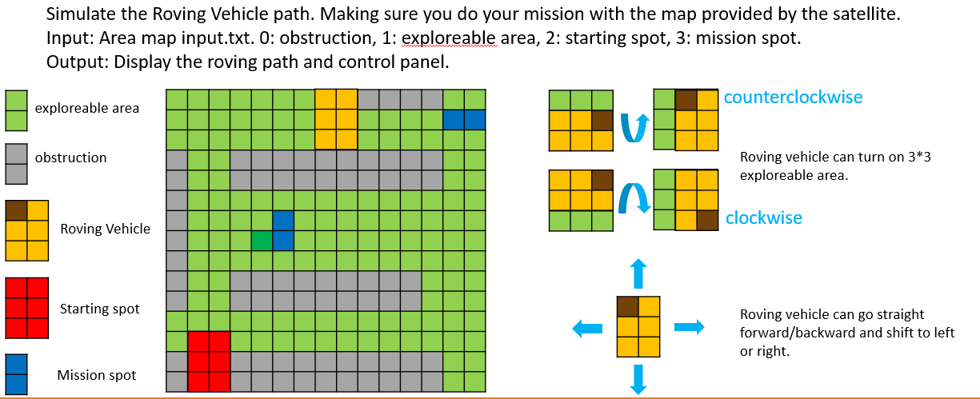

Slide 3
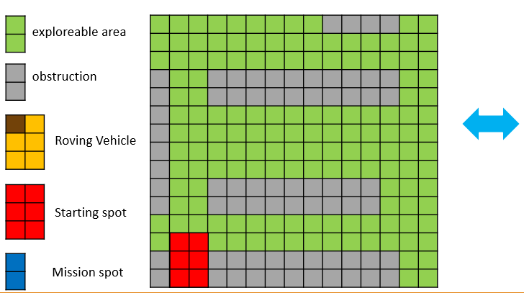
Task:
Because the fuel of the roving vehicle should be used with caution.
So, less fuel is better.
Fuel consumption status:
  Moving forward/backward 1 slot need 1 fuel unit.
  Shifting left/right 1 slot need 2 fuel unit.
  Turn clockwise/counterclockwise need 5 fuel unit.
And you need to do at least 2 tasks:
  If there’s a mission spot(or some spots), you need to find the way to reach all spots.
  If there’s no mission spot, you need to scan the soil spot as many as possible.
111111111000011
111111111111111
111111111111111
011000000000011
011000000000011
011111111111111
011111111111111
011111111111111
011111111111111
111111111111111
122111111111111
022000000000011
022000000000011
input.txt
The program should be able to run the map at least 15*15. The bigger the better.

Slide 4
Program requirement:
Must write by C program
Interface can show the map, path, result, control panel(how many fuel unit your cost, how many slots you scan, … etc).
If there’s a mission spot(or some spots), you need to find the way to reach all spots.
If there’s no mission spot, you need to scan the soil spot as many as possible.

