Slide 1

Legal Forms of Property
Students Name
Institution

Slide 2

The Concept of property
A property refers to anything that is owned by someone or by an entity.
In law, the key concept of property is having the right to ownership, that is the binding term that determines where the property belongs.
There are different types of properties that are governed with different legal systems .
The main three types of property are:
Intellectual property
Personal property
Real property

Slide 3

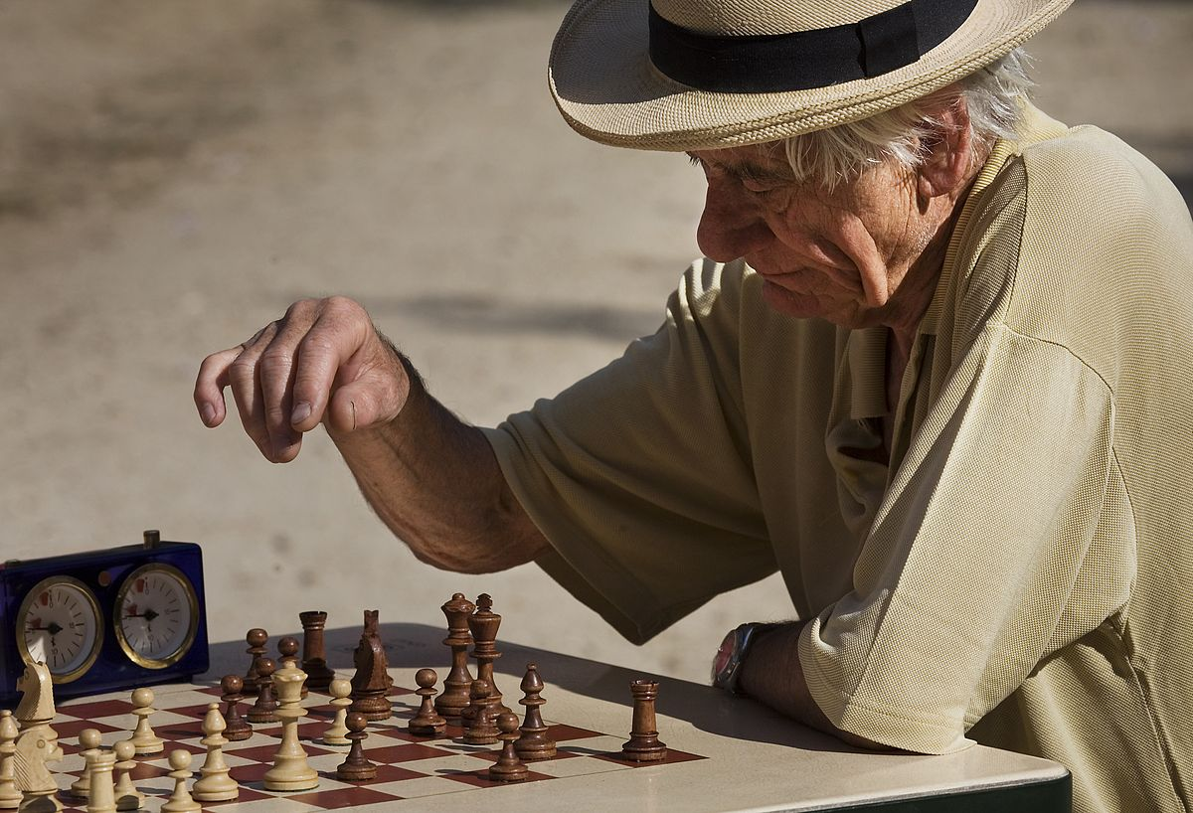
Intellectual Property
It refers to the assets that are created by the mind which are then used to earn money.
They include artistic works, images, symbols and other designs. Examples include music, videos.
Intellectual property is mainly protected by law using copyrights, trademarks and patents.
These factors help owners to earn recognition for their work.
(Ramaekers, 2017)

Slide 4
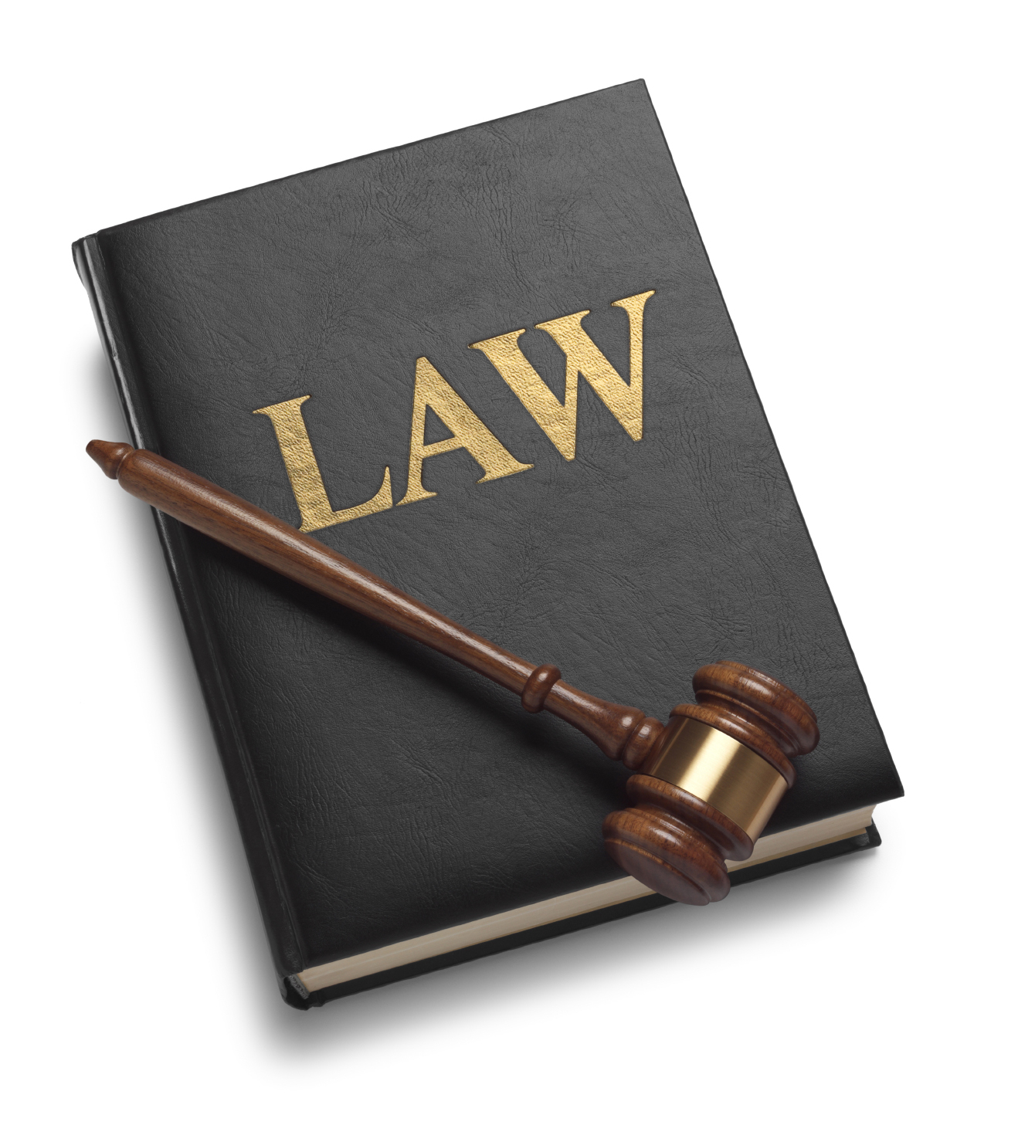
Personal Property
Personal property refers to the items that can be moved from one location to another. They are not fixed like land.
They include clothes, furniture, stocks.
Personal property is further sub-divided into two main groups; the tangible and intangible.
The tangible ones are those that can be physically handled like jewelry while the intangible are those that cant be seen or touched like stocks.

Slide 5

Real Property
Real property refers to the land and other things that are permanently attached to it.
They include buildings, roads, crops.
There are different of estates that are associated with real property.
They involve the fee simple ownership, life estates, future interest, contingent interest or lienholder estate

Slide 6
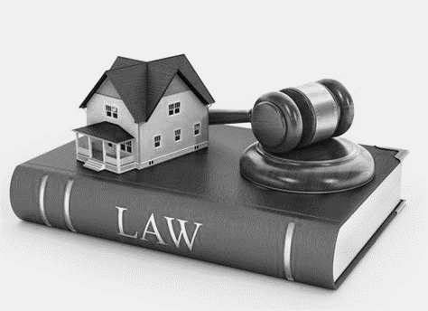
How Property Law Has Changed
There have been numerous changes in the ownership rights of things as people progress
The recognition of new things as objects to be owned has opened many chapters in law, often accompanied with different complexities.
Before the establishment of property rights, most property was owned by the monarch (Rostill, 2015).
Later on, the Napoleonic code was introduced as a act of government to devolve the notion of ownership.
The law was initiated in Greek, where Plato championed for individual possession of land

Slide 7
Property Law
As early as 1200 AD, there was a practice of giving land to people for life in many parts of the world
In Germany for instance, people communally owned land, which each owner having the tight to the title.
However, there was no definite distinction on having titles and rights to ownership regarding real property.
The idea of split ownership was later introduced during the medieval times
More reforms happened after the period where there were many changes in equity regarding property.
The current property law are as a result of liberal movements in the 19th century that influenced registration and court reforms.

Slide 8
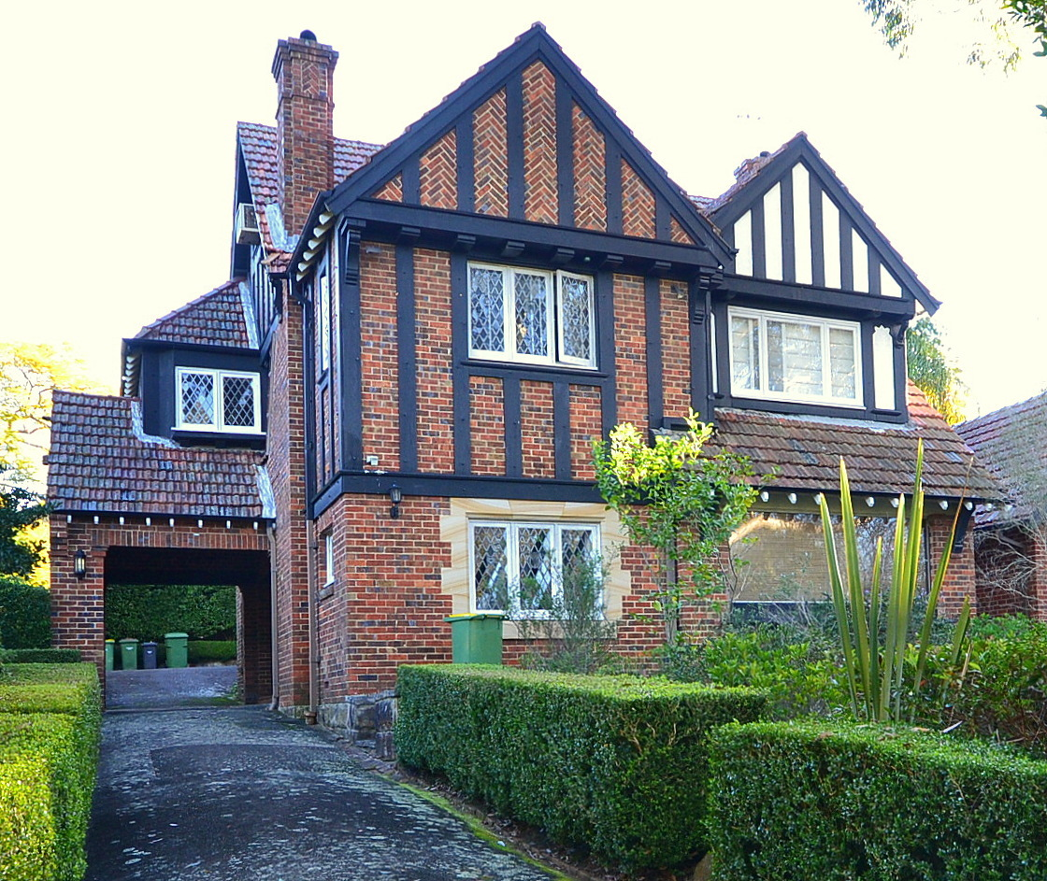
Changes in Property Ownership
The concepts of property and who has the rights to what have changed over the centuries.
These changes vary in different cultures and countries depending on the value attributed to various property
Initially, land and other natural resources were owned community by the society.

Slide 9
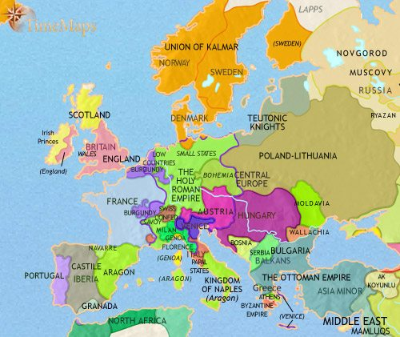
Feudalism
The feudalism idea in the early times assigned rights to property based on people status
Those who had high ranking had more authority over that particular land or natural resources
For instance, monarch and powerful leaders had influence over property than the common population
Men also exercised a lot of authority and owned land unlike women before the liberal reforms.
After the progressive times, a lot of changes occurred concerning who owns property.

Slide 10
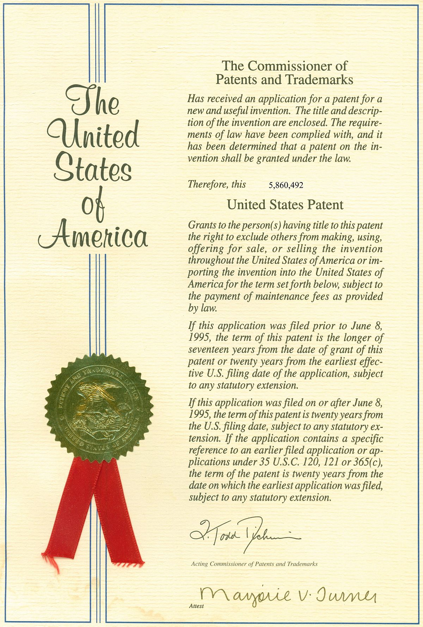
Ownership
The public resources are mostly owned by the government or ruling authority.
The modern law has given people in the society the mandate to acquire and have personal, intellectual and real property.
Currently, both men and women are allowed to won land other property deemed to be of high value
However, there are still other cultures where women are not allowed to won land and other natural resources.

Slide 11
References
Ramaekers, E. (2017). What is Property Law? Oxford Journal of Legal Studies, 29. Retrieved from https://doi.org/10.1093/ojls/gqw032
Rostill, L. (2015). Relative Title and Deemed Ownership in English Personal Property Law. Oxford Journal of Legal Studies, 23. Retrieved from https://doi.org/10.1093/ojls/gqu016

