Slide 1
Protectionism
Student’s Name
Institutional Affiliation
Date

Slide 2
Definition
Protectionism is defined as policies imposed by governments aiming at restricting international trade to save and protect local industries (Demir & Sepli, 2017).
The primary tools trade protectionism uses include the quotas, tariffs, subsidies, and currency manipulation.
Governments raise the prices of imported commodities and making them more expensive than locally produced products.
Notes:
Protectionism refers to policies mainly tariffs imposed by governments to restrict international trade and protect local industries. It involves measured and purposeful actions to control imports to promote exports. Protectionism is the opposite of globalization which allows international trade and welcomes foreign companies. Commonly, protectionism is a politically motivated defense mechanism in many countries (Demir & Sepli, 2017). In the short term, protectionism works but is likely to be destructive in the long term. For example; When the United States’ auto company was expected to move its operations out of other foreign nations to the U.S., the move would have promoted the local auto industry. However, the vehicles would be more expensive. But with the enactment of tariffs on foreign cars, cars made in the U.S. would be less expensive than the imported ones.

Slide 3
History of protectionism
Protectionism was facilitated by wars and economic depressions as peace and prosperity encouraged free trade.
The United States embraced protectionism, and enacted tariffs that reached their highest levels in the 1820s and also during the Great Depression (Williams, 2019).
Today, different governments impose tariffs and quotas depending on the prevailing economic conditions.
Notes:
The European empires embraced the strategies enacted by protectionists between the 17th and 18th centuries. The policies were meant to foster trade as well as improve local markets at the expense of other countries. Under the Smoot-Hawley Tariff Act enacted in 1930, there was a rise in imported commodities by nearly 20%. However, the policies started to change towards the mid-20th century (Williams, 2019). The U.S. government joined 23 countries in 1949 and signed a reciprocal trade agreement known as the General Agreement on Tariffs and Trade that was later replaced by WTO in 1995.

Slide 4
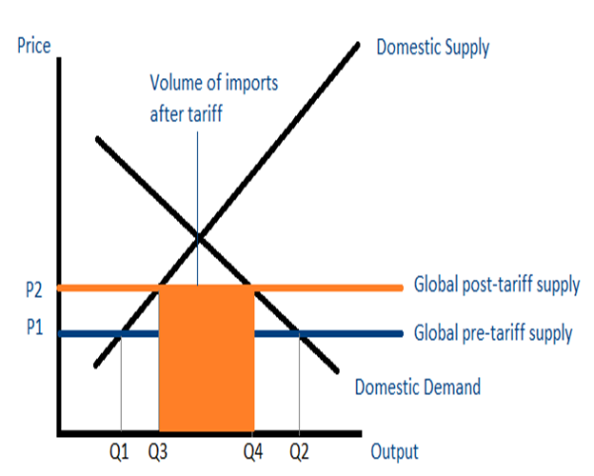
Tools of Protectionism
Tariffs
Tariffs are considered as the taxes or duties imposed on imports.
They aim at increasing the prices of imports in the domestic market hence reducing their demand (Demir & Sepli, 2017).
Notes:
Tariffs are the most common tools of protectionism. Tariffs comprise calculations meant to develop a level at which imports are declined but their decrease or increase might have a great effect on the over all industry. For example; Consider the graph; it shows an analysis of the U.S. market for German-made cars. After the imposition of tariffs, the price increases from P1 to P2. The demand for German-made cars in the United States market decreases from Q2 to Q4. When a country raises its tariffs for imported goods, few or no imports will be made and vice versa.

Slide 5
Quotas
Quotas are types of restrictions on certain volumes or quantities of imports for specific products or services over a particular period.
With quotas, only a certain quantity of goods can be exported to a certain country.
As a form of protectionism, quotas help to prevent dumping which normally happens when foreign producers decide to export their products at lower prices than the production costs.
Notes:
Quotas are basically referred as “non-tariff trade barriers.” Just like tariffs, they cause an increase in the price of imports thus reducing their demand in the local/domestic market (Fouda, 2012). Quotas help to prevent dumping which normally happens when foreign producers decide to export their products at lower prices than the production costs. In some instances, when a government imposes an embargo, whereby importation of certain products is prohibited, there is a likelihood of having severe types of quota.

Slide 6
Government Subsidies
A government can subsidize the domestic industries as a way to protect and help them compete fairly in the global market.
This will ensure that foreign countries do not have a ground to operate. People will concentrate on buying the local products hence fending off foreign industries.
Notes:
Subsidies normally come in the form of direct payments or tax credits. A common form of government subsidy is the farm subsidies. It is ensures that producers lower the local good and services price. This move is considered to be more effective than tariffs as it makes sure that products are cheaper than normal even when they are shipped overseas (Fouda, 2012). The method works best for nations that wholly rely on exports.
Government’s attempt to impose subsidies is to boost a balance of trade. The export subsidies offer incentives for local industries making sure that they expand globally through increased exports internationally (Fouda, 2012).

Slide 7
Currency manipulation
Currency manipulation refers to the government deliberate attempt to lower its currency. Its aim is to make the exports cheaper and more competitive.
A government can lower the value of its currency by having a fixed exchange rate. A good example is China’s Yuan.
Also, a government can create much national debt that will have a similar effect.
Notes:
This strategy is likely to result to currency war and retaliation. A government can lower the value of its currency by having a fixed exchange rate. A good example is China’s Yuan. Also, a government can create much national debt that will have a similar effect. U.S government is recognized for creating a U.S. dollar decline as a way to manipulate its currency (Ostry, 2019).

Slide 8
Advantages of Protectionism
Protects local and new industries from foreign competition and limits over-specialization.
With protectionism, governments are able to prevent foreign companies from competing unnecessarily with the local industries.
Thus, local industries can grow and expand because they are shielded from foreign companies.
This prevents collapsing of the local industries due to stiff competition brought by the foreign companies.
Notes:
Protectionism can work best for growing nations. It protects local industries by reducing import levels, after which it promotes an increased domestic trade balance. Local industries have a good opportunity to grow without experiencing stiff competition from international markets.
Based on The Effects of Protectionist Policies on International Trade, over-specialization is one thing that affects many growing countries. These are countries that rely on imports. Over-specialization occurs as a result of comparative advantage theory working to its extreme (Demir & Sepli, 2017).

Slide 9
Protects declining companies and creates domestic job opportunities.
Another advantage of protectionism is that it protects declining companies
It also lowers imports and creation of domestic job opportunities.
With protectionism, new industries are protected from foreign ones.
These industries are able to grow slowly and make profit.
Job opportunities are also created for the local people.
Notes:
Protectionism is vital in protecting and preventing declining companies or sunset industries. These are industries known to be at the end of the scale. Such industries need to receive support to enable them to decline slowly hence avoiding negative repercussions resulting from their decline (Ostry, 2019). Protectionism ensures a reduction in imports which in turn helps to promote local industries. This promotes the creation of job opportunities. It improves production due to increased market advantage, thus leading to the expansion of industries. Also, the country enjoys increased GDP, which is an improvement of the economy.

Slide 10
Disadvantages of protectionism
Slows economic growth
Protectionism slows economic growth since there are no new companies in a country that could spur economic growth.
A country remains isolated with no new inventions or ideas.
Notes:
Protectionism leads to more layoffs. For example, when the U.S. closes the borders to trade, in return, other nations will also close their borders. Such an action is likely to cause an abrupt layoff among the U.S. workers who depend on exports.
Job outsourcing occurs as a result of a decline in competition. For example, in the U.S., competition has been realized to decline over the decades due to the failure of investing in education, particularly high-tech and engineering (Fajgelbaum et al., 2020). Lack of competition from international markets is leading to a high motivation towards investing in readily available resources.

Slide 11
It leads to increased prices of local goods
Protectionism leads to increase in prices of local goods to the disadvantage of the consumer.
Since the local industries do not face competition, they may misuse this opportunity and raise the prices of products.
The consumer pays a lot of money because there are no other alternatives.
Protectionism also leads to economic isolation.
Notes:
Protectionists lead to increased products prices since competition is absent. Customers are expected to continue paying more even when there are no significant improvements in the products. Also, protectionism leads to political and cultural isolation that plays a great role in causing economic isolation. The United States is a good example of countries embracing protectionism because of massive imports. The country uses protectionist tariffs technique that raises the prices of foreign goods to reduce the competition of local products (Demir & Sepli, 2017).

Slide 12
References
Demir, M. A., & Sepli, A. (2017). The effects of protectionist policies on international trade. International Journal of Social Sciences, 3(2), 136-158.
Fouda, R. A. N. (2012). Protectionism & Free Trade: A Country's Glory or Doom?. International Journal of Trade, Economics, and Finance, 3(5), 351.
Fajgelbaum, P. D., Goldberg, P. K., Kennedy, P. J., & Khandelwal, A. K. (2020). The return to protectionism. The Quarterly Journal of Economics, 135(1), 1-55.
Ostry, J. D. (2019). Why protectionism spells trouble for global economic growth. In International Trade Forum (No. 1, pp. 10-11). International Trade Centre.
Williams, N. (2019). The resilience of protectionism in US trade policy. BUL Rev., 99, 683.

