Slide 1
Child Development
Author
Institutional Affiliation course code
Date of submission

Slide 2
Introduction
Psychology is defined as the study of mind and behaviour. Lifespan development in psychology gives an overview of the changes in behaviour that occur as we develop from conception, infancy till death (Cherry, 2012).
Developmental psychologists have highlighted three developmental domains where individuals acquire varying developmental milestones.
These include; physical, cognitive and psychosocial. Psychologists have observed that development is generally a life-long process which is relatively influenced by nature and nurture

Slide 3
Cont.…
In this presentation, I will discuss the developmental theories of development and the external factors influencing the exhibited behaviour. It is essential to understand that development occurs in the body, brain, reasoning, learning and memory and personality traits.
This presentation will particularly focus on child development because most parents have shown concern regarding the development of their children.
Some have even compared the development and abilities of their children to that of the others around them.

Slide 4
Cont..
Over time, through this course, I have developed an interest in this area of study and have realized that this is believably normal for such parents because they do not understand that various factors are at play in the different facets of human development.
Several questions have been advanced concerning child development, some of which include; the influence of external factors in influencing development, what factors can maximize child growth and minimize detriments to it.
In this sense, this presentation highlights some of the most recognized developmental theories that explain in detail child development.

Slide 5
Erickson's theory of psychosocial development
Erickson in his theory argued that for children to grow in successful adults, the ego must make positive contributions by mastering attitudes, ideas and skills (McLeod, 2013).
Erickson argued that the exhibited competence and abilities by children are usually a result of internal motivation to achieve certain milestones.
In this view, when each milestone is completed successfully, an individual gains the feeling of a healthy personality and competence.

Slide 6
Cont..
Similarly, based on cultural and survival needs, it is important to note that certain cultures may have significant implications in the manner in which individuals solve these milestones (Slater et al. 2003).
It is important to note that Erickson saw the world as a series of age-matched developmental crisis which presents opportunities to develop.
Presenting issues such as trust and mistrust during infancy, it is essential to understand that if these binary crises are not effectively solved then the child develop mistrust for the adults around them.

Slide 7
Cont..
It is at this stage that children develop of the world around them, however, if this is not properly negotiated then they would develop a fundamental lack of trust.
In a sense, Erickson argued that a child with the ability to develop trust develops hope and can grow into an intimate young adult with the capacity to love.

Slide 8
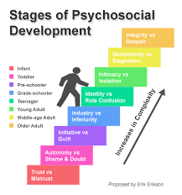
An image showing Erickson’s theory of psychosocial development

Slide 9
Jean Piaget theory of development
Observably, this theory of development particularly focuses on how children change the way they think (Huitt & Hummel, 2003).
He argued that children actively construct knowledge as they explore and manipulate the world around them.
Explanations drawn from this theory of development state that as children grow, their brains also develop.
Piaget highlighted four different stages of developments that correspond with the age of the children arguing that each stage builds upon the knowledge acquired in the previous stage.

Slide 10
Sensorimotor stage
During this stage, a child explores the world around them through direct sensory and motor contact.
It is during this stage of development that object permanence and separation anxiety develops.

Slide 11
Preoperational stage
This is the second stage of development where children use symbols to represent objects.
However, they still do not reason logically. At this stage, a child tends to pretend more and are more egocentric.
Observably, children at this stage of development usually focus on themselves and think very little of others.
It is argued that their arguments and view of things is very skewed since they believe that everyone else sees, thinks and feels just like they do.

Slide 12
Concrete stage
This stage of development is particularly characterized by logical reasoning.
Children at this stage of development exhibit a logical understanding of the conservation principles.
For instance, they understand that the properties of a substance do not change even if its physical appearance is altered.
At this stage, a child understands that the quantity of water remains the same even it is transferred into another jar.

Slide 13
Cont..
It is however essential to note that children who do not properly integrate these ideas of logical reasoning may believe that the quantity of water increases when transferred into taller glasses.
Also, children at this stage are capable of performing simple mathematical operations such as subtraction, multiplication and addition.
This is generally a depiction of inductive reasoning. In contrast, it is worth noting that children who have not developed effective inductive reasoning abilities may struggle using generalized principles to predict the outcome of events.

Slide 14
Formal operational stage
At this stage, children develop the abilities to think abstractly.
Arguments advanced in this stage indicates that children can apply abstract thinking alongside deductive reasoning to create hypothetical ideas and find plausible solutions.

Slide 15
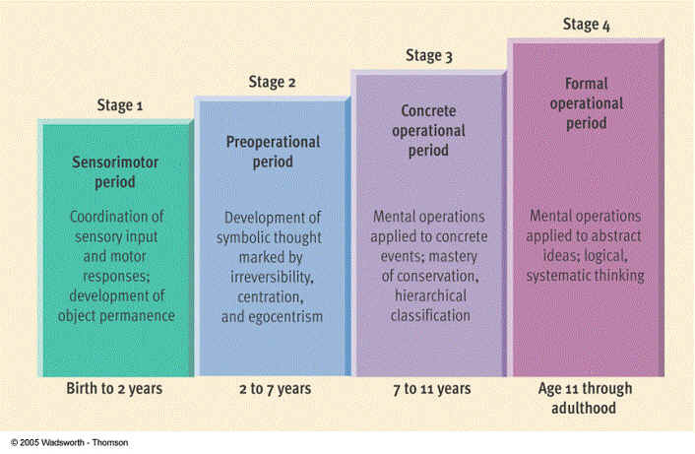
An image showing Piaget’s stages of development

Slide 16
Sigmund's theory of development
Developed the psychoanalytic theory of development and argued that the way parents addressed the sexual desires of their children significantly influenced the development of their personalities and whether or not they would grow to become well-adjusted adults (Freud, 2014).
In terms of sexual development, children undergo various stages of sexual development which include; anal, phallic, genital, latency and oral.
Freud in this theory had argued that child development takes place in the following five psychosexual stages of development; oral, anal, genital, phallic, and latency.

Slide 17
Cont..
It is noted that development in each of these stages translates in drives or instinct on a different part of the body.
Ideally, as individuals grow, it is noted that certain parts of their body become potential sources of frustration or pleasure (Slater et al. 2003).
For this reason, according to this theory, the first five years of child development are quite essential in the development of their personality.
In a sense, the id has to be suppressed to conserve social demands. In his arguments, Freud argued that the conflict between the id, ego and the superego results in the development of mature personality.

Slide 18
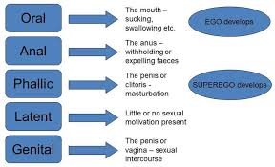
An image showing Freud’s psychosexual development Process

Slide 19
Conclusion
In conclusion, it is important to note that the study of child development is crucial since it helps us understand better human development process in general (Cherry, 2012).
It is important to note that understanding the major theories of child development would help us in understanding the way children develop and ways through which we can help them to become responsible citizens.
Similarly, it helps in determining ways through which their social, educational and emotional can be addressed in case of difficulty in attaining a developmental milestone.

Slide 20
Child development theories help "gain insight into human nature, origins of adult behaviour, origins of differences, and origins, prevention and treatment of developmental problems" (Rhodes, Theories of child development, 2013)

Slide 21
References
Cherry, K. (2012). Child development theories. Psychology. About. com. The New York Times.
Slater, A., Hocking, I., & Loose, J. (2003). Theories and issues in child development. An introduction to developmental psychology, 34-63.
Huitt, W., & Hummel, J. (2003). Piaget's theory of cognitive development. Educational psychology interactive, 3(2), 1-5.
McLeod, S. (2013). Erik Erikson.
Mooney, C. G. (2013). Theories of Childhood: An Introduction to Dewey, Montessori, Erikson, Piaget & Vygotsky. Redleaf Press.
Freud, S. (2014). On the sexual theories of children. Read Books Ltd.

