Slide 1
Adaptive Leadership

Slide 2
Defining adaptive leadership
Adaptive leadership a leadership model that was introduced by Ronald Heifetz and Marty Linsky. Heifetz defines it as the act of mobilizing a group of individuals to handle tough challenges and emerge triumphant in the end.
Changing to enable thriving
Change organization through experimentation
Values different viewpoints
Adaptive changes build upon the past but can also dramatically reorganize for the better.
Adaptive changes take time
https://corporatefinanceinstitute.com/resources/careers/soft-skills/adaptive-leadership/

Slide 3
Defining adaptive leadership
Adaptive leadership explores challenges people and organizations face in their place of work and measures on how to overcome them. It allows junior ranker in the workforce to step forward and come up with a quick and innovative way of thinking. As we know it the world is changing and what we knew of the past is being improved upon which challenge people to think outside of the box, with no real training they have to adapt and overcome this challenge.
Adaptive leadership is an everyday art form. There is not one specific way to execute good leadership.

Slide 4
Technical vs. adaptive work
“The answer to the problem is already known and just needs to be applied.” [Ulstad]
Programmers know how to program, aerospace engineers know how to design planes
People are generally receptive to technical solutions
Prescribing medication to lower blood pressure vs. changing lifestyles to
Sometimes a new product unlike previous projects your company has created needs to be created with a different design philosophy, or marketed with different strategies, to appeal to different audiences.

Slide 5
Identifying an adaptive challenge
Changing a current system of procedure or coming up with a new one.
Values and behavior do not line up.
Elephants in the room need to be addressed.
People avoiding responsibility and work.
No common goals or direction.
From Val Ulstad, “Principles of Adaptive Leadership…”:
There is a gap between the way things are and the desired state.
New learning needs to happen.
Behaviors and attitudes need to change.
Old ways need to change, creating a sense of loss.
Resistance is triggered in stakeholders.

Slide 6
Principles of adaptive leadership
Heifetz and Laurie describe a number of principles underpinning the practice of adaptive leadership:
Identify which challenges are adaptive
Step back and see the big picture
Regulate the distress
Maintain and encourage focus
Let people work on their own / avoid micromanaging
Protect the voices of leadership from below

Slide 7
The balcony and the dance floor
Step back and see the big picture
See what’s happening
See what’s not happening
Balance between time on the dance floor and time looking out over it
Techniques: [from Ross Lunden]
Schedule quiet time
Delegate
Notes:
Patterns and causes

Slide 8
Regulate the distress
Create safe atmosphere
protection, orientation, conflict management, productive norms
Keep personal distress and others distress levels in check.

Slide 9
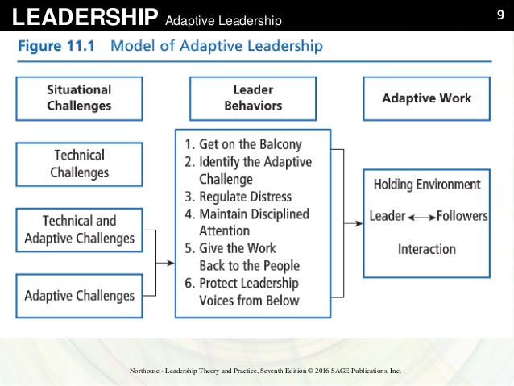

Slide 10
Examples
Final Fantasy XIV
IBM
Cloud computing
Sony
Experimental approach
[Interview with Ronald Heifetz, Creelman Research]

Slide 11
Works Cited
https://www.slideshare.net/ASAFHUMAYUN/adaptive-leadership-59434946
https://leadersinstituteofsa.wordpress.com/2014/02/26/exercising-leadership-adaptive-leadership
Val Ustad, “5 Principles of Adaptive Leadership…”
Interview with Ronald Heifetz, Creelman Research
https://www.thebalancecareers.com/using-principles-of-adaptive-leadership-in-the-workplace-4161276
https://www.youtube.com/watch?v=cRMOLKGFLJk
http://www.central.knowledge.scot.nhs.uk/Leadership/applying-the-principles.html

Slide 12
https://www.cultivatingleadership.co.nz/site/uploads/Adaptive-challenges-and-action-learning.pdf
https://keithdwalker.ca/wp-content/summaries/m-p/Practice%20of%20Adaptive%20Leadership.Heifetz%20et%20al.EBS.pdf

