Slide 1
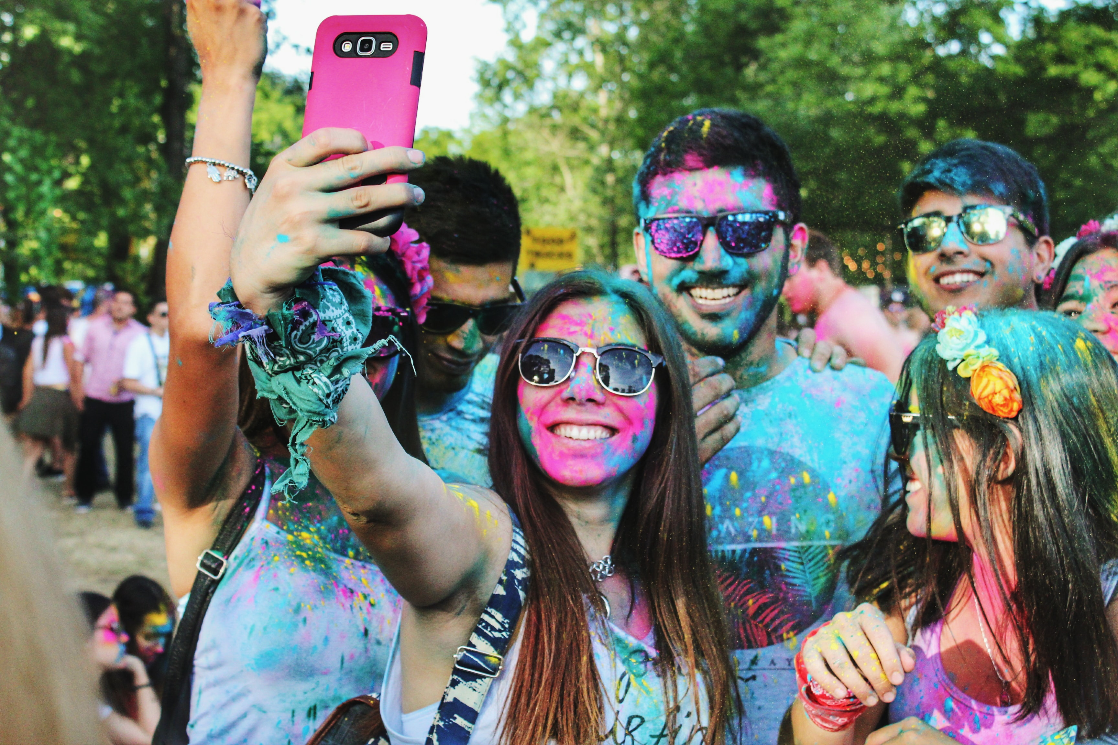




Member exclusive by Sarah Todd. Produced by Chika Dunga
Photo: UNSPLASH/JULIAN GENTILEZZA

Slide 2
Purchasing power
Appealing to younger consumers is as important as ever for businesses. Gen Z—typically categorized as anyone born after either 1995 or 1996—has never known life without smartphones and social media. And, with the help of social platforms, teens have managed to wrest power away from brands and traditional cultural gatekeepers. Companies hoping to appeal to this demographic will have to follow Gen Z’s lead.
9/10
Share of Gen Z consumers who believe companies have a responsibility to address environmental and social issues
40%
Percentage of global consumers today
comprised of Gen Z
$150 billion
Spending power of Gen Z
in the US alone
2
Notes:
Gen Z’s growing consumption power – McKinsey & Company - https://www.mckinsey.com/industries/retail/our-insights/the-influence-of-woke-consumers-on-fashion

Slide 3
Gatekeepers
Gen Z is “the first generation who create what they consume and consume what they create,” in the words of consultant Chloe Combi. They are more likely to watch their peers’ YouTube channels than tune in to traditional TV shows. They get information about the world from Instagram and Snapchat instead of newspapers, books, and magazines. They operate within their own digital ecosystem, outside of many mainstream influences.
3
Notes:
Media consumption behavior of Gen Z – Source, Pew Research - https://www.pewresearch.org/internet/2018/05/31/teens-social-media-technology-2018/#a-growing-share-of-teens-describe-their-internet-use-as-near-constant

Slide 4
Environment
One of the traits that distinguishes Gen Z is its concern with climate change and the environment. In 2019, investment bank Piper Sandler surveyed 9,500 American teens about the most important social or political issue of the day and found that the number-one issue was the environment. A 2019 poll by trend forecaster WGSN revealed that 95% of people between the ages of 18 and 25 were willing to change their habits and lifestyles to combat climate change.
What Gen Z thinks about the environment
Question | Brands | Governments
Who is currently more effective in fighting climate change? | 75% | 25%
Question | Yes | No
Do you believe we are currently experiencing a climate crisis? | 96% | 4%
.
Question | Yes | No
Are you willing to spend more on sustainable products? | 84% | 16%
Question | Yes | No
Are you willing to change your habits and lifestyle to combat global warming? | 95% | 5%
4
Notes:
Quote from WGSN poll about Gen Z’s attitude towards the environment – WGSN, https://www.naumd.com/assets/ArticleImages/Gen_Z_Climate_Engagement.pdf
2019 survey asking 9,500 American teens about the social and political issues – Piper Sandler, http://www.pipersandler.com/3col.aspx?id=5751

Slide 5
Reuse, rent, digitize
Many young people are turning to secondhand shopping in order to stay true to their environmental beliefs while building affordable, varied, and unique wardrobes – something that matters a lot in the age of social media. Industry analysts also predict that Gen Z will be increasingly interested in clothing rentals: Brands including H&M, Urban Outfitters, and American Eagle are already following in the footsteps of Rent the Runway.
.
5
Notes:
2019 Fashion resale market – Source,Thred Up, https://www.thredup.com/resale?tswc_redir=true

Slide 6
Greenwashing
Gen Z values eco – consciousness but this group is also prepared to call out brands that market themselves as environmentally friendly while engaging in contradictory practices. H&M attracted unwanted attention in 2019 when it was grilled by Norwegian regulators over the marketing of its conscious collection as sustainable. As Quartz’s Marc Bain has written, while the clothing in question was made from materials like recycled polyester or citrus peel, “its low cost, high-volume business model is arguably at odds with its sustainability goals.”
.
6
Notes:
Growth of Eco labels around the world – Ecolabel Index, http://www.ecolabelindex.com/

Slide 7
Rethinking gendered consumption
Gen Z is more comfortable with the idea of gender fluidity and gender non-conformity than previous generations. This is evident in the rise of YouTube stars like 21-year-old James Charles (also a CoverGirl spokesperson). To cater to this demographic, companies may market more products as gender-neutral.
35%
Gen Zers who say they know someone who uses a gender-neutral pronoun
59%
Gen Zers who say online forms should include options besides “man” or “woman”
44%
Gen Zers who say they shop exclusively in their own gender category
7
Notes:
Gen Z’s social and political beliefs – Pew Research Center, https://www.pewsocialtrends.org/2019/01/17/generation-z-looks-a-lot-like-millennials-on-key-social-and-political-issues/
https://intelligence.wundermanthompson.com/2016/03/gen-z-goes-beyond-gender-binaries-in-new-innovation-group-data/

Slide 8

The body positive boom
Girls and young women are also challenging mainstream beauty standards. In Piper Sandler’s 2019 poll, 20%
of female teens said that they never wear makeup, compared to just 12% two years ago. Meanwhile, the boom in body-positive accounts on social media, popular with Gen Zers, promote a more inclusive idea of beauty that goes far beyond the white, thin models of yore.”
People are just becoming more comfortable in their own skin and not having
to cover something up. The beauty world is moving toward inclusivity. It’s not about covering up your acne, it’s about treating it.
.
Erinn Murphy, Piper Sandler managing director and senior research analyst
8
Notes:
Quote from Erinn Murphy, Piper Sandler managing director and senior research analyst – Piper Sandler, http://www.pipersandler.com/3col.aspx?id=5751

Slide 9
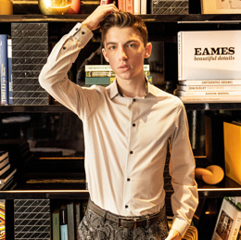
TikTok for the win
Instagram still has plenty of sway –– but for many young people, TikTok is where the real social-media action is at. TikTok boasts more than 800 million monthly active users worldwide as of October 2019, 41% of whom are between the ages of 16 and 24. The site’s emphasis on cleverness and brevity in the form of 15-second video clips makes it perfectly suited to Gen Z’s short digital attention spans.
Eitan Bernath, a 18-year-old chef and former Chopped competitor, shares recipes and cooking videos on TikTok and Instagram.
He attributes his success on TikTok to a strategy that stops people from scrolling past his videos.
I try to do something in the first five seconds that grabs the audience’s attention.”
Eitan Bernath
9
Notes:
Eitan Bernath about page – Eitan Bernath, https://www.eitanbernath.com/about-eitan/

Slide 10
The coronavirus pandemic
The coronavirus pandemic will be a watershed moment in the lives of Gen Z. A few possible effects, based on historical precedent and psychological evidence? This already-thrifty generation could become even more wary of spending if the recession drags on. Young people witnessing governments scramble to put together relief packages may be newly radicalized in the fight for stronger social safety nets. And Gen Zers in countries that fail to fight effectively may experience long-lasting dips in social trust.
2
Coronavirus is the second-most important issue to teens, after
the environment
13%
Decline in year-over-year spending among teens
this spring
47%
Teens who believe the economy is getting worse
.
10
Notes:
Piper Sandler 2020 Taking Stock With Teens survey – Piper Sandler, http://www.pipersandler.com/3col.aspx?id=5956

Slide 11
Global connections
Cultural differences mean that Gen Z’s experiences and priorities will inevitably vary depending on the country in question. But social media’s ability to spread trends around the world means that Gen Z consumers still have a lot more in common than any previous generation. With teens around the world watching each other constantly on social media, telling each other what’s cool and what matters with little regard for what traditional powerbrokers think, companies may have little choice but to do their bidding.
.
11
Notes:
Piper Sandler 2020 Taking Stock With Teens survey – Piper Sandler, http://www.pipersandler.com/3col.aspx?id=5956
Uniquely Gen Z, what brands should know about today’s youngest consumers –– IBM, https://www.ibm.com/downloads/cas/9PPL5YOX

Slide 12
Position Paper Assignment
What if…
  Your brand figured out how to approach and capture this crucial market segment?
Please write a 2-3 page paper due on Tuesday , November 10th that outlines either a new product or service or an adaptation to an existing product or service that will address an opportunity aimed at Generation Zers. You should explain how the current situation is affecting your brand’s performance and how your idea will address the current dilemma as well as positioning your brand for the undoubtedly changed future global environment.
Have fun with this, think outside the box, do a bit of online research.
This will take the place of the Final exam essay and will count as 10% (5% for content and 5% for delivery) of your final grade.

