Slide 1
RECEIVING AND STORING

Slide 2
What is Receiving? Its Importance
Receiving is the proof of purchasing.
It is the act of inspecting and either accepting or rejecting a delivery.
It is the determination of what you got upon ordering.
It is important to establish proper control of purchasing.
Also, in order to check that the delivered order meets the criteria and to control the received products and services.

Slide 3
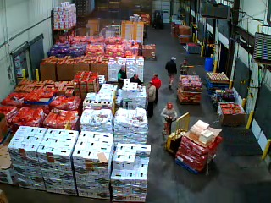

Slide 4
Essentials for receiving
Presence of competent personnel.
Appropriate training of receiving clerks.
Provision/Presence of proper scales.
Proper receiving facilities.
Appropriate receiving hours.
Prior knowledge of purchase orders.

Slide 5
Good receiving practices (P257-260)
Receivers should always check the quality under the top layer.
Always examining packages for leakage or water damages.
Receivers should watch for incomplete payments.
Receivers should always be on the lookout not to receive refrozen merchandise.
Spot checking should be done on portioned products for portioned weights.

Slide 6
Receiving Duties
Dating delivered items.
Pricing all delivered items.
Creating bar codes.
Applying tags.
Cleaning and maintenance.
Backhauling any recyclables.

Slide 7
What is storage? Its objectives (p281-288)
It is an activity performed in conjunction with receiving.
It is the placement of received products in a storage facility.
It is done to prevent loss of merchandise due to theft, pilferage or spoilage.
It is also aimed at preserving quality of received products.

Slide 8
What is needed to achieve storage objectives?
Adequate space.
Adequate temperature and humidity.
Adequate storage equipment.
Proximity of storage area to receiving and production areas.
Access to proper maintenance.
Proper security.
Competent personnel to manage and supervise the storage function.
Storeroom regulations and codes of conduct.

Slide 9
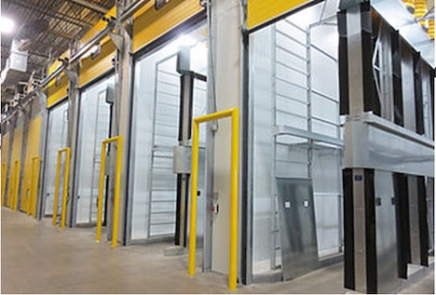

Slide 10
Managing storage facilities
Classification and organization of inventories in an orderly manner.
Determination of inventory usage rates for all inventories.
Keeping track of accumulating surpluses.
Disposing items that the storage facility no longer uses.

Slide 11
Works Cited
Feinstein, A. H., & Stefanelli, J. M. (2010). Purchasing: Selection and procurement for the hospitality industry: Selection and procurement for the hospitality industry (8th ed.). Wiley Global Education 257-288.

