Slide 1
Religious Studies Origins
Mandy MacArthur
Adapted from Dr. Eisener 2017
RELS 1210 – Class 3

Slide 2

WHAT DO YOU SEE?

Slide 3


SNOW
Snow (English)
Neige (French)
Sneeuw (Dutch)
(Arabic)
Schnee (German)
La Neve (Italian)
Nieve (Spanish)
ثلج

Slide 4
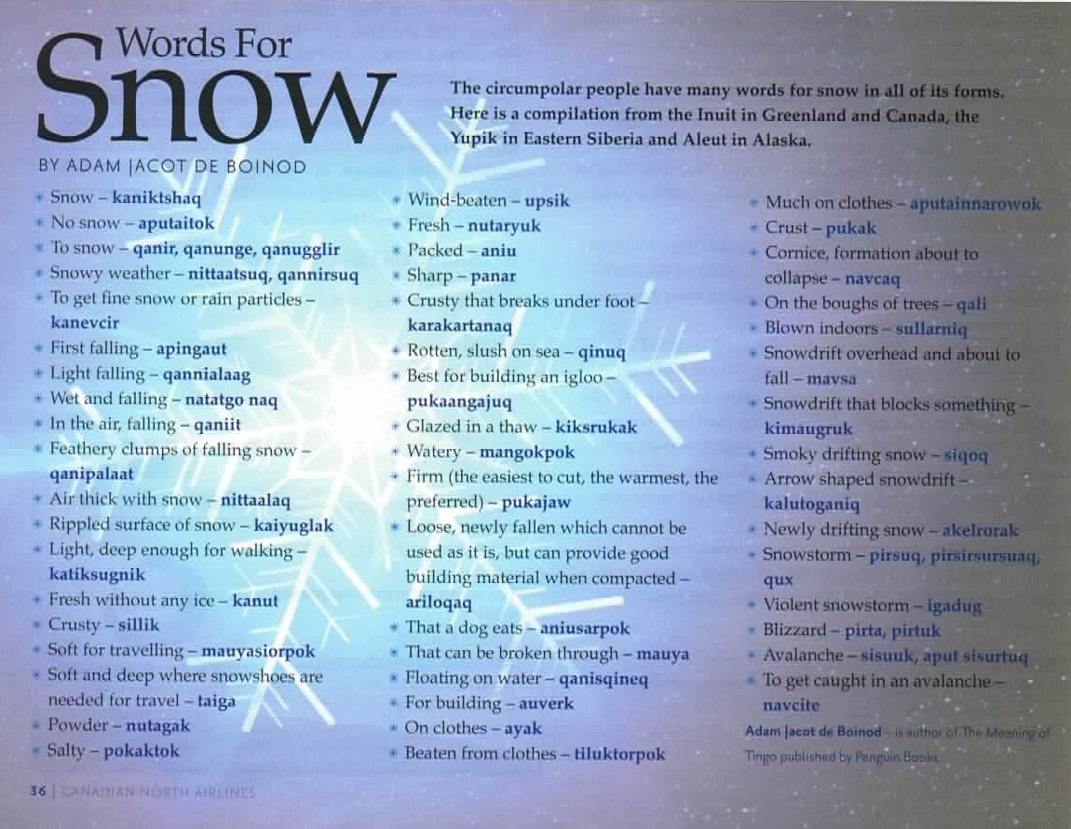

Slide 5
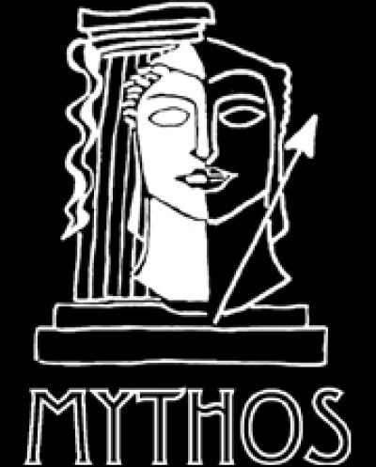
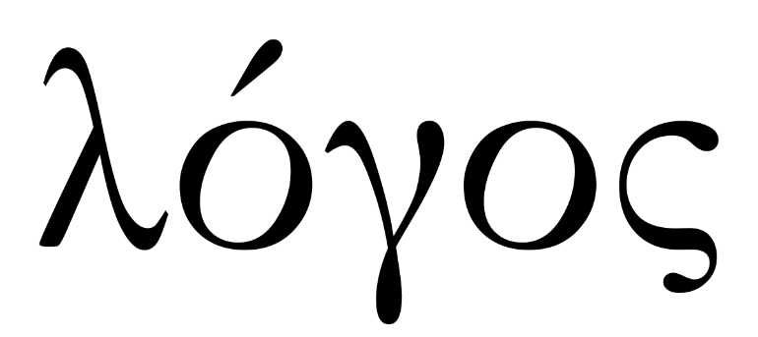
Early Greek Philosophical Thought
We have been handed down these two major ways of thinking and viewing the world from the early Greek thinkers

Slide 6
TWO MODES OF PERCEPTION
LOGOS / LOGICAL
Greek word for “logic” or “discourse”
Rational, pragmatic, scientific
Relies on analytical or critical thinking
Used to describe the world or reality QUANTITATIVELY
Scientific understanding
MYTHOS / MYTHICAL
Greek word for “mouth” or “Story” – oral tradition
Narratives, symbols, metaphor, rituals
Relies on perception and intuition, including drama, poetry, stories, and images
Used to describe the world or reality QUALITATIVELY
Symbolic understanding

Slide 7
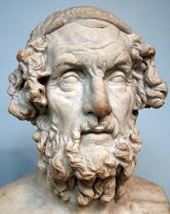
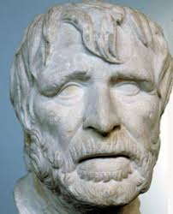
HOMER & HESIOD, 8TH CENTURY
Greek authors/poets
Use of Myth
Theology present in their epics/poems
Order of the world around them – how the world and pantheon of gods/goddesses worked

Slide 8
ANAXIMANDER
6-7th century
Described Aperion
Single, unlimited, formless essence, from which all things arise
XENOPHANES
580-490 BCE
Humans make gods in their own image
Primitive Monotheism
HERODOTUS
484 – 425 BCE
“Father” of History
Origins of Myths as connected to Cultures

Slide 9
MYTH
“Delivered by mouth” – Greek mythos
Oldest and most widespread form of religious language
Conveys a primal or original way of things
Used in Religious Studies as a narrative about sacred reality and its relationship with humans and the natural world
Myth is designed to reveal Ultimate Truth about critical human questions…???

Slide 10
SYMBOLS
“The throw together” – Greek word for a tangible object that points to or signifies something beyond itself
Used to bridge the gap between the sacred and the profane
Evocative – appeals to the emotions and imagination
Religions use symbols to help people connect with the ineffable or the sacred

Slide 11
MYTH & RITUAL
A way for people to participate in the creative power of the sacred
“As myth expresses world foundations in terms of word and image, ritual dramatizes world foundations in terms of performance [i.e. action].”(Wm Paden, Religious Worlds)
Some myths are not remembered or not told anymore, but the ritual related to them remains
Creation stories are often ritualized in order to reconnect with the origin of humanity or gods/goddesses

Slide 12

So… what happened??
The 19th century saw the rise of new academic disciplines:
Classics
Oriental Studies
Anthropology
Sociology
Psychology
*with special mention to Darwin’s theory of evolution (Origins of Species in 1859)

Slide 13
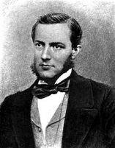
Religious Studies: Origins
Developed in the 19th century as religious texts were increasingly translated into different language and became more accessible
Max Muller identifies Religious Studies as a field of its own and is one of the first influential scholars
This new field of inquiry drew on all the aforementioned disciplines as an interdisciplinary field
Went beyond Theology or Theological Studies

Slide 14
Religious Studies: Origins
Involved a comparative approach
“He who knows one, knows none”
Rational observations – objectivity
Treating all as valid and interesting
A subject that is open to diverse approaches – Segal, The Blackwell Companion to the Study of Religion

Slide 15
Defining the subject – “Religion”
In the textbook (Pals, D.), Nine Theories of Religion, all of the theorists claim that religion consists of “belief or behaviours associated with a supernatural realm of divine or spiritual beings”
How they each choose to deal with the subject is different…

Slide 16
Types of Theory
Looking for the origins of religion throughout history and prehistory
Looking for the psychological and sociological origins of religion
Applying a rational and non-reductionist exploration of religion

Slide 17
1. Historical Approach
Strong influence from Darwin’s evolutionary theory
Began as more of an anthropological area of interest
Saw the earliest and simplest forms of religion in primitive cultures

Slide 18
2. Functionalist or Reductionist Approach
Functionalist explanations of religion in terms of its “non-religious function”
Dismisses religion’s claims of the supernatural and explain it in terms of scientific or social/societal means
Applies reductionism – reducing religion to its most basic form in terms of relevancy, function, or practicality
Pals, D. – “seek[s] not to explain religion, but explain it away” (xxi)

Slide 19
3. Non-reductionist / Phenomenological
Recognizes religion’s psychological roots, but also finds it grounded in normal and valuable emotions
Understands its social importance, but sees nothing irrational or abnormal about it
Looks at religion and religious experience for what it is and does not attempt to reduce it – it has value/meaning
Pals, D. – “it’s in the very nature of humans to create systems of meaning to guide their actions” (xxi)

Slide 20

Questions & Discussion

