Slide 1
Philosophical Trends
RELS 1210 – Class 6
Mandy MacArthur
Adapted from Dr. Eisener, 2017

Slide 2
The Context
We will look at the origins of religious studies through the methodological lens of anthropologists, ethnographers, psychologists, and many more
None of these thinkers lived or worked in a social or intellectual vacuum
The 19th century was a time that was characterized by systematic critique and questioning

Slide 3



The 19th Century was lit
(literally)
Beginning of globalization
Large scale economic integration and industrialization
Invention of the light bulb 1878
First telephone call 1876
Scientific discovery and invention
Advances in modern medicine and disease prevention – contributed to population growth in the West
The Enlightenment and Romanticism

Slide 4
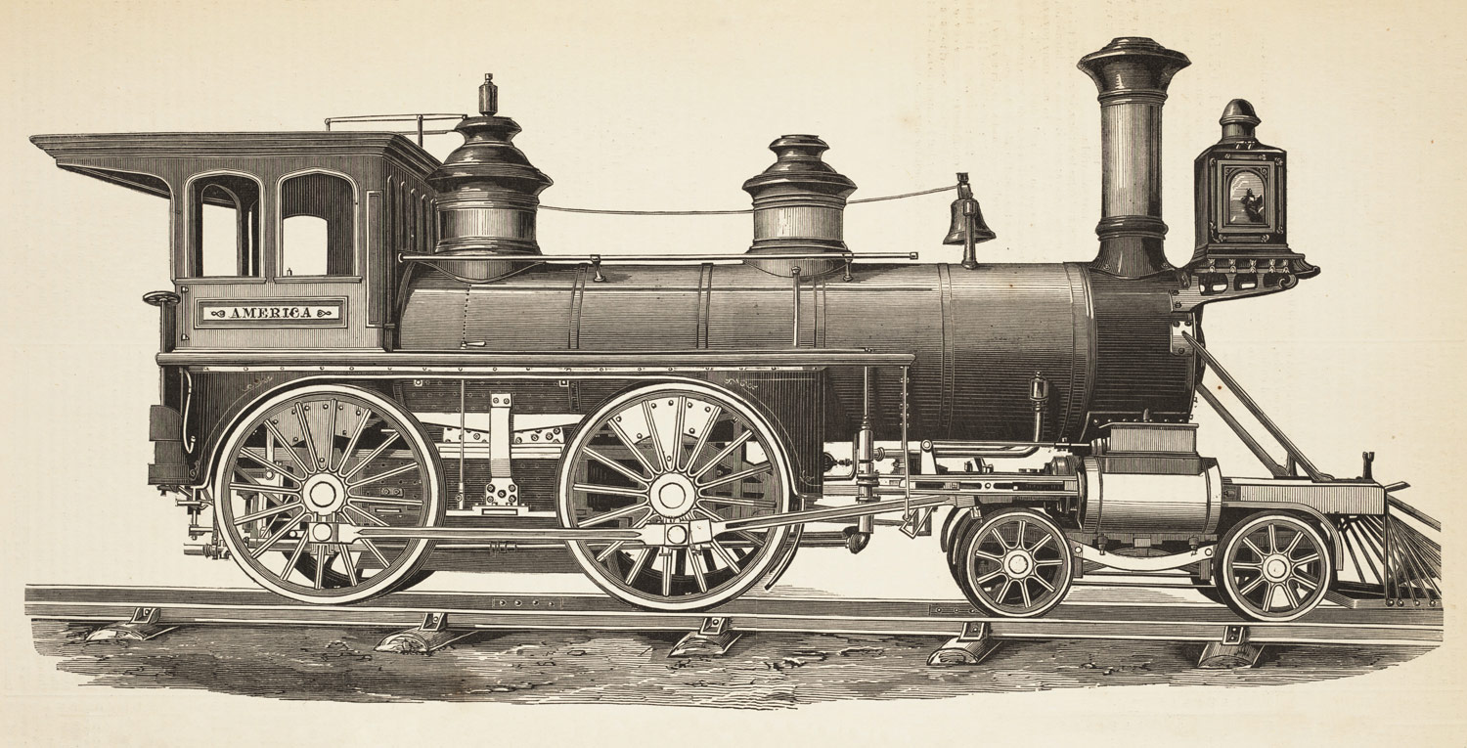
Rise in the British and Russian Empires
By the end of the century, the British Empire controlled 1/5 of the world’s land and ¼ of its population
Decrease in slavery
Introduction of railroads – this drastically changed the way people lived, travelled, transported goods, built cities, etc.

Slide 5
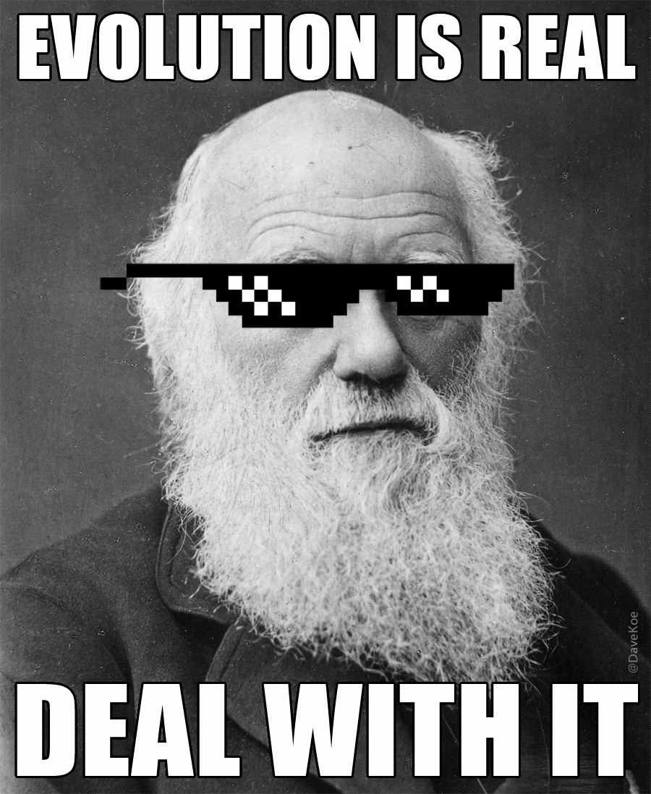
NOT TO MENTION, DARWIN…
Published Origin of Species in 1859
Foundation of evolutionary biology
Populations of species evolve over time through the process of natural selection
Diversity is due to evolution, not God’s creation
Conflicted with the widely believed notion that humans were unique and part of a designed hierarchy, above and unrelated to other animals/species

Slide 6

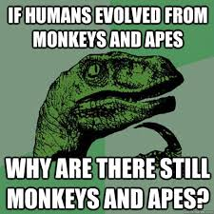
The old answers no longer fit the new questions
The earth was no longer at the centre of the universe
Human beings turned out to be animals
Evolution was no longer conceived of in terms of progress towards perfection, but merely adaptation to
  conditions

Slide 7
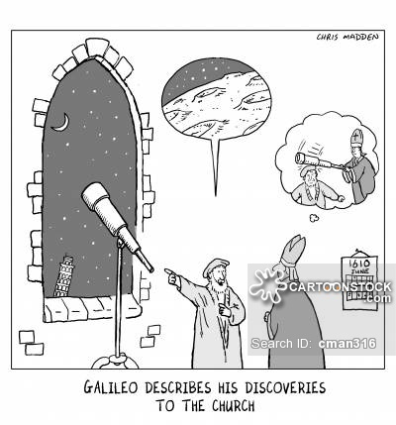
The origin of Religion was described as the result of any one of a number of misunderstandings:
a faulty assumption about spirits
a faulty assumption about the natural world
a means of maintaining social cohesion
or the result of primal lust, murder, and guilt

Slide 8
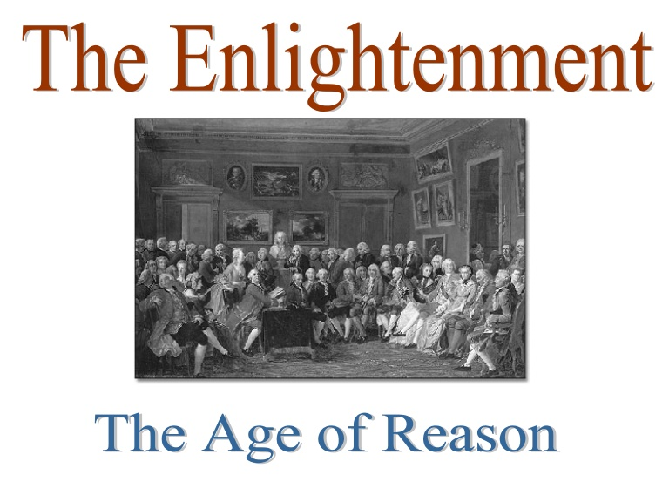
Big Impacts – Philosophical Factors
Rapid advances in science, philosophy, social theory, and politics beginning in the 17th century
Reason and experience replaced faith in religion and traditional authority
This movement was particularly strong in England, France, Scotland, and Germany

Slide 9

The Enlightenment
Philosophical movement in Europe beginning in the 18th cent
Romanticism – emphasis on emotion and being an individual human being as a reaction to the industrial revolution and modernity
REASON AND INTELLECTUALISM HAD AUTHORITY
Contributed to the separation of Church and State, “tolerance” movements, progress
Involved the scientific method and reductionism
Increased questioning of religious doctrine and authority

Slide 10
Big Impacts – Philosophical Factors
Rationalism – any philosophy that emphasizes reason over experience
It implies anti-clerical and anti-authoritarian humanism
Empiricism – seeks to root all knowledge in experience: what can be said through the use of the five senses
Gives authority to the experience

Slide 11
Big Impacts – Philosophical Factors
Humanism - any philosophy with an emphasis on human welfare and human dignity
Characterized by being optimistic about the use of human reason
Deism – the belief that if human reason insists there MUST be a God (deity), but that it cannot be known or approached/contacted
This creator is not involved or interested in the human world

Slide 12

The Importance of Freedom
History is interpreted as progress toward freedom
Freedom of reason means the development of all forms of consciousness OR the ability to know true reality – things as they are
Freedom = the mind and the Absolute can be (are) known

Slide 13
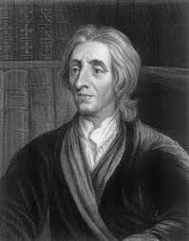
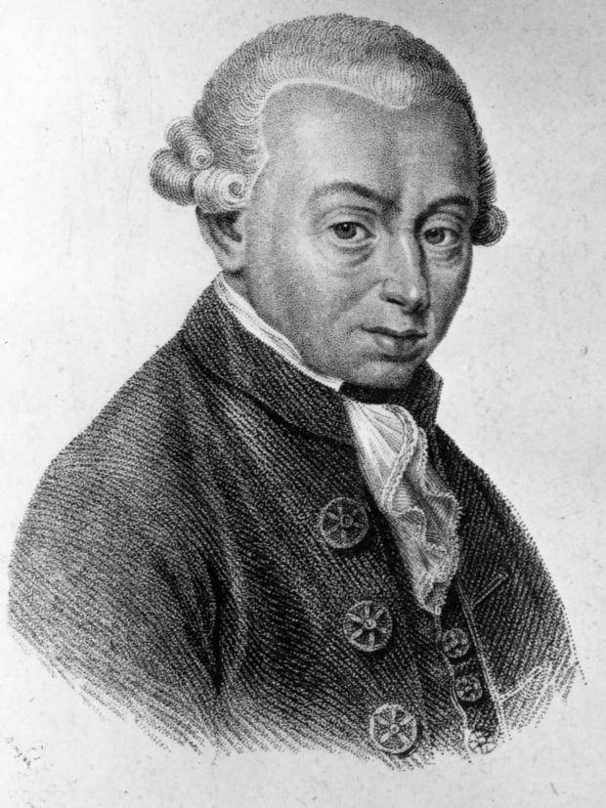
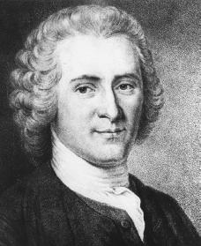
Thinkers’ Impacts
John Locke – philosopher, An Essay Concerning Human Understanding, reconcile philosophy with the new sciences, the human mind needs to be educated, he was a rationalist & and empiricist – all knowledge is apprehended by the senses, human rights are inherent (toleration)
Immanuel Kant – professor of logic, Critique of Pure Reason, questions of knowledge and reason – from sensory perception, BUT the mind is a prisoner to perception, phenomena are actually unknowable, argues against the existence of God
Jean-Jacques Rousseau – political philosopher, influenced the Enlightenment in France, Confessions & Reveries of a Solitary Walker, Age of Sensibility, focused on subjectivity and introspection, the importance of education and policy, with a center on the individual

Slide 14
So based on the context… how do we think the theorists are going to attempt to explain religion?

