Slide 1

The myth of progress
RELS 1210 – Class 7
Mandy MacArthur
Adapted from Dr. Eisener, 2017
Notes:
NOTE:
To change the image on this slide, select the picture and delete it. Then click the Pictures icon in the placeholder to insert your own image.

Slide 2
Approach Stats
HISTORICAL – 25%
FUNCTIONALIST – 46%
NON-REDUCTIONIST – 29%

Slide 3
Why was the 19th century #lit ?

Slide 4
It keeps getting better… Better everyday!
Belief in the progress of the human race – especially in the West – had gained power
The Myth of Progress
Any why would anyone doubt this?
The West had just seen 250+ years of “progress”
  Scientific advances
  Philosophical rationalism
  The flourishing of arts and culture
  The end of slavery
  Rise in literacy
  Greater* gender equality
  Prison reforms
  Declines in poverty
  Advances in quality of life

Slide 5


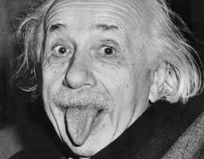



Rapid Technological Advances in early 20th Century

Slide 6
However, with this progress also came the complete rejection of the past
Sense of humanity as being in control of its own destiny
This progress was measured by HAPPINESS, PROGRESS, and PROSPERITY
These were NOT the standard previously used by thousands of generations of humans
This was a new era

Slide 7
To get a sense of this progress
Humans went from using a sharpened rock as a weapon to the use of weapons made of iron – this development took almost 3,000,000 years
Humans then went from the use of iron weapons to successfully developing and using the H-Bomb in only 3,000 years
This is exponential development

Slide 8
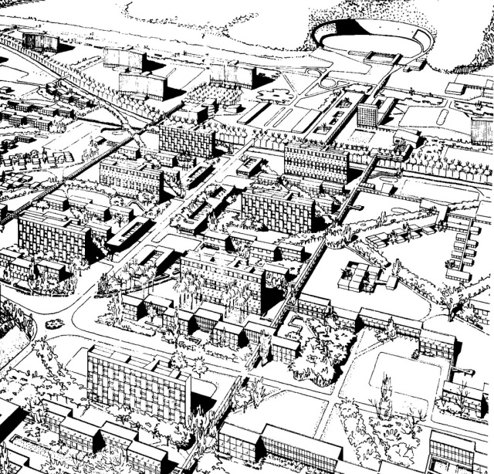
And life indeed was getting better
Railways
Steam engines
Blast furnaces
Textile plants
Coal and iron mines
Improved sanitation
Advances in medicine
Treatment and prevention of diseases
City planning

Slide 9
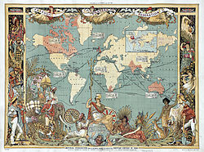
With this progress came a monopoly on authority
The British Empire claimed to have moral authority and who could deny it with all of its progress

Slide 10
Herbert Spencer, an influential English philosopher who was a student of Darwin’s theories, interpreted this technological progress as a social doctrine
Change → Improvement → Perfection
He was also the one who actually coined the phrase “survival of the fittest”
By this time, the idea of eugenics (the use of scientific principles to improve species) was old news
BUT! Its modern form developed in the early 20th century…
It was proposed that the human race MUST strive towards perfection in order to maintain its power and authority
The scientific manipulation of human beings was then seen as the pinnacle of human progress by many scholars, scientists, and even religious leaders
Only science could perfect human nature and human society

Slide 11
So was born THE MYTH of progress
Traditional belief systems had failed
- colonialism, slavery, denial of scientific discoveries, the secondary role of women, the role of faith
Science now had the answers
- advances in biology, geology, chemistry, physics, astronomy, all lead to no longer requiring a Creator to explain
- God of the deists was no longer a philosophical necessity
- everything was now interpreted through Darwin’s theories → survival of the fittest → social Darwinism → eugenics
Progress was measured by technological advance
- no consideration was given to culture to mark progress

Slide 12
4. Western colonialism & the British Empire had brought “civilization” to many lands
- law & order, government, civil service
- public schools
- road systems
- medicine, hospitals, vaccination, control of diseases
- abolition of slavery
- use of English as the “unifying” world language that helped to break down ethnic and cultural differences
5. Religion was now interpreted as an old-fashioned way of looking at the world as a result of ignorance
6. Progress was interpreted as a social duty – moral obligation
- the world must be made better
- the fittest were not just to survive; they were to rule

Slide 13

So why do we care about all of this?!
We care because humanity began to see itself differently. It began to believe it could perfect itself through progress – that “perfection” was attainable. This drastically changed the way humans also began to think and speak about religion.
It also highlights how what is going on around us greatly affects our religious/spiritual understanding of the world and/or nature of reality

Slide 14
Where to begin…
We are going to “consider nine of the most important theories of religion that have been put forward since the idea of a scientific approach to religion caught the imagination of serious scholars of the 19th century.” (Pals, 2015, 9)
1. the theory is presented by discussing the life and background of its spokesperson
2. key ideas are discussed
3. distinctive features are discussed and compared
4. objections by critics

Slide 15
Max Muller & “the science of religion”
1870, during a public lecture, he proposed the idea of studying religion scientifically and methodically
Proposed that science and religion could “get along”
Instead of a theological approach, which ultimately was concerned with what religion was “true” or “right”
Apply an objective method of study/inquiry by gathering various elements of religions from around the world (rituals, beliefs, customs, etc.) – creating facts
Technically, in theory, this scientific method should be able to be applied regardless of one’s own personal beliefs
Claimed this method would be able to explain the entire phenomenon of religion – the worldwide explanation of its origin, development, and diversity
A hope to create a single theory of religion

