Slide 1
Cardiovascular Disease in African Women
Student’s Name
Institution
date

Slide 2
Introduction
Cardiovascular disease (CDV) entails heart conditions that affect the blood vessels and the heart.
Typically, it is linked to accumulation of fatty deposits in the arteries
African women are more vulnerable to the disease than men
Cardiovascular disease pose unique challenges to African women

Slide 3
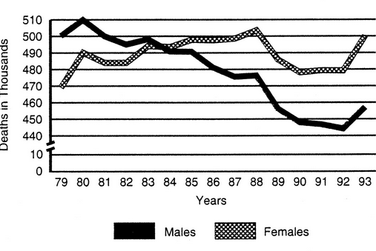
Cardiac disease mortality trends in Africa

Slide 4
Causes
High blood pressure
Smoking
High cholesterol
Increased physical inactivity
Diabetes
Overweight or obesity

Slide 5
Symptoms
Cold sweats
Pain or pressure in the chest
Nausea and fatigue
Pain in the jaw, back, and left shoulder

Slide 6
Risk Factors
High blood pressure
Smoking
Diabetes
High cholesterol
Family history of cardiovascular disease (Umer et al., 2017).
Habitual consumption of excessive sodium

Slide 7
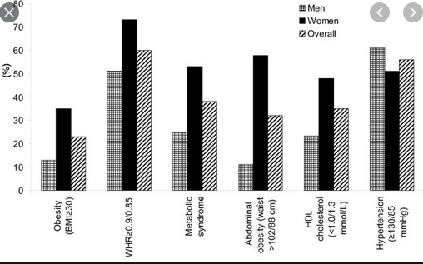
Gender-related differences in the prevalence of cardiovascular disease

Slide 8
Diagnosis
Cardiac catheterization
Holter monitoring
Echocardiogram test (Apple et al., 2021).
Cardiac magnetic resonance imaging (MRI)
Electrocardiogram test
Cardiac computerized tomography (CT) scan
Stress test

Slide 9
Prevention
Engaging in regular exercises
Limiting alcohol intake
No smoking
Eating a healthy diet
Controlling the level of cholesterol in the body

Slide 10
Treatment
Medication like reducing low density lipoprotein
Cardiac rehabilitation such as life counseling
Surgery like replacement surgery (Leong et al., 2017).

Slide 11
Recommendations
What not to do | What to do
Smoking High alcohol intake Eating artery-clogging foods such as high-fat dairy products Increasing the amount of cholesterol in the body | Avoid smoking Avoid alcohol intake Eat more fruits, vegetables as well as lean proteins Maintain a reasonable body weight

Slide 12
Effects of CDV on African Women
The disease leads to deaths of many women compared to men
Women are more vulnerable to various heart related complications such as hypertension

Slide 13
Prevalence
African women are more prone to cardiovascular diseases compared to men
WHO estimates for 2014 assign that various risk factors such as obesity are more prevalent in women than men
Women’s obesity is at 10%-15% while in men it is at 4%-5% (Einarson et al., 2018).
Increased physical inactivity among African women equated to Asian, European and American women is a cause of increased CDV
Tellingly, many women are at higher risk of contracting heart related complications or diseases

Slide 14
Conclusion
Cardiovascular disease has myriad health complications on many African women such as sudden cardiac arrest
Many African women are susceptible to the disease compared to men
The disease can be treated through surgery, medication or cardiac rehabilitation
African women should be taught on ways to decrease their vulnerability to the disease like avoiding smoking and excessive alcohol intake

Slide 15
References
Apple, F. S., Daniels, L. B., Mills, N. L., & Nordestgaard, B. (2021). Biomarkers in Cardiovascular Disease: Utility in Diagnosis, Risk Assessment, and Therapy. Clinical Chemistry, 67(1), 1-3.
Einarson, T. R., Acs, A., Ludwig, C., & Panton, U. H. (2018). Prevalence of cardiovascular disease in type 2 diabetes: a systematic literature review of scientific evidence from across the world in 2007–2017. Cardiovascular diabetology, 17(1), 1-19.
Leong, D. P., Joseph, P. G., McKee, M., Anand, S. S., Teo, K. K., Schwalm, J. D., & Yusuf, S. (2017). Reducing the global burden of cardiovascular disease, part 2: prevention and treatment of cardiovascular disease. Circulation research, 121(6), 695-710.
Umer, A., Kelley, G. A., Cottrell, L. E., Giacobbi, P., Innes, K. E., & Lilly, C. L. (2017). Childhood obesity and adult cardiovascular disease risk factors: a systematic review with meta-analysis. BMC public health, 17(1), 1-24.

