Slide 1
Registered nurses
Name
School

Slide 2
Job analysis
When looking for a new job in the job market, individuals tend to look for what the job responsibilities, duties, skills, and work environment for the position they are looking for. This process is known as job analysis.
When looking for a job, such information is essential to job seekers since they would have a complete understanding of what the job entails and what is required for them once they start the job.
Employers conduct job analysis so that they have all the information for a particular job position that will be useful for aspiring job applicants.
Job analysis is crucial for individuals in developing their careers and helps organizations maximize the talents of their employees

Slide 3

credentials
Bachelor of Science Degree in Nursing (BSN).
Associate's degree in nursing (ADB)
Nursing diploma
Notes:
Like any other profession, a registered nurse needs to have several papers and academic qualifications that deem them fir for the job. A registered nurse should first have a Bachelor of Science Degree in Nursing (BSN). An individual can be a registered nurse if they took a course and attained an associate's degree in nursing (ADB) or a diploma from a nursing program that has been approved. On top of any of these three certifications, a registered nurse must acquire a license for working as a nurse in any hospital or clinic.

Slide 4
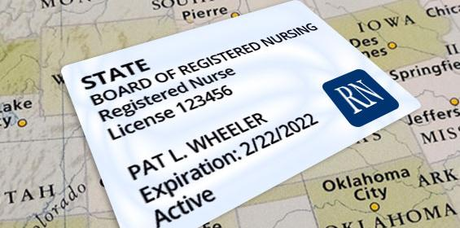
Licenses, certifications, and registrations
National Council Licensure Examination (NCLEX-RN)
criminal background check
cardiopulmonary resuscitation (CPR),
Basic Life Support (BLS),
Advanced Cardiac Life Support (ACLS).
Notes:
States in the United States, the District of Columbia, and other United States territories require all registered nurses to have a nursing license to work. A nurse acquires this license after they graduate from an approved nursing program, and ensure that they have passed the National Council Licensure Examination (NCLEX-RN). Also, all nurses need to go through the criminal background check and pass the test. Other nurses can acquire certification when they have professional associations in areas such as ambulatory care, pediatrics, and many more. Moreover, registered nurses may need a nurse to be certified in cardiopulmonary resuscitation (CPR), Basic Life Support (BLS), and Advanced Cardiac Life Support (ACLS).

Slide 5

Education
Bachelor of Science Degree in nursing
Associate Degree in Nursing
Diploma in Nursing program(s).
Notes:
Irrespective of whether a student pursuing nursing takes a degree or diploma, all students taking nursing programs are exposed to courses in nutrition, chemistry, psychology, and social and behavioral sciences. Bachelor of Science Degree in nursing usually takes four years, whereas ADN and other diploma courses in nursing take 2 or 3 years at least. Those seeking degree programs have an advantage of additional educative areas in communication, leadership, critical thinking, and social sciences. Most hospitals, like applicants who have bachelor’s degree qualifications but any student who graduated in either a degree, diploma, or associate's degree, are qualified for working as a registered nurse. However, if a diploma or associate's student wants to upgrade their education to a degree, they can undertake an RN-BSN program

Slide 6


Knowledge and skills
Critical thinking skills
Communication skills
Compassion
Emotional stability
Organizational skills
Notes:
Critical thinking skills- enable nurses to be able to evaluate the health conditions for their patients, knowing instances of taking corrective actions or referring to higher authorities. Communication skills-nurses interact with patients and their families on a day-to-day basis, and for that, they need practical communication skills to talk to their patients when administering medication or to explain specific concerns and their health conditions as well as medication instructions. Compassion – registered nurses, should be able to show care and compassion towards their patients. Emotional stability- nurses need to be able to contain their emotions and have the ability to cope with human suffering. Organizational skills- nurses need organizational skills to ensure appropriate care is offered to the multiple patients they are managing.

Slide 7

tasks
Assessing patient conditions
Record keeping
Observation-
Administering medication
Patient plans
Notes:
Assessing patient conditions where nurses need to evaluate the requirements for their patients round the clock at any given point in time. This way, they can provide optimal care to patients. In Record keeping, patients who come to health care facilities need their medical records in order, and nurses are responsible for recording patients’ medical information. Registered nurses are close to their patients and need to observe their patients carefully while recording the observations they make. Nurses also, in some situations administer medication to their patients and other treatment plans. Nurses set up patient care plans when appropriate and contribute to existing plans when necessary.

Slide 8

Tasks continuation
Consultation
Collaboration
Operate medical equipment
Diagnostics and tests
Educate patients
Notes:
Consultation-nurses need to consult with doctors when administering care for their patients and get expert opinions. Collaboration with other professionals where nurses need to collaborate with the doctors and other professionals in healthcare systems to offer the best care to patients. Operation of medical equipment in which nurses need to have the ability to operate several medical equipments that is used on patients. Also, nurses need to behave the ability to perform diagnostics and tests on patients to identify what is wrong and the best health care plan for the patient. Nurses also educate their patients and the public on certain health conditions and illnesses.

Slide 9
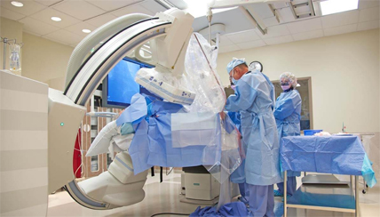
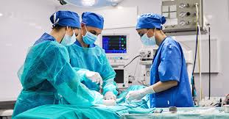
Technology skills and tools used
Cardiology
Pulmonary
Neurological
Gastrointestinal
Eye, ear, nose and throat
Urology
Phlebotomy
Notes:
Cardiology- in cardiology, nurses use telemetry deices and advanced lifesaving-training skills.
Pulmonary- registered nurses need to be able to operate chest tubes, ventilators, and airway management equipment.
Neurological – nurses need to know how to perform lumbar puncture techniques and conscious sedation.
Gastrointestinal- nurses need technical skills in operating feeding tubes and ostomy care.
Eye, ear, nose and throat- registered nurses need to know how to operate fluoro, and woods stamps, use eye care equipment.
Urology- nurses should be capable of using urinary diversion devices and managing dialysis equipment.
Phlebotomy- it is required that a nurses should be able to start and manage IVs, central lines and other ports while conducting their responsibilities.

Slide 10

Wages
Hospitals - $73,650
Nursing and residential care facilities- $63,990
Educational services (state, local and private)- $61,850
Government - $78,390
Notes:
The growth rate for employment for registered nurses is reported to be at 12 percent in a period of 10years (2018-2028). The growth rate is estimated to be faster compared to all occupations and is advocated by factors such as increasing emphasis on preventive care, spiking rate of chronic diseases and conditions, and increasing demand for health services. Registered nurses are well paid and by May 2018, the median annual wage stood at $71,730. In the government sector, nurses earned at least $78,390 annually. State, local, and private hospitals paid registered nurses $73,650 annually; ambulatory healthcare services paid registered nurses $63,320. Nursing and residential care facilities and educational services (state, local, and private) paid $63,990 and $61,850 respectively.

Slide 11
References
Bls.gov. (2019). Registered nurses. Retireved from: https://www.bls.gove/ooh/

