Slide 2
Chapter 2
The Nature and Extent of Crime

Slide 3
Learning Objectives (1 of 2)
Identify how crime is measured in the U.S.
Identify and criticize the major sources of national crime data in the U.S.
Summarize the nature and extent of violent and property crime in the U.S.

Slide 4
Learning Objectives (2 of 2)
Identify the difficulties inherent in recognizing and measuring cybercrime, terrorism, and white-color crime
Distinguish how the fear of crime and actual risk of being victimized are often misinterpreted by the public
Demonstrate an understanding of criminological theories used to explain crime and criminality

Slide 5
Why and How Is Crime Measured? (1 of 2)
Reveals the extent and nature of crime
Used to evaluate the benefits of policy
Helps identify groups that are suffering disproportionate amounts of victimization
Allows efficient and targeted assistance

Slide 6
Why and How Is Crime Measured? (2 of 2)
Federal Bureau of Investigation (FBI) estimates crime by the Uniform Crime Reports (UCR), Supplemental Homicide Report (SHR), and National Incident-Based Reporting System (NIBRS)
Bureau of Justice Statistics (BJS) focuses on victimization with the National Crime Victimization Survey (NCVS)

Slide 7
Measuring Violent and Property Crime (1 of 6)
FBI Measurement of Crime
Uniform Crime Report (UCR) Program: collecting data since 1927 about crime across jurisdictions
Summary Reporting System (SRS)
Supplementary Homicide Reports (SHR)
National Incident Based Reporting System (NIBRS)
National Crime Statistics Exchange (NCS-X)
Bureau of Justice Statistics
National Crime Victimization Survey (NCVS)
Notes:
UCR: oldest national crime data collection effort
In 1927, the International Association of Chiefs of Police (IACP) established a Committee on the Uniform Crime Records to develop a program as well as procedures for uniformly collecting information about crime across jurisdictions.
SRS:
Primarily offers counts of each type of crime
For example: whether a rape was completed or attempted or whether a burglary involved forcible entry
Benefits to SRS:
A stable methodology of trend analysis
Analyzes many levels of geography including cities, regions, and the nation
Offers information on crimes of a broad range of offenses
Covers law enforcement agencies of all 50 states
Collects crime regardless of age of the victim or offender
SHR:
Data from this program have been archived since 1976.
Detailed information on homicides involves:
Victim’s age, sex, and race.
Offender’s age, sex, and race.
Weapon type.
Victim/offender relationship.
Circumstances that led to the homicide.
NIBRS:
Detailed information about crime including nature and types of crimes committed during each incident, victim/offender characteristics, type and value of stolen and recovered property, characteristics of arrested individuals.
Reports are voluntary.
Hierarchy rule: UCR only the most serious crime committed during a criminal event is reported to the FBI, NIBRS allows for all to be included.
Classes of Offenses in NIBRS:
Group A offenses are more serious and frequently occurring offenses; most likely come to attention of law enforcement
Of the 24 categories, there are 52 offenses.
Examples include; animal cruelty, arson, bribery, abduction
Group B offenses only collect arrest data and consist of 10 offenses.
Examples include; disorderly conduct, gambling, trespassing, and curfew violations
Advantages of NIBRS over UCR:
Offers information on all reported crimes occurring within an incident and not just most serious.
Ability to disaggregate data by multiple victim, offender, and incident characteristics.
Disadvantages of NIBRS over UCR:
Reflect only crimes known to the police.
Since it is voluntary, lack of reporting or incomplete reporting.
Data can be manipulated for political or other purposes.
National Crime Statistics Exchange (NCS-X): nationally representative incident-based statistics on crimes using data reported to law enforcement agencies (NIBRS) and a sample
Will recruit a sample from 400 agencies to supplement NIBRS data
Intended to increase our nation’s ability to monitor, respond to, and prevent crime

Slide 8
Measuring Violent and Property Crime (2 of 6)
National Crime Panel: commission by President Johnson to identify causes and characteristics of crime
Commission concluded that even with UCR, there was inadequate data available
Dark figure of crime: crime unknown to the police
National Crime Survey
Commercial Victimization Survey
In 1991 the National Crime Panel became the NCVS
Notes:
National Crime Panel changed its name to National Crime Victimization Survey (NCVS) in 1991.
Today’s primary source of information about the frequency, characteristics, and consequences of violent victimizations against persons 12 and older, and property victimizations against U.S. households.

Slide 9
Measuring Violent and Property Crime (3 of 6)
NCVS:
Survey administered throughout the year in person and over the phone
Households selected via a stratified, multistage cluster sample
Rotating panel design in which persons were interviewed every 6 months for a total of 7 interviews
Large sample size, 158,090 persons aged 12 or older in 90,390 households

Slide 10
Measuring Violent and Property Crime (4 of 6)
Criminal Offenses Measured in NCVS
Rape
Sexual assault
Robbery
Aggravated assault
Simple assault
Pocket-picking and purse-snatching
Burglary
Motor vehicle theft
Property theft

Slide 11
Measuring Violent and Property Crime (5 of 6)
NCVS advantages:
Provides data on reported and unreported crime
Offers a wide range of details on the victim, offender, and context of crimes
High survey response rate
Meaningful long-term trend analysis
Notes:
Victims (i.e. age, gender, race, ethnicity, marital status, SES)
Criminal Offenders (i.e. gender, race, age, drug and alcohol use, and victim-offender relationship)
Context of the crime (i.e. time and place of occurrence, weapons, injury, and economic consequences).

Slide 12
Measuring Violent and Property Crime (6 of 6)
NCVS limitations:
Designed to generate estimates of victimization, but cannot be used to estimate crime at state, local, or county levels
Limited coverage (respondents must be 12 or older)
Limited population coverage (must live in a housing unit or group quarters)
Limited crime coverage
Series victimization: six or more similar but separate victimizations that a victim is unable to recall individually or describe in detail

Slide 13
Violent and Property Crime Rates and Trends (1 of 5)
The U.S. crime rate has been declining since the 1990s
Crime and demographic correlations
Particular personal characteristics are associated with higher rates of murder
Males are murdered at a greater rate than females
Whites are murdered at lower rates than Blacks

Slide 14
Violent and Property Crime Rates and Trends (2 of 5)
Murder tends to involve particular characteristics:
More than three-fourth murder victims were male
Primarily intra-racial

Slide 15
Violent and Property Crime Rates and Trends (3 of 5)
Nonfatal violence:
2016 NCVS indicates that 21.1 per 1,000 persons were victims of nonfatal violence
This represents a 5% increase from the 2014 rate
Rape, sexual assault, robbery, aggravated assault, and simple assault

Slide 16
Violent and Property Crime Rates and Trends (4 of 5)
Findings from the NCVS show that characteristics of violent crime are not uniform in the population:
Relationship between victim and offender varies by gender of victim
Less than half of all nonfatal violent victimizations against males were committed by strangers
Females are more likely to be violently victimized by someone they know

Slide 17
Violent and Property Crime Rates and Trends (5 of 5)
NCVS gathers information on three types of property crimes:
Burglary, motor vehicle theft, and property theft
Most common form of property crime is property theft
A rate of 90.3 per 1,000 households in 2016
Second most common is burglary
A rate of 24.7 per 1,000 households in 2016
Motor vehicle theft is the least common
A rate of 4.4 per 1,000 households in 2016

Slide 18
Measuring Cybercrime, Terrorism, and White-Collar Crime (1 of 2)
Cybercrime:
Measuring is difficult and relatively fragmented; has many forms
Terrorism:
Changes based on shifting goals, strategies, and schemes
Global Terrorism Database: 1970 to present
Terrorism information on threatened, failed, and successful terrorist attacks
None of the national data collection efforts identifies an offender as a terrorist

Slide 19
Measuring Cybercrime, Terrorism, and White-Collar Crime (2 of 2)
White-collar crime:
Data specific to corporate and occupational crimes are rare
UCR offers little more than counts by types of crime:
Reported as fraud, forgery/counterfeiting, embezzlement
NIBRS includes a wider variety of behaviors:
General offense categories of fraud, bad checks, counterfeiting or forgery, and embezzlement

Slide 20
Fear and Risk of Victimization
Paradox between actual risk and fear of victimization
Females are more fearful of victimization than are males
Risk of victimization is higher for males than females
Differences in fear and risk based on income (poorer being more fearful) and age (older being more fearful)
Individual fear of crime increased following 9/11
Hearing about crime increases fear (crime multiplier)

Slide 21
Theory in Criminal Justice (1 of 4)
Theory is tied to data
Use data to test theory/build theory
Theory is fundamental in understanding criminal justice
Many theories are biological and psychological
Forces beyond a person’s control drive individual offending
Criminality may be caused by neurological or psychological abnormalities

Slide 22
Theory in Criminal Justice (2 of 4)
Differential association theory points to criminal behavior that is learned primarily from parents peer groups
Social bond theory argues that a person’s lack of attachment, commitment, belief, and involvement results in crime
Rational Choice theories view temptation and opportunity as keys to understanding criminality
Criminals are goal-oriented individuals who offend based upon the expected effort and reward of committing a crime compared to the chances of being caught and punished

Slide 23
Theory in Criminal Justice (3 of 4)
Life course theories and general theories of crime are more popular than data-gathering techniques
Popular life course theories explore transitions, trajectories, and turning points that decrease social capital, which may result in illegal behavior

Slide 24
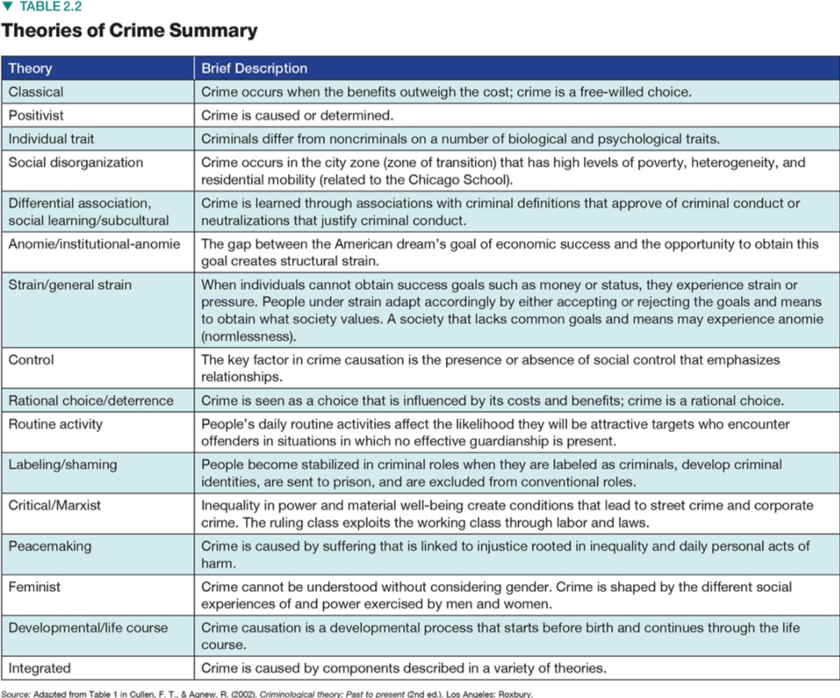
Theory in Criminal Justice (4 of 4)

