Slide 1
Levels of Freedom for Women in the United States vs. The Middle East
Ryan Prater

Slide 2
Introduction
This research had the goal of examining the levels of freedom that women have in the United States versus the Middle East.
Looks at freedom through the lenses of types of governments, laws, ideologies, socioeconomics, racism, classism, and religion, and the family.

Slide 3
Biases
I am liberal, white, feminist woman. I am a current resident of the Deep South, though I have traveled the country, since my father was in the military.
I live in the United States and have never been to the Middle East.
My notions of Middle Easterners come directly from the media and research I have encountered in my studies.

Slide 4
The United States: Overview
The United States is considered a democracy. It is a collection of states governed by a powerful federal government.
Women are allowed to vote, there are protections against sex discrimination in employment, women are given birth control and are allowed to have abortions.
While it is still a patriarchal society, women have been taking strides to become more influential. They take stereotypically masculine jobs and even have begun taking political offices.

Slide 5
Ideologies as Lenses
Classical Liberalism- High value placed on individual’s natural rights to life, liberty, and property and the freedom of the individual to pursue these rights as an independent actor.
Conservativism- Attempts to prevent or slow the transition away from a society based on traditional values and the existing social hierarchy.
Feminism- A diverse social movement promoting equal rights and opportunities for women and men in their personal lives, economic activities, and politics.
Notes:
Danziger 34-40

Slide 6
The Middle East: Overview
The Middle East is a collection of countries that are sometimes at odds with one another. Many of these countries are dictatorships, while some are classified as democracies.
As we know, a democracy doesn’t necessarily mean that a country is democratic (lack of opposition, elections with one candidate).
The countries are not United under one power like the United States, but it seems appropriate to measure levels of freedom for women because the States are a collection of territories with different ideals.
Many countries do not have explicit rights for women, and many see the women as oppressed. Arranged marriages and women as homemakers are relatively common.
Some places, like Saudi Arabia don’t allow women to drive, though there have been studies that prove women are better drivers.

Slide 7
Freedom House Scale
United States
Freedom Status: Free
Political Rights: 1
Civil Liberties: 1
Aggregate Score: 90
*** CL, PR, FR; 1= most free, 7= least free; Aggregate score; 0= worst 100= best
The Middle East (Israel, Syria, Saudi Arabia, Yemen, Egypt)
Freedom Statuses: Israel- Free Syria- Not Free Saudi Arabia- Not Free Yemen- Not Free Egypt- Not Free
PR: Israel- 1 Syria- 7 Saudi Arabia- 7Yemen- 7 Egypt- 6
CL: Israel- 2 Syria- 7 Saudi Arabia- 7 Yemen- 6 Egypt- 5
Aggregate Scores: Israel- 80 Syria- -1 Saudi Arabia- 10 Yemen- 17 Egypt- 27
Notes:
https://freedomhouse.org/report/women039s-rights-middle-east-and-north-africa/womens-rights-middle-east-and-north-africa-2010

Slide 8
Types of Governments
United States
Democracy, Federal Republic
Representative Republic
Checks and Balances
Two Party System and regular elections
The Middle East
Collection of Countries
Parliamentary Republics (Egypt, Israel, Turkey, Yemen)
Traditional Monarchies
Constitutional Monarchies
Notes:
http://www.pbs.org/wgbh/globalconnections/mideast/themes/politics/index.html

Slide 9
Civil Rights Expressed by Governments for Women
United States
Women can: vote, use contraceptives, are ensured equal pay, have federal protections against sex discrimination, have abortions, and serve on the front lines in combat roles
The Middle East
Women can: Syria- Hold political office Saudi Arabia- Vote, run for office.
Women don’t: Syria- In radicalized areas, women are forced to cover their bodies. Saudi Arabia- Drive, have say over male family members
Notes:
https://www.usnews.com/news/the-report/articles/2017-01-20/timeline-the-womens-rights-movement-in-the-us

Slide 10
Religion
United States
There is no set religion in the United States. Under the First Amendment, citizens are free to practice their religion, or lack of religion freely.
While there is no set religion, a large portion of people in the United States practice Christianity.
Many religions are practiced in the United States, and some limit rights of women through moral grounds and values, but not federal law.
Middle East
The Middle East has three main religions: Judaism, Christianity, and Islam. However, Islam is the most common.
There are many sects of Islam with differing core beliefs.
The rules associated with Islam may limit women in addition to the rules of the states.
Notes:
http://www.cotf.edu/earthinfo/meast/mepeo.html

Slide 11
The Family and Work
The United States
According to BLS data, 75% of married mothers were employed in 2016 with children ages 6-17.
92.8% of married fathers with children under 18 were in the labor force.
Mothers are employed less frequently than fathers.
48% of total families have both the mother and father employed.
The Middle East
Typically, less than 50% of women are employed in Middle Eastern and North African countries with the exception of Qatar.
Patriarchal structure of states, weak private sector, inhospitable business environment for women are some causes of lack of women working.
Notes:
https://www.bls.gov/news.release/pdf/famee.pdf
https://erf.org.eg/wp-content/uploads/2017/04/1086.pdf
http://blogs.worldbank.org/arabvoices/despite-high-education-levels-arab-women-still-don-t-have-jobs

Slide 12

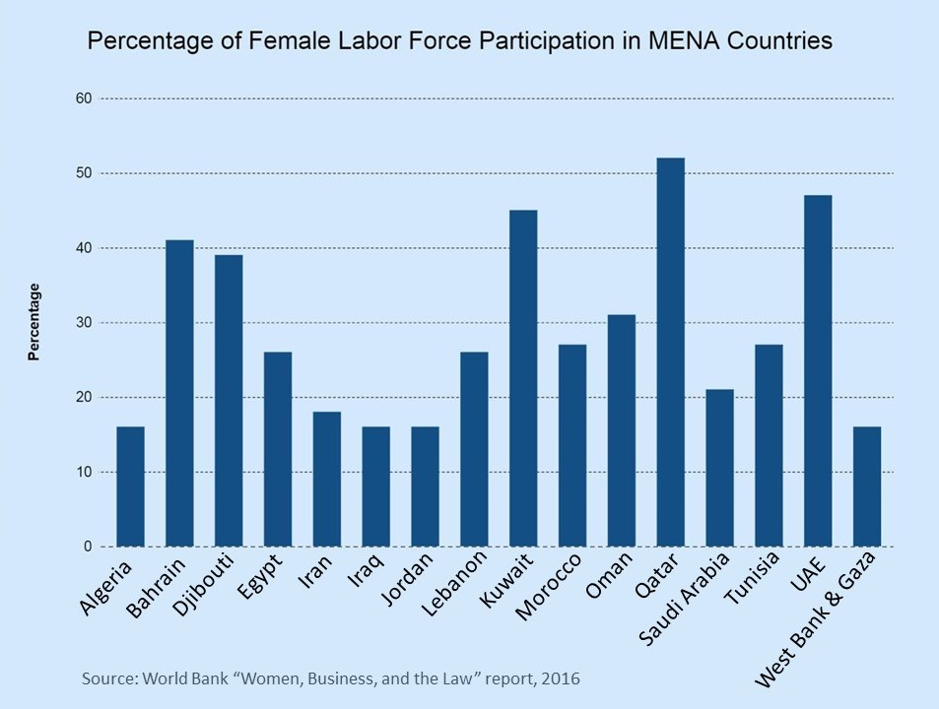

Slide 13
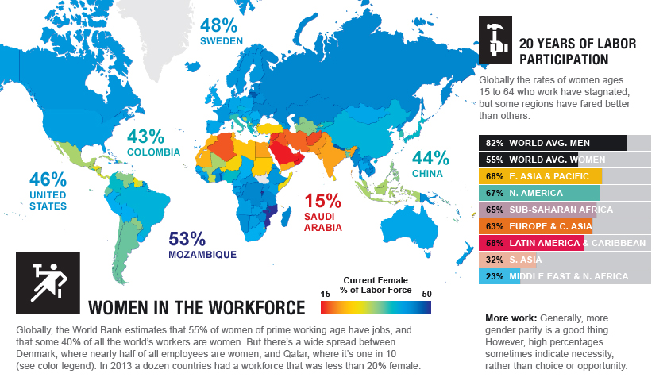
Notes:
http://fortune.com/2015/03/05/women-in-the-workforce/

Slide 14
Socioeconomic Differences
United States
GDP: 18.57 Trillion USD
GNI per capita: 58,030 PPP USD
GNI per capita of women: 41,792 PPP USD
***PPP= Purchasing Power Parity (International Exchange Rate)
The Middle East (Israel, Syria, Saudi Arabia, Yemen, Egypt)
GDP: Israel- 318.7 Billion Syria- 40.41 Billion Saudi Arabia- 646.4 Billion Yemen- 27.32 Billion Egypt- 336.3 Billion
GNI per capita: Israel- 37,400 PPP Syria- 5,090 PPP Saudi Arabia- 55,760 PPP Yemen- 2,490 PPP Egypt- 11,110 PPP
GNI per capita of women: Israel- 24,636 Syria- 1,922 Saudi Arabia- 16, 197 Yemen- 1,775 Egypt-
Notes:
World Bank
http://hdr.undp.org/en/content/estimated-gni-capita-ppp-female-constant-2011-ppp

Slide 15
Education
United States
Free public education is provided to students from K-12, and many colleges offer opportunities for further education.
The GDP per capita is much higher in the United States and less restrictions are pushed onto women, so graduation and employment rates are higher
The Middle East
Education in the Middle East has increased in past years, though dropouts are very common in young children.
The Borgen Project sites poverty as a key element contributing to girls dropping out.

Slide 16


Women in Politics

Slide 17

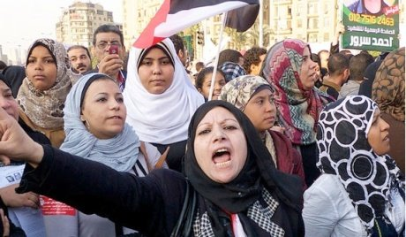
Forward Progression For Gender Equality
Arab Spring 2011 and Women’s March on Washington 2017

Slide 18
Conclusion
Women have more rights overall in accordance to the past. Strides are being made for women’s rights in both regions, though total equality hasn’t been reached.
Women in the United States are freer than women in the Middle East due to many factors including governmental structure, education, and socioeconomics.

