Slide 1
Adrienne Rich "Compulsory Heterosexuality and Lesbian Existence"

Slide 2
1980
Adrienne Rich popularized the phrase "compulsory heterosexuality" in her 1980 essay “Compulsory Heterosexuality and Lesbian Existence

Slide 3
Rich, who died in 2012, was a prominent feminist poet and writer came out as a lesbian in 1976.

Slide 4
Her essay. . .
In the essay, she argues from a specifically lesbian feminist point of view that heterosexuality is not innate in human beings.
Nor is it the only normal sexuality, she said. She further asserted that women can benefit more from relationships with other women than from relationships with men.

Slide 5
Reinforcing Heterosexuality
Compulsory heterosexuality, according to Rich's theory, is in service of and emerges from the subjection of women to men. Men's access to women is protected by compulsory heterosexuality. The institution is reinforced by norms of "proper" feminine behavior.

Slide 6
Culture
How is compulsory heterosexuality enforced by culture? Rich sees the arts and popular culture today (television, films, advertising) as powerful media to reinforce heterosexuality as the only normal behavior.

Slide 7
Lesbian Continuum
She proposes instead that sexuality is on a "lesbian continuum." Until women can have nonsexual relationships with other women, and sexual relationships without the imposition of cultural judgment, Rich did not believe women could really have power, and thus feminism could not achieve its goals under a system of compulsory heterosexuality.

Slide 8
Lesbian Continuum
Rich sees lesbian existence as an act of resistance to this institution, but also as an individual choice, when in fact, the principles of radical lesbianism see lesbianism as necessary, and consider its existence as necessarily outside of the heterosexual political sphere of influence.

Slide 9
Feminist Movement
Compulsory heterosexuality, Rich found, was pervasive even within the feminist movement, essentially dominating both feminist scholarship and feminist activism. Lesbian lives were invisible in history and other serious studies, and lesbians were not welcome and seen as aberrant and therefore a danger to the acceptance of the feminist movement.

Slide 10
Blame the Patriarchy
Rich argued that patriarchal, male-dominated society insists on compulsory heterosexuality because men benefit from male-female relationships.
Society romanticizes the heterosexual relationship. Therefore, she argues, men perpetuate the myth that any other relationships are somehow deviant.

Slide 11
Summary
Rich proposes that all women should separate themselves from men and engage in some form of lesbian relationship, whether it leads to a mere lesbian expression at one time or another or an identified lesbian sexuality. Only then, will it be possible for a woman to truly decide if heterosexuality is the right thing for her. In other words, heterosexuality has been constructed by men historically and culturally to be the only way of existence to further the male need.

Slide 12
Rich wrote in “Compulsory Heterosexuality…” that since humans’ first bond is with the mother, both males and females have a bond or connection with women.
Other FEMINIST THEORISTS disagreed with Rich’s argument that all women have a natural attraction to women.
DIFFERENT VIEWPOINTS

Slide 13
During the 1970s, lesbian feminists were occasionally shunned by other members of the Women’s Liberation Movement. Rich argued that it was necessary to be vocal about lesbianism to break the taboo and reject the compulsory heterosexuality that society forced upon women.
1970s

Slide 14
New Analysis
21st Century Feminism
Since the 1970s disagreement in the feminist movement, lesbian, and other non-heterosexual relationships have become more openly accepted in much of United States society.
Some feminists and LGBTQ scholars continue to examine the term "compulsory heterosexuality" as they explore the biases of a society that prefers heterosexual relationships.

Slide 15
Other Names
Heterosexism: discrimination or prejudice against homosexuals on the assumption that heterosexuality is the normal sexual orientation.
Heteronormativity: Heteronormativity is the belief that heterosexuality, predicated on the gender binary, is the norm

Slide 16
Heterosexual Institutions: Advertising

Slide 17
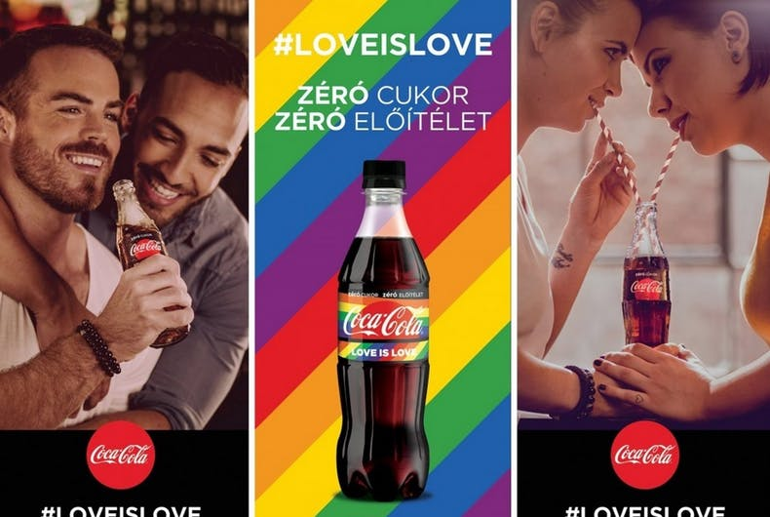

Slide 20
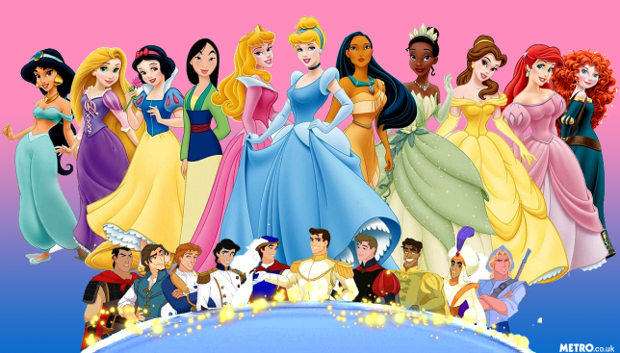

Slide 23
Examples of heterosexual privilege.
Receiving public recognition and support for an intimate relationship (e.g., congratulations for an engagement).
Expressing affection in most social situations and not expecting hostile or violent reactions from others.
Living with your partner openly.
Expressing pain when a relationship ends from death or separation and receiving support from others.
Receiving social acceptance from neighbors, colleagues, and good friends.
Not having to worry that people won’t let their children play with your children because of your sexuality.

Slide 24
More Examples
Learning about romance and relationships from fictional movies and television shows.
Having role models of your gender and sexual orientation.
Having positive and accurate media images of people with whom you can identify.
Expecting to be around others of your sexuality most of the time. Not worrying about being the only one of your sexuality in a class, on a job, or in a social situation.
Talking openly about your relationship, vacations, and family planning you and your lover/partner are doing.

Slide 25
Even more…
Easily finding a neighborhood in which residents will accept how you have constituted your household.
Raising, adopting, and teaching children without people believing that you will molest them or force them into your sexuality.
Working in a job dominated by people of your gender, but not feeling as though you are a representative/spokesperson for your sexuality.
Receiving paid leave from employment when grieving the death of your spouse.
Assuming strangers won’t ask, “How does sex work for you?” or other too-personal questions.

Slide 26
And finally . . .
Sharing health, auto, and homeowners’ insurance policies at reduced rates.
Not having to hide or lie about women- or men-only social activities.
Acting, dressing, or talking as you choose without it being a reflection on people of your sexuality.
Freely teaching about lesbians, gay men, and bisexuals without being seen as having a bias because of your sexuality or forcing your “homosexual agenda” on students.
Having property laws work in your favor, filing joint tax returns, and automatically inheriting from your spouse under probate laws.
Sharing joint child custody.

Slide 27
BOYS BEWARE
https://www.youtube.com/watch?v=fTn7ALbLYPI

