Slide 1
Roles of the media
In influencing the government and its citizens.

Slide 2
Introduction
Media refers to communication channels / outlets.
The three types of media are print, broadcast and the internet.
Media directly influences governments and the society.
Media has a voice and role in politics.
Media is sometimes referred to as the 4th branch of the government because its role is to serve as the watchdog…watching over those who we elect to oversee our national and local governments on behalf of those they serve, the citizens.
Notes:
- Media is communication channels with which information is disseminated to people.
The three types of media include different modes of widespread communication such as;
Print media
-Newspapers
-Magazines
Broadcast Media
-Television
-Radio (Public Broadcast System & Talk Radio)
Internet (New Media)
-Blogs & Podcasts
-Social Media (Twitter, Facebook, Instagram)
- Many people in the society rely on media channels for news and information and thus can be easily influenced by these channels. Information is said to be power.

Slide 3
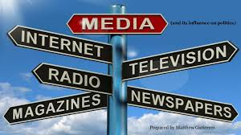
Functions of Media
To inform.
To persuade.
To entertain.
To transmit culture
Linkage.
Surveillance
interpretation
Notes:
The media in its functions uses advertisements, visual representations, special effects and verbal as well as non verbal language.
-Media is used to send and receive information by offering authentic and timely facts and opinions about various events and situations to the masses.
-It also provides education either directly or indirectly through different content. It is an effective tool for mass awareness.
-Media can be used to make influence on others minds, it does this by building opinions and setting agendas in the public mind. It can influence votes, change attitudes or moderate behavior.
-media offers a performance that provides pleasure to people by availing amusement of different kinds. It makes the recreational and leisure time of individual more enjoyable thus entertains.
-it allows for socialization which is the transmission of culture through behaviors that are deemed acceptable by society.
-the media joins different elements of society that are not directly connected such as linking buyers to sellers.
-the media also provides a way for closely and continuously observing society and gives warnings where necessary.
-lastly, it offers explanations of events and situations.

Slide 4
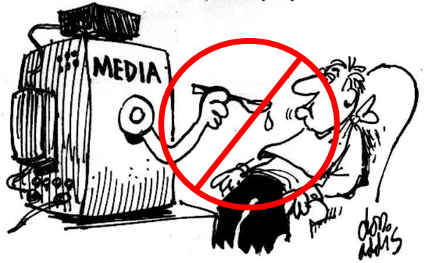
objectives
Identify the possible roles of media in influencing the government and its citizens.
Describe the impact of each role of the media on government and its citizens

Slide 5
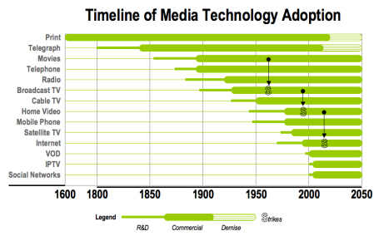

Slide 6
role of media
Educative role
Participatory role (Haro-de-Rosario et al., 2018).
Media’s watchdog function
Sets public agenda.
Being a common carrier
Notes:
--participatory role helps in making political decisions and at times takes a stance to manifest its concern for the public. Through editorial and opinion columns as well as social media discussions, the media can actively take past in politics and governance.
- Most people rely on the media for all or most of their information regarding politics and governance thus whatever the media chooses to talk about is the information that
people receive (Agenda Setting).
- It provides a line of communication between the government and its citizens. Communication that goes both ways with the media as the central player.

Slide 7
Educative role
Helps people understand government policies
Make people aware of what is going on.
Make perception of people about policies
Notes:
To some extent media defines who we are as individuals by presenting information and opinion on everything from what to buy for lunch to who to vote for in the next presidential election.
Plays an important role in how citizens learn about political issues and events thus affects the formation of policy agendas by raising awareness on certain topics. This can increase demand for government action thus force the government to consider.

Slide 8
Watchdog
Also known as the fourth estate.
Makes the policy makers accountable.
Keep an eye on corruption cases and misconduct.
Example is the Watergate scandal of the United States
Notes:
- Watches the government and makes sure that the government is serving the public’s interest and conveys their findings back to the people.
Acts as public representative by holding the government officials accountable on behalf of the people.
checks on the government to promote ethics of public life.

Slide 9
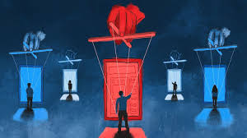
How the media influences government
Impacts elections.
Shapes public opinion (King et al., 2017).
Provides a Medium for Elected Officials.
Use of techniques of propaganda
Notes:
The media is used by candidates for campaigning through advertisements thus influences citizens and persuades them. Various groups/individuals provide campaign coverage (news/updates) via television, newspapers, radio, internet, etc.
Individuals and groups use the media to shape public opinion, or the total of the opinions held concerning a particular issue.
Such medium allow the officials to; Hold press conferences, stage media events, Be interviewed by people in the media and leak information to test public reaction.
Such techniques attempt to promote a particular idea or person and is mostly found in the new media.

Slide 10
References
Haro-de-Rosario, A., Sáez-Martín, A., & del Carmen Caba-Pérez, M. (2018). Using social media to enhance citizen engagement with local government: Twitter or Facebook?. New Media & Society, 20(1), 29-49.
King, G., Schneer, B., & White, A. (2017). How the news media activate public expression and influence national agendas. Science, 358(6364), 776-780.

