Slide 1
Chapter 4
Introduction to Valuation: The Time Value of Money
©2020 McGraw-Hill Education. All rights reserved. Authorized only for instructor use in the classroom. No reproduction or further distribution permitted without the prior written consent of McGraw-Hill Education.

Slide 2
Key Concepts and Skills
After studying this chapter, you should be able to:
  Determine the future value of an investment made today.
  Determine the present value of cash to be received at a future date.
  Calculate the return on an investment.
  Predict how long it takes for an investment to reach a desired value.
Be able to solve time value of money problems using:
  Formulas.
  A financial calculator.
  A spreadsheet.

Slide 3
Chapter Outline
4.1 Future Value and Compounding.
4.2 Present Value and Discounting.
4.3 More on Present and Future Values
Solving for:
Implied interest rate.
Number of periods.

Slide 4
Basic Definitions 1
Present Value (PV).
  The current value of future cash flows discounted at the appropriate discount rate.
  Value at t = 0 on a time line.
Future Value (FV).
  The amount an investment is worth after one or more periods.
  “Later” money on a time line.

Slide 5
Basic Definitions 2
Interest rate (r).
  Discount rate.
  Cost of capital.
  Opportunity cost of capital.
  Required return.
  Terminology depends on usage.

Slide 6
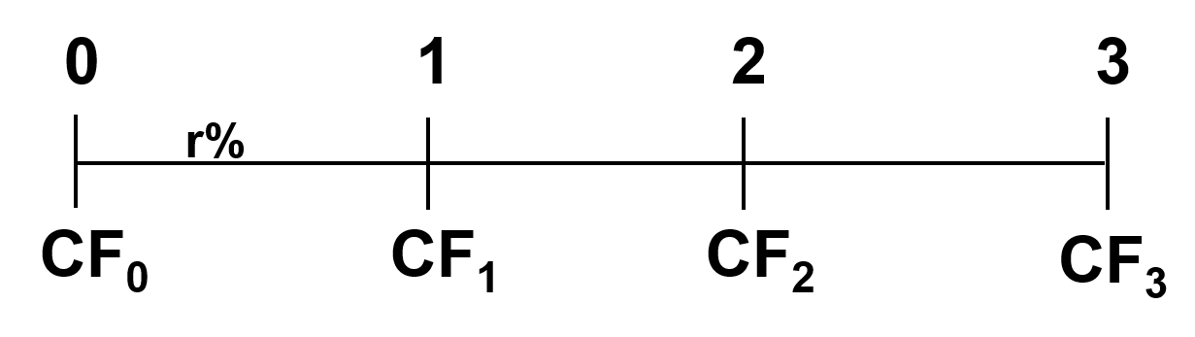
Time Line of Cash Flows 1
Tick marks at ends of periods.
  Time 0 is today;
  Time 1 is the end of Period 1.
+CF = Cash INFLOW −CF = Cash OUTFLOW PMT = Constant CF

Slide 7
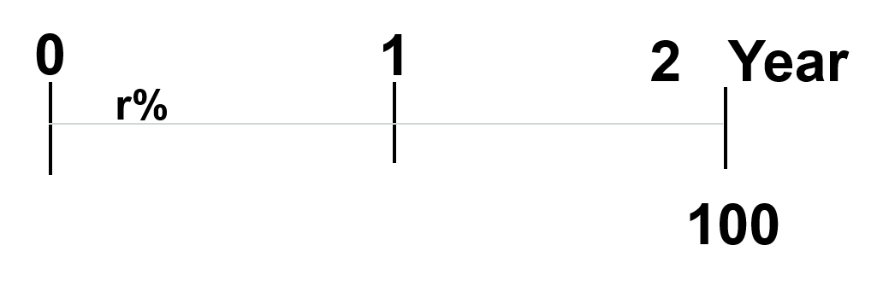
Time Line for a $100 Lump Sum due at the End of Year 2

Slide 8
Future Values: General Formula
  FV = future value.
  PV = present value.
  r = period interest rate, expressed as a decimal.
  t = number of periods.
Future value interest factor = (1 + r)^{t}.
  Note: “y^{x}” key on your calculator.

Slide 9
Future Values: Example 1 (1)
Suppose you invest $100 for one year at 10% per year.
What is the future value in one year?
  Interest = 100(.10) = 10.
  Value in one year.
  = Principal + interest.
  = 100 + 10 = 110.
  Future Value (FV).
  = 100(1 + .10) = 110.

Slide 10
Future Values: Example 1 (2)
Suppose you leave the money in for another year. How much will you have two years from now?
  FV = 100(1.10)(1.10).
  = 100(1.10)² = 121.00.

Slide 11
Effects of Compounding 1
Simple interest.
  Interest earned only on the original principal.
Compound interest.
  Interest earned on principal and on interest received.
  “Interest on interest” – interest earned on reinvestment of previous interest payments.
Return to Quiz

Slide 12
Effects of Compounding 2
Consider the previous example.
  FV w/simple interest.
  = 100 + 10 + 10 = 120.
  FV w/compound interest.
  =100(1.10)² = 121.00.
  The extra 1.00 comes from the interest of .10(10) = 1.00 earned on the first interest payment.

Slide 13
Texas Instruments BA-II Plus 1
FV = future value.
PV = present value.
I/Y = period interest rate (r).
N = number of periods.
One of these MUST be negative.

Slide 14
Texas Instruments BA-II Plus 2
I/Y = period interest rate (r).
  C/Y must equal 1 for the I/Y to be the period rate (C/Y = 1 = default on new BAII+).
  Interest is entered as a percent, not a decimal.
    5% interest = “5”, not “.05.”
PMT = 0 for this chapter only!
Clear the registers before each problem.
  Press 2nd then CLR TVM.
  Or reenter each field.

Slide 15
Texas Instruments BA-II Plus 3
Set number of decimal places to display.
  Press 2nd key,
  Press Format key (above “.”),
  Enter desired decimal places (for example, 4).
  Press Enter to set the displayed choice.

Slide 16
Texas Instruments BA-II Plus 4
Be sure “payment per period” or P/Y is set to “1”
  Press 2nd key,
  Press P/Y (above I/Y),
  Enter “1”,
  Press Enter.
  Press CE/C.

Slide 17
TI BAII+: Set Time Value Parameters
Be sure calculator is set for cash flows at the END of each period.
To set END (for cash flows occurring at the end of the period),
  Press 2nd key,
  Press BGN (above PMT).
    This is a toggle switch. The default is END.
    To change to BEGIN, hit 2nd then Set (above Enter) to go back and forth.
  Note: “BGN” will be displayed at the top right of the screen when the calculator is in BEGIN mode. When in END mode, this indicator will be blank.

Slide 18
Future Values: Example 2
Suppose you invest the $100 from the previous example for 5 years. How much would you have?
Formula Solution:
FV = PV(1+r)^{t}
=100(1.10)⁵
=100(1.6105)
=161.05

Slide 19
Table 4.1
TABLE 4.1 Future value of $100 at 10 percent.
Year | Beginning Amount | Interest Earned | Ending Amount
1 | $100.00 | $10.00 | $110.00
2 | 110.00 | 11.00 | 121.00
3 | 121.00 | 12.10 | 133.10
4 | 133.10 | 13.31 | 146.41
5 | 146.41 | 14.64 | 161.05
 |  | Total interest $61.05

Slide 20
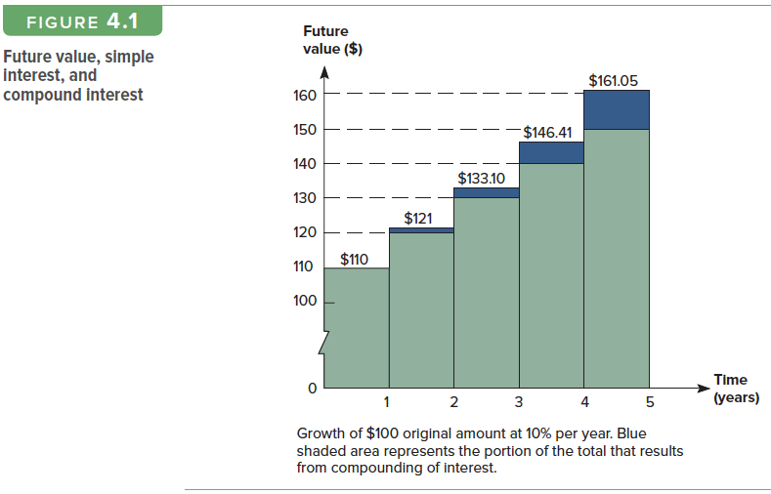
Figure 4.1
Access the text alternative for these images

Slide 21
Texas Instruments BA-II Plus 5
To calculate FV: 10% 5 years PV = $100.
Key Entry | Display
N | 5.00
I/Y | 10.00
PV | −100.00
PMT | 0
CCCF CPT FV 161.05

Slide 22
Excel Spreadsheet Functions
Excel TVM functions:
  =FV(rate,nper,pmt,pv)
  =PV(rate,nper,pmt,fv)
  =RATE(nper,pmt,pv,fv)
  =NPER(rate,pmt,pv,fv).
Use the formula icon (ƒ_{x}) when you can’t remember the exact formula.
Click on the Excel icon to open a spreadsheet containing four different examples.

Slide 23
Future Values: Example 3
Suppose you had a relative deposit $10 at 5.5% interest 200 years ago. How much would the investment be worth today?
200 | N
5.5 | I/Y
10 | PV
0 | PMT
CPT FV | = −447,189.84
Formula Solution:
FV = PV(1+r)^{t}
= 10(1.055)²⁰⁰
= 10(44718.984)
= 447,189.84
Calculator Solution.
Excel Solution: = FV(Rate, Nper, PMT, PV).
= FV(0.055, 200, 0, −10) = 447,189.84.
NOTE: Rate = decimal.

Slide 24
Future Value: General Growth Formula
Suppose your company expects to increase unit sales of widgets by 15% per year for the next 5 years. If you currently sell 3 million widgets in one year, how many widgets do you expect to sell in 5 years?
5 | N
15 | I/Y
3 | PV
0 | PMT
CPT FV | = −6.0341
Formula Solution:
FV = PV(1+r)^{t}
= 3(1.15)⁵
= 3(2.0114)
= 6.0341 million
Calculator Solution.
Excel Solution: = FV(Rate, Nper, PMT, PV).
= FV(0.15,5,0,3) = − 6.0341.

Slide 25
Future Value:
Important Relationship I
For a given interest rate:
  The longer the time period,
  The higher the future value.
For a given r, as t increases, FV increases.

Slide 26
Future Value:
Important Relationship II
For a given time period:
  The higher the interest rate,
  The larger the future value.
For a given t, as r increases, FV increases.

Slide 27
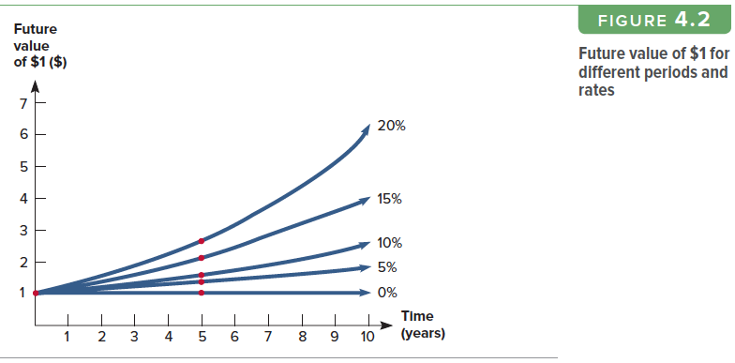
Figure 4.2
Access the text alternative for these images

Slide 28
Quick Quiz: Part 1
What is the difference between simple interest and compound interest? (Slide 4.11)
Suppose you have $500 to invest and you believe that you can earn 8% per year over the next 15 years. (QQ1 Solution)
  How much would you have at the end of 15 years using compound interest?
  How much would you have using simple interest?

Slide 29
Present Values 1
The current value of future cash flows discounted at the appropriate discount rate.
Value at t = 0 on a time line.
Answers the questions:
  How much do I have to invest today to have some amount in the future?
  What is the current value of an amount to be received in the future?

Slide 30
Present Values 2
Present Value = the current value of an amount to be received in the future.
Why is it worth less than face value?
  Opportunity cost.
  Risk & Uncertainty.
  Discount Rate = ƒ (time, risk).

Slide 31
Time Line of Cash Flows 2
Tick marks at ends of periods.
  Time 0 is today;
  Time 1 is the end of Period 1.
+CF = Cash INFLOW −CF = Cash OUTFLOW PMT = Constant CF

Slide 32
Present Values 3
FV = PV(1 + r)^{t}
Rearrange to solve for PV.
      PV = FV / (1 + r)^{t}
      PV= FV(1 + r)^{−t}
“Discounting” = finding the present value of one or more future amounts.
Return to Quiz

Slide 33
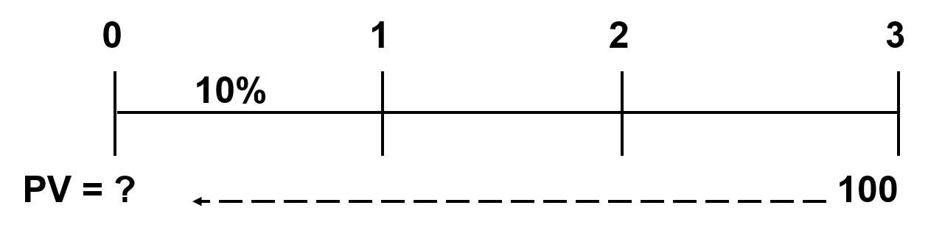
What’s the PV of $100 due in 3
Years if r = 10%?
Finding PVs is discounting, and it’s the reverse of compounding.
Formula: PV = FV(1+r)^{−t} = 100(1.10)⁻³ = $75.13
Calculator: 3 N 10 I/Y 0 PMT 100 FV
CPT PV = −75.13
Excel: = PV(.10,3,0,100) = −75.13

Slide 34
Present Value: Example 1
Single Period
Suppose you need $10,000 in one year for the down payment on a new car. If you can earn 7% annually, how much do you need to invest today?
1 | N
7 | I/Y
0 | PMT
10000 | FV
CPT PV | = −9345.79
Formula Solution:
PV = FV(1+r)^{−t}
= 10,000(1.07)⁻¹
= 10,000/1.07
= 9,345.79
Calculator Solution
Excel Solution: = PV(Rate, Nper, P, FV).
= PV(0.07,1,0,10000) = −9345.79.

Slide 35
Present Values: Example 2
Multi-Periods
You want to begin saving for your daughter’s college education and you estimate that she will need $150,000 in 17 years. If you feel confident that you can earn 8% per year, how much do you need to invest today?
17 | N
8 | I/Y
0 | PMT
150000 | FV
CPT PV | = −40,540.34
Formula Solution:
PV = FV(1+r)^{−t}
= 150,000(1.08)⁻¹⁷
= 150,000/(1.08)¹⁷
= 40,540.34
Calculator Solution:
Excel Solution: = PV(Rate, Nper, PMT, FV).
= PV(0.08,17,0,150000) = −40,540.34.

Slide 36
Present Values: Example 3
Multi-Periods
Your parents set up a trust fund for you 10 years ago that is now worth $19,671.51. If the fund earned 7% per year, how much did your parents invest?
Formula Solution:
PV = FV(1+r)^{−t}
= 19,671.51(1.07)⁻ ¹⁰
= 19.671.51/(1.07)¹⁰
= −10,000
Calculator Solution:
10 | N
7 | I/Y
0 | PMT
19671.51 | FV
CPT PV | = −10000
Excel Solution: = PV(Rate, Nper, Pmt, FV).
= PV(0.07,10,0, 19,671.51) = −10000.

Slide 37
Present Value:
Important Relationship I 1
For a given interest rate:
  The longer the time period,
  The lower the present value.
For a given r, as t increases, PV decreases.

Slide 38
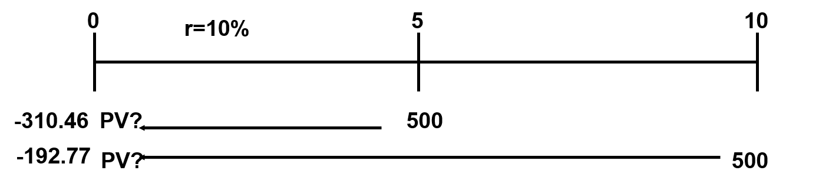
Present Value:
Important Relationship I 2
What is the present value of $500 to be received in 5 years? 10 years? The discount rate is 10%.
5 yrs: PV = 500/(1.10)⁵ = −310.46 (1.10)⁵ = 1.6105
10 yrs: PV = 500/(1.10)¹⁰ = −192.77 (1.10)¹⁰ = 2.5937
Access the text alternative for these images

Slide 39
Present Value:
Important Relationship II 1
For a given time period:
  The higher the interest rate,
  The smaller the present value.
For a given t, as r increases, PV decreases.

Slide 40
Present Value:
Important Relationship II 2
What is the present value of $500 received in 5 years if the interest rate is 10%? 15%?
5 | N
10 | I/Y
0 | PMT
500 | FV
CPT PV | = −310.46
Rate = 10%
Calculator Solution:
Rate = 15%
Calculator Solution:
5 | N
15 | I/Y
0 | PMT
500 | FV
CPT PV | = −248.59

Slide 41
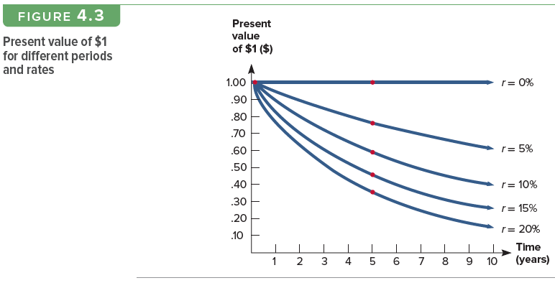
Figure 4.3
Access the text alternative for these images

Slide 42
Quick Quiz: Part 2
What is the relationship between present value and future value? (Slide 4.32)
Suppose you need $15,000 in 3 years. If you can earn 6% annually, how much do you need to invest today? (Solution)
If you could invest the money at 8%, would you have to invest more or less than at 6%? How much? (Solution)

Slide 43
The Basic PV Equation—Refresher
PV = FV / (1 + r)^{t}
There are four parts to this equation.
  PV, FV, r and t.
  Know any three, solve for the fourth.
Be sure and remember the sign convention.
+CF = Cash INFLOW −CF = Cash OUTFLOW.

Slide 44
Discount Rate
To find the implied interest rate, rearrange the basic PV equation and solve for r:
FV = PV(1 + r)^{t}
r = (FV / PV)^{1/t} − 1
If using formulas with a calculator, make use of both the y^{x} and the 1/x keys.

Slide 45
Discount Rate: Example 1
You are looking at an investment that will pay $1200 in 5 years if you invest $1000 today. What is the implied rate of interest?
  Formula:
    r = (1200 / 1000)^{1/5} − 1 = .03714 = 3.714%.
  Calculator – the sign convention matters!!!
    5 N
    −1000 PV (you pay $1,000 today).
    0 PMT
    1200 FV (you receive $1,200 in 5 years).
    CPT I/Y = 3.714%
  Excel: = RATE(5,0,−1000,1200) = 0.03714.

Slide 46
Discount Rate: Example 2
Suppose you are offered an investment that will allow you to double your money in 6 years. You have $10,000 to invest. What is the implied rate of interest?
6 | N
−10000 | PV
0 | PMT
20000 | FV
CPT I/Y | = 12.25%
  Excel: =RATE(6,0,−10000,20000) = 0.1225

Slide 47
Discount Rate: Example 3
Suppose you have a 1-year old son and you want to provide $75,000 in 17 years towards his college education. You currently have $5,000 to invest. What interest rate must you earn to have the $75,000 when you need it?
Calculator:
17 N, −5000 PV, 0 PMT, 75000 FV, CPT I/Y = 17.27%
Excel: =RATE(17,0,−5000,75000) = 0.1727

Slide 48
Quick Quiz: Part 3
What are some situations in which you might want to compute the implied interest rate?
Suppose you are offered the following investment choices:
  You can invest $500 today and receive $600 in 5 years. The investment is considered low risk.
  You can invest the $500 in a bank account paying 4% annually.
  What is the implied interest rate for the first choice and which investment should you choose? (Solution)

Slide 49
Finding the Number of Periods
Start with basic equation and solve for t:
FV = PV(1 + r)^{t}
Calculator: CPT N.
Excel: = NPER(Rate, Pmt, PV, FV).

Slide 50
Number of Periods: Example 1
You want to purchase a new car and you are willing to pay $20,000. If you can invest at 10% per year and you currently have $15,000, how long will it be before you have enough money to pay cash for the car?
Calculator Solution:
10 I/Y; −15000 PV; 20000 FV;
CPT N = 3.02 years.
Excel: =NPER(0.10,0,−15000,20000) = 3.02.

Slide 51
Number of Periods: Example 2
Formula Solution:
  FV/PV = 20,000/15,000 = 1.333
  ln(1.333) = 0.2877
  ln(1.10) = 0.0953
  t = 0.2877/0.0953 = 3.0189

Slide 52
Quick Quiz: Part 4
When might you want to compute the number of periods?
Suppose you want to buy some new furniture for your family room. You currently have $500 and the furniture you want costs $600. If you can earn 6%, how long will you have to wait if you don’t add any additional money?
(Solution)

Slide 53
Example: Work the Web
Many financial calculators are available online.
Click on this link to go to the present value portion of the Moneychimp web site and work the following example:
  You need $40,000 in 15 years. If you can earn 9.8% interest, how much do you need to invest today?
  You should get $9,841.

Slide 54
Table 4.4
TABLE 4.4 Summary of time value of money calculations.
I. | Symbols PV = Present value, what future cash flows are worth today FV_{t} = Future value, what cash flows are worth in the future r = Interest rate, rate of return, or discount rate per period—typically, but not always, one year t = Number of periods—typically, but not always, the number of years C = Cash amount
II. | Future value of C invested at r percent per period for t periods FV_{t} = C × (1 + r)^{t} The term (1 + r)^{t} is called the future value factor.
III. | Present value of C to be received in t periods at r percent per period PV = C/(1 + r)^{t} The term 1/(1 + r)^{t} is called the present value factor.
IV. | The basic present value equation giving the relationship between present and future value is: PV = FV_{t} /(1 + r)^{t}

Slide 55
Quick Quiz 1 Solution
Invest $500 at 8% per year over 15 years.
How much would you have at the end of 15 years using compound interest?
    15 N, 8 I/Y, −500 PV, 0 PMT, CPT FV 1586.08.
    500(1.08)¹⁵ = 1586.08.
    =FV(.08, 15, 0, −500).
How much would you have using simple interest?
    500 + 15(500)(.08) = 1,100.
Return to Quiz

Slide 56
Quick Quiz 2 Solution 1
You need $15,000 in 3 years. You can earn 6% annually, how much do you need to invest today?
3 N 6 I/Y 15000 FV 0 PMT.
CPT PV = −12594.29.
PV= 15000/(1.06)³ = 15000/(1.191016) =
= 15000 × 0.83962) = 12594.29.
=PV(.06, 3, 0, 15000).
Return to Quiz

Slide 57
Quick Quiz 2 Solution 2
You need $15,000 in 3 years. If you could invest the money at 8%, would you have to invest more or less than at 6%? How much?
3 N 8 I/Y 15000 FV 0 PMT
CPT PV = −11907.48
PV= 15000/(1.08)³ = 15000/(1.125971)
= 15000 × (0.79383) = 11907.48
=PV(.08, 3, 0, 15000)
Difference = $686.81
Return to Quiz

Slide 58
Quick Quiz 3 Solution
Investment choices:
  Invest $500 today and receive $600 in 5 years. The investment is considered low risk.
  Invest the $500 in a bank account paying 4% annually.
  What is the implied interest rate for the first choice and which investment should you choose?
  5 N −500 PV 0 PMT 600 FV CPT I/Y 3.714%
  r = (600/500)^{1/5} − 1 = 3.714%.
  =RATE(5, 0, −500, 600).
  The bank account pays a higher rate.
Return to Quiz

Slide 59
Quick Quiz 4 Solution
  Suppose you want to buy some new furniture For your family room. You currently have $500 And the furniture you want costs $600. If you can earn 6%, how long will you have to wait if you don’t add any additional money?
  6 I/Y −500 PV 0 PMT 600 FV CPT N = 3.13 years
  t = ln(600/500) / ln(1.06) = 3.13 years.
  =NPER(.06, 0, −500, 600).
Return to Quiz

Slide 60
Chapter 4
END

Slide 61
Accessibility Content:
Text Alternatives for Images

Slide 62
Figure 4.1 Text Alternative
This bar graph shows x-axis with Time in years for zero to 5 and the y-axis shows future value $ from zero to 160. The bar for zero to 1 is made up of $100 original amount plus $10 growth at 10 percent. The bar for 1 to 2 years is made up of $100 original plus $20 simple interest plus $1 compound interest. The bar for 2 to 3 years is made up of $100 original plus $30 simple interest plus $3.10 compound interest. The bar for 3 to 4 years is made up of $100 original plus $40 simple interest plus $6.41 compound interest. The bar for 4 to 5 years is made up of $100 original plus $50 simple interest plus $11.05 compound interest.
Return to slide containing original image

Slide 63
Figure 4.2 Text Alternative
This line graph shows x-axis in Time (years) from zero to 10 and y-axis for future value of $1 in dollars. There are 5 graph lines that all begin at the y-intercept of 1. They represent interest rates 0%, 5%, 10%, 15% and 20%. The 0% line is parallel to the x-axis. The 5% graph line is curvilinear above the zero line, with the 10% above the 5%, the 15% above the 10% and the 20% above the 15%.
Return to slide containing original image

Slide 64
Present Value:
Important Relationship I 2 Text Alternative
A cash flow of 500 at year 5 has a present value of negative 310.46 at year 0. A cash flow of 500 at year 10 has a present value of negative 192.77 at year 0.
Return to slide containing original image

Slide 65
Figure 4.3 Text Alternative
This line graph shows x-axis in Time (years) from zero to 10 and y-axis for future value of $1 in dollars. There are 5 graph lines that all begin at the y-intercept of 1. They represent interest rates 0%, 5%, 10%, 15% and 20%. The 0% line is parallel to the x-axis. The 5% graph line is curvilinear below the zero line, with the 10% below the 5%, the 15% below the 10%, and the 20% below the 15%.
Return to slide containing original image

