Slide 1
Lakewood Community Pool
Proposed Aquatic Center for Residents
Notes:
This file created specifically for Andrea Ivory

Slide 2
Community Pool Overview
Estimated cost: $25 million
Estimated revenue: $1.3 million from swim meets
Two-phase project

Slide 3
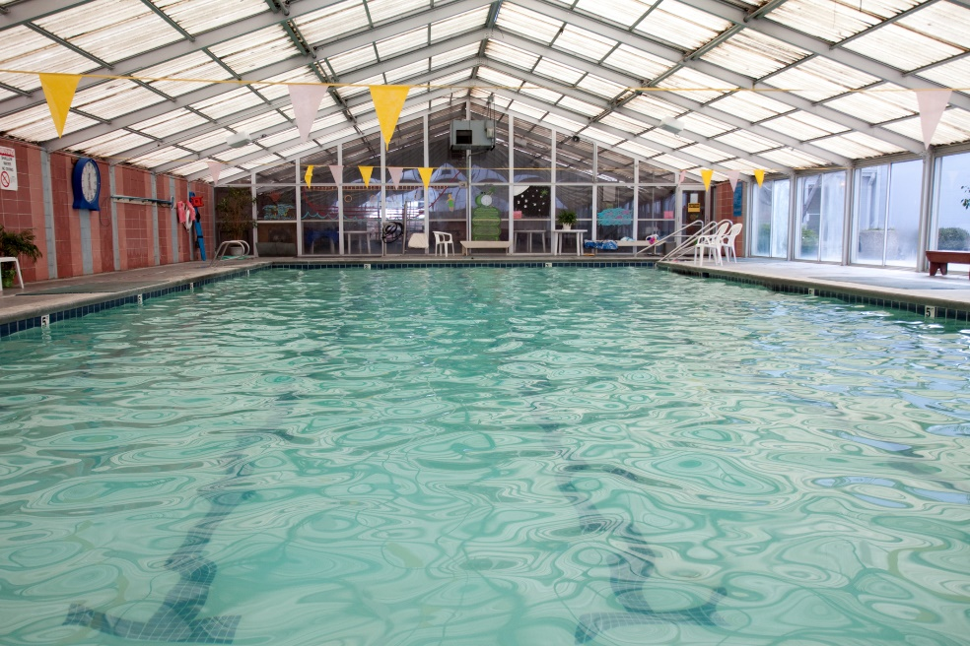
Phase 1
Diving & lap pools
Locker rooms
Concesions

Slide 4
Second Phase
Therapy
Outdoor
Picnic

Slide 5
Main Purposes
Competitions
Swimming lessons
  Children and adults
Physical rehabilitation
Community events

Slide 6
Swimming Health Benefits

