Slide 1
NUTRITION AND FOOD: SEAFOOD
PRESENTED
BY
(STUDENT’S NAME)
ON
(DUE DATE)

Slide 2
What is Seafood?
By definition, seafood refers to edible aquatic animals, including both freshwater and ocean creatures but excluding mammals.
These are non-toxic aquatic species which are exploited by humans for food.
The exploitation of aquatic species has expanded in the recent past and currently includes even the toxic aquatic species like blowfish which can be prepared to make them harmless to the human consumer.
Seafood as well includes edible sea plants like some microalgae and seaweeds which are widely consumed by humans as seafood in different parts of the world especially in Asia.

Slide 3
Seafood Safety
Most dieticians agree that the seafood supply is safe for human consumption.
However, bacteria that can cause illness just like in other perishable foods are the main concern with regard to seafood safety.
Other seafood safety concerns arise from naturally occurring or human-made toxins like harmful chemicals that are responsible for the contamination of the aquatic environment.
However, these food safety risks are greatly minimized when seafood is properly handled and cooked.

Slide 4
Consumer Trends in Seafood
The consumption of seafood shows a steady rising trend as people embrace healthy eating and ethical consumerism.
For instance, the U.S. fish and shellfish market topped in 2016 with $17bn, an increase of 14% from 2011 and growth is expected to reach $18.4bn by 2021.
The need for healthy eating has turned the focus of consumers to the exploitation of seafoods as the main source of proteins, commonly referred to as clean proteins.
The trends in seafood consumption also indicate that more consumers are moving from restaurants to homes, meaning that seafood consumption is becoming more and more adventurous.
In addition, this trend in seafood consumption indicates that consumers are moving towards fresher seafoods that are less-processed.

Slide 5
Nutritional Value of Seafood
The main nutritional advantage of seafood is that it contains clean protein which is highly recommended for a healthy eating diet.
Seafood is a low-calorie diet which contributes greatly to good heart health by reducing the risk of heart diseases.
Seafood is also low in saturated fat and sodium, something that makes it highly advantageous in reducing the risk of high blood pressure to the consumer.
In addition, seafood is a rich source of many minerals and vitamins that are essential for the general good health of the body.

Slide 6
Seafood Classifications
Seafood is majorly classified into three categories which include fish, shellfish, and sea vegetables.
Major ocean fish species include tuna, sardine, mackerel, codfish, salmon, herring, flatfish, and redfish.
Major species of fresh water fish include catfish, pike perch, pike, whitefish, trout, eel, and carp.
On the other hand, shellfish include such species as echinoderms, crustaceans, and molluscs.
The sea vegetables which are mainly consumed as seafood include microalgae and seaweeds.

Slide 7
Fish Products
One major fish product is fish protein concentrate which is prepared from whole fish or other aquatic animals.
Gelatin is another fish product which is used in food industry as a thickening, gelling, or stabilizing agent.
Another fish product is fish albumin that used in food and pharmaceuticals as suspending, whipping, or stabilizing agent.
Isinglass is a fish product used for clarifying beverages like vinegar, beer, and wine.
Pearl Essence is another fish product used for photography, fishing rods, textiles, and electric light switches.
Chitosan is a fish product that used as a coagulant aid in sewage treatment.

Slide 8
Fresh and Frozen Seafood
The freshness of seafood refers to the quality of the seafood, hence fresh seafood is that which is of good quality.
Seafood quality cannot be improved once it leaves the water but it can only be maintained.
The best way to maintain seafood quality is by freezing it, hence frozen seafood is the best quality seafood.
Once the fresh seafood leaves the water, exposure to rising ambient temperature as time passes increases bacterial growth in seafood, diminishing its quality and eventually spoiling it.
To prevent cellular damage, seafood needs to be frozen as quickly as possible after leaving the water.

Slide 9
Summary
Seafood is a general term that is used to refer to aquatic animals and vegetables that are edible by humans.
Seafood is majorly classified into three categories which include fish, shellfish, and sea vegetables.
Seafood is safe, nutritious and healthy as it contains clean protein, is a low-calorie diet, low in saturated fat and sodium, and a rich source of many minerals and vitamins.
The consumption of seafood shows a steady rising trend as people embrace healthy eating and ethical consumerism.
The best way to maintain seafood quality is by freezing it, hence frozen seafood is the best quality seafood.

Slide 10
Fried Tilapia Recipe
Ingredients:
2 pieces medium tilapia cleaned and scales removed
2 teaspoons salt
1 cup cooking oil
Procedure:
Rub salt all over the fish including the insides.
Heat oil in a wide frying pan
When the oil is hot, put-in the tilapia. Cover the frying pan, but make sure to open it a little so that steam can come out. Fry each side in medium heat for about 6 to 10 minutes. Note: I usually wait until I don’t hear any sound. This means that the liquid is gone and the fish is crisp.
Remove from the pan and arrange in a serving plate.
Serve with your favorite condiments and side dish.

Slide 11
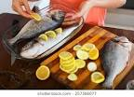



Picture preparing dish

Slide 12
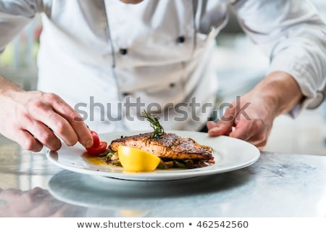
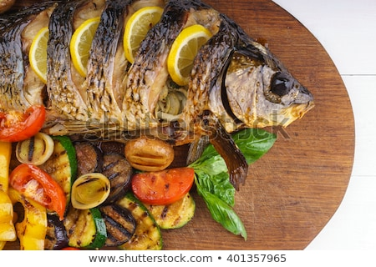
Final Product

